Slide 1
“ Women Innovators”
By Sumedha Saraogi
Sr. V.P. Global BD & Branding
DQ Entertainment International

Slide 2
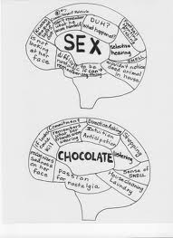
Men are from Mars and
Women are from Venus???
Notes:
Contrary to what some people believe or lead you to believe, you know the Men Are From Mars, Women Are From Venus theory…I personally do not believe there is any inherent difference between a man and woman when it comes to the ability to be creative or innovative. Both may be obsessed with one thing or another..but that does not give either an edge over the other when it comes to innovation because innovation is definitely not a gender driven attribute.

Slide 3
Innovation is manifesting the new

Slide 4
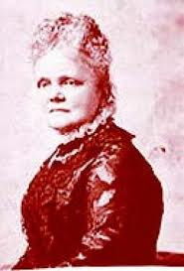
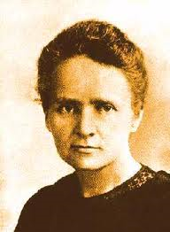
women bring a unique perspective to innovation through their own life experiences
Josephine Cochran – Invented The Dish washer
Marie Curie – Discovered Radium
Elsie Macgill - Queen of Hurricanes

Slide 6
Women in Animation
Reiko Okuyama
Kazuko Nakamura
Atsuko FUKUSHIMA Robot Carnival, Labyrinth
Shizuka Hayashi Doraemon, Sinchan
Tehzeeb Khurana, Sherry Bharda, Simi Nallaseth, Geetanjali Rao, Shilpa Ranade, Nina Sabnani and Rekha Thorat,

Slide 7
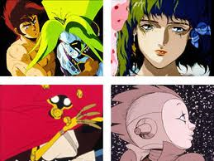
Doraemon – Shinchan -- Robocarnival

Slide 8
Creativity thrives on uniqueness: Dare to be different!
If you have a passions, it has an energy to it!
Innovation is not the domain of the ingenious
Imagination is the highest kite we can fly.

Slide 9
On a personal note ….
No giving up. Ever.
No self pity
Look within
Be patient!
Be passionate
No shortcuts
No substitute for hardwork

Slide 10
Thank You

