Slide 1
Ascending the Corporate Ladder
Seema Grover
Dr Reddy’s Laboratories Ltd
Mergers &Acquisition

Slide 2
INDEX
Introduction
Your Influencers are people with you
Rules of the Game
My Journey
Thank you

Slide 3
Introduction
Happy Morning
The Thought I firmly believe in
“ Life battles don’t always go
To the stronger and faster man
But sooner or later the man who wins
Is the man who thinks he can”

Slide 4
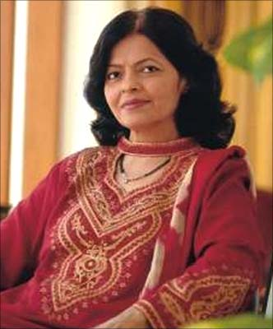
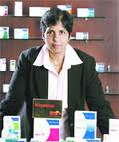
Your Influencers are people with you ….
Kalpana morporia is on Board of Dr Reddy’s Laboratories and she plays a dynamic role during Board discussions.
She believes :-
If women want they can reach the top in the corporate ladder. There is nothing like glass ceiling for women in corporate sector. What matters is performance.
Ritha Chandrachud , SVP heads the India business.
She taught me:
You get what you negotiate
Ask for higher roles…
Ask for higher responsibilities…
Be Assertive
Notes:
Kalpana:Moreover, with the diminishing of gender divide, women with their ability are best suitable to head corporate businesses.

Slide 5
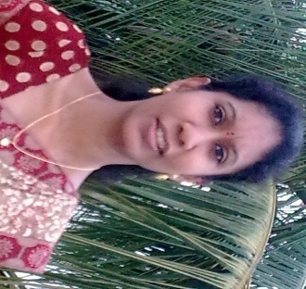
Your Influencers are people with you ….
Mythli – Heads Corp Communication , GMR
She believes:
At work , leave the Mother in you , No emotions
New definition of Networking
Saroja – Corporate Finance , Dr Reddy
She believes:
Where there is will , there is a way.
It is courage, faith, endurance and a dogged determination to surmount all obstacles that builds the bridge.
My family is the Biggest asset I have
My Bosses , their confidence and trust in you…

Slide 6
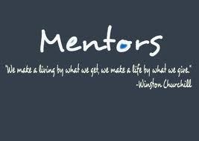
Follow – Few Rules of the Game
Kiss the princes. Lose the frogs. Choose women-friendly and family-friendly companies.
Performance
Loyal
Be loyal ... to yourself. Put yourself first in any competitive work environment.
Performance matters ...., Work Hard…
Hard
work
Success
Mentor knows best, so cultivate relationships with people whose
judgment you trust. Behind every stellar executive is a world of mentors.

Slide 7
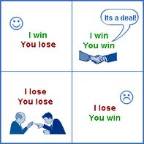
Rules of the Game
Expect diamonds. Always keep the jewelry. You get what you negotiate.Ask for higher roles
Ask for higher responsibilities..
Be Assertive
Savor the experience. Enjoy every aspect of your career. Party your way to the top. Your network is your job.
Wake up and make the cappuccino. Don't work so hard that you forget to enjoy your life.

Slide 8
IM VS “AS IS” JORDAN
My Journey…..
2011-till date
Associate Director – Mergers & Acquisition
Monetary
Designation
Bandwidth and Experience
2008-10
Head Planning for Dr Reddy’s Group
Women Friendly
Flexible timings
Crèche facility
2007-08
IT team
2004-06
Joined Dr Reddy’s
Accounting Exposure
2001-04
Learning Phase
1997 – 2000
Completed CA

Slide 9
My Journey…..
Way forward
Journey continues…..
THANK YOU FOR YOUR ATTENTION !

