Slide 1
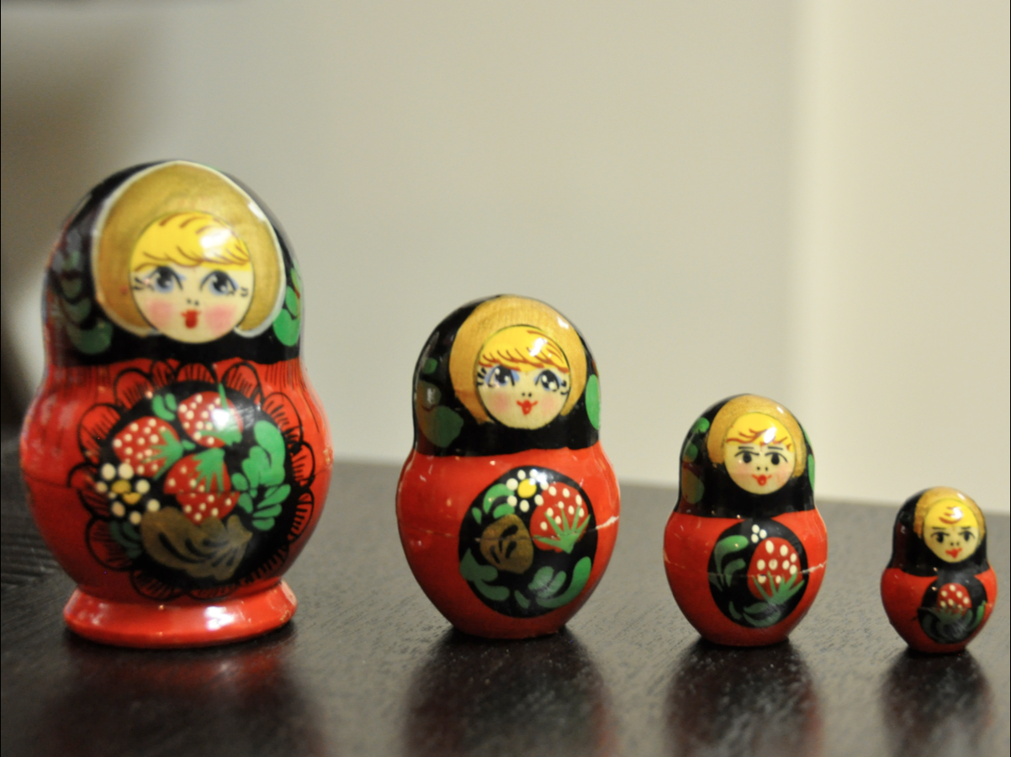
Design Strategy for
Cross-Device User Experience
Silicon India WebApps 2011 Chennai
Ashutosh Kumar, Yahoo! Design

Slide 2
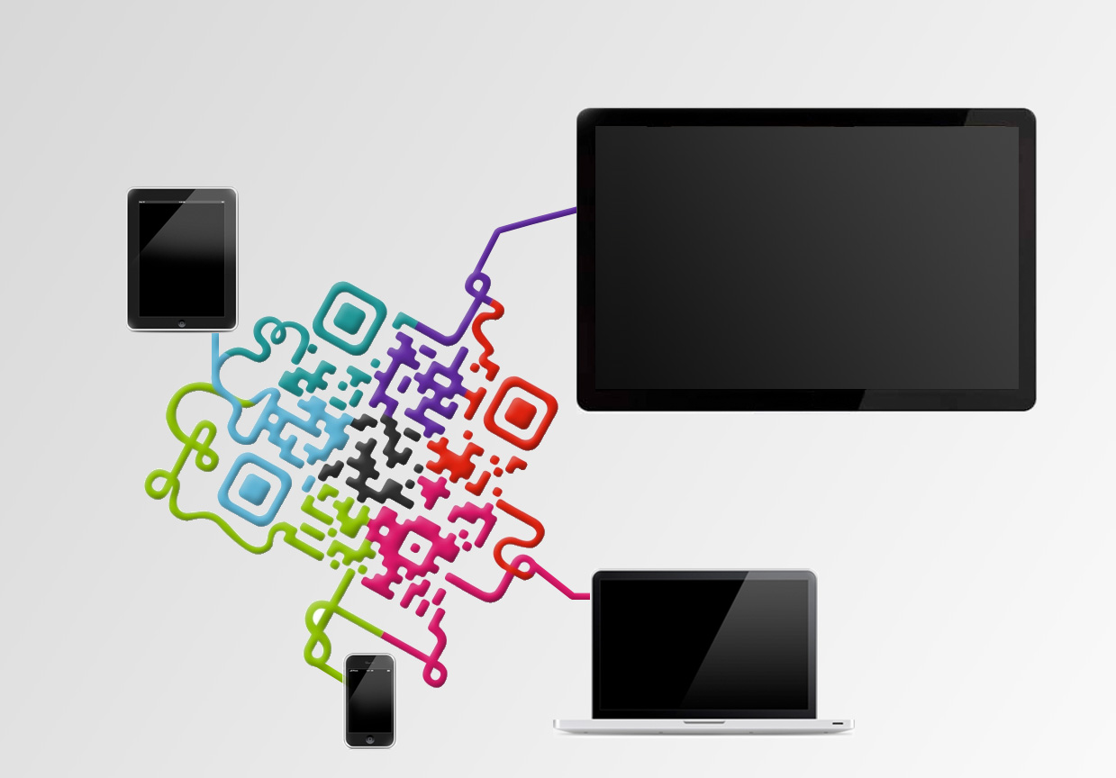
About me...
- Industrial designer from IIT Mumbai
- Designing User Experiences for 11 years
- Principal Interaction Designer in Yahoo!
Past: Worked with HumanFactors
ashutoshk77@yahoo.com
ashutoshk77

Slide 3
Evolving Nature of UX Complexity
User Profiles are vast and wide.

Slide 4
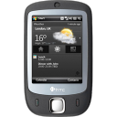
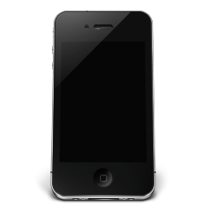
Too Many Devices
These users are using multiple devices, sometimes to do the same tasks

Slide 5
Typical Device Usage Pattern
Multi tasking
Subconscious
Short Attention
Low connection
Variable Time and attention
High connection, High attention span, Desk work
Variable tasks
Low connection
Variable Time and attention
Full Attention
Relaxing
Entertainment
Full Attention
Focused
Lying in bed
Morning
Commute to Work
Office Hours
Commute to Home
Relax
Before Bed

Slide 6
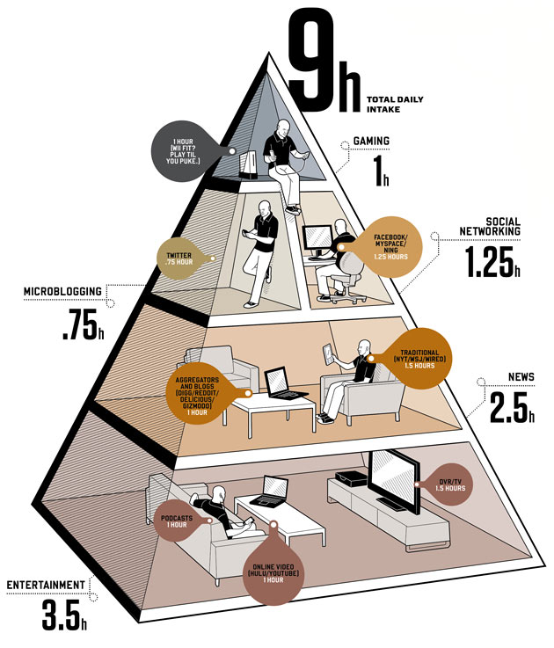
People are spending more time on internet devices

Slide 7
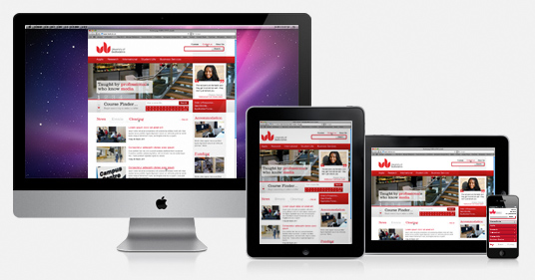
How do we achieve a seamless experience across devices?

Slide 8
Typical Design Process
Concept Evaluation
Evaluation and Testing
To cater multiple device world… we need more considerations…
Changing Technology Trends
Play on Device Strengths
Responsive Design

Slide 9
Rapid Technology Changes

Slide 10
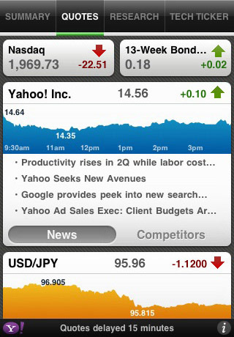
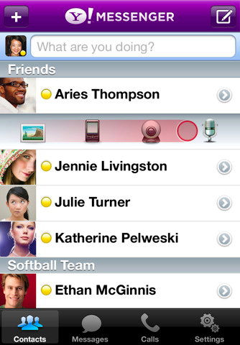
Consumption Pattern is Changing
Yahoo! Finance
Yahoo! Deals
Yahoo! Messenger

Slide 11
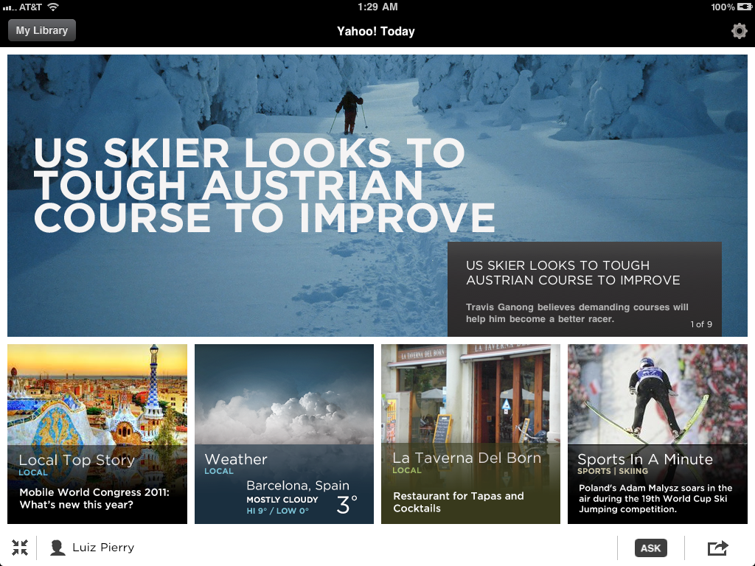
Consumption Pattern is Changing

Slide 12
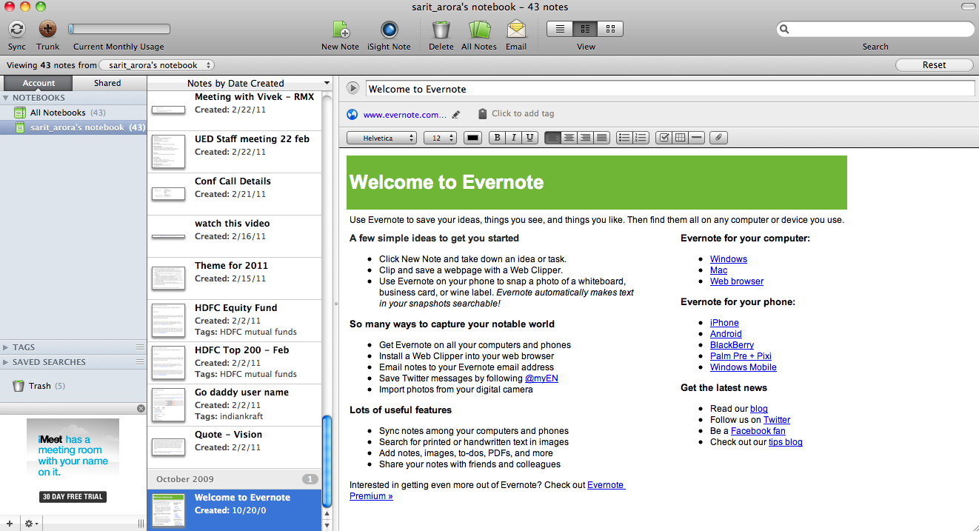
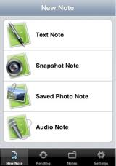
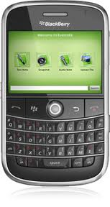
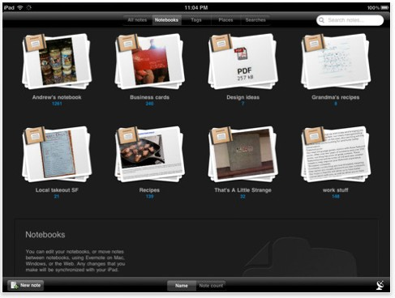
Play on Device Strength

Slide 13
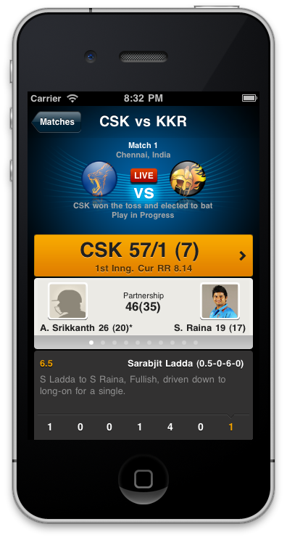
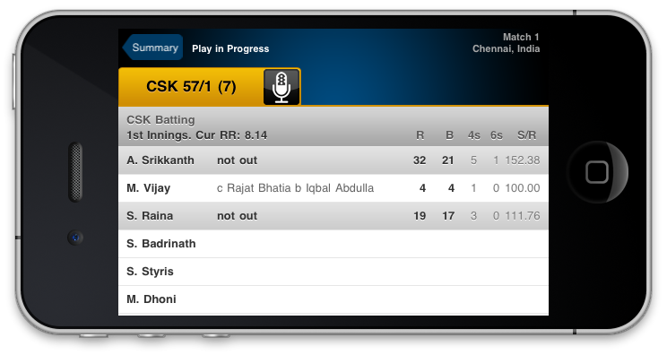
Play on Device Strength

Slide 14
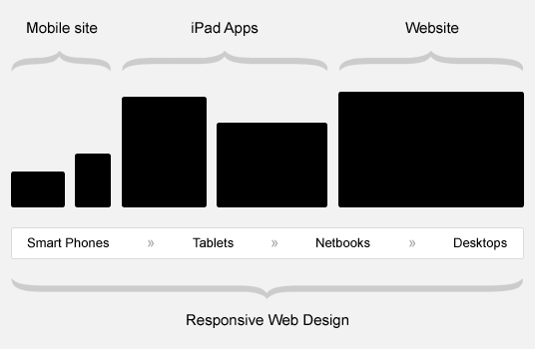
Can we have a single Design?

Slide 15
What is Responsive Design
“A design that "responds" to the user’s behavior and environment based on screen size, platform and orientation.”
Adaptive layout to suit different screen sizes
Resizing images to suit the screen resolution
Serving low-bandwidth images to mobile devices
Render only essential elements on smaller screens
Providing “touch-friendly” links and buttons for mobile users
Detecting and responding to mobile features

Slide 16
Responsive Design Ingredients
Flexible Images
Media Queries
Seamless UX across devices
Adoptive Layouts

Slide 17
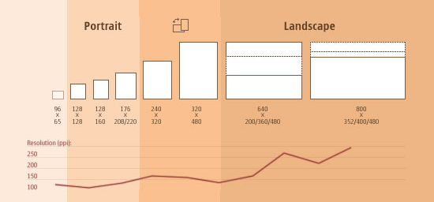
Why Responsive Design
@ Morten Hjerde
Flexible layouts are “Necessity” NOT “luxury” for websites unlike years ago.
Keep creating custom solutions for each Device is not always feasible.
One responsive design is easy to manage and maintain.

Slide 18
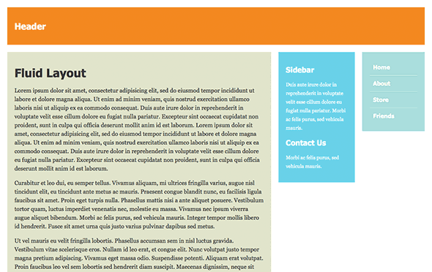
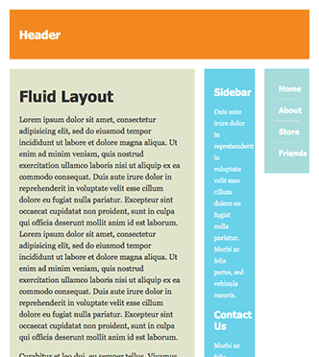
Fluid Design Limitations
When rendered on smaller widths… fluid design starts degrading

Slide 19
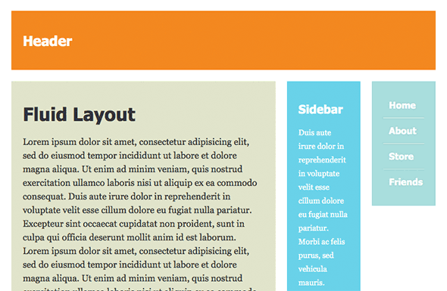
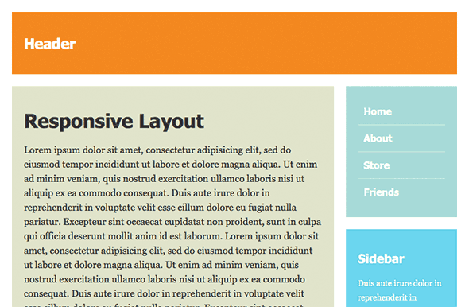
Adoptive Layout
In response to the changed screen size, layout is changed suitably for optimum viewing experience.

Slide 20
Adoptive Layout
ADOPTIVE LAYOUT

Slide 21
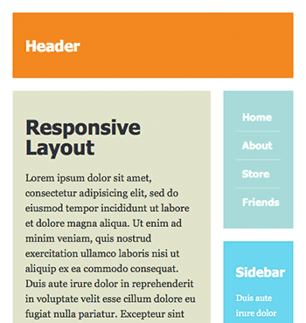
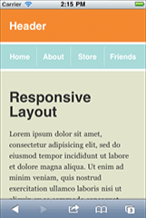
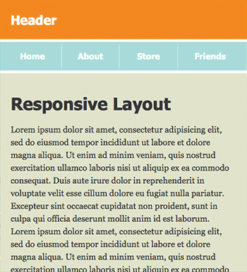
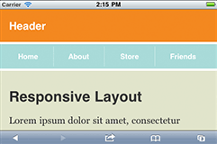
Responsive Layout Rendering
real estate wastage
Device targeting through CSS3 Media Queries
max-device-width: <width>
max-device-width: <width>
<link rel="stylesheet" type="text/css"
media="screen and (max-device-width: 480px)” href=”small.css”/>
Gutters are removed while rendering on small device

Slide 22
Fluid Images
Scaling Images with the Layout Container
Hiding and Revealing Portions of Images
Flexible images
img { max-width: 100%;

Slide 23
Displaying Essential Content Only
We can…
shrink things proportionally & rearrange elements to fit in smaller screens But does user need that very same content on smaller screen or mobile device?
display: none
<meta name="viewport" content="width=device-width" /

Slide 24
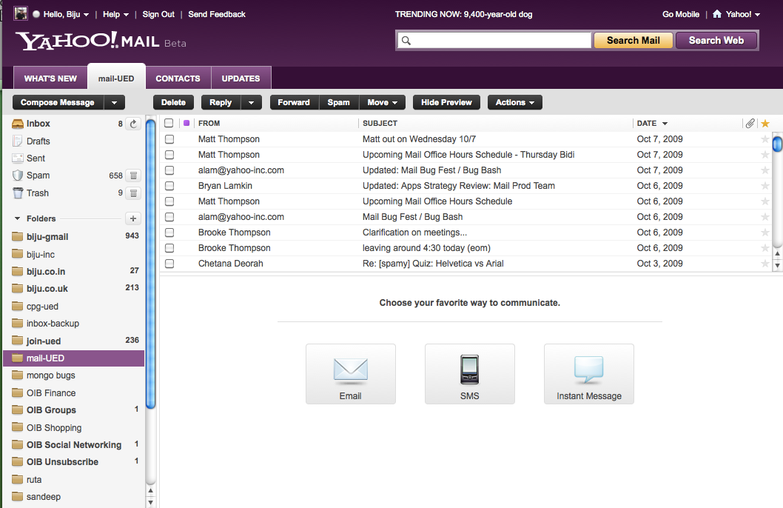
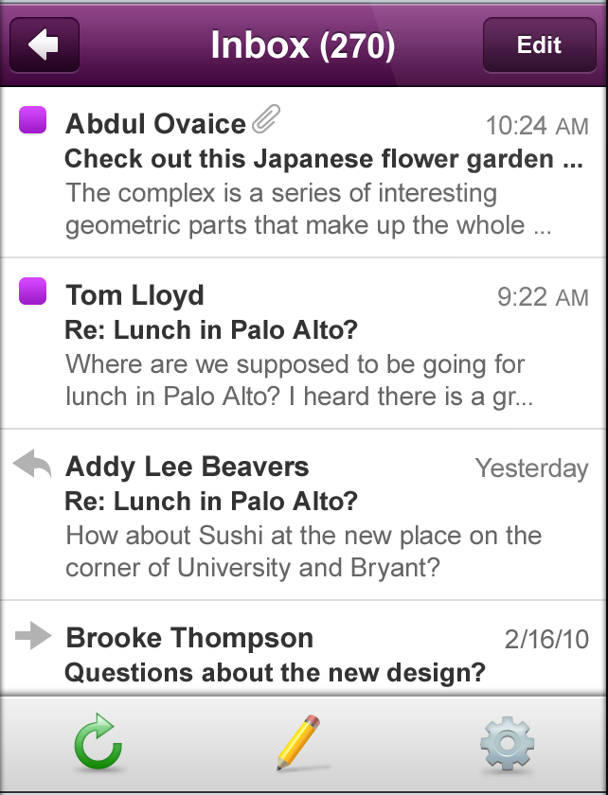
Provide Essential Content Only
With 80% less screen space, we should know what matters most
The application for small devices should provide only what customers need and nothing else

Slide 25
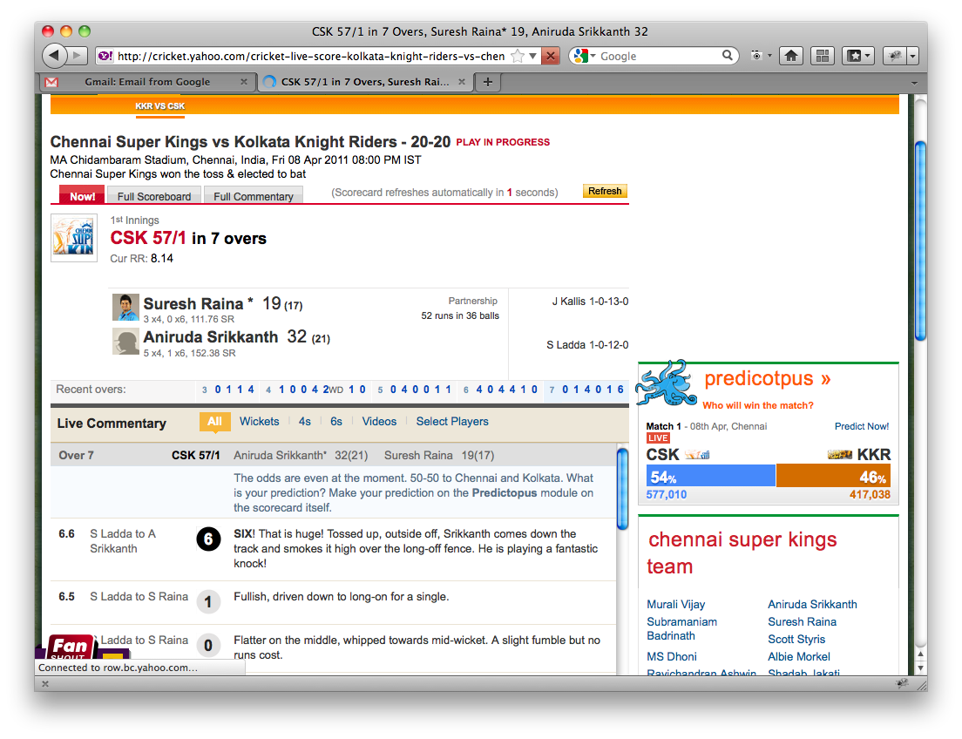
Provide Essential Content Only

Slide 26
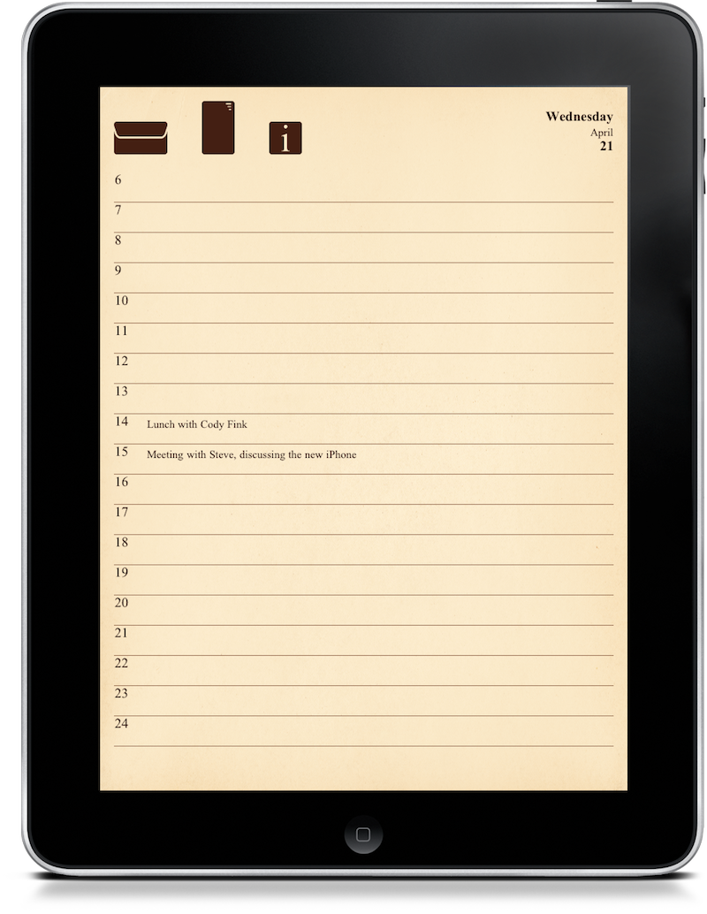
Touch Friendly Design Considerations
Visually differentiate links.. from content w/o relying on mouse over discovery. CSS hover states (a:hover) is unsupported.
Design obvious drop-down menus… tap-to-open needs a link / button like affordance
Design for device rotation…
Most of the devices supporting rotation so detect the rotation and switch CSS for optimum layout.
Design for fat Fingers…
In spite of advanced touch screens…finger is not
As accurate as cursor so…space out your links & interactive elements optimally.

Slide 27
Touch Experience Design - Target
45-48 px is ideal targets for finger.
Hit targets are proportional to the device resolution so…
Keep touchable element size to 10 mm minimum
Visual feedback is critical and necessary in a touchable environment. it is still visible after released touch and guides a user through an interface.
Audible feedback is secondary mechanism Use audible cues in specific ranges to cut through the user’s natural environment.
Keep Tolerances to avoid accidentally hitting an adjacent element.

Slide 28
Touch Experience Design - Gestures
Leverage standard gestural controls to respond exactly as a user would expect.
Provide easy access to functionality (buttons, sliders, menu items, etc.) but allow advanced, learnable gestures as shortcuts.
Distinguish between global, system-level gestures and local, app-level gestures.
Don’t put labels below a control, as it can be obscured by the user's own hand.
Trigger actions on release, not on press.

Slide 29
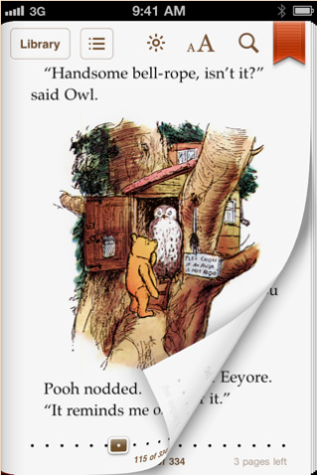
Touch Experience Design - Transitions
In Touch UI, Transition animations help confirm that action is completed.
Engages user and provides a immersive dive in to application context.
Transitions should be simple, elegant and subtle NOT dramatic to draw attention to themselves.
Provide touch, press and release states for actionable elements in absence of focus states or hover states.

Slide 30
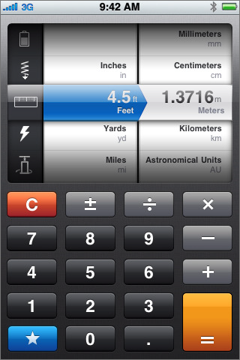
Touch Friendly Input Controls
Text field vs. pickers

Slide 31
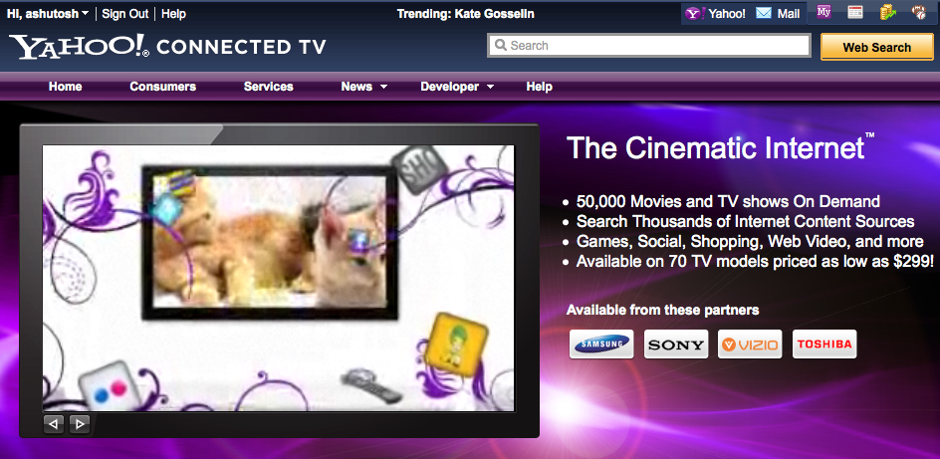
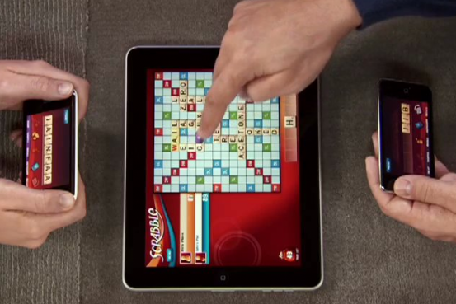
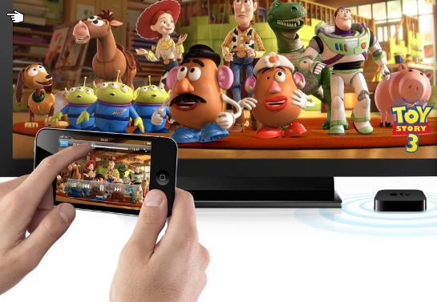
Emerging Trends…
Content for Connected devices
Complementary Apps
Device Shifting

Slide 32
Thank You
Credits: Yahoo! Images, Flicker, Google Images, Iconarchive
ashutoshk77
ashutoshk77@yahoo.com
8197820540

