Slide 1
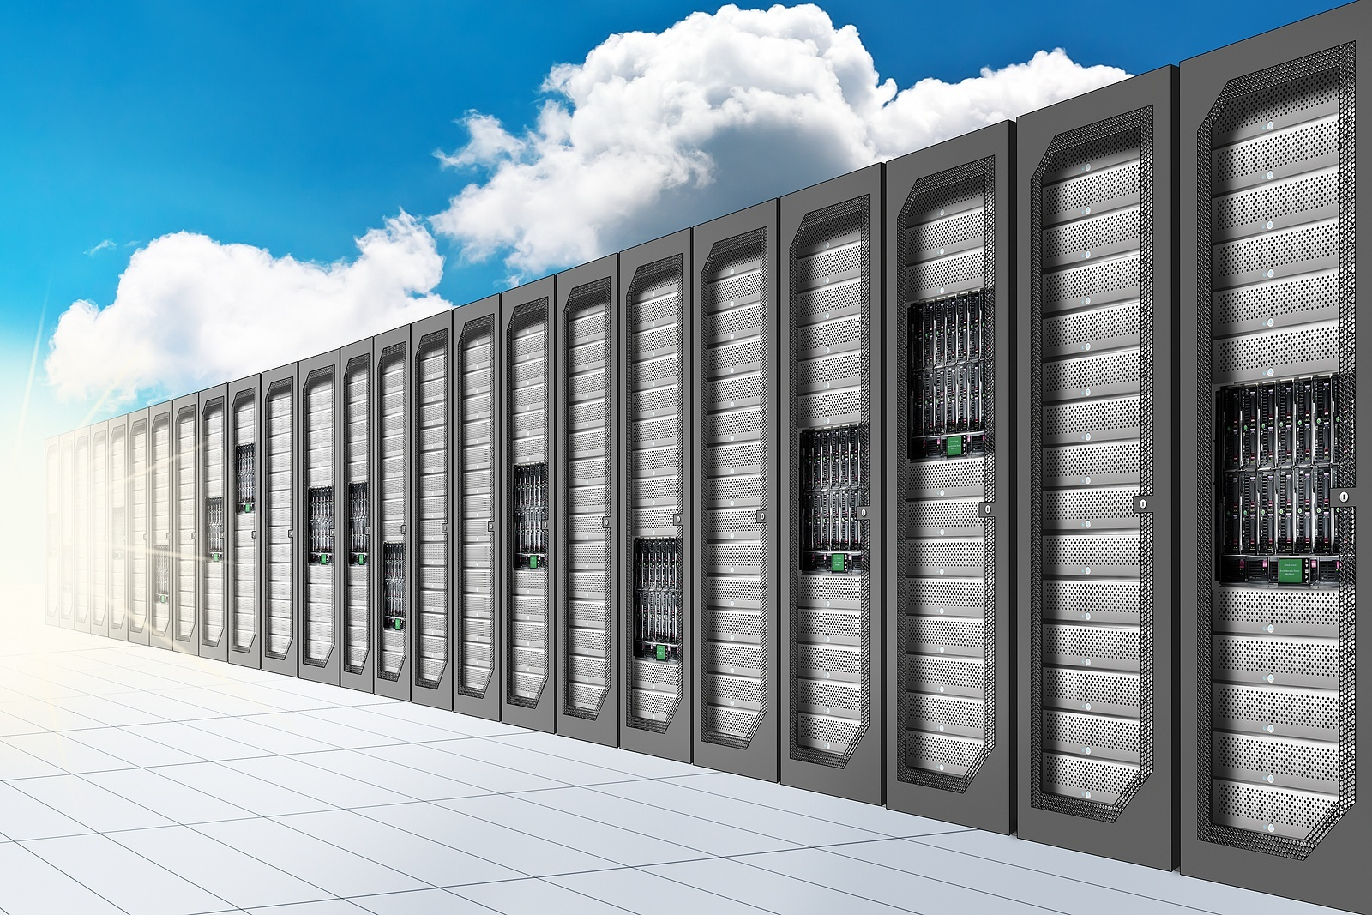
WEB APPLICATIONS IN Cloud
5th, November 2011

Slide 2










Syntel Corporate Overview
National Minority Supplier Development Council
HQ in USA – Troy, MI
28 offices (US, Europe, India) including 14 Global development centers
Founded in 1980
Global Headcount of 18,027 on June 30,2011
Revenues of $532M (2010), 2011 Guidance $625 to $640M
Profitable since inception
Zero Debt; Strong Cash Position
NASDAQ: SYNT
Adherence to SEC Norms and NASDAQ Listing Requirements
Financials audited & certified in USA
PASSION
TALENT
INNOVATION
Entrepreneurial Culture
“Customers for Life” Philosophy
More than 18,000 professionals
Multi-skilled workforce with technology skills and business expertise
Corporate DNA of Innovation
Integrated IT and KPO Services
Targeted industry solutions
Customized Business Solutions
Notes:
2

Slide 3
CLOUD PLATFORM

Slide 4


Cloud Reference Architecture
VIRTUALIZED INFRASTRUCTURE
INFRASTRUCTURE
First step to building a cloud Infrastructure
Ability to host multiple operating systems on a physical machine
Better utilization of physical resources
Ability to snapshot an environment for later rollback for backup/restore purposes

Slide 5
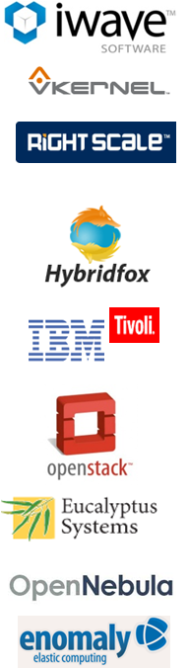
Cloud Reference Architecture
INFRASTRUCTURE AS A SERVICE (IAAS)
MANAGEMENT FABRIC
Making of IAAS from Virtualized Infrastructure
Ability to scale up and scale down VMs
Ability to create an image catalogue for frequently used configurations
Offer self service to end user
Ability to meter and bill based on usage
Ability to burst into public clouds for sudden load surge

Slide 6
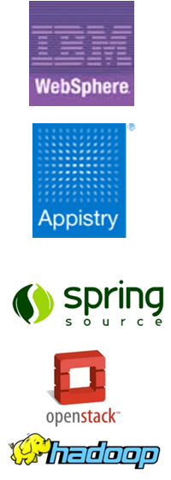
Cloud Reference Architecture
PLATFORM AS A SERVICE (PAAS)
PLATFORM
Making of PAAS to achieve Application virtualization
Ability to seamlessly scale up and down without user intervention
Self Healing and platform in-built reliability

Slide 7
Cloud Reference Architecture

Slide 8
APPLICATION DESIGN PRINCIPLES

Slide 9
Cloud Application Best Practices
Scalable Applications
Atomicity
Idempotent Functions
Parallelism
Stateless
Functions
Computational Storage
Eventual Consistency

Slide 10
Atomicity
Tasks should have a specific and clearly defined purpose
See Robert Martin’s Single Responsibility Principle
Execution of the function is self contained
Benefits
Atomic methods are easier to migrate between instances
Upon error, atomic methods are easier to restart or repair

Slide 11
Idempotence
“Idempotent operations are operations that can be applied multiple times without changing the result”
Idempotent Tasks can be retried
Set Salary to 60K
If run twice, salary will still be set to 60k
Non-Idempotent Tasks cannot safely be retried
Retrieve current salary and increase by 10k
If run twice, salary will be increased 20k, not 10k
Notes:
Take second example, retrieve salary and increase by 10k. One task – problem!
But do in two tasks. Task one is get salary – idempotent Second task, take salary from request and add 10k - idempotent

Slide 12
Idempotence Function?
Function
Function
Get Salary
Put Salary in Request
Get Salary
Increase 10k
Commit
Execution
Flow
Function
Not Idempotent
Get Salary From Request
Increase 10k
Commit
Idempotent

Slide 13
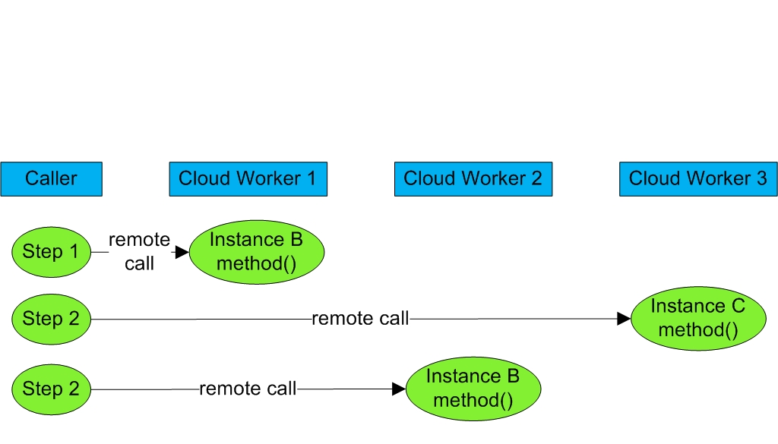
Stateless Functions
Tasks should be constructed so that they do not hold state information necessary across multiple request invocation
Benefit
Improved scalability, load balancing, and reliablity

Slide 14
Parallelism
Cloud Platform will run multiple instances of the same function on the same machine simultaneously
Function must be reentrant to prevent errors due to side effects
int g_var = 1;
int f()
{
g_var = g_var + 2;
return g_var;
}
This code will return indeterminate results if invoked in parallel

Slide 15





Merging Computation & Storage
By dynamically routing application workloads to relevant data nodes, computational storage fully leverages distributed execution and minimizes the moving of data.
Benefits:
10-100x performance gains
Commodity infrastructure economics
Increased infrastructure utilization
Accelerated application delivery (time-to-market)
Built-in disaster recovery
Support for standard development frameworks/tools
Notes:
Computational storage allows application processing to happen local to your data by routing application workloads to relevant data nodes.
In doing so, computational storage enables significant increases in performance and efficiency while dramatically reducing application TCO.

Slide 16
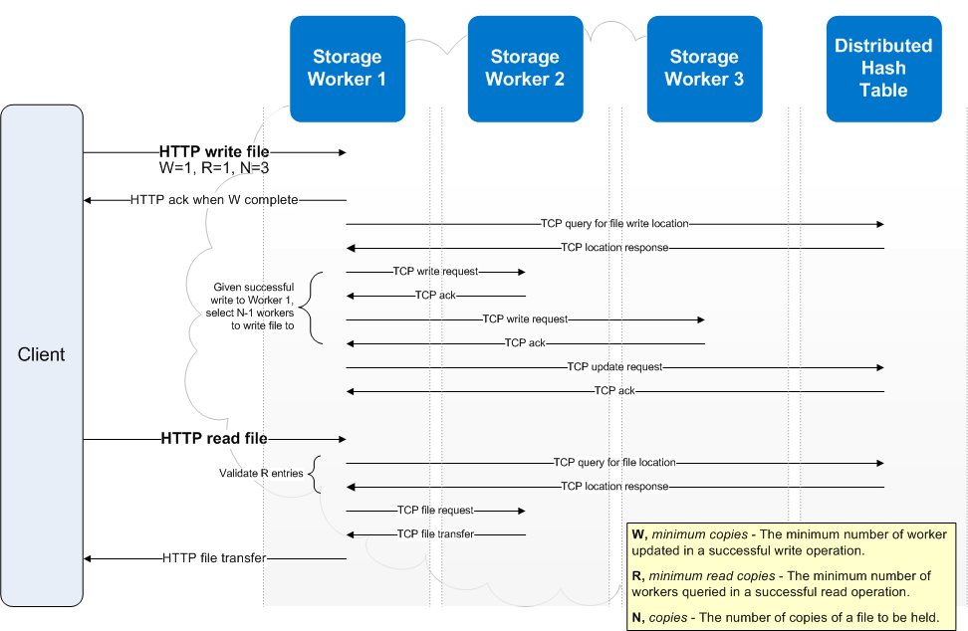
Eventual Consistency
System wide or per file setting;
N – number of copies
W – min number of workers updated in successful write
R – min number for workers updated in a successful read

Slide 17
R+W > N = Always Consistent
As long as the number of Reads (R) required plus the number of Writes (W) is greater than the number of Copies (N), Consistency is guaranteed
Insert File A.txt N=3, R=2, W=2
Update File A.txt (In Progress)
Read File A.txt
Update File A.txt (2nd Copy)
Read File A.txt
Worker 1
Worker 2
Worker 3
A.txt
A.txt
A.txt
Version 2
Version 1
Version 2
Version 1
Version 2
Version 1

Slide 18
ApplicationS IN CLOUD

Slide 19
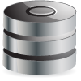
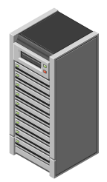




Typical Web App Architecture
Database
Application Server / Business Logic
Web Server /
Presentation Layer
Client Browser
Notes:
This is your classic three tier architecture. Incoming requests are fielded by a web server. The web server probably also draws files (such as images, PDFs, music, and so forth) from a file server. The web server farms processing out to a number of servers running an application server. This is where the bulk of your application’s business logic probably resides. You probably maintain a relational database on the back-end as well.

Slide 20
Web Application Design
A typical web application could need:
Infrastructure
Compute Power, Storage Space, Networking
Messaging between components
Caching
Session Management
Security
Storage
Storage for static web content i.e. html, images, music, etc.
Transaction storage
Storage for logs, reports, archives

Slide 21
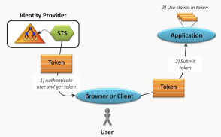
Security Design Considerations
Using local authentication
Relying on Cloud provider’s security model
Virtual Private Cloud
Federated Identity (Claim Based Authentication)

Slide 22

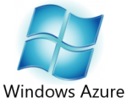
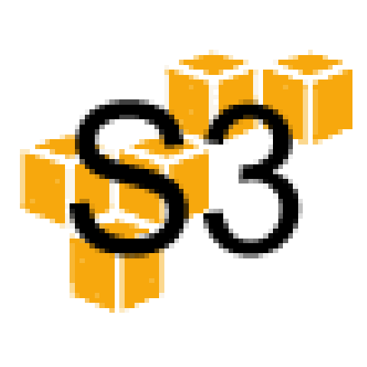






Leverage Many Storage Options
Distributed File System
Cloud Memory
NoSQL
RDBMS

Slide 23
SharePoint with Cloud Storage via RBS
Database server acts as a
pass through for Documents
Only Reference Data retained
Grow your Storage Repository, as
needed, on commodity hardware

Slide 24
Some New Constraints & Some New Options
CONSTRAINTS
I need more than xxGB of RAM per instance
Distribute load across multiple instances; use a shared distributed cache
My current server specs are better than an IAAS instance
Run more instances but only when you need them
I need static IPs for my servers
Boot scripts that re-configure software from configuration database
NEW OPTIONS
I can take static data physically near the user
Amazon Cloudfront, Azure CDN
My Application can control the resources I need
Self monitoring

Slide 25
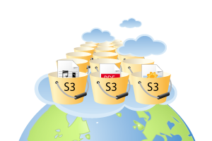
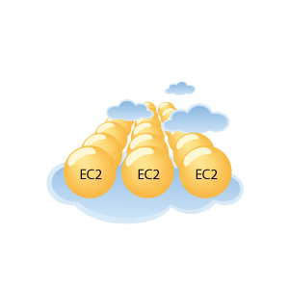
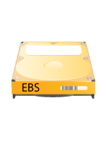


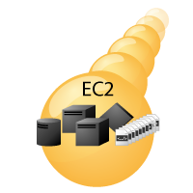

View of a Web-Application on Amazon Cloud
SimpleDB
SQS
Client Browser
Notes:
Compute power (Amazon EC2)
Storage capacity for images, music, etc. (Amazon S3)
Content distribution (Amazon CloudFront)
Database storage (Amazon EBS)
Messaging btw. components (Amazon SQS)
Payment options to enable e-commerce (Amazon FPS)
Load balancing for optimal performance (Amazon EC2)

Slide 26
Public v/s Private : CASE STUDY

Slide 27
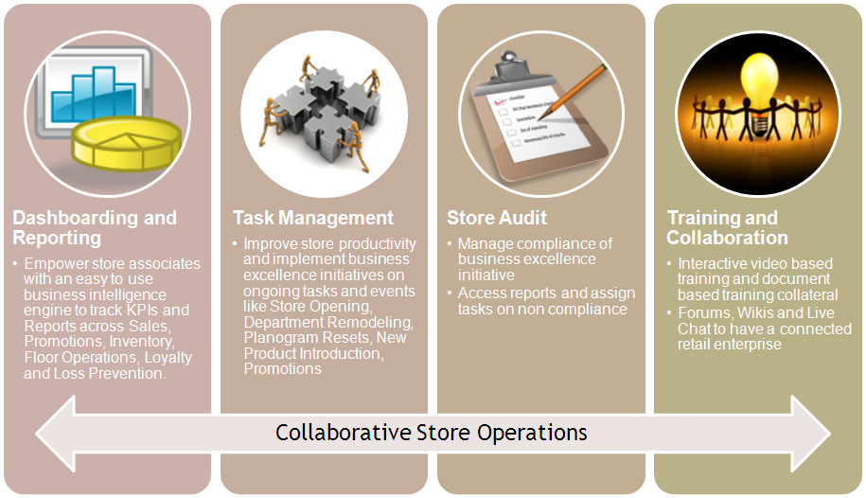
Application Overview – Store Service Workbench
A unique solution to offer a blend of Business Intelligence, collaboration and operations management for Retail Stores
Aides store managers at the retail stores to analyze business information to predict the right needs and growth
Helps in Operations Management of daily tasks and audits in a transparent manner, reducing administrative overheads
Proves a collaboration platform to facilitate induction and training, broadcasting information across stores and locations, etc

Slide 28
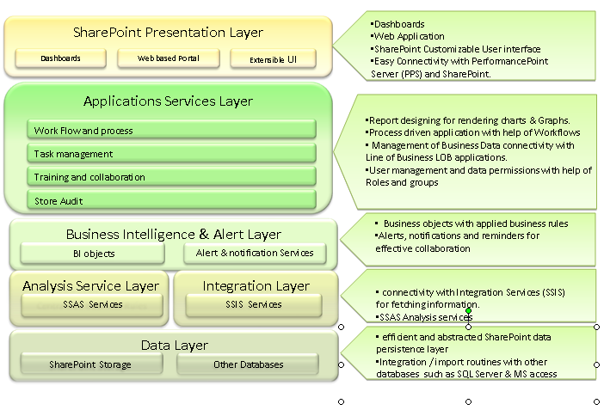
Application Architecture

Slide 29
Migration to Azure/BPOS
Process
Understood the architecture and requirement of the SSW solutions
Understood the Azure and BPOS platform
For each of the components in the architecture
Assessed if it can be hosted in Azure
Envisioned the layers and communication flow in the proposed solution
Brainstormed any inhibitors and roadblocks
Evaluated the benefits of the solution
Azure
Microsoft does not support servers such as SharePoint, Performance Point within Azure
BPOS
Current BPOS offering does not permit connecting to custom SQL databases.
Performance Point Server is also not supported by SharePoint Online in BPOS
Authentication is through custom users, or after synchronizing with Active Directory.
Limited customization of SharePoint lists
SQL Azure
SSAS is not currently supported in SQL Azure
SSIS is not currently supported in SQL Azure

Slide 30
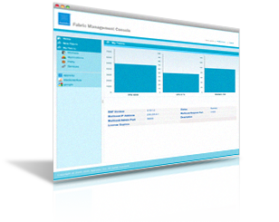

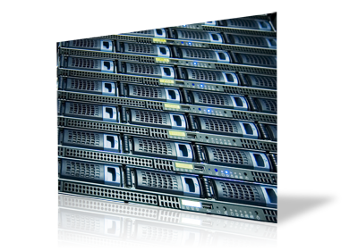
Appistry Overview
Appistry CloudIQ Platform
CloudIQ Manager
CloudIQ Engine
CloudIQ Storage
Future
Platform for cloud services and cloud-enabled applications
Use stand-alone or combine with commercial and/or open source software

Slide 31
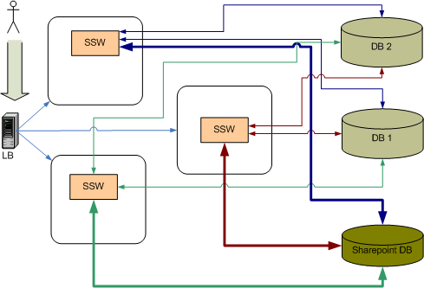
Migration to Private Cloud : Cloud IQ
Benefits
Removes the limitations of public cloud
Provides scalability, fault tolerance, elasticity and reliability to the overall solution
Can be easily moved into multi-tenant architecture
Approach – Phase 1
Install SharePoint with silent installs using Cloud IQ Manager
Deploy the entire solution as one single block hosted on the Cloud IQ platform using Cloud IQ Manager
Add a load balancer outside of the cloud network for access to the SharePoint site
Create separate SharePoint site for each customer to ensure different access and multi-tenancy
Create separate custom databases for each customer to support other features such as Business Intelligence, etc
Ensure that each customer information is segregated using a customer id, which will translate into a different connection string for the database

Slide 32
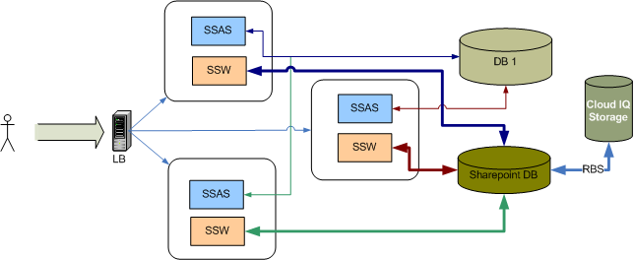
Migration to Private Cloud : Cloud IQ
Approach - Phase 2
Install SharePoint with silent installs using Cloud IQ Manager
Add a load balancer outside of the cloud network for access to the SharePoint site
Create separate SharePoint site for each customer to ensure different access and multi-tenancy
Create a single database for all the customers and change schema to include a Customer ID as a reference key to support multi-tenancy
Extend Blob storage to Cloud IQ Storage using Remote Blob Storage in SQL Server 2008
Separate the cube generation logic into custom .net code that invokes SSAS service to create SSAS cubes and persist it on the local machine.
Deploy this code into Cloud IQ Engine to ensure reliability
Invoke the above from the Presentation Tier (Performance Point Server) through .Net Remoting

Slide 33
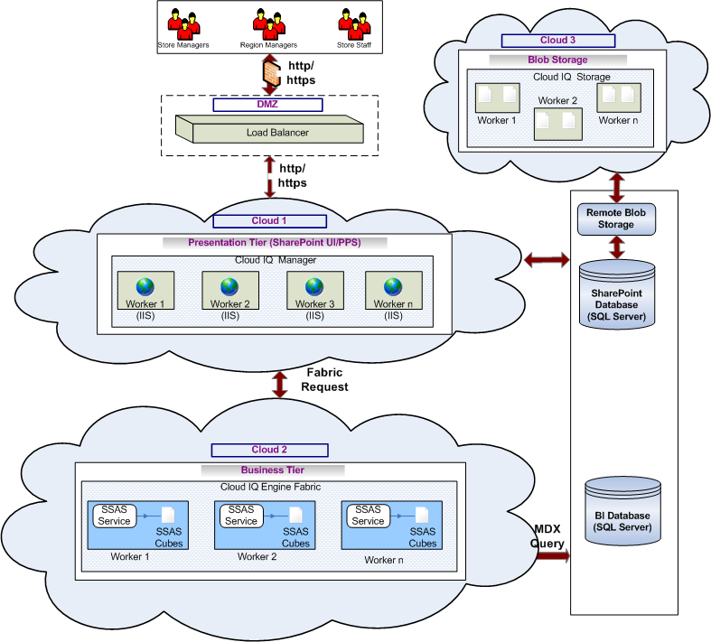
SSW – Final Architecture
Implementation of three private clouds
Can be combined to a single cloud
Benefits
Reliability of SSAS process
Higher Scalability
Faster access by caching SSAS cubes
Faster BLOB functions by way of removal from SQL Server
Reliability of BLOB
storage

Slide 34
Learning and Conclusion
Learning
Assess each application with respect to a number of parameters before migrating to cloud
Evaluate the technical capabilities of cloud offerings before making decisions
Employ a staggered approach to moving applications to cloud
Multi-tenancy is an important attribute for SAAS based cloud implementations
Conclusions
For certain cases, private cloud can be the only alternative in order to achieve the elasticity and reliability of the cloud
Security is an important consideration in order to move an application to public cloud

