Slide 1
Entrepreneurship – Pleasure, Pressure and Perils

Slide 2
Perils
Pressure
Pleasure
The spirit of
entrepreneurship

Slide 3
Fundamental question ?
Why the f*@$ you want to do it ?

Slide 4
Odds are against you ☹
High infant mortality rates of start ups : Less than 5 % monetise
Too many mountains to conquer
Too many master to please
In the past – “unemployed “ tag – changing now
Living hand to mouth
So , once again , why the………

Slide 5
To be (an entrepreneur) or not to be…
Big question – Why do it at all?
Let’s begin with “why”:
To get rich?
Follow a passion?
Scratch an itch?
Just got laid off?
To manage your own destiny?
Want more personal , discretionary time ?
There are lots of valid reasons to become an entrepreneur, but you’d better know your reason !

Slide 6
To be an entrepreneur you need two things
Passion for an idea
Stupidity to believe the idea will actually work out

Slide 7
Plentiful opportunities today
Indian economy -strongly poised and continuing growth – right from metros to rural areas
Increased the prosperity and spending levels of people across the country
Increasing demand for quality of services, business opportunities are emerging in every pocket of the country
Technological advancement, increasing spending power of the consumers and favorable demographics provide some best business opportunities

Slide 8
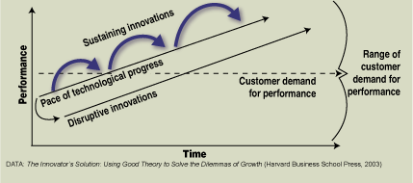
Great Opportunity for today’s India to Embrace Innovation
Source: Clayton Christensen, The Innovator’s Solution, 2003

Slide 9
Best of the times
Supportive ecosystem
Angels, seed and VC investors
Increased M&A , value creation and monetisation possibilities
Internet , ecommerce offer disruptive innovation potential
Key Question :
If not now , When ?
If not you , who else ?

Slide 10
Pressure
-taking the plunge
-surviving the take off

Slide 11
The Big Idea
Ability to deal with uncertainty
Opportunity Identification
Assess opportunity
Market side
Market study
Competition
Watch against prudent assessment vs “paralysis by analysis”
Key Challenge
Approach
Supply side
Resources required
Capabilities in hand
Be prepared to take a “Call”

Slide 12
External Capital vs. Bootstrapping?
What is the peak funding requirement?
What capital needed to break even?
What is the risk appetite and funding ability?
Non-financial benefits of external capital?

Slide 13
Profitability vs Scale
Do businesses need to be scalable – Boutique/ Lifestyle Businesses?
Individual predisposition
Commercial prerequisite for scale
What is your end objective?

Slide 14
Built to Last vs Built to Flip
What is your end objective?
Company life cycle – Product life cycle
Stakeholders’ predisposition
External environment

Slide 15
Greenfield vs. Proven Models
Blue Ocean strategy
Tolerance for mistakes – No peer comparison
Setting own standards
Lesser margin for error
Market estimation and potential
Availability of skills and expertise
Imitation strategy or Follow best practices

Slide 16
TutorVista
Guiding axiom: Innovate – be a pioneer
New opportunities- Internet , VoIP, technology
Don’t be a follower – no ITS / ITES/BPO/ CC
Scalable business
No head on conflict with big players
Create barriers to entry through scale / model
Result: New Business model that offers
Price / convenience / value

Slide 17
Perils

Slide 18
Key challenges for an entrepreneur
Getting Resources
Team
Finance
Infrastructure
Concept Finalization
Get additional data points
Test market
Iteratively fine tune
Market Acceptance
Attaining critical mass
Acquiring reference clients
Sales & Marketing
Direct
Alliance / Partnering approach

Slide 19
Key challenges for an entrepreneur
Be a learning organization
Act, learn, improve, guard against procrastination for attaining best solution
Accept feedback
Be flexible to change
Make the call; take “Individual decisions”
Follow the money

Slide 20
TutorVista: Challenges
Creating a different workforce
Average age : 50
Many of them : Computer Illiterate
Working at midnight and at 3 AM IST
Flaky Internet connection
Sudden disruption
Remote distributed work force without
face to face contact
Lesson: Be prepared; plan for any event

Slide 21
TutorVista: Challenges
No past practices to follow
New concept – will students accept e-tutor
Will US / UK parents accept Indian tutor
Can we acquire customers profitably ?
Can we hire , train and deploy Tutors
cost effectively ?
Will the technology platform be able to
handle thousands of sessions in real-time
Will the platform / portal be able to scale ?
Lesson: Launch quickly , learn and fix
Problems; Create flexible organization; Use speed as competitive weapon

Slide 22
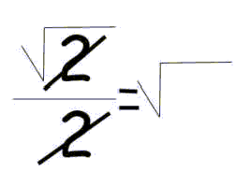
One on One Education Benefits Everyone – Struggling to Expert
Some Examples:
From an 8th grade student

Slide 23
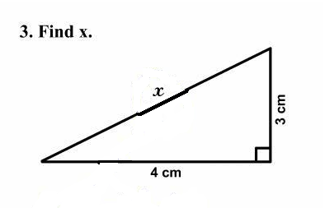
Interesting Perspectives from Actual Students
Name / email hidden to protect confidentiality

Slide 24
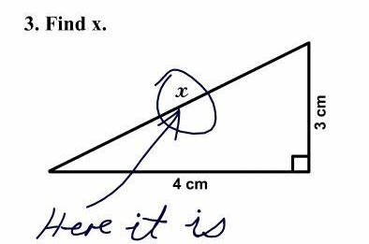
Interesting Perspectives from Actual Students
Name / email hidden to protect confidentiality
Needs no comment

Slide 25
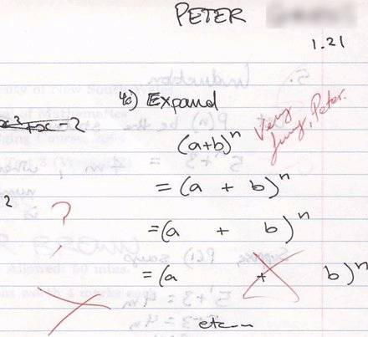
Sample from a Session with Peter – 10th grade
Algebra- polynomial expansion
Literal meaning of expansion !

Slide 26
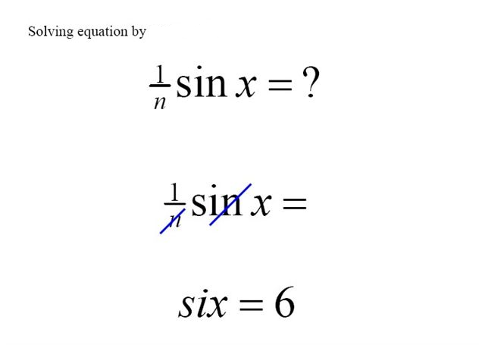
Delivering Scalable Service for all Types of Students
Trigonometry problem form a 9th grader :
Input profile of studnets varies
40 % are struggling students\
Start level can be 3 grades lower

Slide 27
Pleasure

Slide 28
Entrepreneur: leader among men
Creative personality
Ability to be innovative
Ability to look into future
Ability to lead and direct
Self Confidence

Slide 29
An entrepreneur enjoys
Personal Benefits
Acquisition of many traits like time management, learning to value money, turning street smart
Get rewarded as per one’s hard work and intelligence
Freedom to deploy all the skills and capabilities one possesses
Self satisfaction for making a difference

Slide 30
An entrepreneur enjoys
Social Benefits
Strong recognition in society; An employer demands more respect than an employee
Chance to develop important contacts which may help increase business through partnerships, advices from experts
Collateral benefits pertaining to being a successful entrepreneur include better access to financial and human resources

Slide 31
Wrong reasons to become an entrepreneur

Slide 32
I want to be my own master
You think you are tired of working 12 hours a day
Are you tired of working for others ?
Looking for a better work – life balance
To be successful, one has to please others, be it customers, vendors, financial backers or partners. No man is an island.

Slide 33
I have got a better idea
Doesn’t every body claim to have an idea ?
Execution is the key differentiating factor between the one successful venture and 99 failed ones.

Slide 34
I want to be a strategic thinker
Do you think other’s can’t visualize the bigger picture
Start-ups require constant slogging and paying attention to detail.
Entrepreneurs have to be everything from the office boy to the CEO.

Slide 35
Tons of money – That’s what I need!
You mean to say the world wants to stay poor
Money is not guaranteed but hardship, struggle, and pain-staking sacrifices are.
If money is the primary reason, vagaries of the business and the other ups and downs will lead to disappointment.

Slide 36
I’m tired of 12-hour work days
Who doesn’t want a work – life balance?
Creating/running a successful start-up requires 24 X 7 schedule.
Boundary between personal and professional life ceases to exist outside the corporate world.

Slide 37
Successful entrepreneur needs
Great idea
Leadership
Vision
Good team
Determination to succeed
A good mentor
Ability to accept failure as the stepping stone to success
Belief in oneself
Passion and commitment

Slide 38
Always remember
1. Have clarity - crack the code
2. Reverse engineer - work backwards
3. Build networks and relationships – sell, sell, sell
4. Deserve before you desire
5. Be frugal - make the money last longer
6. Raise capital when you don’t need
7. Don’t sweat over small stuff, have end state
8. When struggling to inch forward, take a giant leap
Tomorrow's world will belong to those
who break out of the standard mould and step out.

Slide 39
Perils
Pressure
Pleasure
Ask yourself :
- If not now , then when ??
- If not you , Who ???

Slide 40
THANK YOU
ganesh@tutorvista.com
www.TutorVista.com

