Slide 1
Current Environment Challenges & Way forward – SME’s

Slide 2
CHALLENGES
DOMESTIC
INTERNATIONAL
ECONOMIC
POLITICAL
ECONOMIC
INEREST RATES
FOREX RATE
UNCERTAINITY
INFLATION
TAX ENVIRONMENT

Slide 3
Past Estimates

Slide 4
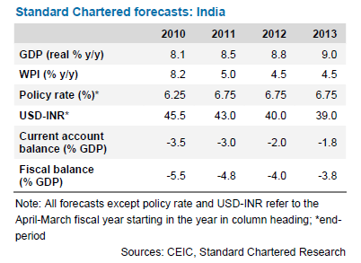
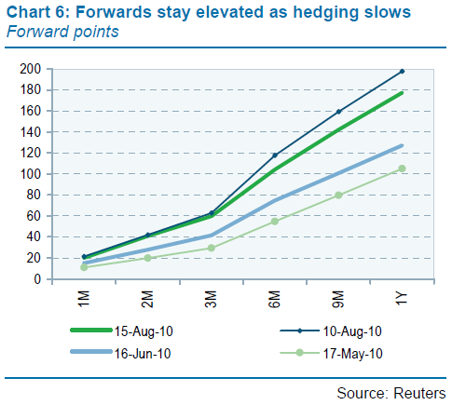
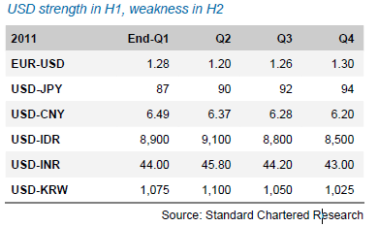
Environment – Currency – Bank Projn Jan’11
Appreciating Rupee, but forward premiums are high………
Current Forward premiums – 250 Ps PA

Slide 5
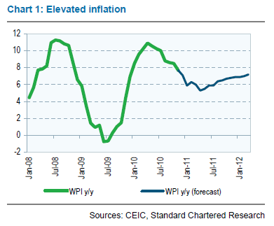
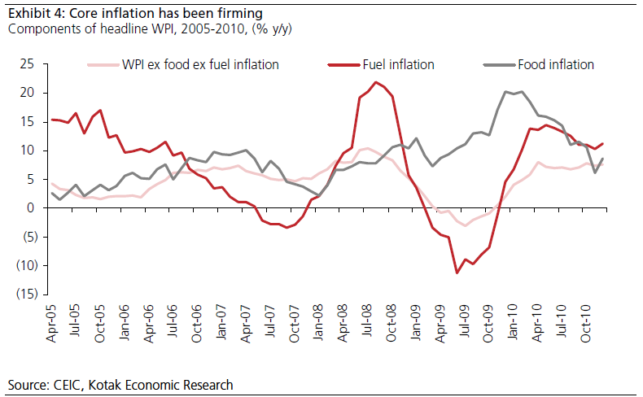
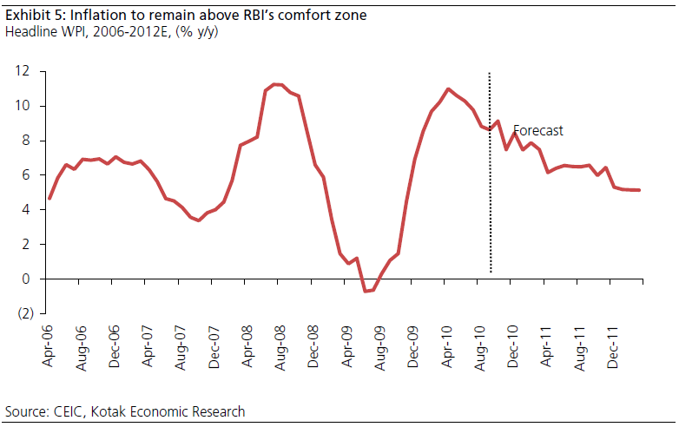
Environment – Costs Jan’11
Power tariff hike proposed for industries
Details of the hike:
HT ferro alloys: Rs 2.40 to Rs 2.90 per unit; HT commercial: Rs 5.16 to Rs 6.16; HT government lift schemes: Rs 2.36 to Rs 2.86 (revenue gain Rs 112 crore) and Railway traction: Rs 3.95 to Rs 4.75.
Impact on input costs…

Slide 6
Current situation

Slide 7
INTERNATIONAL ENVIRONMENT
FOREX RATE
Highly fluctuating foreign currency (short term fluctuations);
eg: US $ moved from month average of Rs.44.37 (in Apr-11) to Rs.52.70 in Week 4 of Nov-11 in a span of less than a year
Way ahead:
Smart Hedging, protect a base rate but not with profit motive;
Natural hedge (Import substitution);
Lower global economic growth, eurozone issue to impact rate of exchange.
Volatility is realty. Live with it.
India no longer insulated from the world.
Avg. weekly rate in Nov-11
Source: RBI

Slide 8
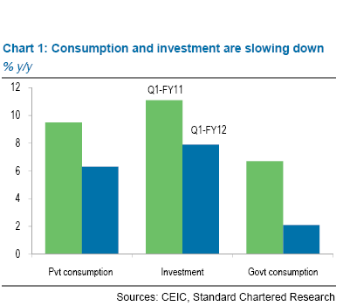
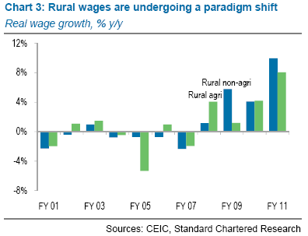
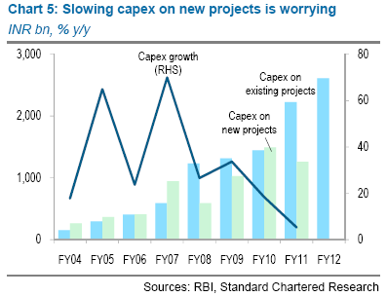
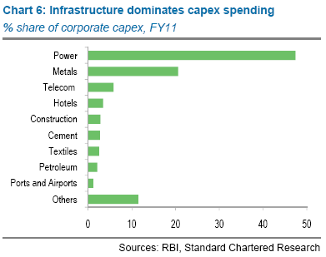
GDP

Slide 9
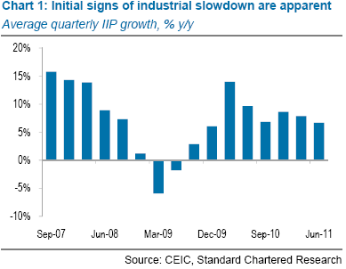
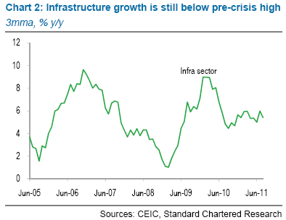
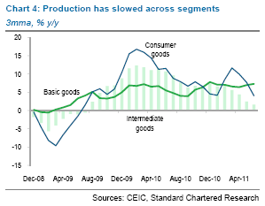
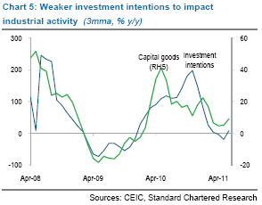
GDP Industry

Slide 10
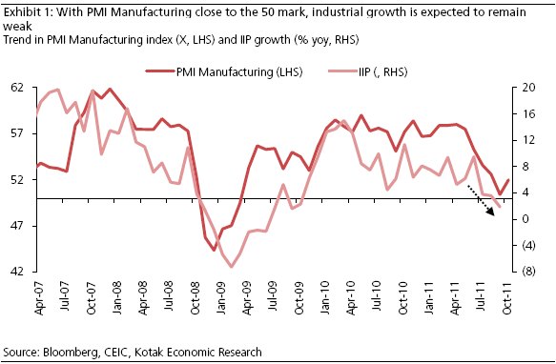
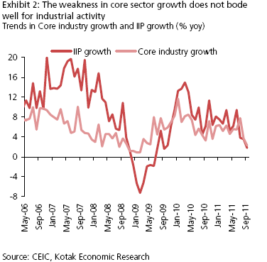
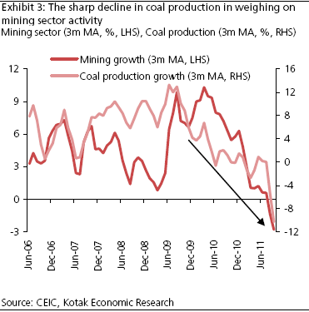
INDIA’S INDUSTRIAL PRODUCTION

Slide 11
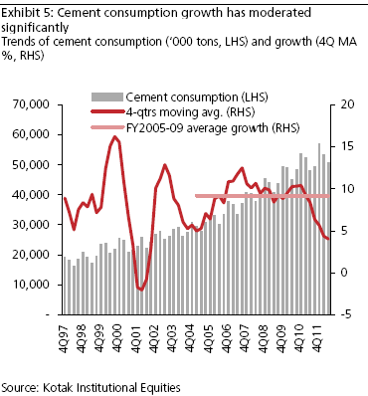
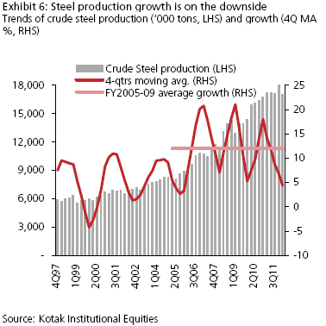
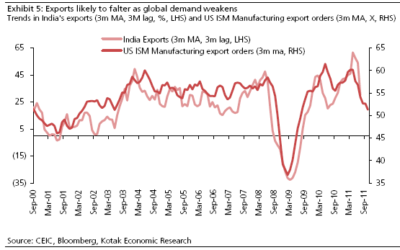

Slide 12
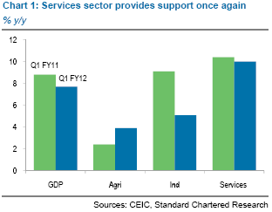
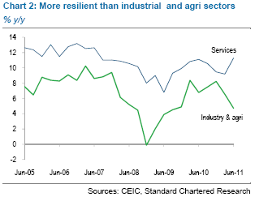
GDP Services Sector

Slide 13
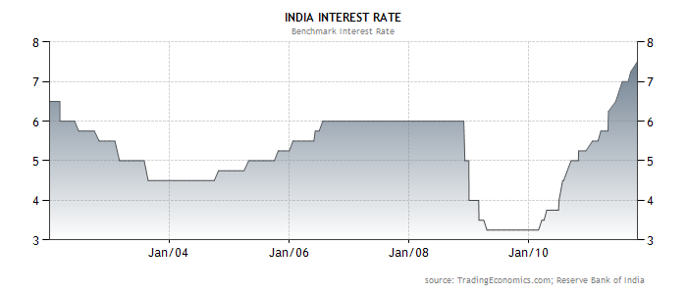
DOMESTIC ENVIRONMENT
INTEREST RATES
High interest rate environment@ 15%
Increasing the Repo rates by RBI for arresting the inflation is affecting the Industrial growth due to high borrowing costs..
Options:
Use of low cost borrowing options such as PCFC, need to be traded off with Rupee depreciation.
Higher interest rates are affecting industry
RBI to continue to tweak interest rate to control inflation in relation with Industry growth.
RBI caught between devil and deep sea – (depreciating rupee & higher inflation)

Slide 14
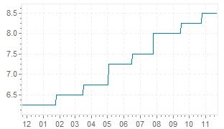
Graph Indian interest rate RBI - interest rates last year
change date | percentage
october 25 2011 | 8.500 %
september 16 2011 | 8.250 %
july 26 2011 | 8.000 %
june 16 2011 | 7.500 %
may 03 2011 | 7.250 %
march 17 2011 | 6.750 %
january 25 2011 | 6.500 %
november 02 2010 | 6.250 %
september 16 2010 | 6.000 %
july 27 2010 | 5.750 %
RBI latest interest rate changes
Graph Indian interest rate RBI - interest rates last year
Interest rate tweaked 7 times over last 10 months

Slide 15
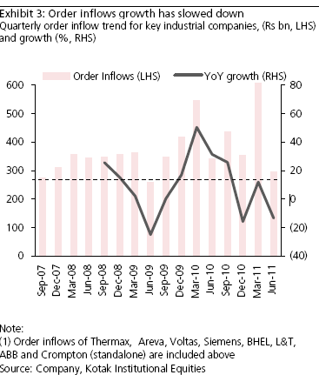
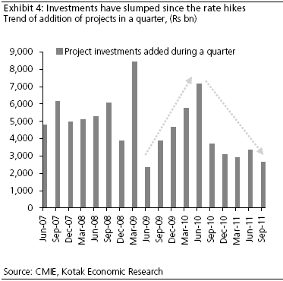

Slide 16
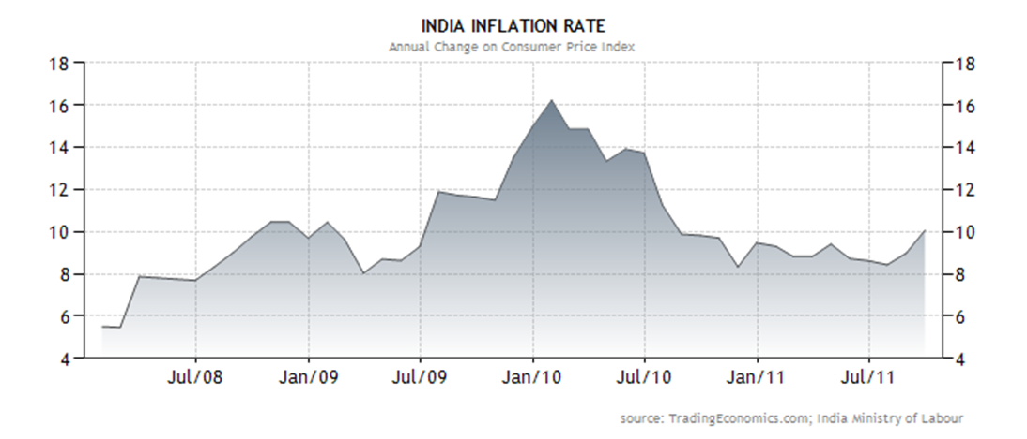
INFLATION
Inflation driven both by monetary supply and also short supply of goods
Rising inflation, inflation high at 10.1%

Slide 17
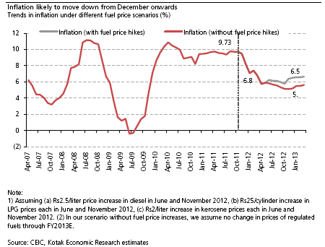
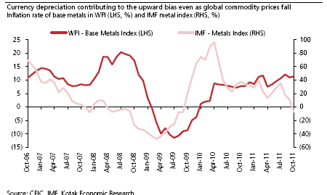
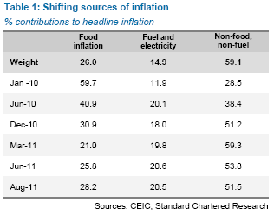
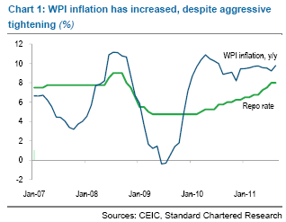
INFLATION

Slide 18
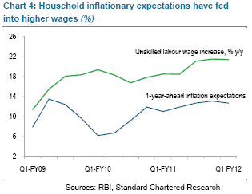
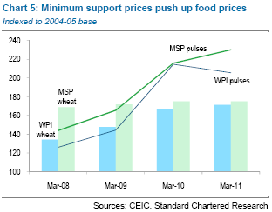

Slide 19
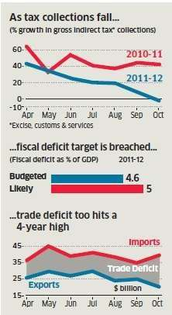
TAX ENVIRONMENT
Uncertainty on introduction of GST, GST would remove cascading effects of tax
Service tax on wide number of areas by introduction of negative list which is small and tax is levied on invoice instead of receipt basis;
Government Direct tax collections are lower by ~40% to Rs. 2.32 Lakh Cr. YTD Oct’11, against target of Rs.5.85 Lakh Cr for the year leading to increase in fiscal deficit target (as % of GDP) from Budet of 4.6% to 5%.
POLITICAL UNCERTAINITY
Political unrest is causing delays in decision making in the implementation of reforms and providing necessary support.

Slide 20
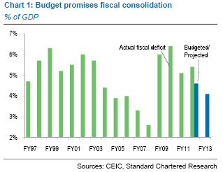
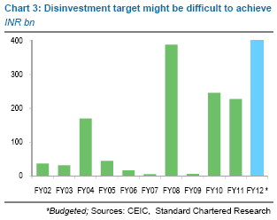
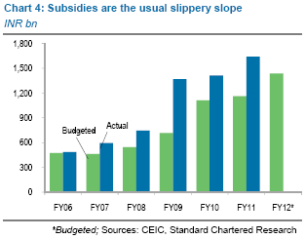
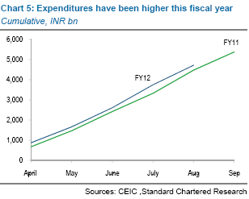
Fiscal Policy

Slide 21
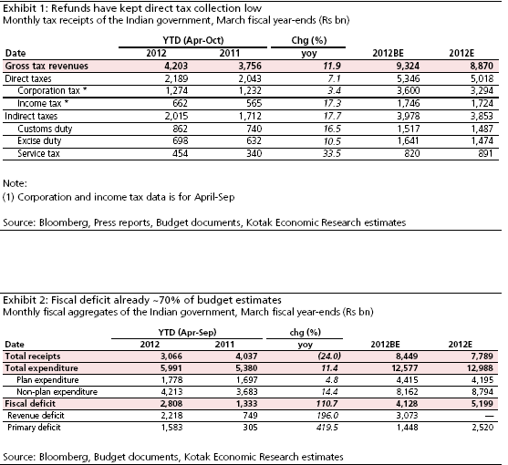
TWIN DEFICITS

Slide 22
Way Forward
Challenges Summary:
Increase in inflation expected to come down beyond Dec’11 (Base effect)
Fiscal Deficit expected to be around 5.8%
GDP FY’12 expected to be around 7%
Interest rate increase should taper off.
Power situation very grim. Impact of lower coal production and water level
Rupee expected to be weak till the europe crisis is reolved
Options:
Forex front hedging a good strategy for exports. Importers to hedge for short term at every fall.
Domestic consumption still good.
Innovation and Productivity to separate “Men from Boys”
Currency Volatility a reality.
Investment policies will be opened up to attract FDI investment.

