Slide 1
Mobile Marketing – True Mobile strategy.
Strategic Marketing Summit – 24th Sep- Chennai
-Shivkumar Mudaliar- Business head –Tamilnadu Circle - UNINOR

Slide 2
Mobile Marketing – True mobile strategy
“Google’s acquisition of Admob validates that Mobile advertising is real, results measurable, having considerable value and should be a factor if not central pillar in any brand marketing strategy going forward”

Slide 3
What is Mobile Marketing ?
Ability to connect brands to customers via the mobile phone
Mobile acts as a Content delivery as well as direct response vehicle.
Big tool for “Customerization”- Combining operational driven mass customization with customized marketing in a way to respond to individual consumer need on product services and messages on one to one basis.
Three prime characteristics of mobile as a marketing channel:
Location specific
Personalized
Interactive

Slide 4
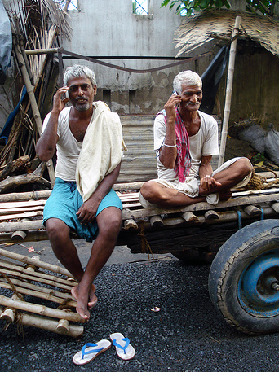
Why Market To Consumers Via Mobile Phones?
Region | Population (Millions) | Mobile subscribers (M) | Mobile active users (M)*
India | 1210 | 852 | 596
TN | 72 | 72 | 50
Consumers use mobile phones as their “first screen” not their “third screen”:
• 580M+ mobile phones in China
• 340M+ mobile phones in Western Europe
• 310M+ mobile phones in the US
• 470M+ mobile phones in India
▪ Consumers have a 1:1 relationship with their mobile phone:
• Almost never a shared device unlike television or the PC
• Kept close at work, at home, on-the-go
• Personalized – brand, color, features, ring tones, are highly customized
▪ Consumers are increasingly using their phones for more than just calls:
• Content (games, sports scores, maps) is driving consumer data usage
• Improved screen quality (color and size) is making rich media desirable
• Enhanced networks are making mobile data useful and usable
* Estimates based on a KPMG study

Slide 5
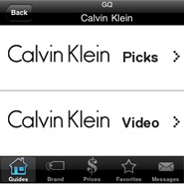
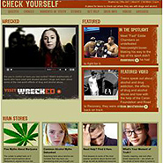
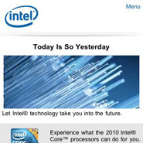
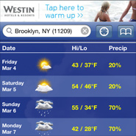
Mobile Marketing – Successful campaigns
App sponsored to Deliver new product line to mobile shoppers, with models displaying new summer look
Drugfree.ORG biggest public service campaign to prevent teen from drug abuse-Used cha-cha data base to deliver free answers on related topics
Intel-Meet the processor campaign” to drive customers to Website using exact broad match key words in Bing online serach
Westin Ad on weather channel of iPhone –Exceptionally rich powerful mobile rich media campaign

Slide 6
Mobile Marketing medium and formats
Delivery Medium
Formats
SMS marketing
MMS marketing
Mobile marketing via Ad-RBT
Mobile marketing via IVR
In-game marketing
WAP marketing
Mobile marketing Via Mobile TV channels- Break thru
Messaging
Display
Click-to-Web
App-within-an-app
Click-to-call and click-to-text
Click-to-rich media
Search
Google’s innovations ( Location based search ”near me now” , Map Navigator, Voice search, Goggles-Image search
Video ad formats
Launch of iPad

Slide 7
Recent trends
Economic downturn -> Downward trend in advertising spends
However, mobile market is bucking that trend
Apple's iPhone & iPad as a platform
Strong growth in startups developing these platforms
Giants like Google and Apple also in the race
Smartphone platforms like Android, IOS, Bada supporting app eco systems
Developments across globe enabling mobile advertising process
Launch of cross-networks media packages (Sweden, Estonia and Lithuania)
GSMA Mobile Audience Measurment (UK, Germany and Sweden)
Organization of industry events to share best practices

Slide 8
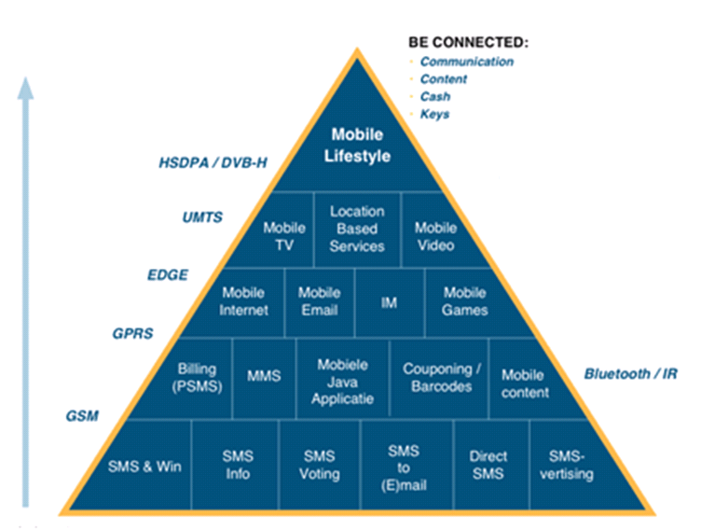
Technology offerings

Slide 9
Opportunity in India
Technology
Smart phones
Content developers
Advent of 3G
HSDPA
UMTS
WIMAX to be rolled out soon
Future prospects
LTE 4G
High speed data transfer
Smartphones sales of ~ 12 million likely in 2011
~ 100% growth YoY
Proportion to increase from 3.6% to 5.7%
Multi-utlity
Apple App store has 350K mobile apps with 65K iPad apps
Android :150k apps.
Mobile ad spends expected to cross $2.5Bn by 2014 from current 700mn
Devices with superior Form Factor (iPad)- High end experience and engagement
On Mobile
Hungama
One97
IMI Mobiles
MobME
India times

Slide 10
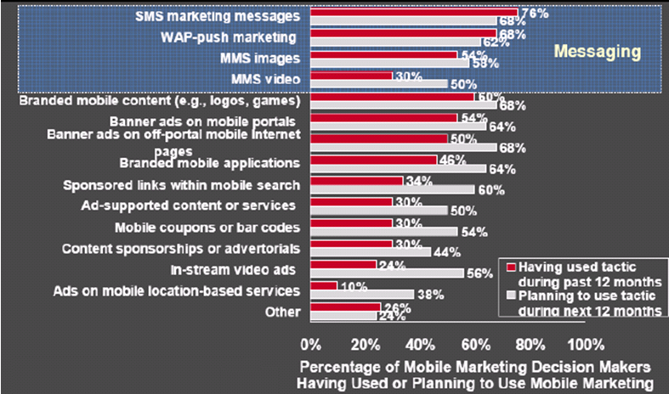
Leveraging Mobile marketing into your market mix
Consumers dependence on mobile makes it one of the most potent channels in the market mix.
Source: Jupiter Research
Mobiles biggest advantage is that it gives legs to your other channels such as catalogs, retail stores, direct response television , Radio and E-commerce. (Text response superior)
Being a always –On connected device has the unique capability to direct a consumer from one touch point to another making path to purchase less complex and generates better ROI by enhancing all your channels to drive better traffic.

Slide 11
What’s The Takeaway For Marketers? As always, some will benefit more than others
Right Now
Consumer brand companies have the most to gain from this medium
• The more global the brand the greater the opportunity
• Limited ad inventory in certain geographies (e.g., US) in rich media formats (e.g.,
game downloads) can allow an aggressive player to shut out competition
For direct marketers
• Early movers will benefit from the novelty effect
• The call to action has to match the medium
• e.g., call or text now is better than directing consumers to a website
Longer Term
Improved targeting of ads based on location, time, and consumer
demographics will increase as technology and consumer adoption improves
Frequent measurement of effectiveness will be key as the medium is
evolving rapidly

Slide 12
Few Secrets to run successful mobile campaign
Consider how consumers use their mobile devices
Use mobile advt. to influence based on shopping behaviour
• Avoid Buying Cheap Inventory
Evaluuate quality of those impressions, ”You get what you Paid for”
Leverage targeting parameters
Mobile offers unique behavioral, demographical, location and keyword based targeting
• Deliver Engaging Post-Click Experience
Thru rich media creatives, ability to view videos, drive to social media sites, apps download & direct product purchase
• Cross Platform content creation
Create Ads for multiple platform for connecting gaming devices,tablest ,feature phones and mobile TV channels to ensure limitless usage and success
• Test, Test and Optimize:
Test what works and what does not and optimise on the fly to increase ROI
Challenges
Complex Eco system with different platforms like iPhone, iPad, Android, RIM,Windows.
Privacy laws (Do not track ) limits reach. Lack of experience for new entrants-Uncertainity
Lack of effective tracking tools.

Slide 13
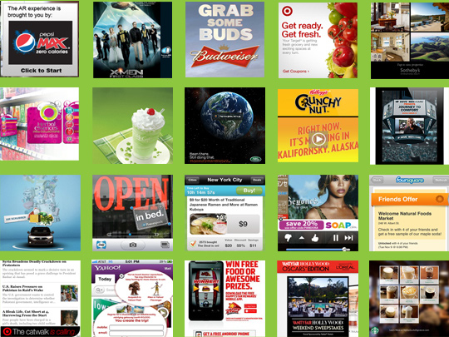
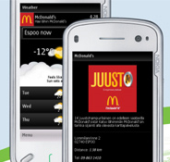
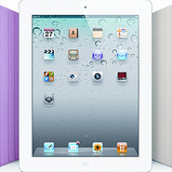
Thank you ….. Lets move on to Q &A

