Slide 1


“Ecommerce” is for all businesses & all consumers
Valerie R. Wagoner
Founder & CEO, ZipDial
valrozycki
080 300 88 572

Slide 2
What is your business? ZipDial your response!
080 300 500 17 for Ecommerce
080 300 500 42 for Retail
080 300 500 36 for Goods
080 300 500 43 for Services

Slide 3
Everyone is doing “Ecommerce”

Slide 4
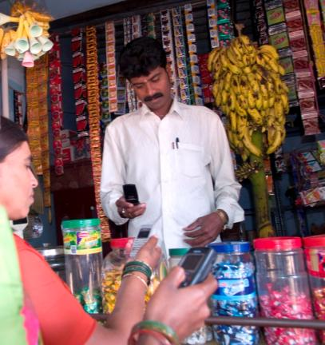
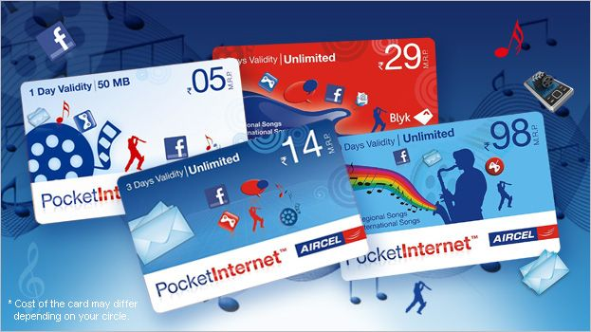
Your Future Growth Market

Slide 5
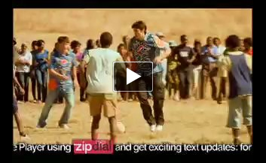
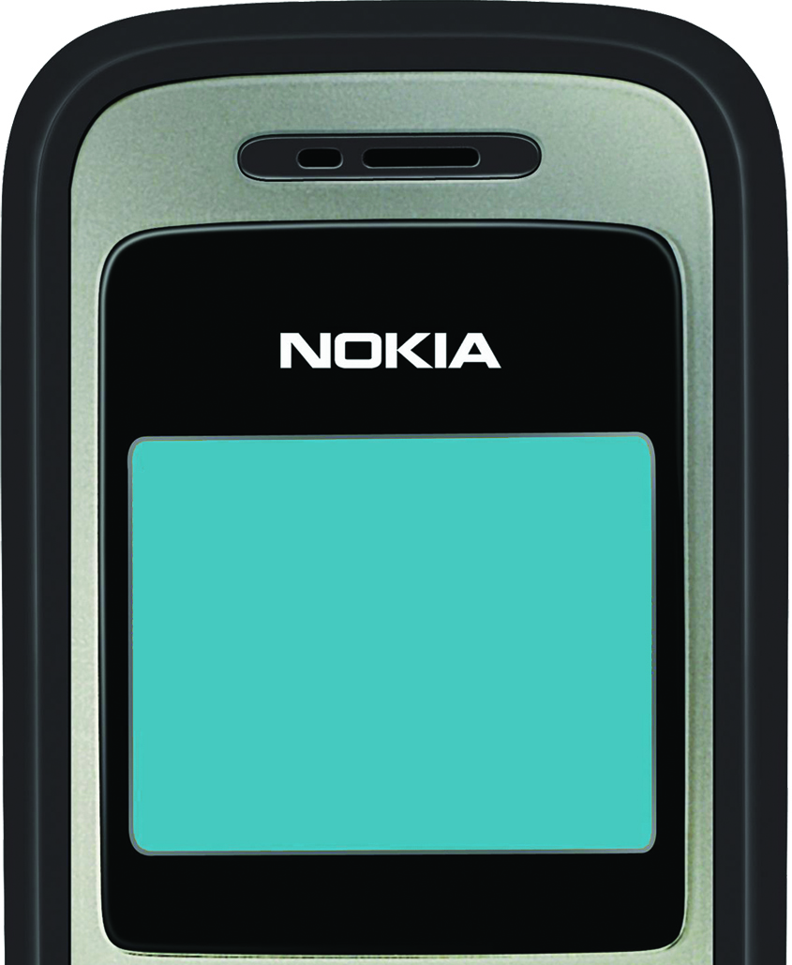


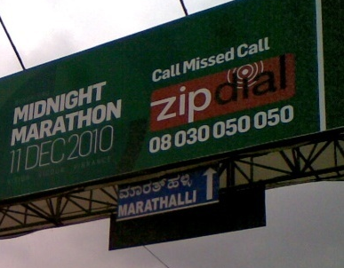
Turn All Media into Interactive & “Online”
Television
SMS Campaigns
ZipDial in campaigns across all media, online & offline
Double to 20 times
more responses
than other
call-to-action
New project – villas starting at 50 lakh. ZipDial 08030050022
Newspaper & Print Ads
Online Banners
Outdoor Hoardings

Slide 6


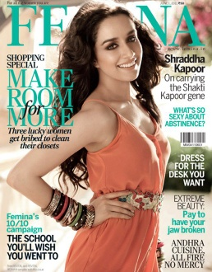

Offline “Click-Through-Rates”
Delivered 2.3x Responses than Harpers!
Delivered 30% fewer responses than Harpers.

Slide 7


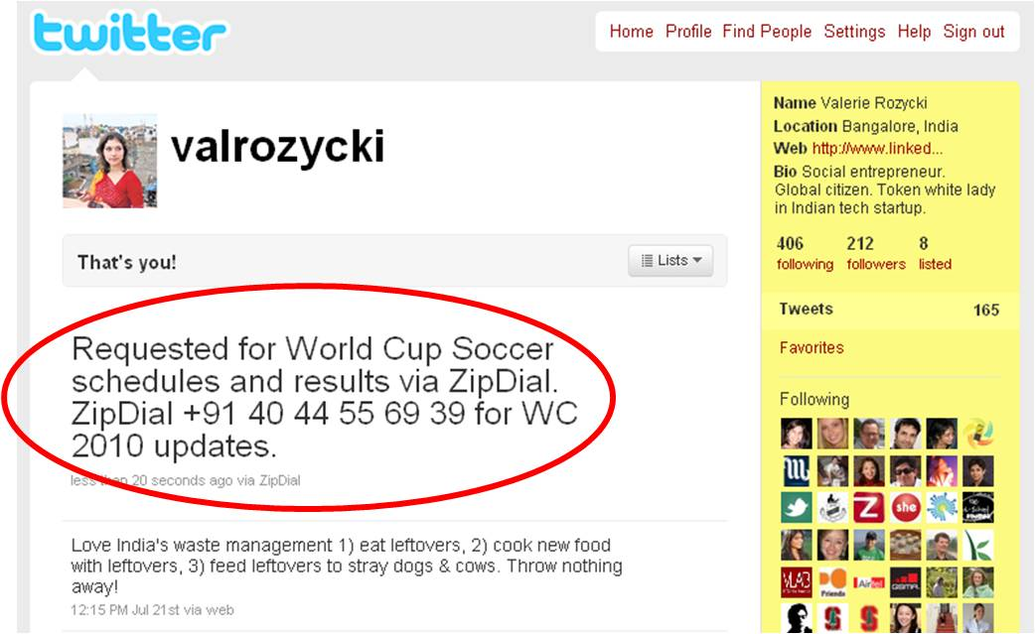
Offline goes Social & Viral

Slide 8
Feedback Please! 080 300 500 02 – Positive 080 300 500 16 – Neutral 080 300 500 18 – Negative Valerie R. Wagoner Founder & CEO, ZipDial
valrozycki
080 300 88 572

Slide 9
What are the right tools for Mobile Engagement?
Handsets are Not Internet-Enabled “Only 6% of ‘most used handsets’ are internet enabled (WAP/GPRS/EDGE/Wi-Fi).”
~ Juxt Consult, July, 2011
* Juxt Consult, 2011. Figures as of June, based on individual surveys of 201,839 people / 48,765 households
Half of Indians never SMS,
but everyone can call
Source: TNS Mobile Life Survey, Jan 2011

Slide 10

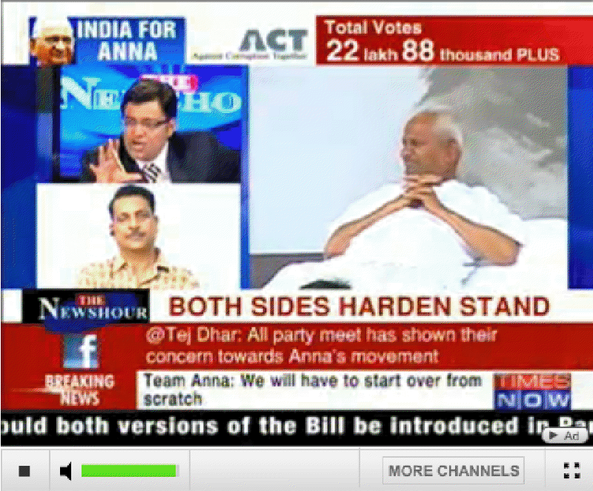
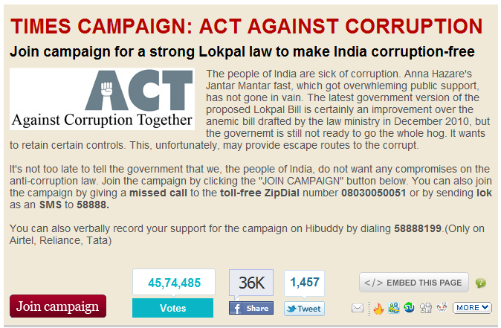
100% Reach to All Consumers
ZipDial to vote for a stronger Lokpal Bill
ZipDial enabled more reach than Facebook or Twitter with 7.6 Million votes over 4.5 Million voters, more than 100x the no. of Facebook supporters in 2 weeks time
Television
Online

Slide 11
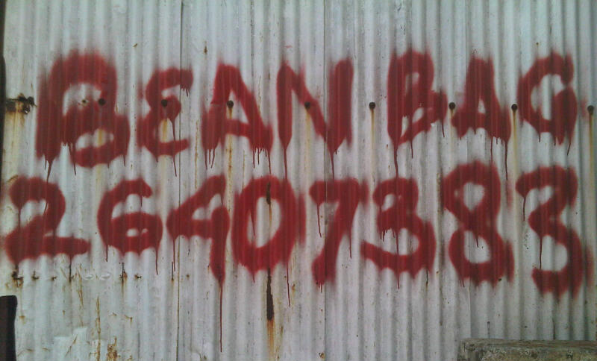
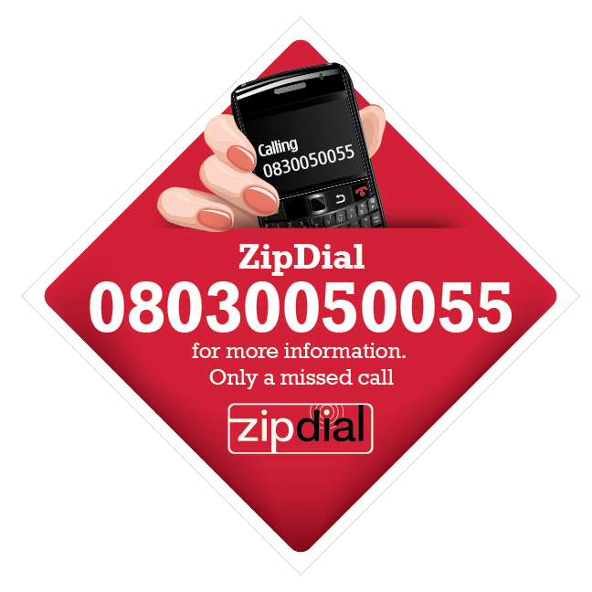
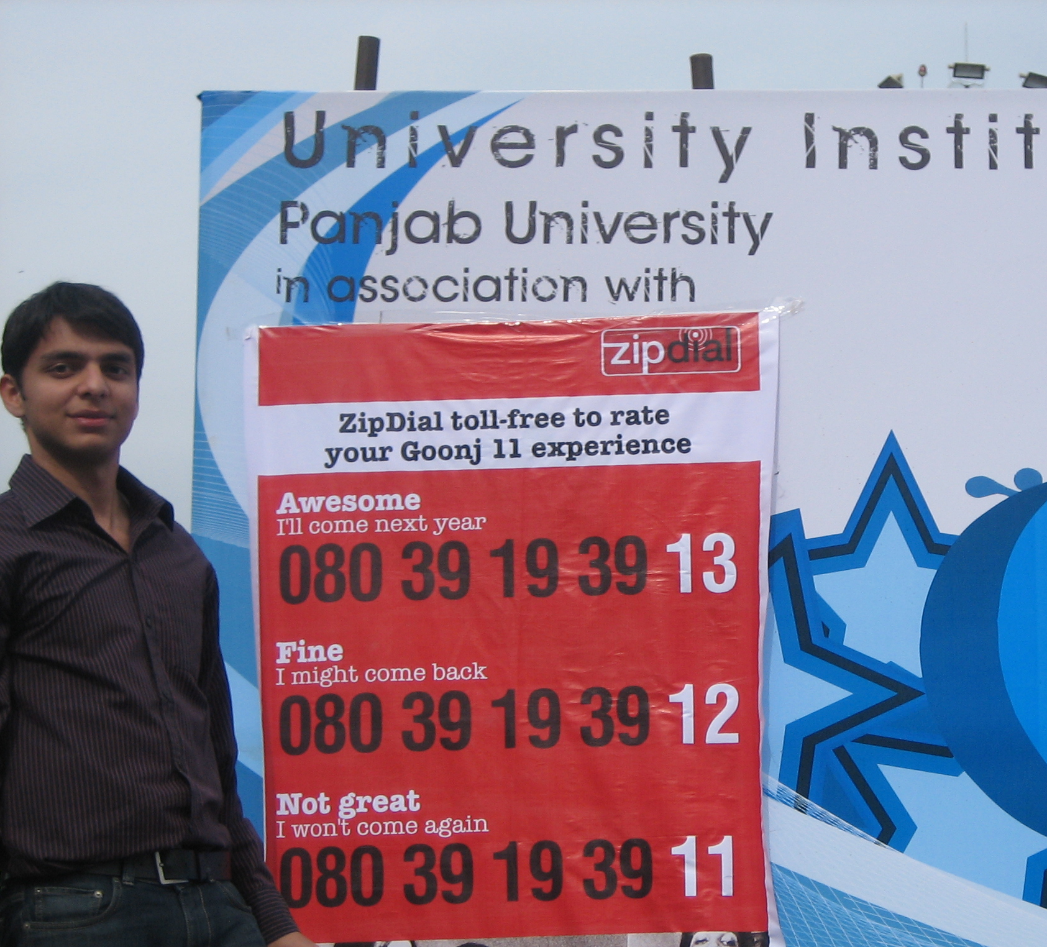
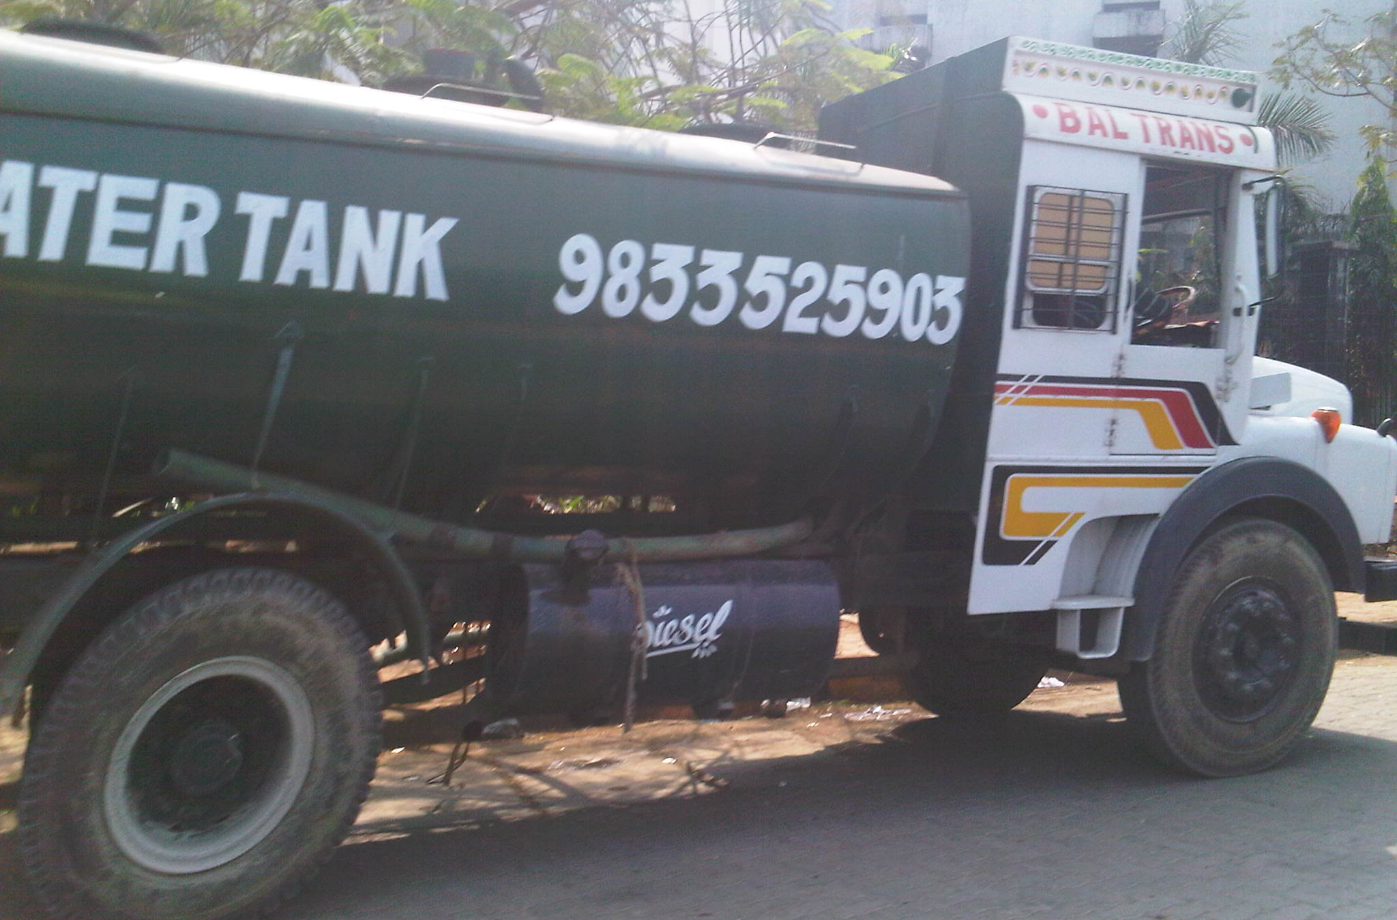
…and Even the Smallest Go Live in 2 Minutes!

Slide 12

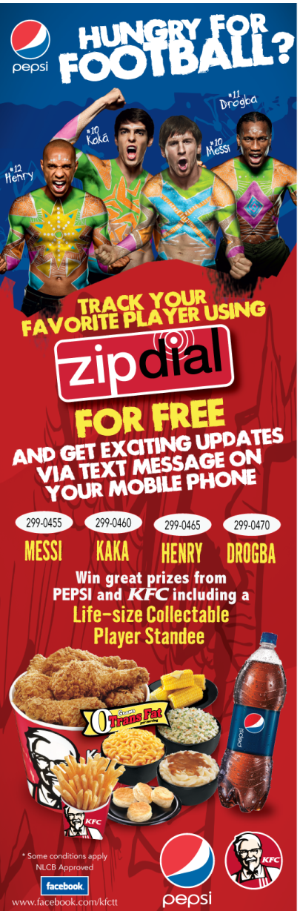



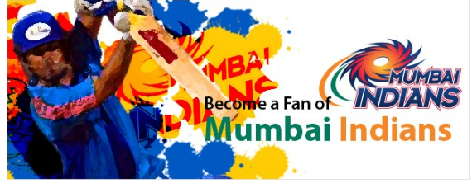






Proven by Brands

