Slide 1
Opportunities : Mobile Ecosystem
Huge Potential for Indian Market
Samir Karande
CEO @ MobiPrimo

Slide 2
How important is mobile?
A personal device
Always on and always with you
Everyone has it – rich/poor, urban/rural …
Being used for increasingly lot more things
Not just for voice
Essentially has become ‘sixth sensory organ’
Can you think about your life without mobile…

Slide 3
Global: Mobile opportunity scale
World Population: 6.7B
Newspaper global circulation: 1.7B
TV sets in the world: 1.5B
PC’s in the world: 1B+
Internet users in the world: 2B+
Mobile subs: 5.3B (77% of world population, 3.8B in emerging geographies.)
Over 90% of world population has a mobile signal available in easy reach
1.3B Handsets were sold last year
This year over 4B sms users would send 8T+ sms’s
Mobile is the biggest opportunity in the history
of Hi-Tech industry

Slide 4
India: Mobile opportunity scale
Population : 1.2 B
TV viewers : 500 M (CAGR 3.8%)
PC users : 100 M (CAGR 17%)
Broadband connections: 12 M (CAGR 10%)
Mobile subscribers : 850 M (CAGR 39.4%)
Mobile internet users : 150 M (CAGR 233%)
Mobile opportunity
8x bigger than PCs
12x bigger than internet

Slide 5
Lets put things in perspective (India)
Mobile internet users : 150 M
Mobile only internet users: 88 M
63 M are < 25 yrs of age
4% are > 35 yrs of age
48 M are students
78 M are males
Target users for mobile offerings
Young population : < 25 yr of age
Student population : 13-20 yr of age
Young male population : < 25 yr of age
Build a business by identifying mobile offerings that is interesting and sticky for your target consumer segment

Slide 6
Choose correct mobile platform
Worldwide smartphone operating system (OS) market share in 2009-2015
OS | 2009 | 2010 | 2011 | 2015
Android | 3.9% | 22.7% | 38.5% | 48.8%
BlackBerry | 19.9% | 16.0% | 13.4% | 11.1%
iOS | 14.4% | 15.7% | 19.4% | 17.2%
Symbian | 46.9% | 37.6% | 19.2% | 0.1%
Windows Phone | 8.7% | 4.2% | 5.6% | 19.5%
Others | 6.1% | 3.8% | 3.9% | 3.3%
Total smartphones sold | 172 million | 297 million | 468 million | 631 million
Source: Gartner (April 2011)
Analyze your target user
Who is your target user
Affordability for the user
Current lifestyle and requirements
Projected requirements for the user
Can s/he pay for mobile application
Which payment channel cover 80+% base

Slide 7
Why not focus on Indian market?
Indian Market
Presents huge opportunity
Growing market
Relatively lower competition
Lower cost of sales and marketing
Same/Similar solution will suite other emerging markets
Brazil, Indonesia, Kenya …
Challenges
Payment channels are lacking
Operator channel is pervasive but costly
Innovative use case identification is key
Stickiness built into the product is essential

Slide 8
Emerging segments
Travel / Hospitality
Health
Education
Social
Local – location specific services

Slide 9
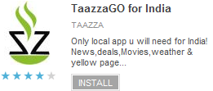
Snapshot: Popular applications in India
Indian rail timetable, PNR status
50K + downloads
Download and collaborate for music lovers
50K + downloads
Book movie/show tickets
50K + downloads
18K restaurant menu from 10 cities
10K + downloads
Local app for news, yellow pages, deals
10K + downloads

Slide 10
Putting money where mouth is
MobiPrimo is focused on Indian mobile market
Providing solutions to consumers
Social network and Cloud based collaboration
Launched new product this week
Social Text Messaging solutions
Backup SMS from your phone, unlimited store for free
Access your SMS from any phone + Facebook
Publish your SMS on Facebook and Global Wall
Available on Android Market and Facebook
Sign up at www.fbdata.com/textup

Slide 11
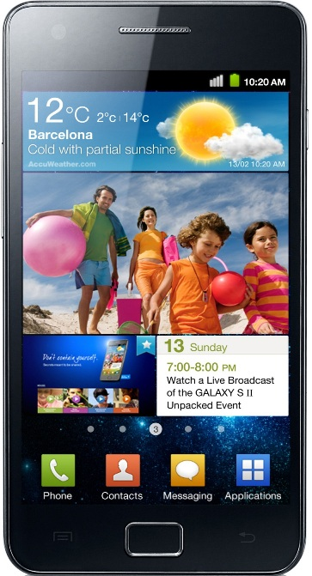
Win best Android phone in market simply by using
Contest ends on 18th Sep 2011
Get details at : www.fbdata.com
www.fbdata.com/contest.html

Slide 12
Thank you
You could reach me on :
samir@mobiprimo.com
www.mobiprimo.com
www.fbdata.com

