Slide 1



Rapid Game Development with Corona SDK
- Altaf Rehmani

Slide 2



Altaf Rehmani - Introduction
15 Yrs Financial Services IT
3 Years Startup Experience (redbytes.in)
Merged with Iniquus IT services Ltd.
Projects:
Capital Markets: Trading, Settlement, Treasury, Compliance
Clients: Publishers, Real Estate, Retailers, Catering

Slide 3








Apr – Sep 2011

Slide 4

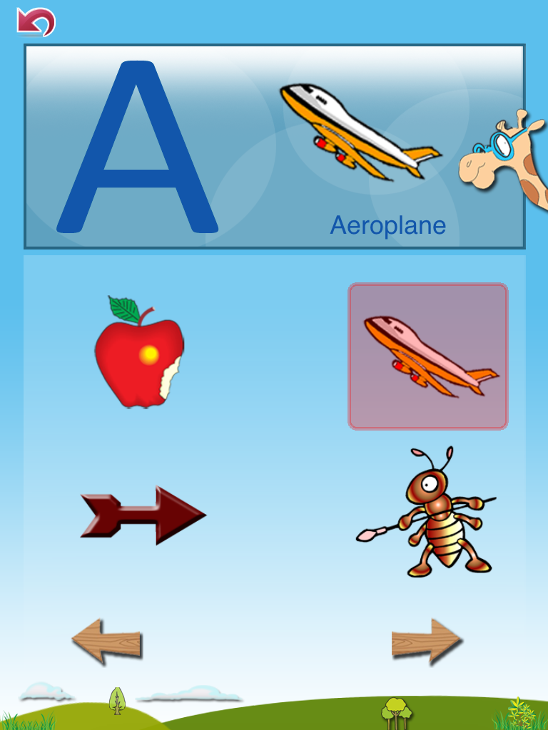
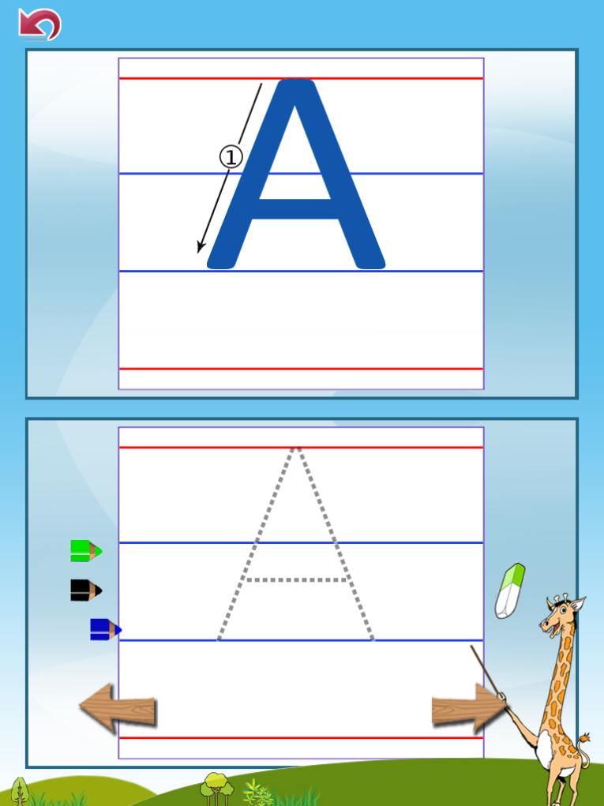
Recently Developed Apps
Fun With ABC

Slide 5
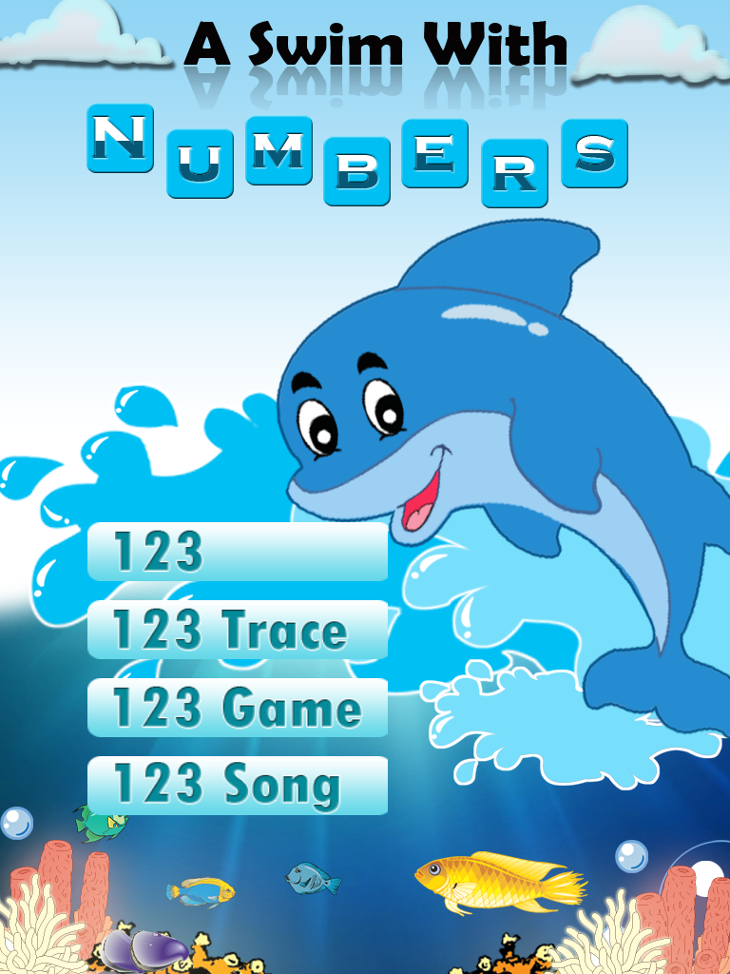
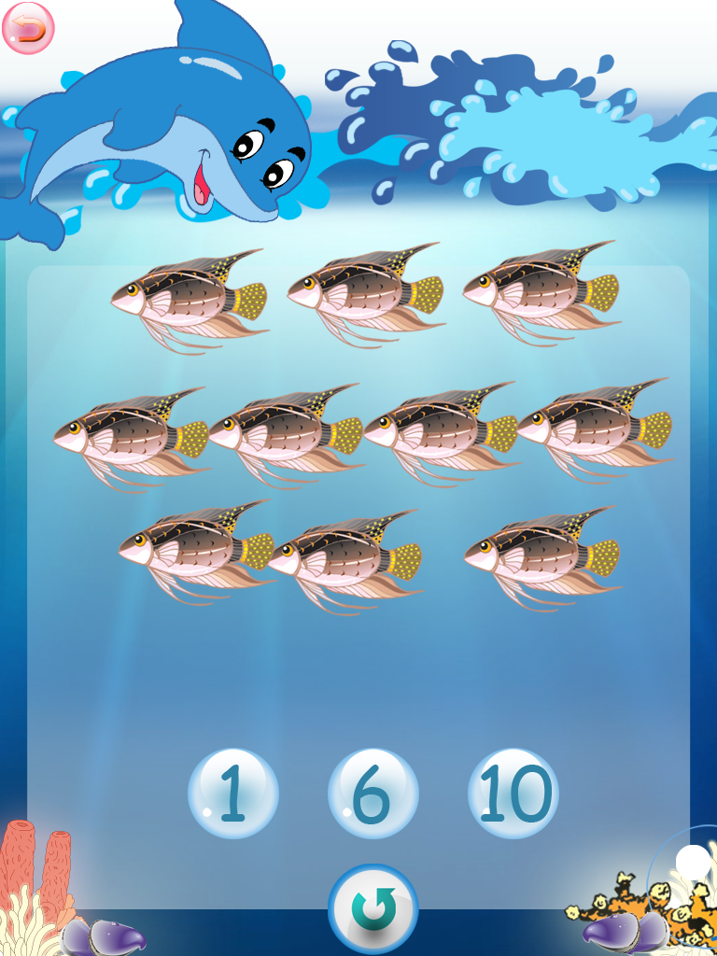
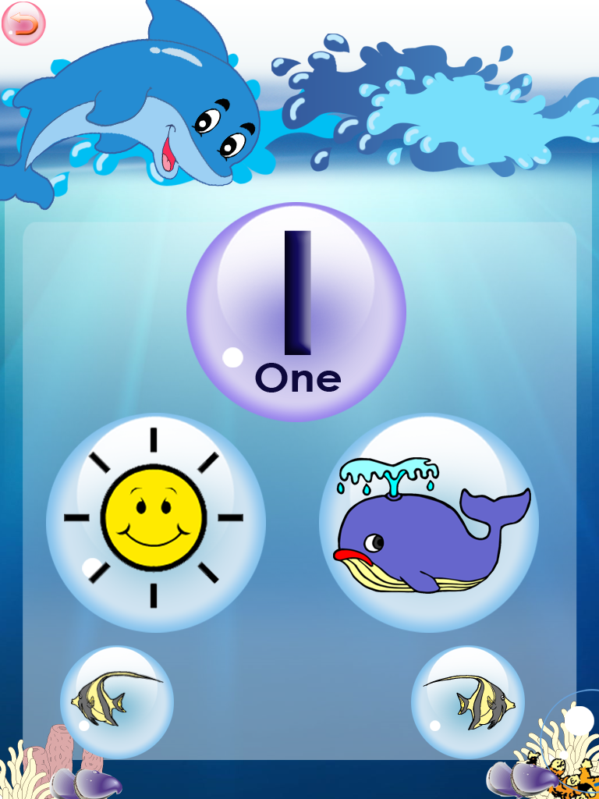
Swim With numbers

Slide 6

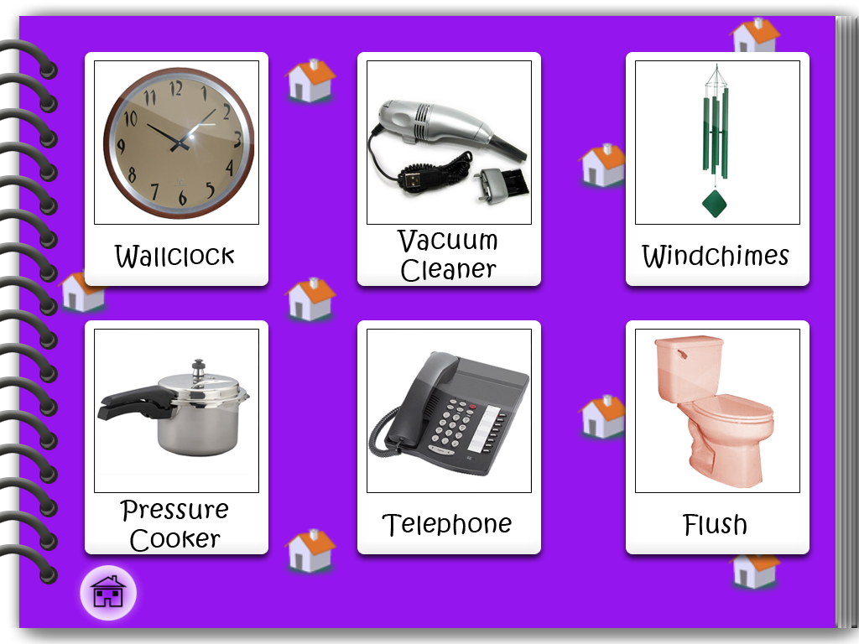

My Talking album

Slide 7


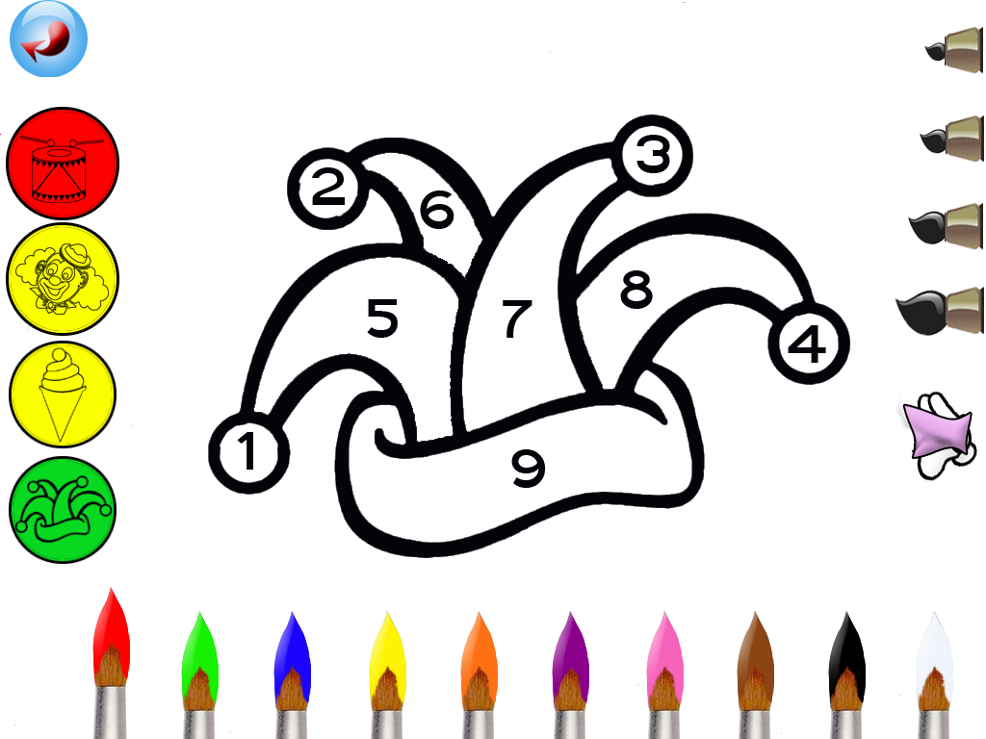
Color Carnival

Slide 8
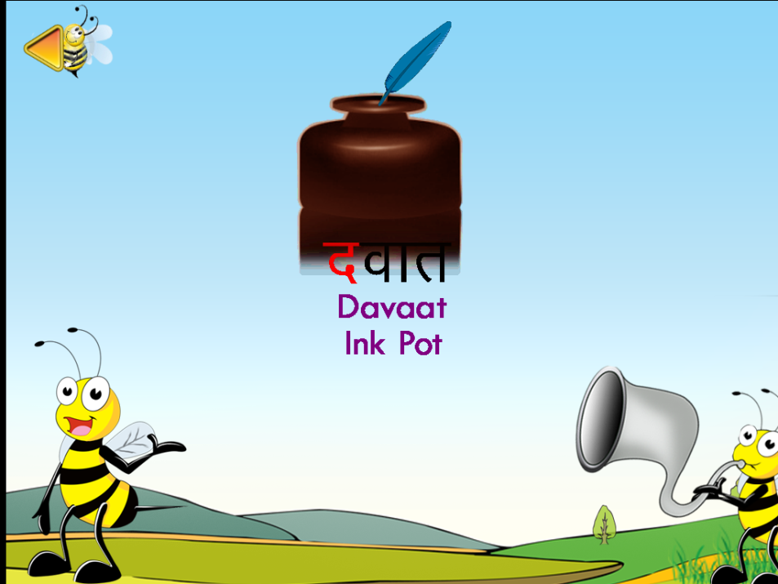

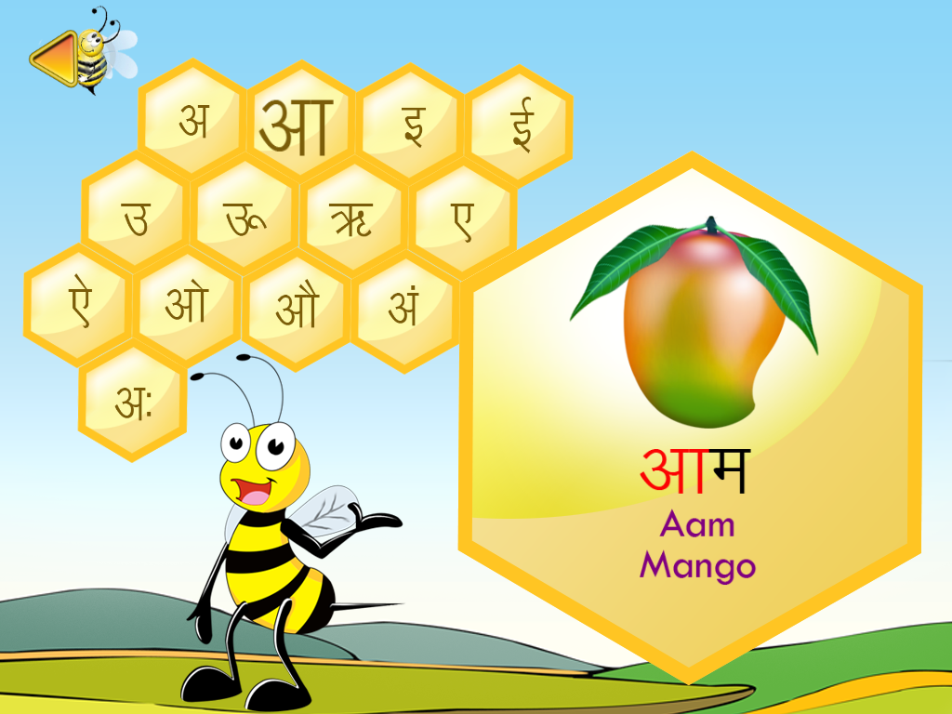
Learning Hindi

Slide 9
What is Corona?
A cross development mobile sdk from AnscaMobile (http://www.anscamobile.com)
An SDK that empowers developers to write mobile games and graphical rich apps for iOS and Android, quickly, and easily.
Corona produced apps have been downloaded 22m times
Corona apps are approved for the Nook Platform.
More platforms may be added in the future

Slide 10
Success Stories
Bubble Ball 14 yr old – Robert Nay (> 7m Downloads)
Float – Crawl Space games ~ 1 million downloads; one day to prototype; 2 months to develop
Blast Monkeys – > 300K downloads: created in 14 days

Slide 11
What is the SDK?
Lua Interpreter (110KB interpreter)
Open GL – ES 2.0 (graphics hardware acceleration standard)
Native C, C++ libraries (injected at runtime depending on the platform)

Slide 12
Things we love about the SDK
Huge Productivity Gains
Cross Platform Ability for iOS and Android
Simple, effective Dev environment and workflow
Helpful and active community
API keeps expanding
Physics and other Framework support
Lots of sample code and third party tools
Migration path from Flash to Corona

Slide 13
Productivity
Displaying an image
Objective C (iOS)
Java (Android)
Corona sdk (both platforms)
Display.newImage(“myImage.png”)

Slide 14
Simple and effective dev workflow
Projects are kept separate folders
Assets are compiled into app
App Code starts in the “main.lua”
Code Editors of your choice:
Text Wrangler, BBEdit, Xcode, Notepad ++ ...

Slide 15
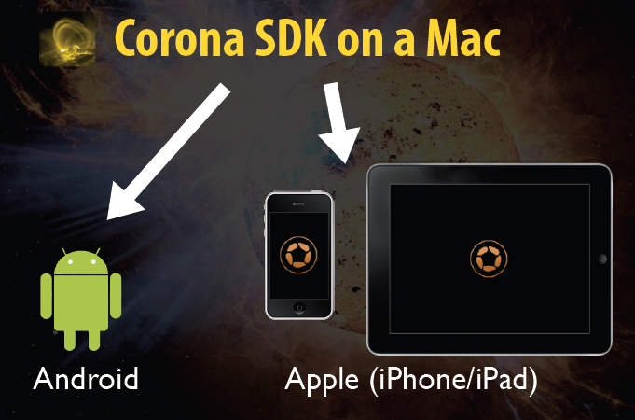
Cross Platform Development
Support for Nook in the Final stages.
More Platforms – in the future

Slide 16
SDK is good at
2-D Games
Graphical-oriented Utilities
Rapid Prototyping
Apps which are graphical in nature

Slide 17
Limitations of the SDK for android
Android Only 2.2 or higher
Android Armv7 only.
iOS notifications not available
Android inapp purchase – not available
iAds only possible through a workaround
Some features don’t work yet on android
when not to use
If you need native code integration and 3rd party toolkits integrated
If you need a business app with native device UI controls targeting both platforms

Slide 18
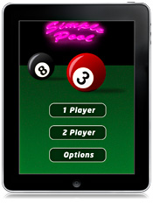
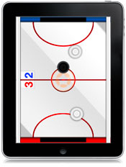


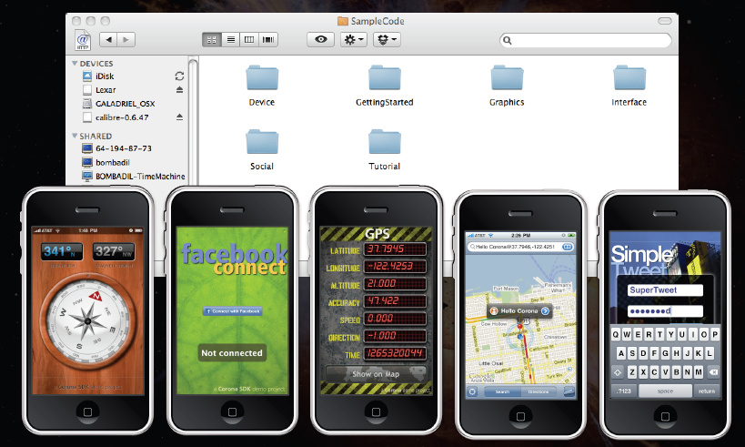
Sample Code available
And Much More..

Slide 19
What about Lua?
Lua is small
As small as <100 KB (DLL/LIB)
Easy runs on small devices or in small apps.
Lua is simple to use
To use-well suited for small software
To learn- ~20 keywords, ~20 operators
Lua is fast
Apart from this, dynamic typing first class functions, easy interop, written in C, ample libraries.

Slide 20
Things we like about corona
SDK is easy to use
Lua is a simple language to learn
Ability to publish to both iOS and Android

Slide 21
App Dev Experiences
The Good
Real Fast development
Ability to cater for multiple resolution and devices
Focus on creativity and content
Excellent community of developers
Source code available for common patterns
Daily build, improved features
Challenges
Android and iOS differences
Native UI look
Limited to what the SDK has to offer.
Both platforms may not have common elements
Marketing and App discovery

Slide 22
Looking for
Publishers
Schools
Training & Consulting
Partners
www.thetinytapps.com
www.facebook.com/tinytapps
apps@redbytes.in
Twitter: altafr

