Slide 1
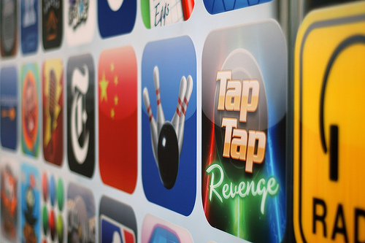

The Mobile Apps Mania – Are we ready?

Slide 2

Trends
App store market continues to grow exponentially
Gartner projects app store revenues of $15 Bn in 2011, up 190% from 5.2 bn in 2010
17.7 bn downloads forecasted in 2011, up from 8.2 bn in 2010
Apple dominates the market, Android and others catching up
Apple sold apps worth $ 1.8 Bn in 2010, had a market share of 84% in 2010
Carriers trying to stay in the race, yet to make it big
Airtel’s Apps central claims over 30 mn apps downloads since launch, and over 2 lac downloads per day by end-2010

Slide 3
Competitive landscape
A Market with 32 App Stores with more than 15 App store providers --
Major - App store announcements and launches
Providers ---
Amdocs
Cellmania
Comverse
Ericsson
Everypoint
GetJar
Handango
Handmark
Ideaworks 3D Javaground
Mobango
PocketGear
, Ondeego,
OnMobile,
Qualcomm
SlideME, Sun Microsystems
Tanla
Notes:
3

Slide 4
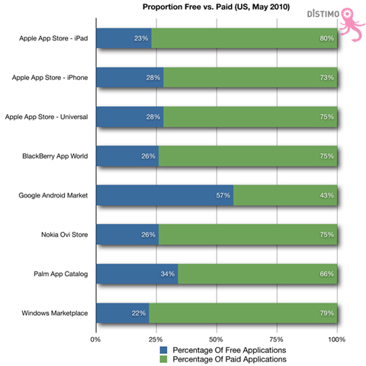
But there are Challenges…
Market is incredibly fragmented – especially in India which is predominantly a feature-phone market
Applications developed for Apple will not work on Android devices and vice versa
Consumer is shopping for value – significant downloads are for free
Where is the money for the developer? – skewed revenue shares, how to justify buss case/ investments…
Lot more work for developers – which platform to build for?
How do you handle the churn – apps shelf life is reducing…

Slide 5

So, is it a bubble that will burst?

Slide 6

Quite Unlikely…
India
Economy : Eleventh-largest, Growing
Population: 1.2 Billion; 70% Rural
Literacy :64%, 21 scheduled languages , English Subsidiary
Median Age :24.9 years
Tele density: 54% with 600 Million Subs, Projected 1.15 Billion by 2013
Diverse Culture: Religious, 80% Hindus and 14% Muslims

Slide 7
Next Generation App store
Key Features:
Integrated App Store
Integrated Ecosystem
Device Agnostic/Service provider Agnostic
Large pool of Applications across platforms and continuous innovation
Support various business models
Adaptors SDK’s/Open API for integration
Applications porting support
Security certified/Functional certification
Multiple billing channels
Subscription Management
Multi Tenancy
Partner Management
Enhanced user profile management
Localization/Personalization
Delivery
Discovery
Enhanced
user Experience
Distribution

Slide 8
End users expect all type of apps to be offered: free device based apps currently form the bulk of downloads
Various models
Application functionality requirements
Revenue model
Charged
77% of total applications available on the Apple Apps store catalogue are not free – primarily using device functionality
Market evolution in this direction is most beneficial for MNOs as it uses two assets they typically control: payment and network intelligence
Free
Nearly 76% of Apple’s app store downloads are free – primarily using device functionality although some now use network connectivity
Google Maps bypasses network intelligence on location using its own location APIs or device GPS capability
Device based (using device’s core functionality)
Network connectivity (uses packet or SMS based interactivity)
Network / subscriber intelligence (leverage specific network controls - QoS, SMS, MMS - or information - location, presence, subscriber personalisation)

Slide 9




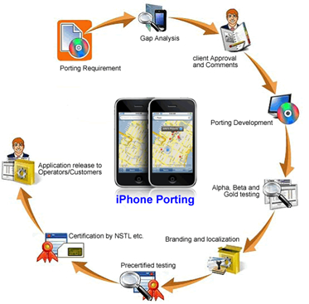


Focusing on the developer Ecosystem
Periodic Idea Contests
Quality Tested
Ideas Screening by Experts
Approval
Convert to Apps thru Developer Forum
Innovative app ideas through ‘Ideation Factory’
Contributed by 100,000+ Professionals & University Students
Converted through own Developer Forum

Slide 10
To each its own!
Apps categories for the urban market
Urban-rural comparison of handset and VAS service penetration
Customer
Enterprise
Travel
Games
Love
Social
Books
Lifestyle
Health
Business & Professional
Organizers
Productivity
Penetration | Rural | Urban | Total
GPRS Handsets | 23.6% | 41.4% | 33.8%
CRBT | 19.1% | 20.7% | 20.0%
P2P SMS | 40.2% | 47.0% | 44.1%
For Music Lovers
Radio
MP3 Players
Mobi TV
FM Players
Song composer
Learn Guitar
For the Literate
Ultimate Jokes
SMS One
Partner Compatibility
Mundu IM
Find Me
Apps categories for the Rural market
For the not-so-literate
Picassa Photos
Ascendo photos
Paint pad
Virtual radio
Audio SMS
Video SMS
Religion
Entertainment
Music, Photo, themes
Utilities
Education

Slide 11
Apps categories
Top 5 Application Categories to Work Most for India
Education
Entertainment
Religion
Utilities
Games
Calculators
Expense Manager
Memory Booster
Battery Watch
Data Recovery
Bluetooth File Manager
Wi-Fi Radar
Phone Torch
Swap
Super Pool
Urban Combat
Mr. Revolver
Puzzles
FreeCell
Valentines Heart
Ultimate Sudoku
Word snake
Bounce Ball
Global Cricket
MF 3D Snooker
Radio
Prediction
Love Match
Subli Mobi (Social)
Super Flirt
Evan MP3 Player
Composer
Power Movie
Mobi tubia
Geeta Saar
Shani Dev
Krishna
Islamic Organizer
Hajj Guide
The Holy Quran
Prayer Times
Encyclopedia
Learn English
Oxford Dictionary
Britannica Mobile
Wikipedia
Trigonometry
Puzzles
MSDict Oxford Multilanguage Pack

