Slide 1
Integrating Java EA Applications to cloud using Boomi
Mahesh Gidwani
08/20/2011

Slide 2
Agenda
Enterprise IT Landscape
Dell Boomi AtomSphere
AtomSphere Core Component
True Multi-tenancy
Distributed Architecture
Boomi in your Enterprise
Simple integration
Example
Advantage and Features
Quick live demo

Slide 3
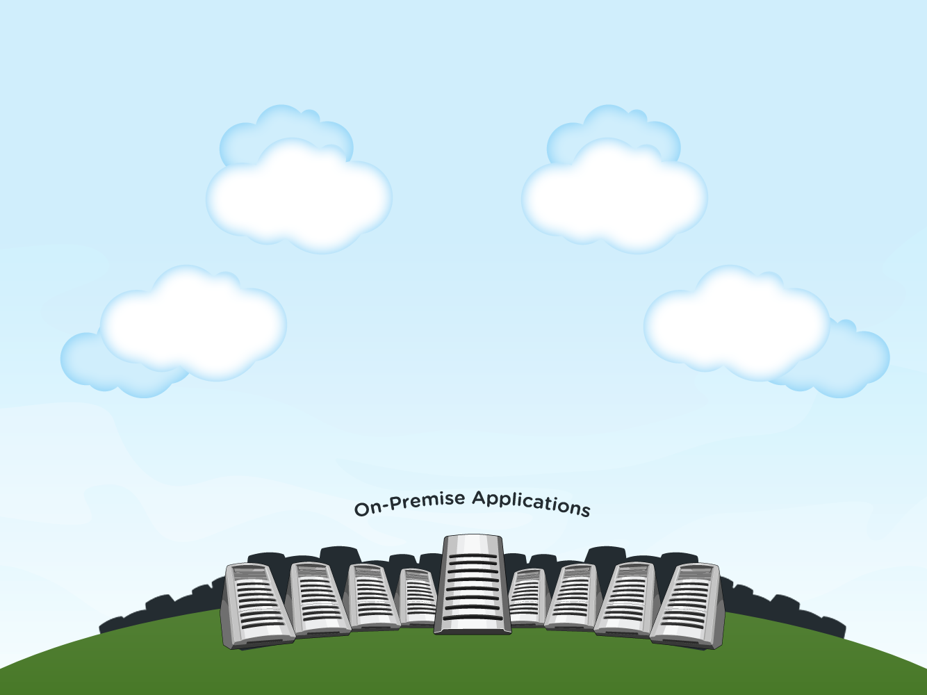
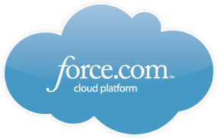
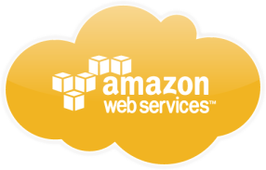
Enterprise IT Land space …
PaaS Apps
Cloud Services
Social Networks
SaaS Apps
Enterprise Service Bus

Slide 4
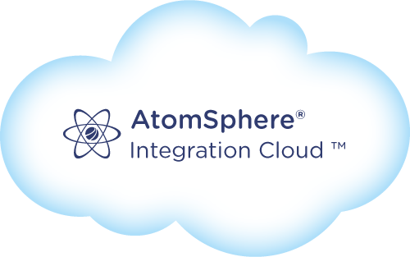
Dell Boomi Integration to the rescue …
PaaS Apps
Cloud Services
Social Networks
SaaS Apps

Slide 5
What is Boomi AtomShpere
Integration Platform-as-a-Service
Cloud based integration system
Auto updates
Integrates
Easy to Use
Browser based visual IDE
Pay as you go
Cloud to cloud applications
Drag and drop features
On premise to cloud applications
Provides
Pre-built Connectors for SalesForce.com, SAP, Databases and so on
SDK to build your on connectors

Slide 6
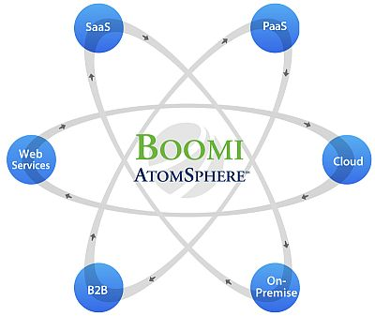
Core Components
Securi
ty
Management
APIs
Scheduler
Integration Process
Connectors
Cloud Commination
Data Profile
Data Maps
AtomSphere
Atom/Molecule

Slide 7
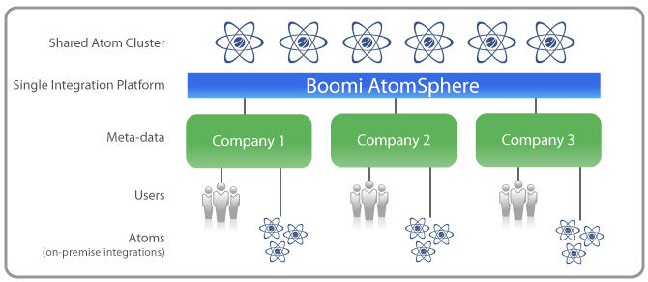
True Multi-tenancy

Slide 8
Boomi in your Enterprise
128 bit encryption (metadata only)
SFTP
server
DMZ

Slide 9
Distributed Architecture
Europe
Head Quarters
Asia
Latin America
New Acquisition
Patent-Pending AtomTM Technology
Centralized Control
Distributed Execution
Infinitely Scalable
No Single Point of Failure
Quickly integrate New Acquisition

Slide 10
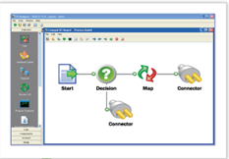
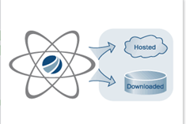
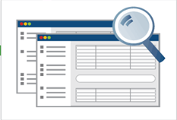
Simple integration
Build
AtomSphere library of connectors and maps
Visually designs integration processes and loads them into a lightweight, dynamic run-time engine for execution
Deploy
Deploy Atoms to the AtomSphere for SaaS, PaaS, or Cloud integration or safely behind a firewall for on-premise applications
Manage
Monitor and maintain the status of all deployed Atoms, integration processes and trading partners regardless of location
Uses a feature-rich web-based dashboard

Slide 11
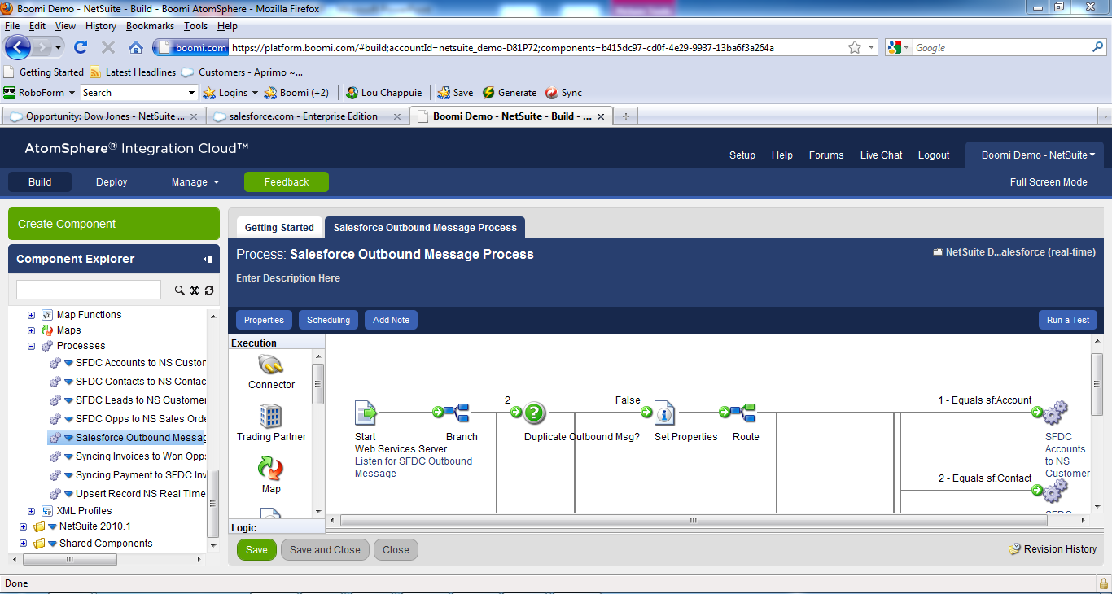
One, easy-to-use visual tool
Fast and browser based
No developer needed -minimal IT involvement
Self-service: Create, test first, then deploy
Simple drag and drop
Easy mapping via visual interface
Centralized control

Slide 12
Example: Java-SalesForce.come Integration
Account & contact
Customer & contact
Enterprise Application
Won opportunity
Sales Agreement
Enterprise Application
Update
Agreement Signed
Enterprise Application

Slide 13
Ways to integrate
AtomSphere
JMS
Web Services

Slide 14
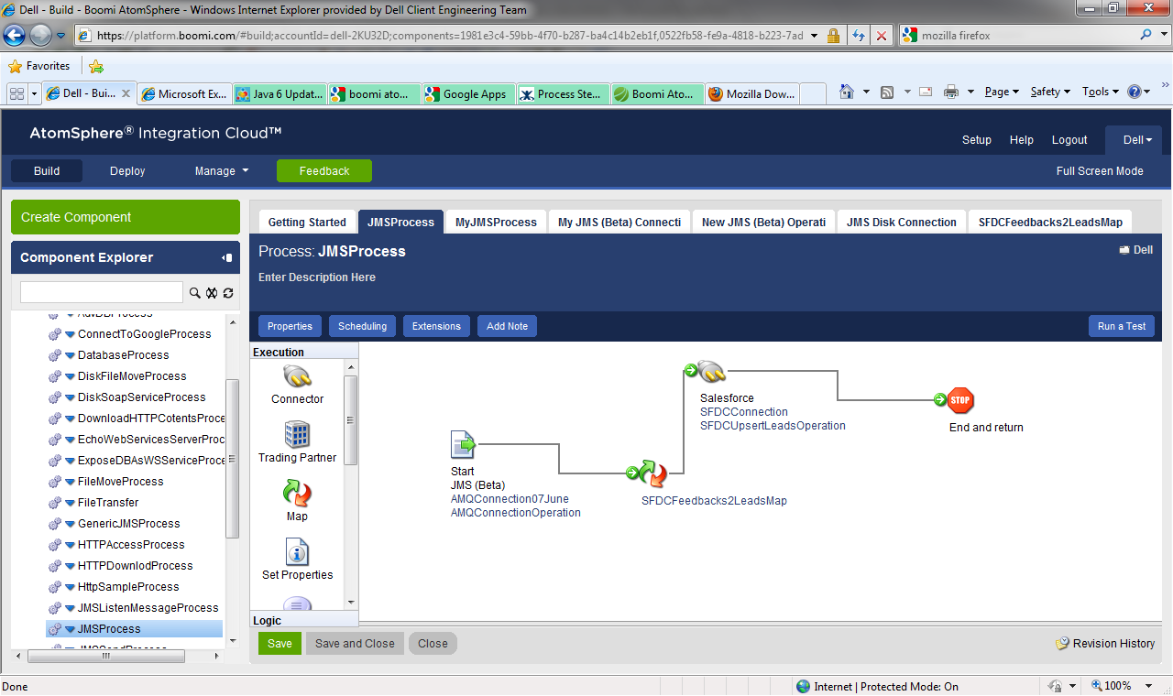
Example: Java-SalesForce.come Integration

Slide 15
Boomi’s Capabilities your Advantage
1
Enterprise Integration capability at a fraction of the cost
2
Drag and drop workflow — no coding required
3
Support for simple to complex business logic
4
Simple wizards for browsing applications
5
Access to hundreds of applications and data sources
7
Any-to-any data transformation
8
Industry certified security model
9
Build your own new connectors
Notes:
- 16 put compellent on the top and storage show they won every category + better together — acc copilot as #8

Slide 16
Integration Cloud Features
1
No hardware/software to install
2
Automatic Updates
3
Usage based pricing
4
Multi-tenant architecture
5
Globally accessible via any Internet browser
6
Boomi Suggest
7
Massive scalability
8
Feedback
9
Vibrant Community
Notes:
- 16 put compellent on the top and storage show they won every category + better together — acc copilot as #8

Slide 17
Resources
Web Site
http://boomi.com
Help Link
http://help.boomi.com
http://www.boomi.com/forums
Notes:
- 16 put compellent on the top and storage show they won every category + better together — acc copilot as #8

Slide 18
Thank you

