Slide 1

Enabling Innovation in eCommerce
Rajesh Ramachandran
General Manager and Head of eBay India Development Center
Oct 29,, 2010

Slide 2
We understand you!
Monetization is the most critical thing for developer ecosystems
eCommerce is the best industry for developers to monetize in, that where the $$ are
A robust, open and easy-to-use commerce platform with the best opportunity to delight users and make money”
eBay is the biggest and most open commerce platform on the planet

Slide 3
Commerce is going digital around the world
Internet growth is fueling an eCommerce explosion
1.2 Billion Internet users in 2008 growing to 1.7 Billion in 2010
From 848 Million Internet buyers in 2008 to 1.1 Billion in 2010
US$ 763 Billion of eCommerce in 2008 is expected to reach US $1 Trillion in 2010
Online Shopping is becoming mainstream

Slide 4


























Web 2.0 Social and Mobile Trends Are Affecting E-Commerce and CRM
Listen & Learn
Evaluate & Shop
Our Laptop-Based Tools:
E-mail
Instant Messaging
Browsers
Applications
Camera
Mobile and the Web Make a Great Match
Participate & Communicate
Our Mobile-Based Tools:
E-mail
SMS, MMS, Instant Messaging
Browsers
Applications
Camera
Play & Interact
Share & Broadcast
Notes:
Strategic Imperative: Firms must conduct scenario planning to estimate how future Web 2.0 social trends and mobile devices might affect their online sales of products and services or their online sales working practices.
Social and mobile trends will influence many of the characteristics of successful technology products and services. Conversely, ignoring the social context of technology is a recipe for failure. Major social trends that will influence technology markets include:
Evaluate and Shop: Consumers and customers have become very comfortable with using the Web to research products/services and to buy them.
Listen and Learn: People express their views using a single interaction, such as posting reviews, posting to a Wiki, or blogging opinions on subjects, products and services. People both known and unknown to the poster may come to read and learn from them.
Participate and Form Communities: People gather and build networks of online friends and communicate with them in a one-to-many approach by posting items (text, pictures, video, URLs and so on) and updating their status to let their friends know what they are doing and thinking.
Play and Interact: People participate in gaming communities to have fun and to interact with each other while removing the need to be physically in the same location.
Share and Broadcast: People use photo-sharing and video-broadcasting sites to share their images and actions with the world.
Action Item: Your organization's CRM initiatives and websites exist in this environment, so make sure you understand the new ways in which the Web enables people to socialize. This is important for your organization's longevity.

Slide 5

Best monetization
for ecommerce
opportunity
developers
Got eBay?

Slide 6
eBay : The Biggest eCommerce opportunity for Developers
90 Million Shoppers spending money
27 Million Sellers investing in their business
100,000 Developers already building eBay apps
5 Minutes is all it takes to get started coding!
eBay Developers Program founded in 2000, Developer applications accounts for over 25% of eBay.com listings

Slide 7






eBay is the world’s largest eCommerce Player
The largest e-Commerce Community in the world
We give our sellers access to all our markets and consumers across the world
Unlike other e-Commerce sites, our sellers own their goods and anyone can be a seller on eBay
Low cost of entrepreneurship for everybody
Buyers
Sellers
Variety
Great Deals
Convenience
Fun & Community
Faster, lower-cost distribution
Increase sales
Maximize price
Entrepreneurial Platform
We make inefficient markets efficient for millions of users

Slide 8

We are 15 years young…
Founded in September 1995
Now a Fortune 500 company
One of the top 100 brands in the world
eBay users worldwide trade more than $1,890 worth of goods on the site every second
Gross Merchandise Volume (Sales) of
$60 billion
in 2008
eBay users trade in more than 50,000 categories
No 1.
eCommerce player with operations in
39 markets
92
million active eBay users from 150 countries
®

Slide 9

… with a leadership position in India…
Founded in March 2000 (formerly Baazee.com)
Since Aug 2004, a 100% subsidiary of eBay Inc.
eBay India is India’s leading eCommerce marketplace (with over 2.5 million registered users from 2,471 cities)
Most popular online shopping destination (Source: IDC)
On any given day, eBay India has over 4,00,000 live listings across 2,000 categories of products and services

Slide 10




Key elements of a GREAT platform
  Data APIs & Developer Tools
  Robust Infrastructure
  Path to Monetization
  A Real Partnership

Slide 11
A great platform provides data and tools . . .
  Data APIs & Developer Tools
Rich Set of APIs
Support for Popular Technologies
Standards-based
Tools and Resources
Support
More than 200 APIs
Java , Flash/Flex, PHP,.NET
SOAP, XML, JSON, NVP
Tech Docs, Samples, Tutorials, Sandbox
Forums, Paid Support, KB Articles

Slide 12
Platforms require scale and stability
  Robust Infrastructure
Highly Scalable
Secure Data Access
Product Grade Testing Environment
1B calls in 2002 -> 125B calls in 2009
Auth N Auth, HTTPS
eBay Sandbox

Slide 13
Provide ROI for developers
  Path to Monetization
Business Model
Distribution
Affiliate Revenue, Subscription Fees
Open eBay & Application Catalog, Solutions Marketing

Slide 14
And a real partnership with participants
  A Real Partnership
Ongoing Communication
Marketing
Developer Council, Blogs, Newsletter, RSS, Developer Conference, Public Relations
Certification, Case Studies & Featured Developers

Slide 15
More than 13,000 live applications
60% of eBay listings from Web services

Slide 16
Success is more than just platform adoption . . .
Collaboration with Developers
A Key Ingredient for Business Success

Slide 17
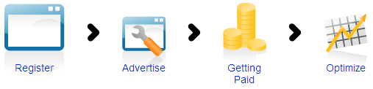
Create the opportunity . . .
Applications for eBay Sellers
  Diverse set of desktop and web applications
  The Open eBay Apps opportunity ( http://apps.ebay.com )
  Address millions of sellers listing items every quarter
Drive traffic to eBay
  Custom / Niche buyer experiences
  eBay Partner Network

Slide 18
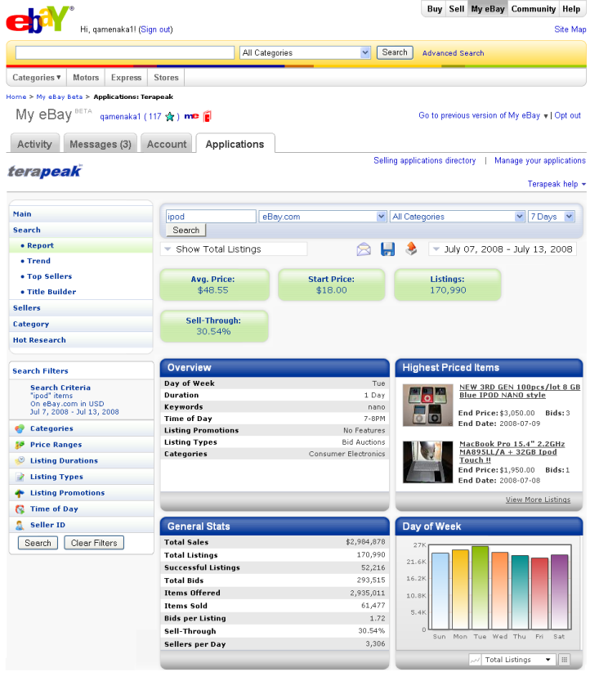



Continuously evolve the opportunities . . .
Open eBay is a application marketplace where developers can build applications ON eBay and monetize them through varied subscription models.
eBay Sellers
3P developers

Slide 19
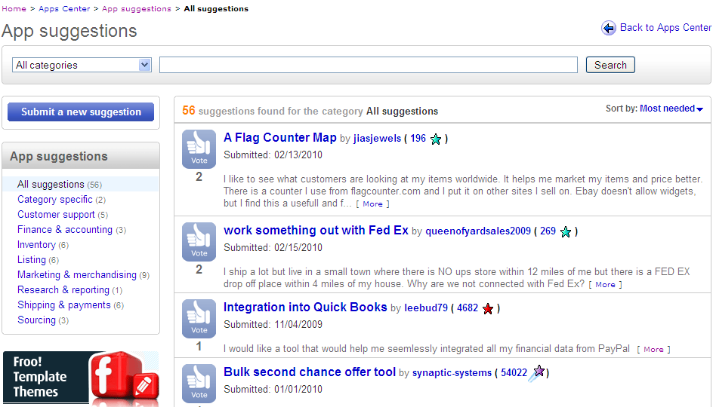
Seeding Ideas . . .

Slide 20
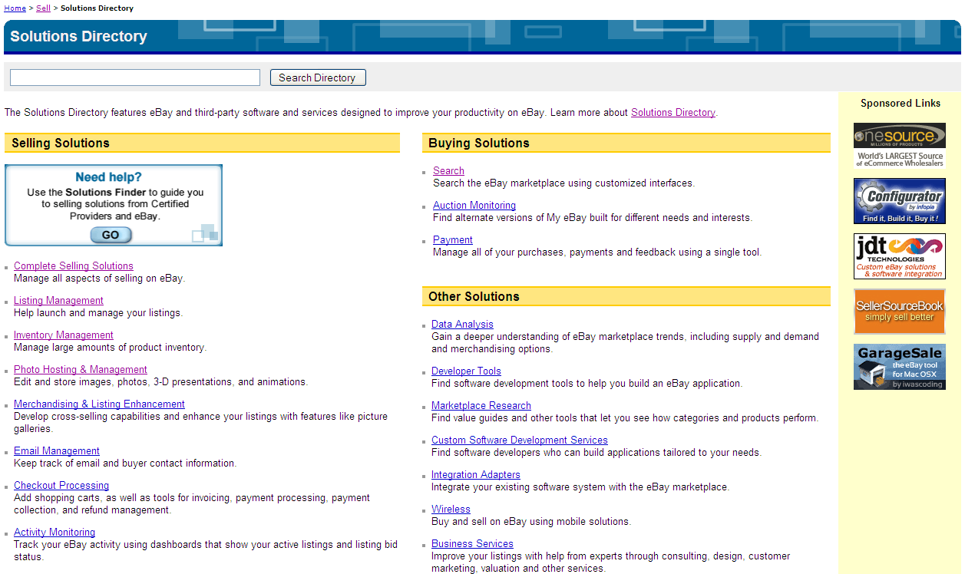
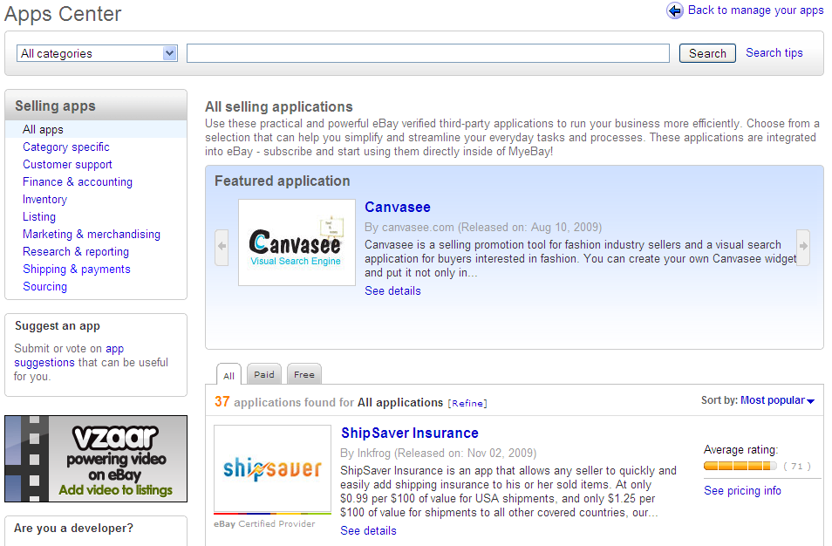
Market 3rd party applications

Slide 21
































We opened our doors to your apps
Allowing developers to embed apps where sellers do their business . . .
. . . directly inside of MyeBay
Notes:
Last year I stood before you an announced our next generation platform, Open eBay, a new opportunity for you to monetize your apps by reaching customers directly inside of MyeBay. I’m excited to see the momentum we’ve gained this past year, since our launch to sellers last August. We are hearing great things about your apps.
Sellers are telling us that applications like Back Office Live by MTI, Outright and others available through the apps center are helping them simplify their business operations and grow their profitability on eBay.

Slide 22
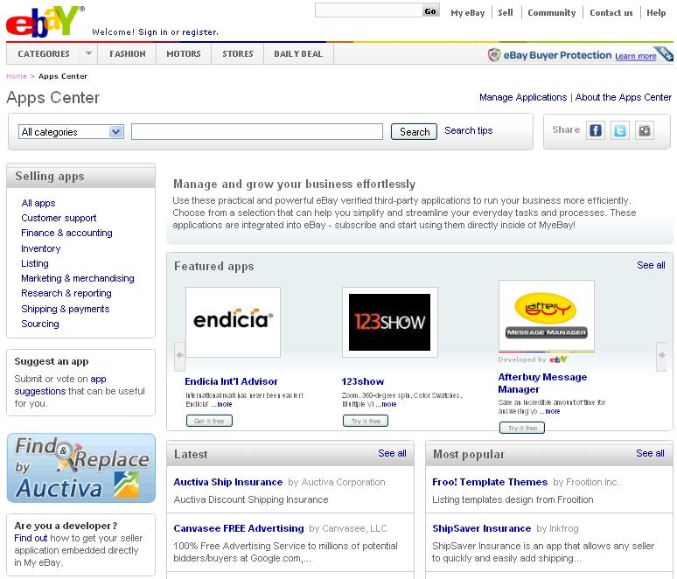
You are growing with us!
45 Apps in 8 categories
87k subscriptions
Market size of millions of active US sellers
Expanding soon to international sellers
Notes:
Mention the Intuit App – demo at DevCon, will be delivered later this year to eBay Sellers. Intuit is demoing their QBO – eBay integration this week at DevCon, an integration that uses the Open eBay platform to deliver an integrated accounting solution to eBay sellers directly in-the-river inside of MyeBay.
Several other developers are here today at DevCon and are working on their 2nd and 3rd apps!
22

Slide 23
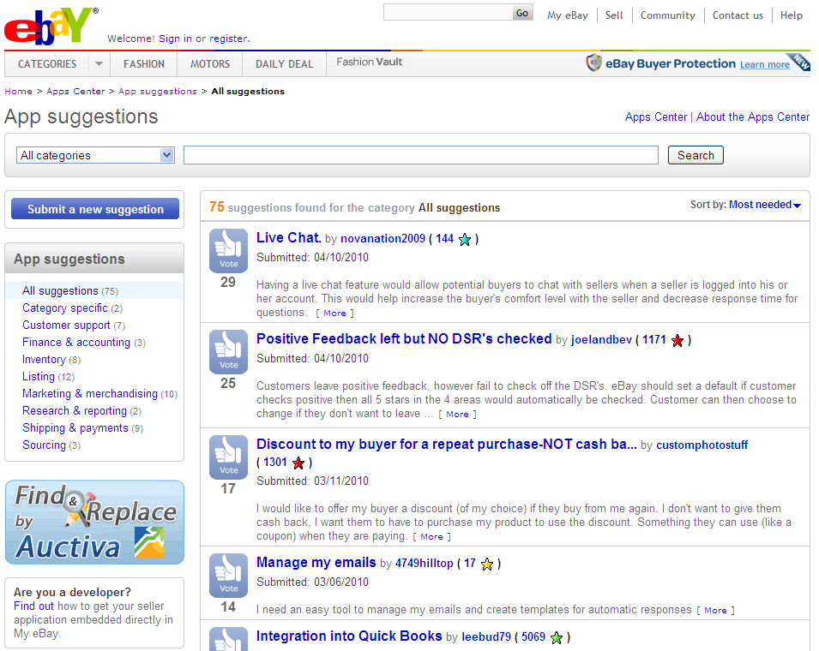
Connecting you directly to sellers
Notes:
We’ve also started our effort to deliver vetted app ideas directly to you, enabling you to hear and understand the needs eBay seller community. This portal was released to site in March 2010 and sellers are beginning to discover and use it.
All it takes is one killer idea to get you started…. Look for more investments in this area coming later this year.

Slide 24

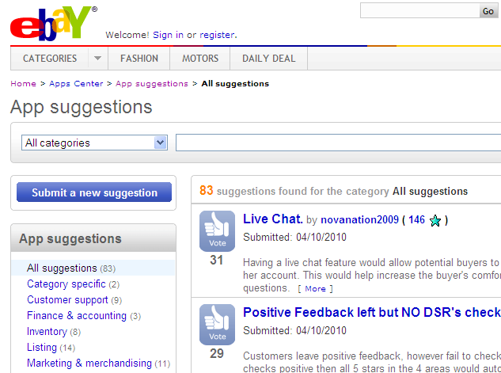


More Ideas . . .
App Suggestions Phase II
App reviews & comments
Social sharing / community
Custom solutions
Notes:
1. Help developers hear the voice and needs of sellers ( ideas, voting)
2. Help developers and sellers connect and communicate (comments)
3. Help sellers connect with developers who can solve their custom problems. ( ie. Elance, oDesk)

Slide 25

Best developer opportunity in eCommerce
Notes:
eBay is the largest eCommerce marketplace on the planet. With an open platform, investments in technology and a partnership with you, we want to position the eBay platform as the biggest developer monetization opportunity in eCommerce.

Slide 26







Enthusiasts…
It’s my Church!
It’s my breath!!
It’s my Passion
They LOVE eBay !!!!!!!!
They LOVE eBay!!!!!!!!
It’s my Hobby

Slide 27

2009 Recap:
Open eBay Apps and Apps Center
40+ Apps in 8 categories, growing monthly
90k subscriptions
Several Developers
on their 3rd apps!
Access to millions
of eBay Sellers
Notes:
Rename this as AppStore-

Slide 28
2010: Grow with Us!
1
Success Factors
2
Customer Focus
Growth and expansion opportunities both on and off-eBay
Attractive Monetization models
Rapid Innovation, Leading edge technology
Web and Mobile

Slide 29
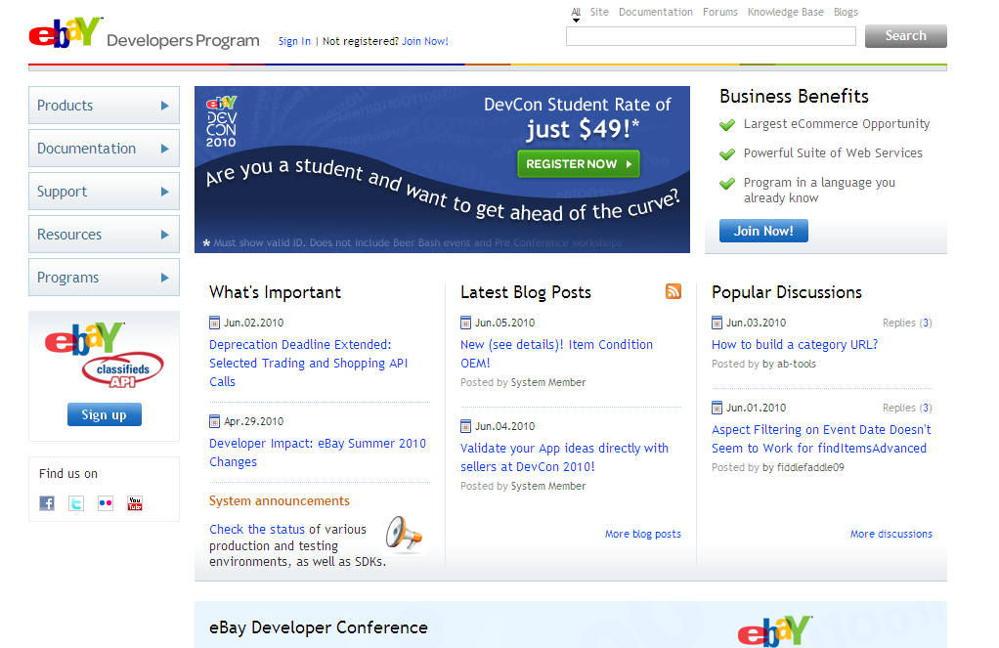
New Home for developer.ebay.com

Slide 30
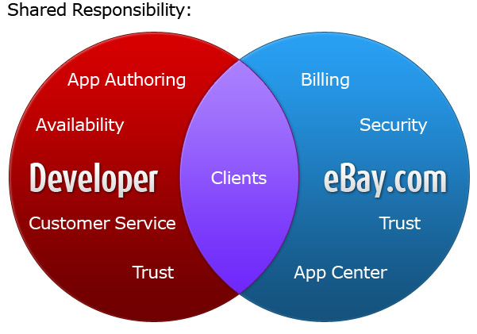
Open eBay App Opportunity
Developers benefit by integrating, promoting and monetizing their applications on the world’s largest
e-commerce site

Slide 31
Billing Plans
eBay takes care of the billing management
If you charge for your app the developer will get 80% of the fee, eBay/PayPal® receive the remaining 20%
Submit billing plan along with business readiness review
All apps are required to have a minimum 7 days free trial

Slide 32
Want to know more?
Developer.ebay.com
Apps.ebay.com
Spot registration in the eBay booth
Contact
  Rajesh.ramachandran@ebay.com
  Anand.Mahadevan@ebay.com

Slide 33


