Slide 1
Leadership Training and Development
Siddhartha Banerjee
Strategic HR Summit
15th October 2011
Chennai

Slide 2
What do we have here…
Why Leadership Development – The need, the drivers , the implications
Designing a Best in Class Leadership Strategy
The Idea Story

Slide 3
Why Leadership Development

Slide 4
The need ….
Research shows that strong leadership pools drive organizational performance.
Leaders with top leadership skills are 50% more likely to substantially outperform revenue expectations and 80% more likely to outperform profit expectations.
A CLC Human Resources poll in September 2009 showed that for 89% of organizations, the profile of successful leaders is changing.
Meeting tomorrow’s business challenges requires new skills and different qualities and therefore a fresh models for finding, developing, and engaging next-generation leaders.
Baby boomers as a generation is retiring, who will step into the leadership roles they leave behind?
More than 50 % of business and HR executives expect severe to moderate shortages in executive leadership within the next three to five years.
And more than 60 % of executives say leadership development and
talent management are their companies’ most critical people issues.

Slide 5
The Drivers…
Aggressive growth strategies.
  Savvy, effective companies recognize that their business strategy will shape the leadership qualities needed to drive growth.
Higher expectations for returns on leadership development.
  While cost containment continues to be a priority for many businesses, forward-thinking organizations are focusing more on value delivered..
Generational shifts.
  New generations of leaders have different expectations, values, and work preferences from those that their boomer predecessors have had.
Notes:
Aggressive Growth Strategies:
Mergers or acquisitions increase the need for leaders who can manage assimilation and change.
Strategies that revolve around innovation require risk-intelligent leaders who are creative thinkers.
Global expansion, increases demand for culturally aware leaders
Higher expectations on leadership development:
What is the business value of your current approach to leadership development?
Does your development st rategy uncover hidden talent in your organization to identify the full array of future leaders?
As more companies look for tangible business results, leadership development programs are finding themselves increasingly under the microscope
Generational shift:
And while external factors certainly play a big part in driving those differences, companies have the opportunity to shape those expectations, too. Whether focused on career options, global mobility, total rewards, or all of the above, new leaders need new ways to navigate the Corporate Lattice surrounding them.

Slide 6
Hence the Implications…..
Selection and assessment.
  kinds of leaders needed to execute business strategy in the future.
  Identifying people that possess the qualities we seek.
  Enough potential leaders within, or should hire from the outside
Development.
  How to grow own leaders
  How to develop prospective leaders to develop new skills and knowledge.
  Would the development dimension be different : mentors, coaches, and other resources, as well as customized, hands-on learning opportunities.
  Should development have better linkages between business goals and leadership development investments.
Measurement.
  New ways of understanding how value gets created.
  And questions like:
    Are you beating the street year after year?
    Are you improving relationships with customers?
    Are your leaders helping to build your company’s reputation for excellence?

Slide 7
Designing a Best in Class Leadership Organisation

Slide 8
12 components of an Effective Leadership Strategy Imperatives (Source : 2010 The Corporate Executive Board)
IDENTIFY LEADERSHIP NEEDS
Identify critical leadership capabilities and risks based on strategic priorities
2. Identify critical positions
ASSESS CAPABILITIES AND GAPS
Assess the talent pipeline for critical succession risks
Identify high-potential talent
Identify critical competency gaps
SOURCE LEADERS
6. Make the “build versus buy” decision
7. Focus recruiting investments on critical needs
8. Focus on high-impact development activities
ENABLE IMPACT
9. Support leaders across transitions
10. Align organization and role design to support effective leadership
11. Adjust leadership expectations to changing needs
12. Enable line leader ownership of talent management

Slide 9
1.Identify Critical Leadership Capabilities and
Risk based on Strategic Priorities
Align leadership strategy to the organization’s strategic goals not only to current leadership needs.
Engage senior business leaders using business frameworks and tools to obtain a common understanding of long-and short-term business objectives and outlook.
Define the human capital implications of these objectives by identifying the capabilities needed to achieve strategic priorities.
Standard Chartered SPA process
(Strategic People Agenda Review Process )
Background:
Annual, 90-minute strategic talent assessment led by business unit GM presenting to CEO and Head of HR
Key Characteristics:
  1. Integrated talent and capability review
  2. Review owned by business leader (not HR)
  3. Focus on key talent risks to strategic business priorities
COMMON PITFALL
Focusing on current leadership gaps not future strategic gaps when prioritizing critical competencies

Slide 10
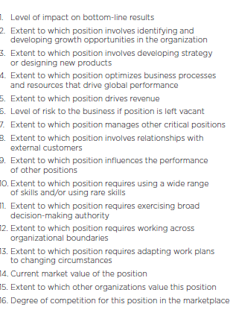
2. Identify Critical Positions
Defining Critical Roles—16 Aspects to Consider
Prioritize roles based on their criticality to strategy execution.
Identify positions across the organization that directly impact key business factors like revenue or product development.
COMMON PITFALL
Indiscriminately focusing on all roles above a certain level and not prioritizing roles with significant revenue impact or low talent availability

Slide 11
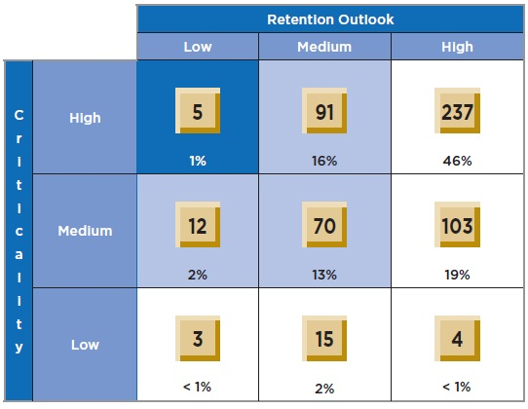
3. Assess Talent Pipeline for Critical Succession Risks
Prevent vacancy risk in critical roles by assessing the talent pipeline.
Assess the performance and retention outlook of people within critical roles. This might include benchmarking their compensation and future career opportunities (within and outside of the organization).
Consider compiling talent profiles to successfully match successors to roles and gain a clear picture of the strength of the pipeline for critical roles.
Analyze the availability of second-level talent to ensure that potential gaps are flagged up on time.
Duke’s Retention–Criticality Matrix
Insights
Duke identifies the number of leaders and their retention outlook and role criticality to assess the capabilities at risk.
2. The organization uses performance review data and talent profiles to assess the availability and compatibility of successors.
3. Duke then analyzes succession risks for critical roles where incumbents have a low retention outlook and moving successors might cause “second-level” risks.
COMMON PITFALL
Misjudging true pipeline risks or strengths by focusing only on the turnover risk of current executives and not successors

Slide 12
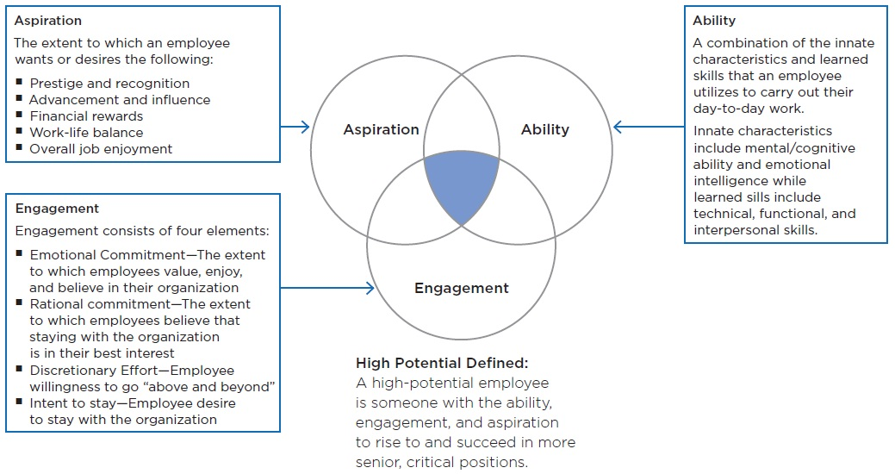
4. Identify High Potential Talent
Assess ability, aspiration, and engagement to identify high-potential employees.
CLC Human Resources’ research shows that current performance alone does not predict success at more senior levels.
Evaluate ability, aspiration, and engagement to correctly identify high-potential talent.
COMMON PITFALL
Assuming that performance is a synonym for potential

Slide 13
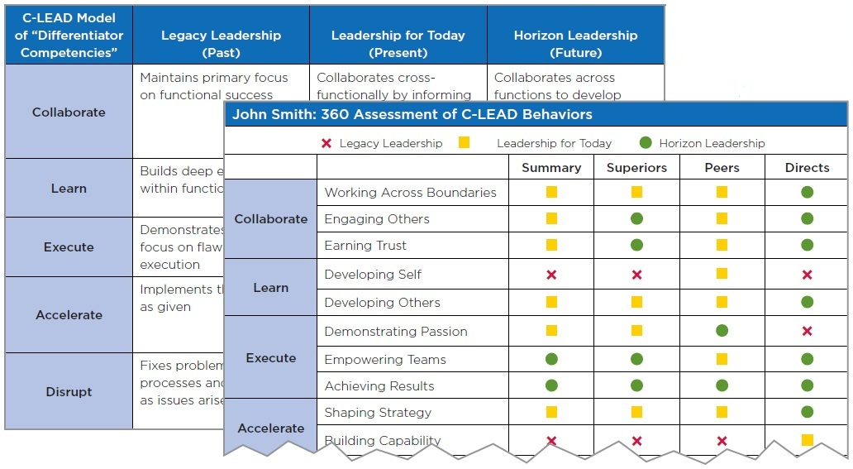
5. IDENTIFY CRITICAL COMPETENCY GAPS
Assess and highlight leaders’ existing competency levels against competencies critical in the future.
Compile information from performance management systems, competency assessments, HR business partner conversations, and experience inventories to gain a detailed picture of leader’s capabilities.
Highlight misalignments with competencies critical for future success to improve self-awareness.
Cisco Highlights Leadership Competency Gaps
Build Self-Awareness— Assessments build leaders’ self-awareness of whether they are demonstrating the transition from Legacy Leadership to Cisco’s Horizon Leadership.
Define Temporal Differentiation—Cisco delineates the difference among past, present, and future demonstration of C-LEAD behaviors to help leaders make distinct behavioral changes.
COMMON PITFALL
Assuming that all skill gaps are equally important and failing to create leader awareness of gaps.

Slide 14
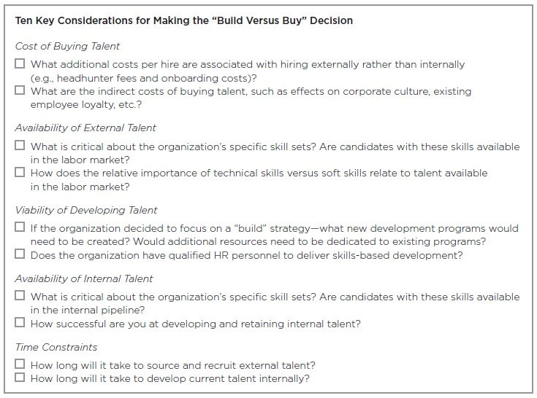
6. MAKE THE “BUILD VERSUS BUY” DECISION
Consider the right balance between recruiting external talent and building talent internally.
Organizations need to consider whether recruiting needed skills externally or developing capabilities internally will be more effective in providing high-quality talent in the long run.
Considerations should include the cost of buying leaders externally, the availability of leaders internally and externally, the availability of viable development interventions, and time constraints for filling the gaps.
COMMON PITFALL
Selecting “build” or “buy” option because of company tradition without considering what will best serve current needs

Slide 15
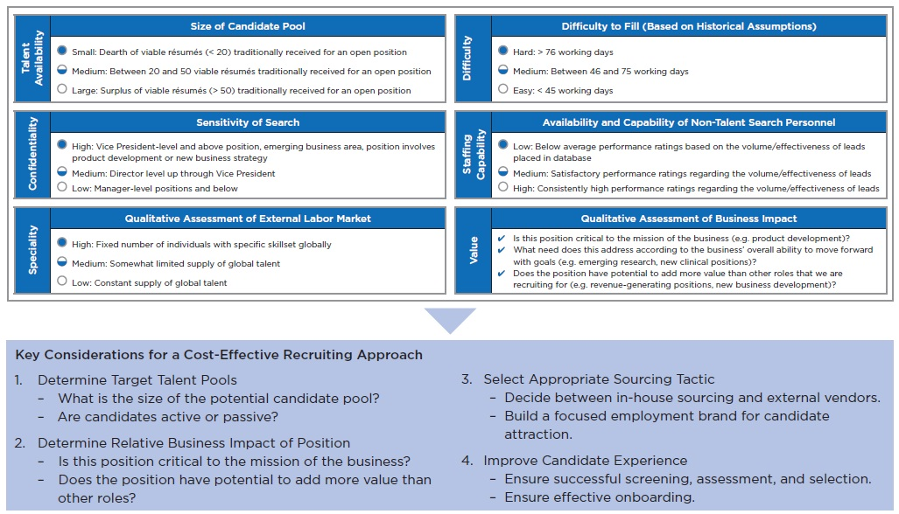
7. FOCUS RECRUITING INVESTMENTS ON CRITICAL NEEDS
AstraZeneca’s Recruiting Prioritization Considerations
Center your recruiting strategy on critical positions and capability needs.
An effective recruiting strategy is based on business objectives and anchored in the wider HR strategy.
Recruiting executives can translate the identified needs and objectives into tangible recruiting priorities and processes to focus on the ones that will yield the highest return.
COMMON PITFALL
Spreading recruiting resources equally across all roles and failing to assess the relative business importance of different positions and capabilities

Slide 16
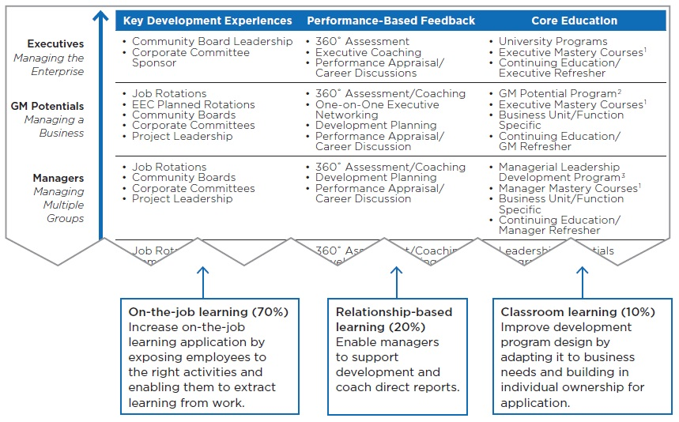
8. FOCUS ON HIGH-IMPACT DEVELOPMENT ACTIVITIES
Company X ‘s 70–20–10 Leadership Development Architecture
Leverage multiple learning channels to maximize the impact of development offers.
Use the 70–20–10 approach to training and development to address critical skill gaps with on-the-job learning (70%), relationship-based development (20%), and classroom-based learning (10%).
Increase learning application through relevancy of learning content, enabling managers to support their direct reports, and building individual ownership.
COMMON PITFALL
Over-focusing development resources on classroom-based training instead of leveraging multiple learning channels and enabling learner application

Slide 17
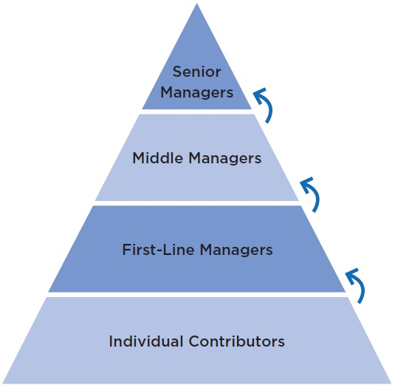
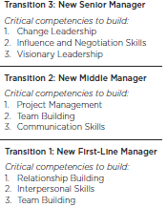
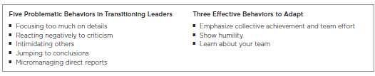
9. SUPPORT LEADERS ACROSS TRANSITIONS
CLC Learning and Development’s Model for Successful Transitions
Activate key “transition behaviors” and support networks of transitioning leaders.
Facilitate successful transitions by enabling leaders to build on already existing skills.
Educate transitioning leaders about the most problematic behaviors they should avoid and how they can engage their new team to strive together for success.
COMMON PITFALL
Do not overwhelm leaders by leaving them without support in managing transitions

Slide 18
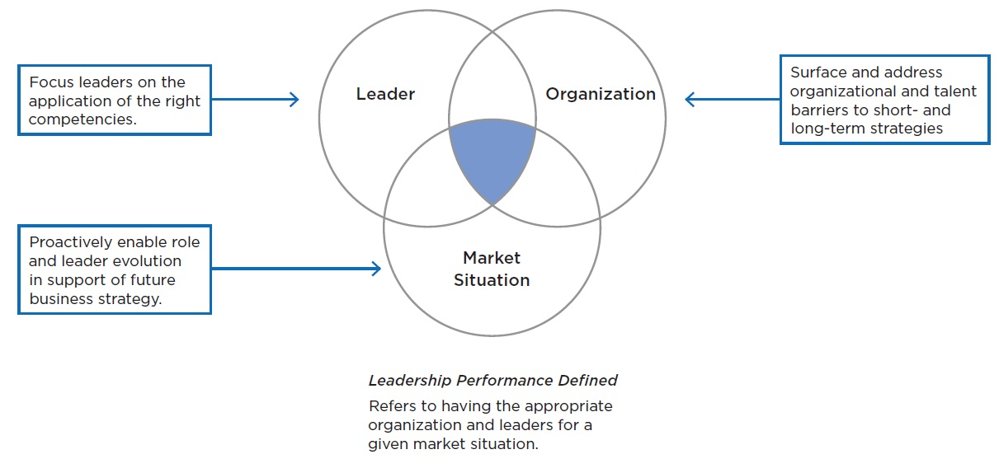
10. ALIGN ORGANIZATION AND ROLE DESIGN TO SUPPORT LEADERSHIP PERFORMANCE
Create the environment for high performance.
After having identified critical business priorities and competencies, focus leaders on the application of these competencies.
Surface and address organizational barriers (such as role design, reporting lines) that may undermine leaders’ success.
Proactively consider market changes and align leaders and organizational resources in support of future strategy
Three Mandates to Ensure Strong Leadership Performance
COMMON PITFALL
Over-focusing on creating new development programs for leaders instead of leveraging additional components of leadership performance to improve effectiveness

Slide 19
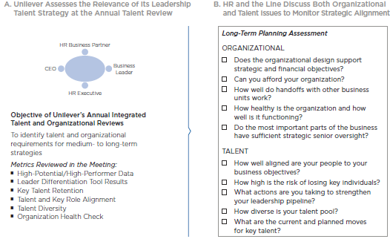
11. ADJUST LEADERSHIP EXPECTATIONS TO CHANGING NEEDS
Assess the alignment of your leadership strategy with evolving strategic priorities.
Monitor progress and alignment of your leadership talent strategy by creating an iterative approach involving business leaders.
Assess the alignment of your leadership talent strategy with organizational strategy by discussing them in the same forum.
COMMON PITFALL
Viewing the creation of a leadership strategy as a one-off process, neglecting to monitor its alignment to business strategy and failing to make it a line leader-led process
Source: Unilever

Slide 20
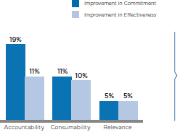
12. ENABLE LINE LEADER OWNERSHIP OF TALENT
MANAGEMENT
Three Attributes of HR Processes Drive Effective Line Leader Involvement
Impact on Line Leader Commitment and Effectiveness
Involve business leaders by promoting business relevance, simplicity, and accountability.
Most business leaders have the skills to effectively support their organization’s leadership strategy but HR can increase their commitment and effectiveness by making it more business-relevant, simplifying participation, and holding leaders accountable for their talent outcomes.
IMPERATIVES FOR HR
■ Build Business Relevance
–Create annual opportunities (e.g., talent reviews) for business leaders to gain an integrated understanding of their talent and business challenges
■ Improve Consumability
–Provide clear guidance on key talent outcomes and the activities to achieve them
–Integrate talent management processes into business workflow
■ Leverage Soft and Hard Accountability
–Hold business leaders accountable for business unit–specific as well as organization-wide talent metrics.
–Incorporate qualitative assessments into talent reviews to foster an environment of effect talent management
COMMON PITFALL
Focusing on building business leaders’ skills in talent management instead of enabling them to apply their business skills to leadership initiatives

Slide 21
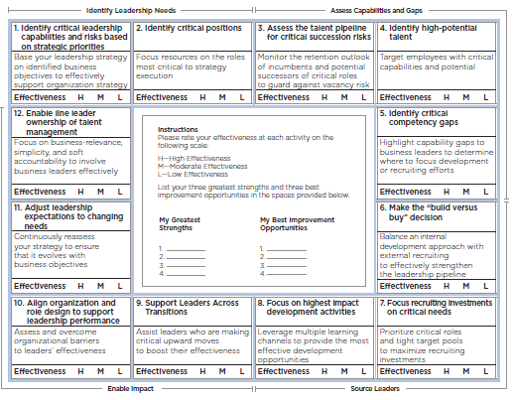
LEADERSHIP STRATEGY EFFECTIVENESS DIAGNOSTIC
A Simple Tool for HR to Assess the Effectiveness of Its Leadership Strategy
Assess the effectiveness of your leadership strategy.
To evaluate which steps to improve in order to achieve an effective leadership strategy.

Slide 22
IDEA
An Idea can change your life!!!

Slide 23
“The brand of leadership that we seek to build, combines the virtues
of professionalism with the commanding power of the mind, heart and
soul.
The mind which has the intellect to perceive the right from the wrong,
the heart which has an emotional bond with this great organization
that cannot be severed, and a soul that is indomitable.”
Mr. Kumar Mangalam Birla
Chairman, Aditya Birla Group

Slide 24

Global in Vision. Guided by Values.
“Our vision is to be in the Fortune 200 by 2015, with revenues of 65 billion dollars and an EBITDA target of 10 billion dollars”.
Mr. Kumar Mangalam Birla Chairman, Aditya Birla Group, 2010
OUR VISION
To be a premium global conglomerate
with a clear focus on each business
OUR MISSION
To deliver superior value to our customers, shareholders, employees
and society at large.
OUR VALUES
Integrity
Commitment
Passion
Seamlessness
Speed

Slide 25
IDEA … an uncommon journey..
Idea’s journey to what it is today has been a story in itself, a unique and uncommon one in many aspects!

Slide 26






Integration of every entity executed well..
Embracing the best of what each entity had to offer

Slide 27
Idea’s Journey so far…
1997
2 Service Areas
2000
3 Service Areas
2002
5 Service Areas
2004
8 Service Areas
2006 – Aug 10
11 Service Areas to PAN India
Merged with
Tata Cellular (Andhra Pradesh)
Acquired RPG Cellcom (Madhya Pradesh)
Commenced Delhi operations
Became a pan India 2G service provider
Partner in Indus Towers
Winner of 3G spectrum in 11 service areas
Commenced operations in Maharashtra & Gujarat
Acquired Escotel
(Haryana, UP(W), Kerala)

Slide 28


Growth of an IDEA
IDEA Cellular “FASTEST GROWING COMPANY IN INDIA” – 2010
  Average 4 Year Sales growth – 59.6%
  Average 4 Year PAT growth – 102.2%
-
IDEA Cellular “EMERGING COMPANY OF THE YEAR 2009”
-

Slide 29
Performance Snapshot
In Rs Cr.

Slide 30
Idea – India’s 3rd Largest Telco
In Rs. Cr
Fastest growing major telco
Source: TRAI Revenue Report

Slide 31
Amongst Top 10 telcos in the world
( Bn MOUs Per day )
Q3 FY11
Q2 FY11
Q4 FY11
Q4 FY11
YTD Sep
CY 10
Q3
FY11
Q4
FY11
Q4
FY11
Q4
FY11
Q3
FY11
MOUs for Verizon on Estimated Basis.

Slide 32
Steady & Swift Subscriber Growth
95.04
No. Of Subscribers (Mn)
Jun-11
65% Average Growth Rate Over the Past 6 Years

Slide 33




Idea: A Champion Brand
4th Buzziest Brand of the Year - 2008, 2009 & 2010 - Afaqs
Effies 2009 Silver Award for “Democracy” campaign
Effies 2008 for “Education for All” campaign
Campaign of the Year – Awards for Brand Excellence
Digital Brand of the Year 2010 – BBC Campaign India
Silver ABBY for ‘Best Website with Social Media Integration’ for Mobile Roadie Hunt @ Idea & Silver Olive Crown for ‘Best Digital Campaign’
Yahoo Big Chair Award for ‘Best Mobile Innovation’
Silver– Outdoor Advertising Awards (Plan of the year - local)
Notes:
33

Slide 34





The Power of an Idea
“What an idea Sirji” campaigns offering simple solutions to complex problems

Slide 35
Fuelling Our Growth - People Power
Balancing work-life
Being a good Social citizen
Developing capability
Inspiring excellence
Engage & Express
Connect with the last mile
Trust based leadership
“When a gifted team dedicates itself to unselfish trust and combines instinct with boldness and effort, it is ready to climb”

Slide 36
Trust based leadership
Trust based leadership
Fostering ambition, aggression and achievement
Open & Transparent communication
Decentralized structure
Leadership accessibility
Connect with the last mile
Value
Centric
Culture
Engage & Express
Inspiring excellence
With a strong foundation of values
Leading by example – Walk the Talk
Developing capability
Enriching Life
Being a good Social citizen
Notes:
Percentage of FH & Above with tenure > 4yrs: 66.7% (Stable and able leadership)
2. Idea as a company is a very high trust organization. This is in keeping with the strong value system of Aditya Birla Group. What we have been able to achieve over the last few years is only due to our high trust levels which percolate top down, from the senior leadership to the front end staff. Also it’s been our endeavor to cherish, nurture and strengthen trust in all our management and leadership actions. This contributes to the high level of trust our employees have in the organization. From employees, our expectation will be their appreciating, absorbing and aligning to our strong value system rooted in Aditya Birla Group and manifesting the same in their day to day behaviour.

Slide 37







Reinforcing Our Values
“I believe that great and lasting businesses are never built on the quick sands of opportunism. If living by our values means, perhaps growing at a pace slower than we would otherwise have liked, so be it.” - Kumar Mangalam Birla
“Value our values” workshop for every new joinee
Employee handbook on “Values we value”
ABG Value Leaders Awards
Value Standards Committee
Integrity
Commitment
Passion
Seamlessness
Speed
Notes:
MC members attended the ABG 2 day “Value our values” workshop when ABG acquired Idea (18 members)
In the last financial year, more then 1000 (1014) E-learning VOV courses were completed. Also, 525 employees attended VOV workshops

Slide 38
Empowered Operations
Managing Director
CxOs
Circle Management Teams
Operations
Decentralized structure enabling highly empowered
circle management

Slide 39
Organizational Connect
Trust based leadership
Temps 3091
Connect with the last mile
Channel- Sales 31398
65,916
Connected by One Idea
Engage & Express
Contact Centre 13500
Channel- Service 4600
Inspiring excellence
ICSL 2965
Developing capability
Enriching Life
Becoming a good Social citizen
Notes:
1. Establishing an emotional connect with our external stakeholders has been an agenda with the leadership team

Slide 40
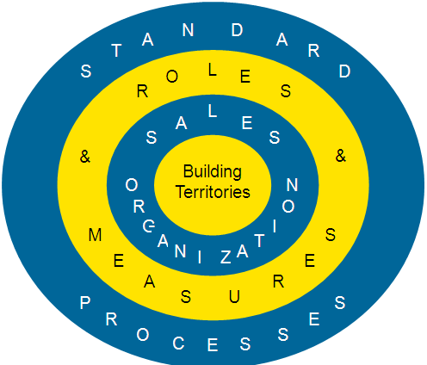

Building leadership at the last mile
Crack Sales System:
Building Blocks:
Bottom up approach
Modular Structure to support Scalability
Elements to bring in Commonality
Market working linked with face time required for top customers/ business partners
Focus on capability building through coaching
A framework for structured interaction of the leadership of the company with the external stakeholders.
2800+ strong Rural Sales organization with our
“Son of the Soil approach”
Notes:
More than 1,50,000 (1,57,975) mandays of training for ICSL employees
2. Connect Program
Need: Engage with people associated with our partner organizations to create an emotional connect
1 day in CC and Rural Market
R&R for Channel/Business Partners
226 Visits happened & 158 varied forms of Recognitions
3. Talent Development – ICSL
Sales Training Man days: 17589
Performance Coaching: 15178 Man days
Change Readiness through Business trainings
MNP 9844 Man-hours
3G Training 7304 Man-hours
Channel Partners
Sales Training Man days: 123310
MNP 120380 Man-hours
3G Training 32876 Man-hours (ongoing)
4. Findings from Performance Track of TSM’s/TSE’s undergone performance coaching 10-11
The Performance Track of 696 TSM’s/TSE’s from 14 circles AP, UP W, Bihar, Gujarat, Haryana, Kerala, Maharashtra, MPCG, Rajasthan, Tamil Nadu, UP E, Karnataka, West Bengal and Punjab who have completed performance Coaching during 10-11 were tracked on the following parameters.
Average unbarring percentage Target vs achievement
Average V top up/ coupon Target vs achievement
No: of LUT Sites
No: of retail outlets
NB: The parameters identified were taken for an average period of 3 months pre coaching and post coaching.
Findings from post Coaching period
70% TSM’s/TSE’s have shown improvement in unbarring %
73% TSM’s/TSE’s have shown improvement in V top up/coupon%
53% TSM’s/TSE’s have shown reduction in no: of LUT sites.
84% TSM’s/TSE’s has shown increase in no: of retail outlets
Highlights-
The Avg target vs achievement of TSM’s/TSE’s on unbarring has gone up from 85% to 98% post completion of Performance coaching
The Avg target vs achievement of TSM’s/TSE’s on Average Recharge revenue has gone up from 77% to 87% post completion of Performance coaching
The Average no: of retail outlets per TSM/TSE has gone up from 205 outlets to 239 outlets per TSM/TSE post completion of Performance coaching

Slide 41
Last Mile Focus
Regular Zonal Visits
Process roll-outs
Initiatve updates
Trainings/
workshops
CMT updates
All Team Meets held in zones
regularly
Instrumental in creating a better connect with the organization
Notes:
More than 800(811) visits to zones for ATMs, OHS & new initiative roll-outs, TQM projects, Training etc.
Emags on Circle updates sent across to all employees

Slide 42
What do !deans think !

Slide 43

Our People Speak…
Trust based leadership
  High Confidence in business leadership in managing emerging challenges
  Opportunities to learn and grow
  Clarity on criteria for performance evaluation
  High confidence in ability to attract good talent
Connect with the last mile
Engage & Express
Inspiring excellence
Developing capability
Enriching Life
~80% of Leavers willing to rejoin Idea*
Becoming a good Social citizen
* Peoplestrong Exit Survey 2010
Notes:
Percentage of FH & Above with tenure > 4yrs: 66.7%
2. Our high Employee advocacy is proven from the fact that approx. 40% of our external hires are hired through employee referral.
3. IDEA Advantage: Out of 175 ex-employees, 139 wants to rejoin IDEA

Slide 44
Gallup Speaks..
Growth of Idea
Sustaining & Driving Engagement
47% increase in Employee base
70% increase in geographical footprint
98.4% participation in the last OHS
  Participation rate consistently above 97% for each OHS conducted
*Gallup Global Average Participation: 87%
Impact of Q12 on overall engagement
Higher engagement levels - Superior business results !

Slide 45
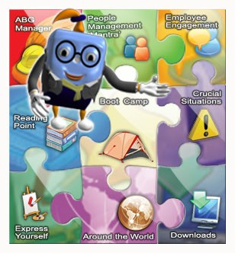
Developing People Managers
High Performing
&
Engaged
Team
Organization
Good People Managers
Inspiring ABG Manager
Portal to help Managers in building their team effectiveness
OHS Surveys and Vaartalap to track team engagement

Slide 46
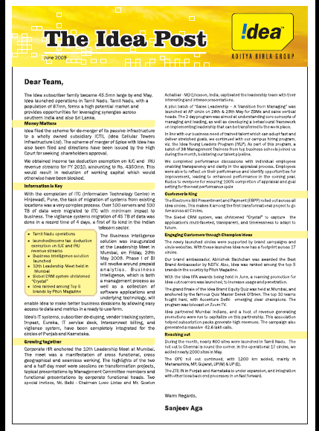
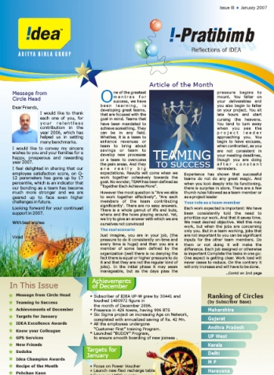
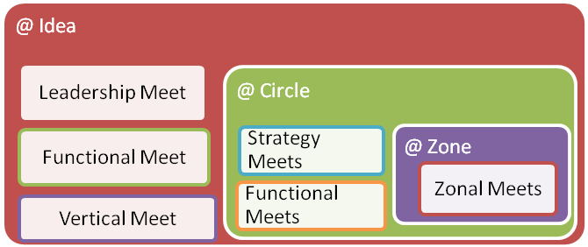
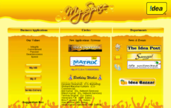


Culture of Openness and Transparency
Strategy Meets at !DEA
Address by the MD to all employees on business performance, insights and way forward.
Redress Mechanism for Employee Concerns

Slide 47
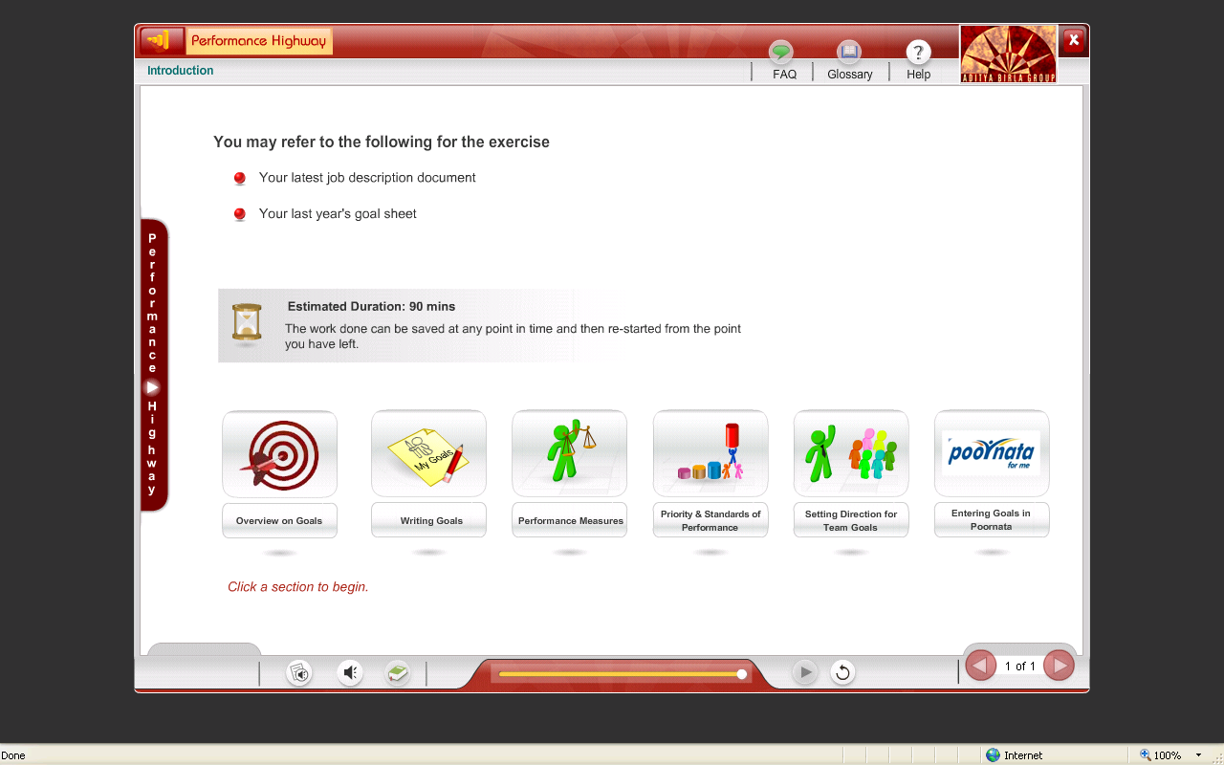

Creating a High-performance culture
Trust based leadership
Implementation
Impact
Extensive training conducted on using the Performance Highway
Templates of Goal Framework developed to support in writing of SMART goals
Connect with the last mile
More than 90% of the Goals set had defined performance measures
Standardization of Goal Framework with top down goal low
Engage & Express
Inspiring excellence
Developing capability
Enriching Life
Becoming a good Social citizen
Notes:
1. Performance Management
91% of the Goals for 2010-11 with performance measure defined
79% of the goals for 2010 – 11 with SOP (ME/EE/FEE) defined
Standardized goal framework for 20 additional roles covering 2500 employees
1st Business in ABG to automate PIP
2. Performance Highway:
Over 4500 employees wrote their Goals through Performance Highway
6300 Man-hours of training on the PH process for Goal Writing
Development & launch of Performance Highway – Telecom version
1st time visual available for cascade of Goals from Manager to team member
Compensation
Participated in the 1 year old telecom forum with 4 other leading Telecom Service Providers to benchmark Idea Compensation for 130 Benchmark positions, Policies and Benefits

Slide 48


Inspiring Excellence
Aditya Birla Awards
Idea Rewards
Outstanding Leaders
Distinguished Achievers
Exceptional Contributors
Young Professionals
!dea Star
Champion award
Excellence award
Selling Star award
Individual
Individual
And SMILEYS!!!
Function/
Business
Team Excellence award
Masterminds award
Best Zone award
Team
Sun and Planet Awards – organizational excellence
ABG Value Leaders
Making ABG an aspirational employer for women
Building an Environmentally Sustainable Organization
Others
Values
Value Champions
Notes:
Idea Rewards
1. Spot Recognition - Idea Star Award/Smiley/e-Smiley
- Departmental & Interdepartmental
- Informal Recognition
2. Valuable Contribution - Excellence Award
3. Outstanding Sales Performance - Selling Star Award
4. Most Valuable Contribution - Champion Award
5. Outstanding Zonal Performance- Best Zone Award
6. Most Valuable Contribution as a Team- Team Excellence Award
7. Core Values (ABG) - Value Champion Award
8. Outstanding Contribution towards Process Excellence/Innovation- Masterminds Award
Aditya Birla Awards
1. The SUN & PLANET AWARDS 2010 are a part of the “Aditya Birla Award for Outstanding Achievement” of which the Chairman’s award is also a part.
The ‘Sun’ Award will reflect the achievement of overall excellence. The ‘Planet’ Awards that revolve around the “Sun” will focus on excellence in specified areas depending upon the strategic direction, business focus, and priority areas for the Group for that cycle.
2. ABG Value Leaders: 2010 – A Competition to honour Value Champions
The ABG Value Leaders competition seeks to highlight anecdotes of situations and people who do not allow the Values to be compromised. Stories of such experiences become a part of the organization folklore, but sometimes remain confined to the location or unit. The purpose of this competition is to recognize exceptional display of living the Values, and also to disseminate their inspiring stories throughout the Group.
3. Making ABG an aspirational employer for women - A Competition for Women Managers:
The Aditya Birla Group has been in line with the evolving trends among its women employees and believes that women in the workforce have unique set of capabilities, priorities and aspirations. It is important to understand from the Women Managers of the Group on the key attributes/ aspects that Aditya Birla Group needs to build/develop that will lead us to be considered among the Best Employer for Women Globally.
4. Building an Environmentally Sustainable Organization:
This is a competition to seek ideas on what could the Group adopt, adapt and focus on to make our business units / businesses environmentally sustainable and take progressive measures to remain environmentally sensitive in our thought, feeling and action.

Slide 49
Developing capabilites – Our framework
Trust based leadership
Learning Deployment
Distance Learning programs
HR Academy
Webinars
Pratibimb
Gwiki
Drishtikon
E Learning
Gwiki
IMPACT – Online quiz
KNOWLEDGE – SMS based learning
Gyandhara
Bahi Shal
Connect with the last mile
Virtual
Engage & Express
Inspiring excellence
EXPERIENCE
! Disha – Coaching Skills
Management School
Saksham
Development Assessment Centre
Gyanodaya programs
Performance Coaching
Parivartan
!Evolve - Grid Programs
Management Development Programs
Corporate Theatre
Sales Training
Business related trainings (MNP, 3G, UCS)
Developing people capability
Enriching Life
Face to
Face
Becoming a good Social citizen
Select
Mass
REACH
Notes:
Virtual Learning
GWIKI : Co:creating kowledge, a wikipedia for ABG. Gwiki is an editable intranet which enables knowledge & information management among employees. Interactive features like discussion forums, surveys, chat, blog, lateral search enabling business information are part of this.
Talent Development:
In-house leadership Programs:
!Evolve: Role Based training inputs for all employees. They have helped us to reach out to our team members with respect to their level/role wise development needs. It has, therefore, facilitated Career Stage wise Competency Development. Competency development – 4827 employees through 357 programs
!Disha: Change Management is an important part of Leadership Management. The Coaching Skills programme is aimed at equipping our Leaders with capability to guide larger team members improve from their current situation and proactively change for the better. A lot of HoDs have started the Coaching practice in their Circles and the movement is catching on. 52 HODs attended the 2 day coaching skills program
ISABS & Parivartan: Aimed at helping a person overcome internal conflicts and take charge of self as well as immediate environment. In Parivartan 90 day closure of 58 employees has been achieved effectively and employees have reported improvement. Employees upto the level of DGM are encouraged to participate in Parivartan and GM and above are nominated for ISABS. Parivartan: 59 participants attended Parivartan and 58 (30 of FY-10 & 28 of FY-11) participants closed their action plan successfully
Business Trainings: MNP & 3G: Have helped employees especially in Sales Function become conversant with the concept and application. Since we leveraged our internal content creation and execution capability the turn around was fast and we could cover the employees without incurring substantial cost.
Sales Training: Has become an integral part of Circle Sales Function. The CSTMs based on inputs from Sales Leadership Team and also monthly Sales Review are able to plan trainings that meet the local requirement. The content is internally available which gets customized as per requirement. Further, product trainings/refreshers as well as snippets for channel have helped in increasing the knowledge and skill level of the frontline teams.
Details
Grid: no of programs 357, no of participants 4827, Training mandays 8093
Management School: 62 DGM & Sr. Managers covered
Saksham: 117 Managers & Asst. Managers covered
Corporate Theatre initiated and rolled out internally
Internal Development Assessment Centre: Trained and developed 5 new internal DAC assessors
Created and implemented internal DAC: 3 Sales heads identified from the process
Ran successfully Learning & Development Week nationally with focus on show casing MDF & Sales training offerings
E learning:
No of unique users: 1,935 (till date 7,242)
No of courses completed: 13,215 courses
~98% of employees registered in Gyanodaya
Virtual pool of trainers to broad base training execution
Change Readiness: Training of employees, field Sales force & Channel partners to educate the customers on new services viz. 3G, MNP

Slide 50
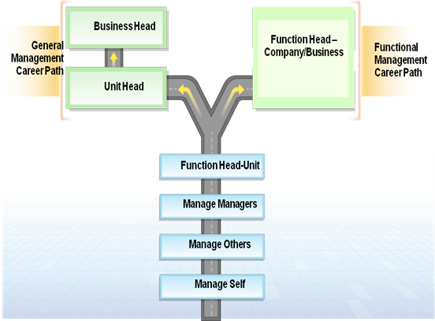
Talent Development Framework
Talent Segmentation
Competency Framework
Potential Validation - DAC
Functional Competencies
Behavioural Competencies
Individual Development Plan (IDP)
Competencies
Talent Review Discussion
Career Management & Succession Planning

Slide 51

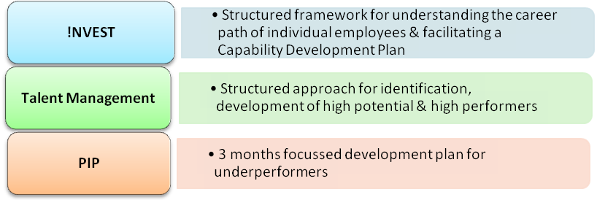
Enabling Careers – Inclusive approach
Internal Assessment Center for selection of talents for key positions.
Notes:
Talent Management:
211 Talent Pool (existing, since 2008)
Low attrition - 27 attrition (since 2008, Attrition: ~12:8%)
Growth opportunities with 119 Talent Pool movements out of the 211 talent pool members (56% movements)
FY09-10 Inter-circle movements = 871, Intra-circle movements = 429
FY10-11 Inter Circle movements = 309, Intra Circle movemens = 632
Regular Talent reviews done
!NVEST:
This aimed towards strengthen the current Performance Management System and focus on the career discussion
between the employees and their managers. The initiative provides an opportunity to an employee to plan and work
on his/her career development. The manager & organization will facilitate in this capability development plan.

Slide 52



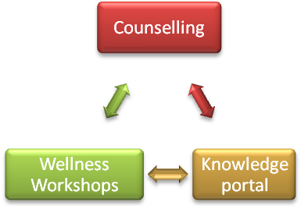
Life Unlimited : Our Employee Wellness Program
Trust based leadership
“Life Unlimited” is an online portal which provides two distinct types of services:-
Counselling support to address and resolve issues that are important for employees and their family.
A knowledge portal with self help tools, like- stress audits, various articles on parenting, career issues, relationships.
Connect with the last mile
Engage & Express
Inspiring excellence
Wellness@ Idea
Health Initiatives @ Idea
Developing people capability
Enriching Life
Becoming a good Social citizen
Notes:
Life Unlimited provides free & confidential counselling support to our employees and their families to address and resolve everyday life issues that are important for them. 20 Circle Wellness Champions are trained for the implementation of the Life Unlimited and in turn create network of internal Wellness Champion to ensure the wellbeing of each employee
Highest no. of registrations out of all group companies
FY10-11
Registrations - 1699
Counseling - 157
Self Assessment - 1203
Articles Read - 2253

Slide 53

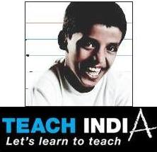

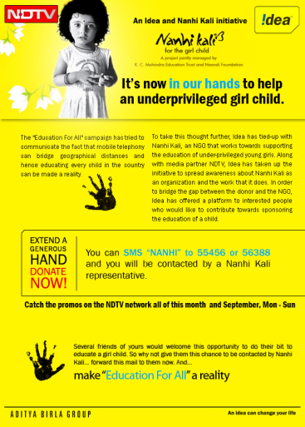

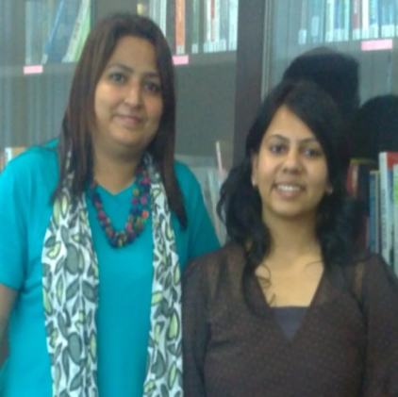
Being a good social citizen
Trust based leadership
Blood Donation Drives
Connect with the last mile
Engage & Express
Nanhi Kali
Initiative
Inspiring excellence
Developing people capability
GiveIndia
A Payroll Giving Program
Teach for India
Our Gen Y Champions committed to the cause
Enriching Life
Being a good Social citizen
Notes:
2 Idea employees were selected post a rigorous selection process in Teach for India – ABG led intervention wherein ABG employees get a chance to teach underprivileged children for 2 years as part of secondment to the said foundation
Give India – Rolled out in ~250 idea employees volunteered
“Bus Karo”: Reach your workplace, the green way:
Monthly Voluntary Contribution from each employee towards a noble cause
Blood Donation drives regularly held
Visits to orphanages and Old age homes are done on a regular basis

Slide 54

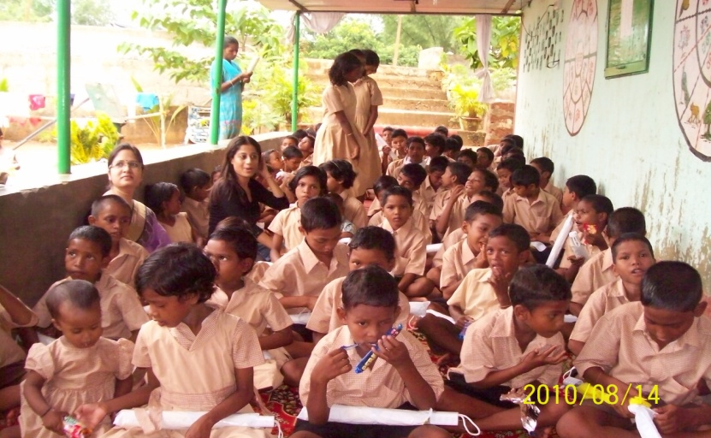
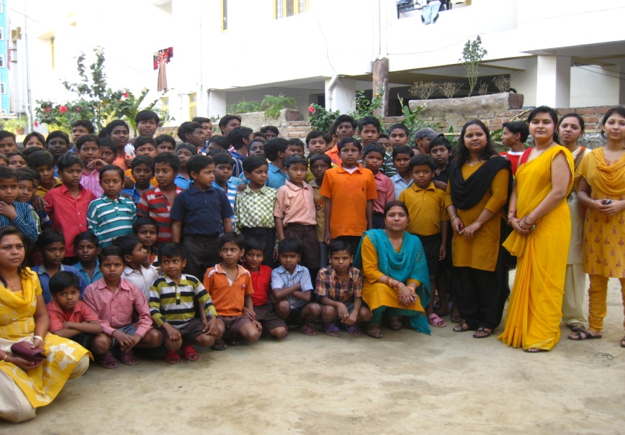
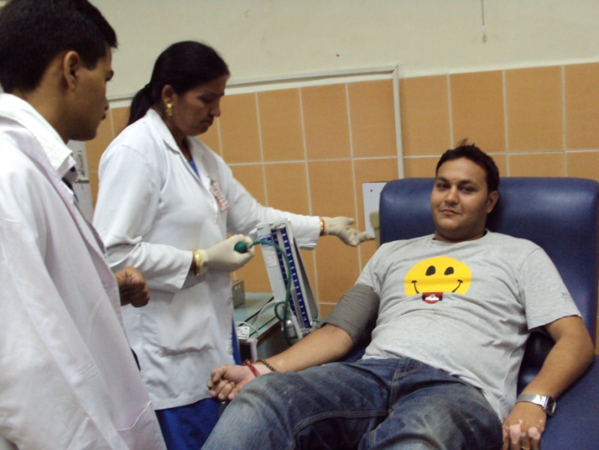
We discovered the joy of giving
By opening our hearts!

Slide 55
“An organization’s ability to learn, and translate that learning into action rapidly, is the ultimate competitive advantage.”
- Jack Welch
Thank You

Slide 56
Measure | OHS | OHS V | OHS VI | OHS VII
 | 2005 | 2006 | 2008 | 2010
Number of Circles | 9 | 11 | 13 | 22
Number of Employees | 2849 | 3912 | 4437 | 6528
Participation (%) | 96% | 95% | 97% | 98% (Increase by 1%)
% Engaged | 21% | 31% | 46% | 48% (Increase by 2%)
Q12 Grand Mean | 3.58 | 3.77 | 3.99 | 4.01 (Increase by 0.02)
Overall Satisfaction | 3.68 | 3.78 | 3.98 | 4.00 (Increase by 0.02)
Advocacy | 3.80 | 3.9 | 4.20 | 4.17 (Marginal decrease)
Stability | 3.41 | 3.7 | 4.04 | 4.09 (Increase by 0.05)
Engagement Ratio | 1.2:1 | 2.2 : 1 | 4.6 : 1 | 4.8:1

Slide 57
Demystifying Leadership – The Complexity of Defining and Describing Leadership

Slide 58
Demystifying Leadership
“Leadership is one of the most observed and least understood phenomena on earth.”
- J. M Burns
“ The aura with which we tend to surround the words leader and leadership makes it hard to think clearly. Good sense call for demystification.”
- John Gardner

Slide 59
Why the myth exists – The complexity of defining and describing leadership
Significant number of unknowns and many of them constantly changing :
  Different levels of organisation requires different leadership behaviour and practices.
  Leadership occurs in extremely diverse enviornment , eg strat-up vs established organisations.
  Different skills are required at different stages of a person’s career

Slide 60
Why the myth exists ….
  4. Leadership is driven by major events, eg Churchill through World War II was a premier leader, and when the war was over he was voted out.
  5. Lack of robust measure of leadership effectiveness especially on important business drivers like impact on customers, employees, organisation and shareholders.
  6. Much of leadership analysis and development has been ‘looking at the rear – view mirror: Current competencies vs future effectiveness requirements.

Slide 61
Why the myth exists ….
  7. The wide variety of leadership styles used within different organisations to motivate and inspire employees. Though all approaches of motivation are right however problem occurs when a recognition and celebration leader attempts to function that way in a process metrics organisation.
  Intelligence, physical characteristics ,viz. height, emotional and personal charecteristics, viz. assesrtiveness, have some correlation with leadership effectiveness, however to assume a cause and effect relationship hampers the work of those concerned with development.
  Last but not the least an absence of common and adequate language to define leadership.
So Can Leadership have a common language – A conceptual framework….

Slide 62
The Leadership Tent – A Conceptual Framework
Character
Leading organisational Change
Focus on Results
Interpersonal Skills
Personal Capability
Character as the center pole is the core of Leadership effectiveness
Source: The Extraordinary Leader – Turning Good Managers to Great Leaders : John H Zenger and Joseph Folkman

Slide 63
Adopt a Model for Leadership:
  A common language

Slide 64
While I have done some research I would not structure my presentation on them but would build up upon two premises:
  Leadership like any other skill can be learnt and it require desire for the individual
  COP
  What can individual do
  What can organisation do.

Slide 65
Building Organisations that produce great leaders

Slide 66
Questions.
What is needed?
  Building
Talent management and

Slide 67
In Conclusion
Insight 1. Building a sustainable leadership organisation with so much of change in the enviornment whether it is pace of the change or quantum of change is very difficult. Each organisation has to keep revisiting it’s hardware (the specific leadership competencies to focus on, the

Slide 68
16 competencies that make Effective Leaders.
Character
Displaying High Integrity and Honesty
Personal Capability
2. Technical and Professional Expertise
3. Solving Problems and analysing issues
4. Innovation
5. Practicing Self Development
Focus on Result
6. Focus on Result
7. Establish Stretch Goals
8.Take responsibility for outcomes/initiative
Interpersonal Skills
9. Communicating Powerfully and Prolifically.
10. Inspiring and Motivating Others to High Performance
11. Building Relationships
12. Developing Others
13. Collaboration and Teamwork
Leading Organisational Change
14. Developing Strategic Perspective
15. Championing Change
16. Connect Internal groups with the outside world

