Slide 1
Nokia overview
NAVTEQ
CEO
Nokia Siemens Networks
Operating Profit 2.84 Billion US$
Sales :
42.4 Billion US$
Corporate Development
Mobile Phones
Smart Devices
Markets
Present in 73 countries
CFO Office
Number of Employees
60815
Handsets sold per day 1 Million
Human Resources
Handset volumes 352.6 Million
Legal & Intellectual property
Services & Developer Experience
Corporate Relations & Responsibility
Design
Quality & Capability Development
Workplace Resources
CTO Office

Slide 2
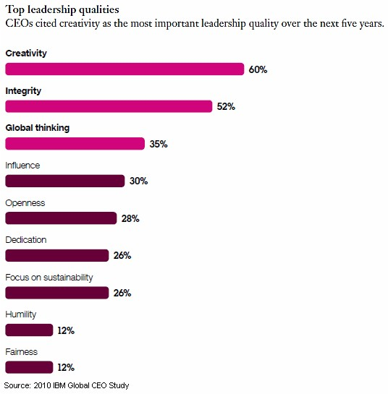
Notes:
Many CEOs are doubtful their companies can handle a volatile, increasingly complex business environment: 79% expect high or very high levels of business complexity over the next five years, and only 49% say their organizations are fully prepared to deal with that increased complexity, according to a study by IBM. To cope with those changing business realities, most CEOs plan to focus both on developing new revenue sources and stronger customer relationships over the next five years.
Below, other findings from the biennial IBM Global CEO Study, based on interviews with 1,541 CEOs, general managers, and senior public-sector leaders from 60 countries and 33 industries.

Slide 3
Innovation Triangle
Business Performance
$ $
Networks
New Business
Partners
Innovations
Ideas
Processes
Creativity
Culture
People
Innovation in Performance Management

Slide 4
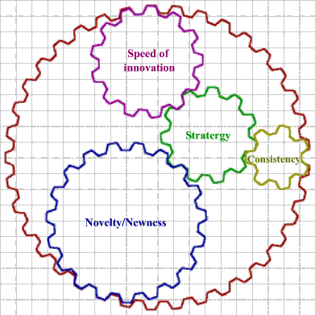
Innovation is key to Business Performance
Notes:
Deﬁnitions of innovation and the impact of innovation on business performance In reviewing the literature on innovation, various deﬁnitions emerge highlighting different dimensions of innovation performance.
The most commonly held concept of innovation performance refers to the newness and novelty of products or processes which has been adopted in several studies.
The second dimension of innovation is related to the speed of innovation which has been interpreted in two different ways. First, speed refers to the lead time required for developing and introducing new products. In a world of shortening product life cycles where the life of a particular product can be measured in months, the capability to replace products frequently with better versions is increasingly important. This produces a growing pressure on ﬁrms not just to introduce new products, but to do so faster than their competitors. Second, speed is also associated with how early a ﬁrm adopts new technology emerging in the industry. This deﬁnition is based on the ﬁve categories of innovators developed by Rogers (1983), namely innovators, early adopters, early majority, late adopters and laggards. The early adopters of innovation would have more signiﬁcant beneﬁts from the innovation albeit facing a higher degree of risk.
The third dimension of Innovation is concerned with the consistency and continuity of ﬁrms in innovating over time. Companies that are known as world-class product innovators, in the main, focus on developing new products, and do so without ignoring other entry requirements for competition. As a result, they consistently introduce new products into the marketplace.
The fourth dimension of innovation refers to the strategy and capability of ﬁrms to introduce new products in a new market In certain cases, these ﬁrms even strive to create new markets, a strategy commonly based on the principle of ‘ﬁrst-mover advantages

Slide 5
Aligning Employee Performance to Business Plans
Expertise

Slide 6
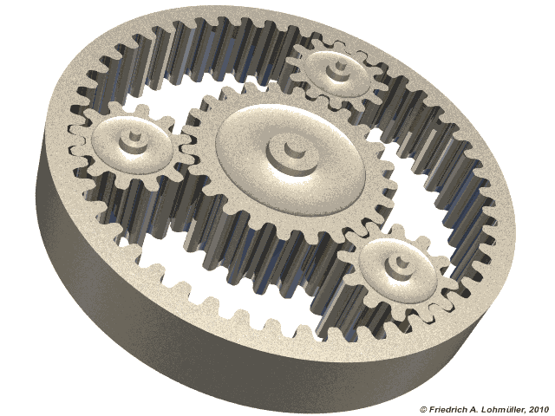
Business Performance
How to ensure High Performance
Senior Mgt. Involvement
Shared vision of the Future
Innovation Mindset
Strategic Innovation Agenda
Notes:
Purposes of building performance culture are also common across organizations
Source: McKinsey analysis
Performance culture
Purpose
Drive company performance
Ensure every staff is performing to their highest level
Set alignment and develop momentum for the whole organization
Align stakeholders
Communicate consistent message to external stakeholders (e.g. regulators, investors, customers
Accumulate human capital
Maintain staff morale with sense of achievement and belonging
Attract new talent

Slide 7
What makes performance management work
Performance Management
Performance Evaluation
Objective Alignment
Compensation
Competence Development
Development Planning
Leadership Development
Talent Acquisition
Talent Rotation/ Global Mobility
Talent Review
Talent Engagement
Career Path
Talent Management

Slide 8
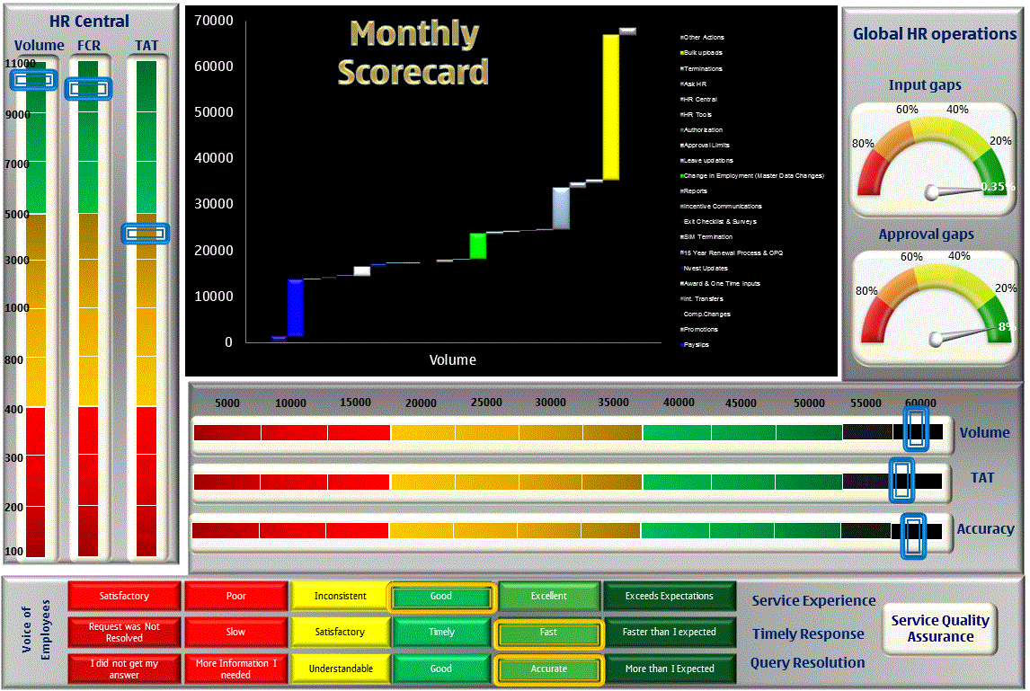
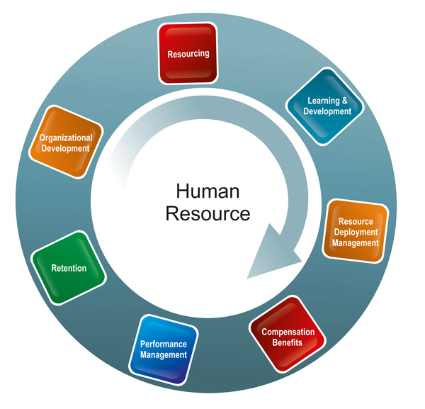
Effective Business Performance Management, Performance Measurement
Resourcing
Talent Management
Payroll Management
Performance Management
SF
SAP

Slide 9
Thank you

