Slide 1
Performance Management System

Slide 2
Annual Performance Review
AL Story???

Slide 3
Quota
Notes:
Why do we bother with the charade, anyway its all decided by Quota

Slide 4
Periodic Reviews

Slide 5
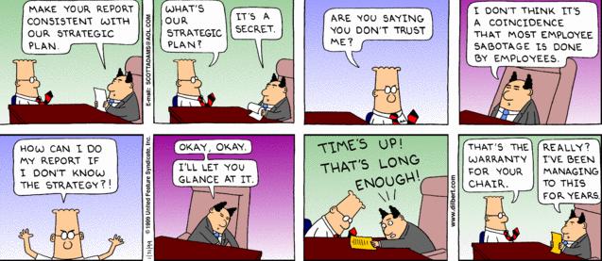
Strategic Alignment

Slide 6
Goal Setting

Slide 7
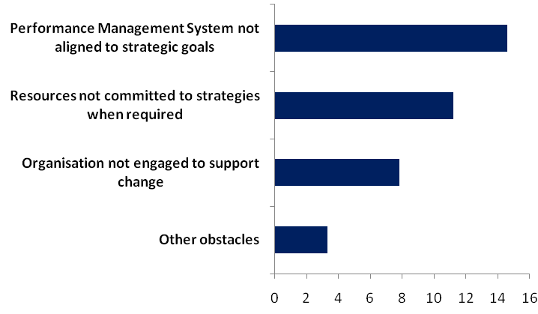
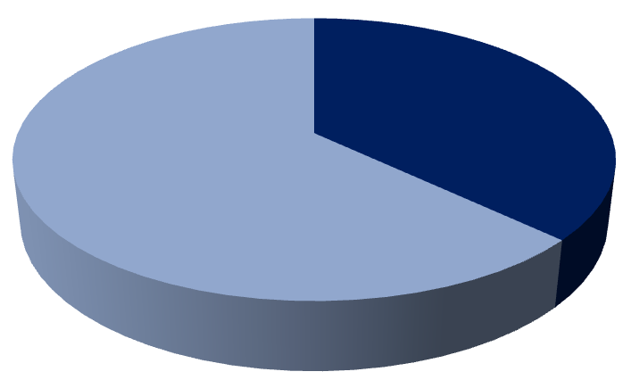
A Call to Arms
Companies report losing nearly 40% of total potential value of their strategic plans on account of flawed execution
Misaligned Performance Management and resource allocation systems are responsible for two-thirds of this lost value
14.6%
37% of Potential lost to execution barriers
11.2%
63% of Potential Achieved
7.8%
3.3%

Slide 8
Barriers to Performance
Aligning Performance Management System to Strategy Goals
Allocating Resources to Strategies when required
Building Support for Change across the organization
The goal is to get all oars moving in the same direction; otherwise you aren’t going anywhere.
If everyone saw the same thing in their crystal ball, there wouldn’t be an execution problem.
Assumed barrier
Everybody has a scorecard, but they don’t monitor it often enough in enough detail
Assumed barrier
It is tough to get everyone to hear the same message about the need to implement a strategy
Actual Barrier
Failure to explicitly link critical few long-term goals to annual personal objectives horizontally and vertically
Actual Barrier
Inability to identify and engage employees most critical to executing a strategy successfully

Slide 9
The Misalignment
Corporate Objective: Improve Profitability
Operations
R & D
ED: “Be the lowest cost producer”
ED: “Be the first to market with leading technology”
SD: “Lower total production cost”
Horizontal Message Degradation
Objectives are interpreted differently at senior levels, creating conflicting goals and activities
GM: “Lower inventory costs”
DM: “Improve inventory turns”
Vertical Message Degradation
Inability to link corporate objectives to individual employee goals, causes confusion or even inappropriate action
Manager: “Ship more”
Employee: “Go faster – but what about mistakes and damages?”
Notes:
Strategic objectives are not always achieved because functions and geographies pursue conflicting goals
… and objectives are not effectively communicated down the line

Slide 10
AL - PMS until 2008
Paper & Pen based
SMART Goals
X
Timelines
Transparency
Goal setting by II Qtr
Appraisals dragged till III Qtr
Alignment, inter-linkages and cascading was by accident
Lack of clarity on roles and goals
Slipping timelines
Continual Firefighting
Review meetings dreaded and avoided
X

Slide 11
Management by Objectives
MBO = Objectives, Objectives, Objectives

Slide 12
PMS - Vision
Key driver for high performance, agile culture
Linkage with corporate strategy, vision and values
Focus on reinforcing differentiating competencies
Consistent, demanding standards for everyone
Talent Differentiation and identification of Future leaders
Focus on performance enhancement rather than performance appraisal

Slide 13
First Steps – Online PMS
Objective, standard template
Cascading of Goals - mandatory
Manager Feedback - mandatory
On-time capturing of quality of feedback meeting
Timeline adherence through auto-lock
Quarterly Review - mandatory

Slide 14
Cultural Change
Self Appraisal
Mandatory feedback meeting with appraiser
Critical Incidents Diary
Appraiser/ Reviewer dialogue
Joint Appraisal Review Committee at functional level

Slide 15
GENMOD: Horizontal Strategic Alignment
Vision, Strategy, Business Goals
Customer Inspired Solutions
Gate Review
Product Portfolio Planning
Gate Review
Program (Program Manager, Core team, extended members)
Quarterly Stage Gate Reviews

Slide 16
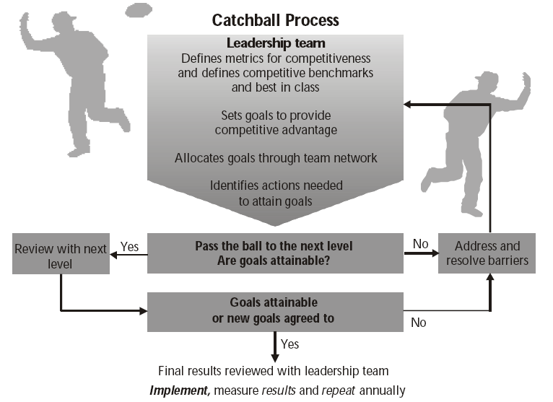
Vertical Alignment through Catch-Ball
Leadership Team
Sets Strategic Goals
Defines Deliverables
Assigns RACI

Slide 17
9 Cells Matrix
Potential x Performance Matrix for talent differentiation
Potential tested on competency framework: 10 competencies for 4 contribution bands
Unique Development Plan for each cell
Superstars put on fast track leadership pipeline

Slide 18
Transformation
Performance Enhancement Process
Mutuality – involvement of all stakeholders
Development focus
Objective , simplified Goals
Supervisory Coaching
Quarterly Reviews and Feedback
Critical Incidents Diary
Transformation
Performance Management System
Top Down and not aligned
Judgment/ appraisal focus
Subjective, complex KRAs
Supervisory Judgment
Once a year appraisal
Generic (biased) feedback
Notes:
The feedback quality enhanced - related to positive, critical incidents etc.

Slide 19
Moving forward
Leadership Scorecard
Innovative Reward Scheme
70:20:10

