Slide 1
Attrition Management High Engagement and Low Attrition
Strategic HR Summit 2011- Chennai
15th October 2011

Slide 2
Attrition … my 6 cents
Name : Chandrasekhar C
Title : Country HR Manager – BAS & GIT- India
Company : Hewlett-Packard

Slide 3
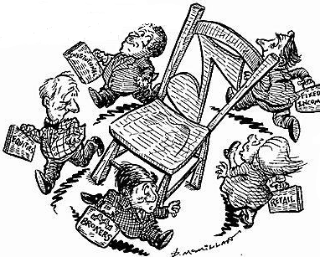
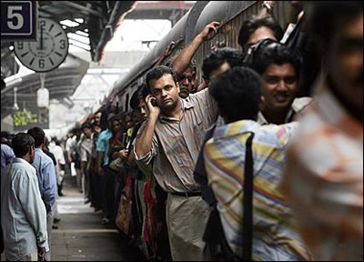
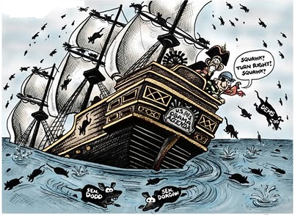
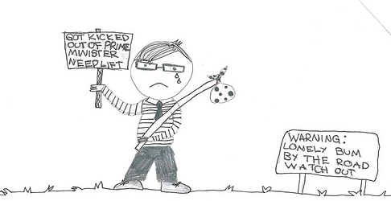
Attrition – the other side…
Definition: A reduction in numbers usually in result of…
Single seat multiple applicants
-Hitting the Glass Ceiling
Unbilled available
Ramp Down
Floaters
High cost low Value
Low Performance
People getting off a train
Musical Chair
Weight Loss Program
Sinking Ship…
Need a lift
Moral : Watch out ONLY WIN retention

Slide 4
Attrition – Cure vs Prevention
MONEY
ONSITE
JOB
CHANGE
LOCATION
????
Drugs that might cure Attrition…
“Prevention is better than Cure”

Slide 5
Attrition – not magical …
“Yesterday he was fine…not sure what happened today”
“I wish I had known this already”
“This attrition is a news… I never expected”
“I am not an astrologer to know this”
Manager
If a manager can not predict the attrition of an employee he values, then the problem is not attrition
There can’t be any better source to know an employee’s decision of leaving than personal connect
Facilitate for effective Connect

Slide 6
Let Us INTROSPECT……
Which one of the above period of your life, do you keep it close to your heart and why?
Opportunity
Encouragement
Friends
Freedom
Care
FUN
Different stroke for different people
BUSINESS priority and PEOPLE priority can’t travel in opposite directions
Identify and nurture your key talent

Slide 7
MY 6 CENTS
Watch out ONLY WIN retention (remember the other side of Attrition)
Prevention is better than cure
Attrition can never be a SURPRISE… Connect to know
Different stroke for different people
BUSINESS Priority and PEOPLE priority can’t travel in opposite directions
Identify and nurture your key talent

