Slide 1
Attrition Management High Engagement and Low Attrition
Panel Discussion

Slide 2
Key to Engagement – Values & Motivation
Saurabh Singh
National Head
Pearson Talent Assessment

Slide 3
About Pearson Talent Assessment
We are a division of Pearson Group
$8.4bn, 37000+ employees, operation in 60+ countries
Pearson Education is the world’s leading education company. Leading brands: Longman, Prentice Hall, Addison Wellesley, Scott Foresman
The Financial Times is the most international source of business news, data and analysis. Leading brands: FT, Economist, IDC
The Penguin Group is one of the world’s great consumer publishers. Fiction, non-fiction, reference books
3

Slide 4
Attrition – A Plaguing Challenge
Attrition – increased organizational cost
Limits optimal utilization of HR potential
Disrupts workflow due to unplanned exits and costly replacements
A drain on the organization’s resources like recruitment expenses, training and orientation resources and time of stakeholders
Leads to insecurity among co-workers

Slide 5
Attrition: A perspective !
Reducing attrition may not always be the same as increasing retention.
Addressing workplace factors contributing to a negative experience like monotonous nature of job , poor mentoring, workplace politics, low career growth, irregular working hours, lack of recognition can help manage attrition
Motivational & fitment issues are among the most important intrinsic factors for employee exits

Slide 6
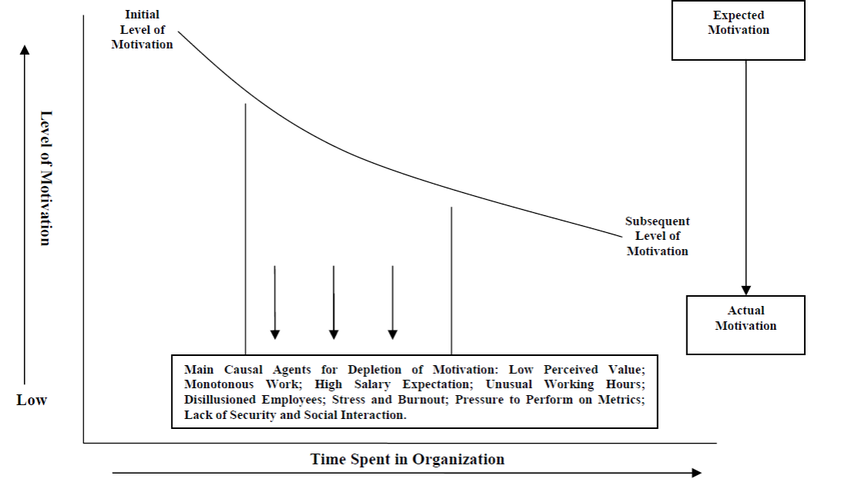
Level of Motivation has a direct effect on Attrition

Slide 7
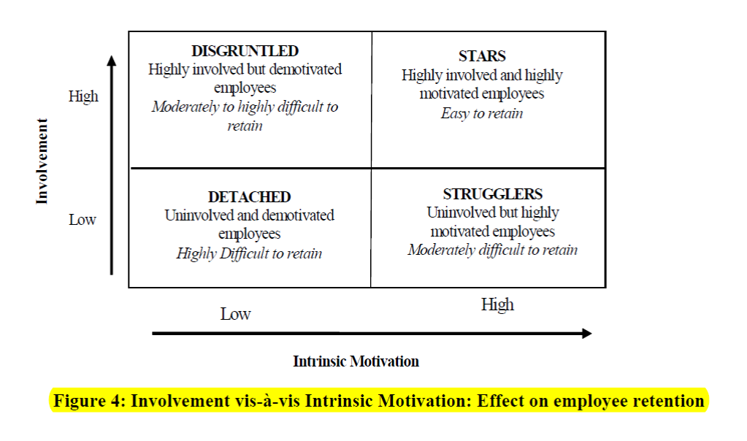
High involvement – High Motivation works wonders !

Slide 8
Inter-personal Motivators
Recognition
Independence
Benevolence
Support
Conformity
Power

Slide 9
Personal Motivators
Materialism
Conviction
Orderliness
Goal
orientation
Achievement
Variety

Slide 10
How to ensure high sustenance in Organization !
Employee involvement adds to employees’ growth needs and sense of achievement by an optimal utilization of skills and potential.
Employee participation in planning ,decision making and in articulating new policies - improves employee motivation.
Finding ways to intrinsically motivate employees can have a direct impact on their effectiveness and performance thereby resulting in sustenance as well

