Slide 1
Presentation:
Innovations In Performance Management

Slide 2
Agenda
About Us
Breakthrough Performance Management Strategies

Slide 3
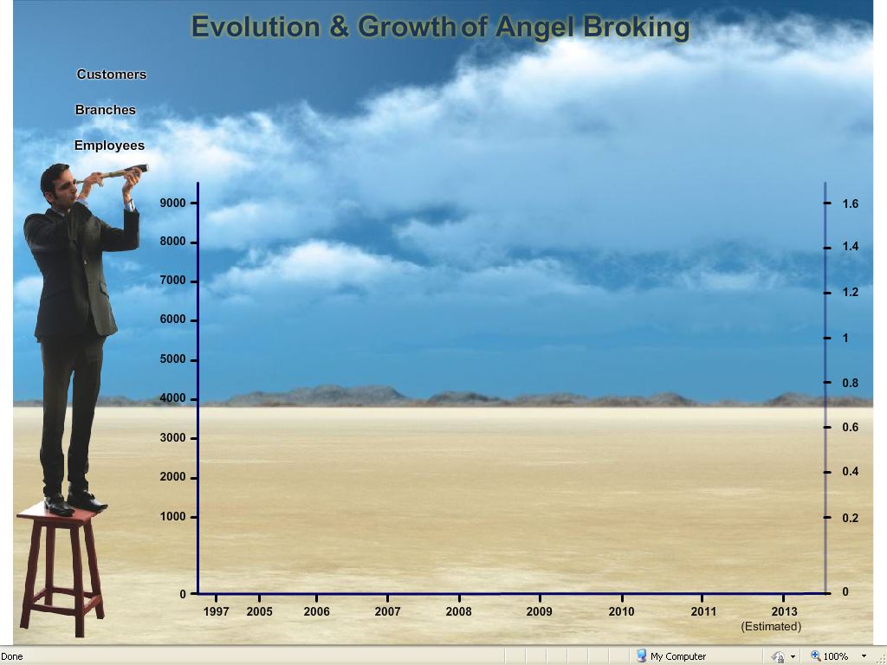
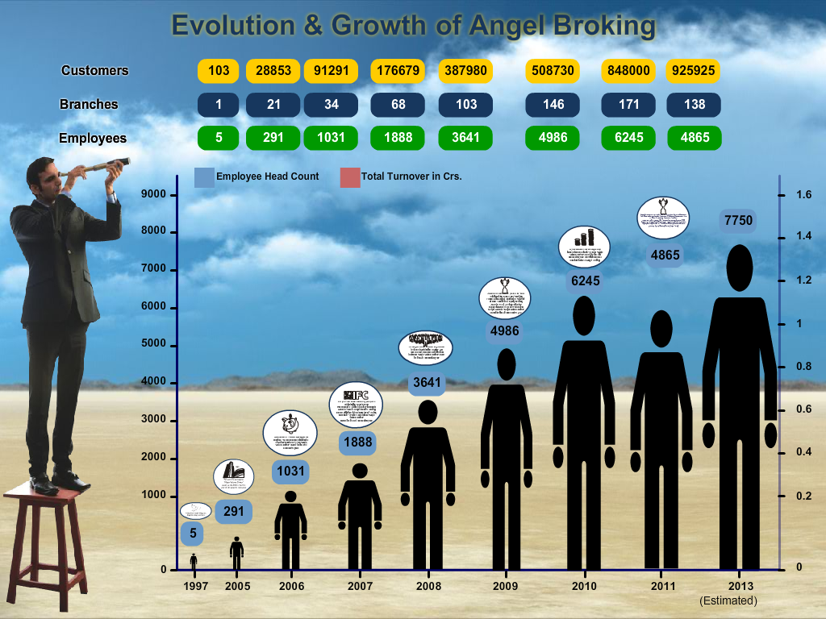
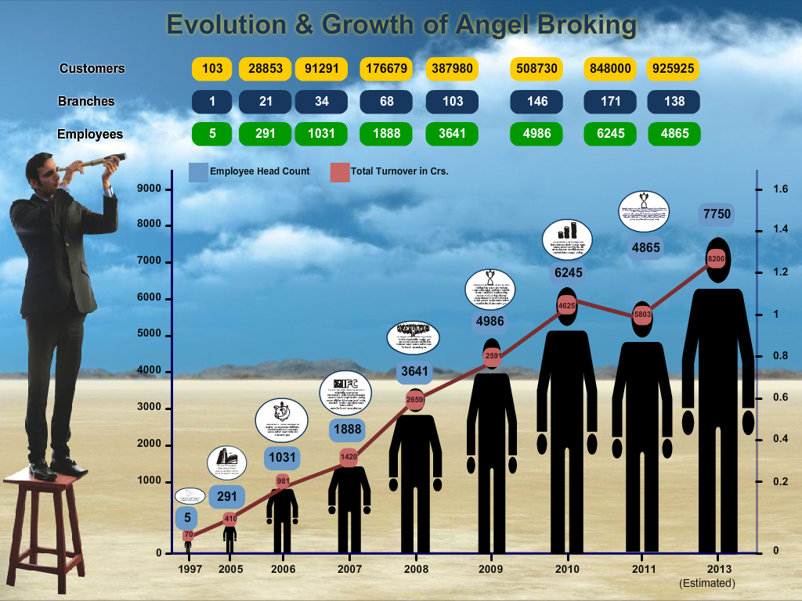

Slide 5
Agenda
About Us
Breakthrough Performance Management Strategies

Slide 6
Interpreneurship
‘In-sourced Entrepreneurs’

Slide 7
The PMS Pyramid
Promoter
Board Level (Balance Scorecard – 5 year rolling)
Senior Management (Balance Scorecard)
Interdependence
MANAGEMENT SUPPORT
(Career Progression Plan)
What do I get & give?
BASIC NEEDS (Credit System)
What do I get?

Slide 8
Breakthrough PMS strategies
Credit System based PMS

Slide 9
Sales
Incentive
Amt of increase 30,240 `
26 % Increase in yearly
New mthly ctc 12,120 `
Additional 3 Accounts
7200 `per month
86400 ` Annual Incentive
35% of Incentives as Increments
Salary Justified @ 4 a/c
New salary matches next level or role then next in line for Promotion
Monthly CTC
` 9600
Credit per Account ` 2400
Performance Credit (2960)
Executive -2400
TL - 400
SALES MANAGER – 100
CSO - 80

Slide 10
Recruitment
Incentive
Amt of increase 29,400 `
17.5 % Increase in yearly
New mthly CTC 16,400 `
Additional 10hires
7000 ` per month
84000 ` Annual Incentive
35% of Incentives as Increments
Salary Justified @ 20hires
New salary matches next level or role then next in line for Promotion
Monthly CTC
` 14000
Credit per Hire
` 700
Performance Credit
Executive -700
Manager - 300
Zonal - 200
CSO - 50

Slide 11
Summary
About Us
Breakthrough Game Changers
Credit based PMS

Slide 12
Q & A

