Slide 1
Advantages of Reconfigurable System Architectures
Vidhumouli H
Xilinx

Slide 2
Advances in Reconfigurable Platforms
Challenges and How Latest Innovations Address
Processing Platform Offerings
  Focus on Hard Processing with Configurability
Considerations: How to best evaluate your design needs
New Advances in Reconfigurable Processing Platforms
  Key advantages of each and limitations

Slide 3
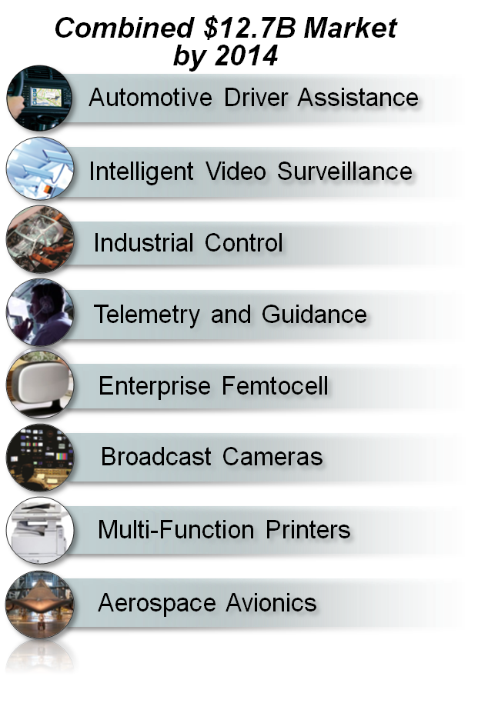

Embedded Designers are Asking For More
More than a processor delivers…
More than an ASIC or ASSP delivers…
More than an FPGA delivers…
Notes:
The programmable imperative is great, but the challenge in an FPGA for volume applications is to deliver the capacity at the power and cost of the ASIC and ASSP.

Slide 4
Embedded Processing Needs and Limitations
The Need
Higher Performance
Lower Cost
Lower Power
Smaller Form Factor
Greater Flexibility
The Limitations
Microprocessors have insufficient signal processing
Multiple chip implementations are too expensive
Multiple chip implementations burn too much power
Multiple chip implementations take up too much room
ASICs/ASSPs cannot adapt to rapid changes in requirements and provide completive differentiation
Notes:
PowerPC was the right choice at the time…

Slide 5
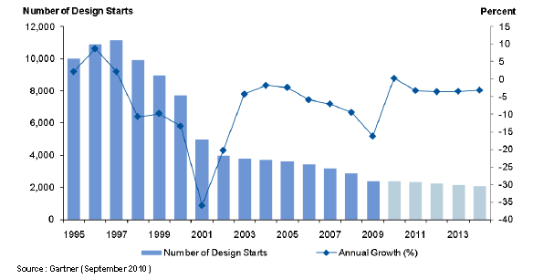
ASIC Starts Continued Drop
Fueling the Programmable Imperative

Slide 6
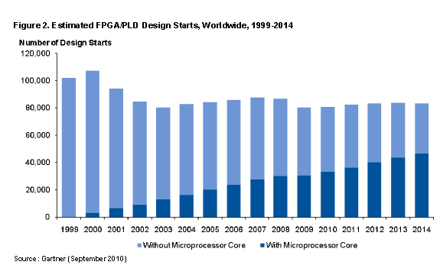
Increasing Demand for Processing in Reconfigurable Platforms

Slide 7

PROCESSOR CORE TRENDS

Slide 8
Increasing Design Costs

Slide 9
Embedded Processing Design Considerations

Slide 10

Embedded Design Considerations
Architect
  Architecture and Processor selection
  HW and SW Partitioning
Software Developer
  Waiting for HW Before SW Development
  Tools support
  Code Optimization
  HW/SW Co-debug
HW Designer
  Processing System Development
  Hand-crafting RTL for Parallel DSP Acceleration
  IP Availability and Integration from Multiple Sources
  Cross-domain development / debug

Slide 11
What’s Needed in Embedded Processing Systems
Key Requirements
Higher Performance with
Lower System Power
More Integration with
Reduced System Cost
Increased Scalability
IP Inter-operability
Design Re-use
Ease of Programming
Extensive Ecosystem
Improved Products
Increased Productivity
Notes:
Need full range of embedded product line – not just processors in high end chips
Need unified architecture – across device families so make it easy to migrate both SW and HW across diff levels of product
Need to raise design abstraction – like LabView offering from NI, ESL, other
Need to free designers from having to reinvent what is already proven to go beyond that

Slide 12
Extensible Processing Platform Examples

Slide 13
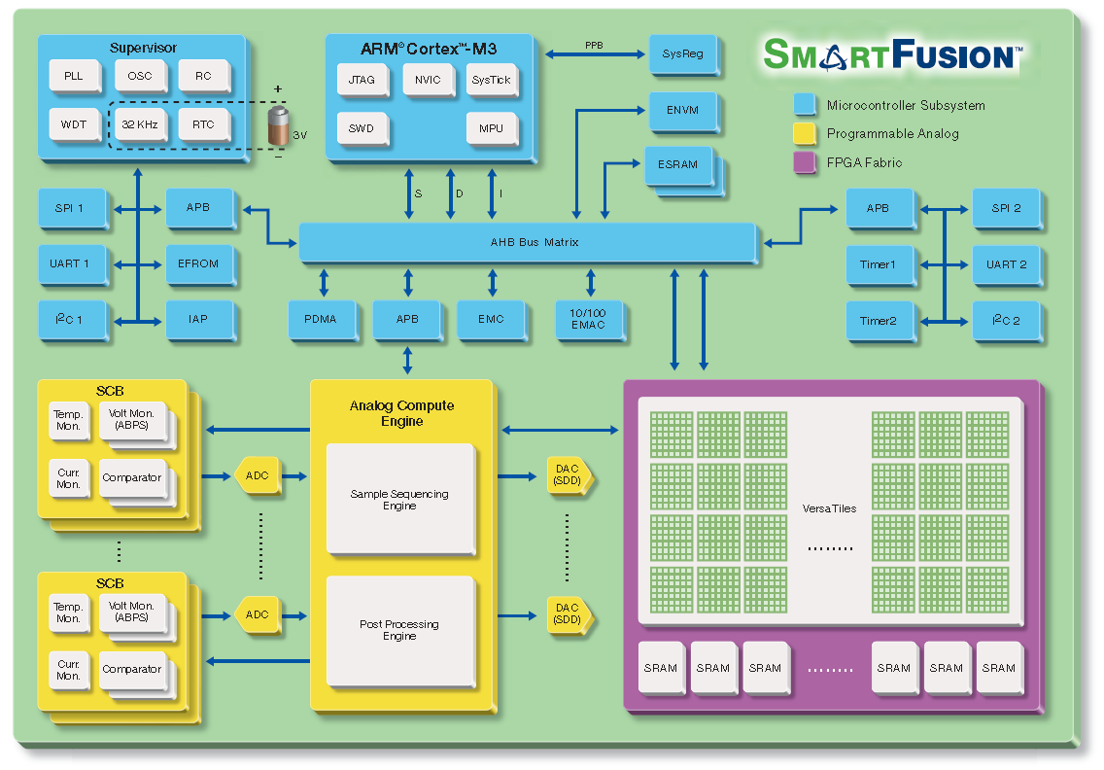

Smart Fusion from Mircosemi
Notes:
FPGA +ARM Cortex-M3
Analog and Digital Mixed signal FPGA.
Secure flash IP
Kiel + IAR Systems and GNU
Micrium

Slide 14
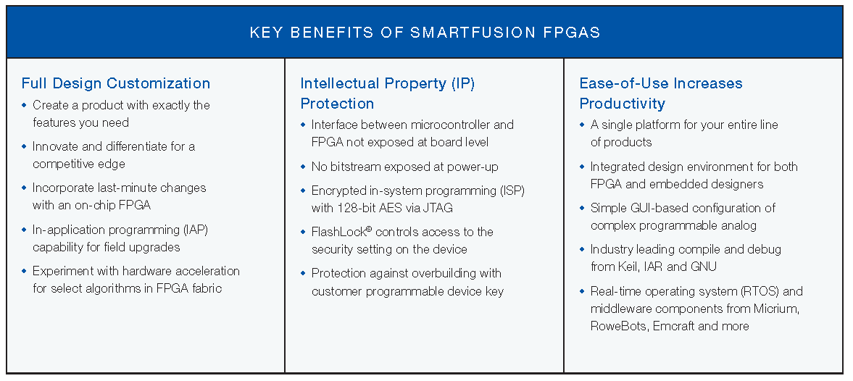
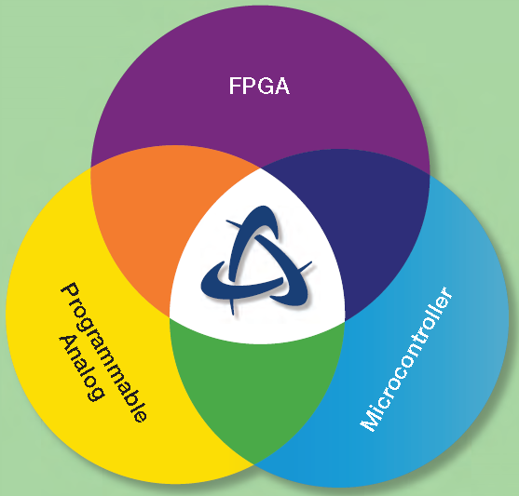
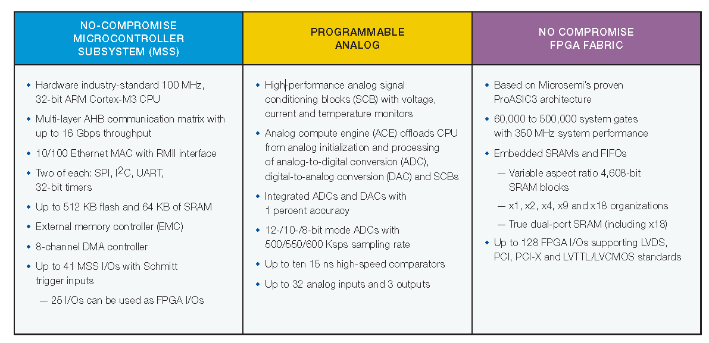
More than a Microcontroller

Slide 15
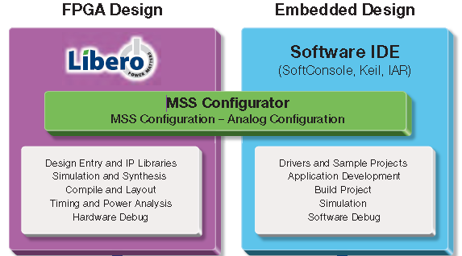
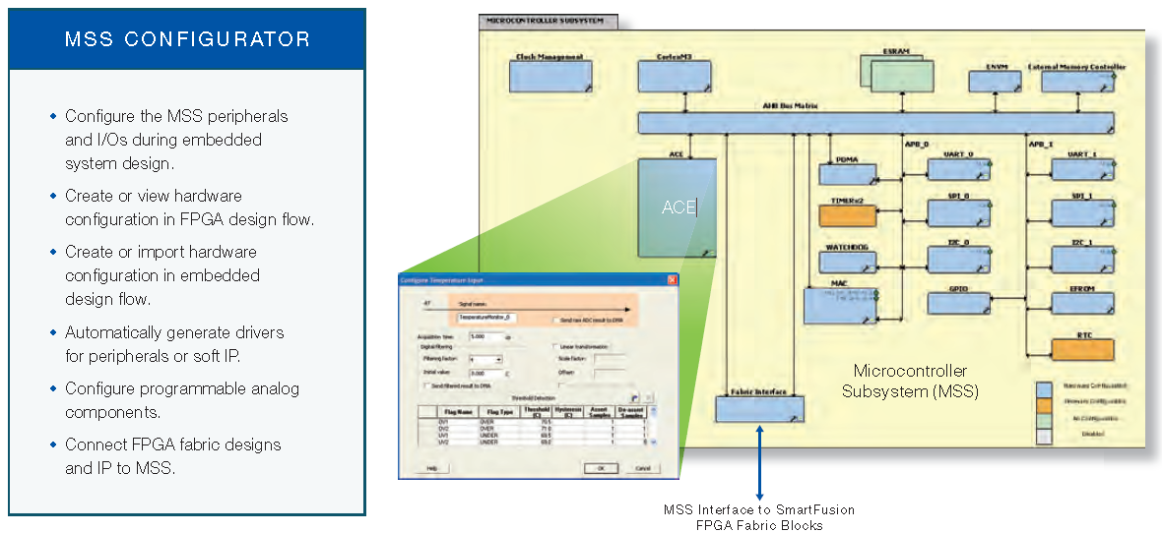
Tools Flow with Processing Configurator and IP
Notes:
Embedded Design: Softconsole Eclipse based IDE
FPGA design : Libero IDE
Analog Design: MSS configurator Grapical based configuration

Slide 16
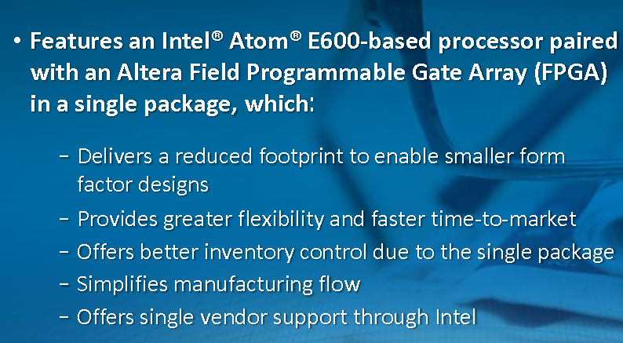
Intel Atom E600 Series paired with FPGA
Notes:
Arria GX2 FPGA
Provide gate count and features..

Slide 17
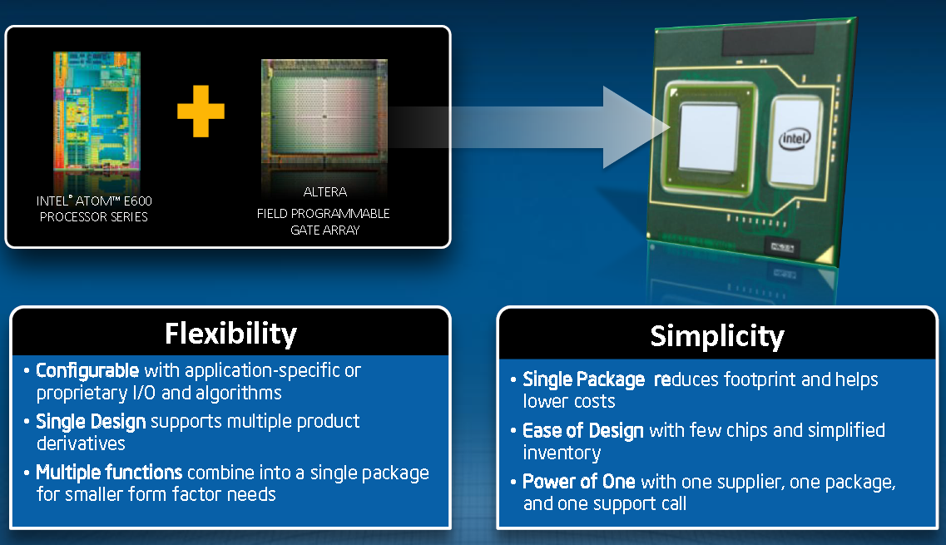

Intel Atom with FPGA Fabric

Slide 18
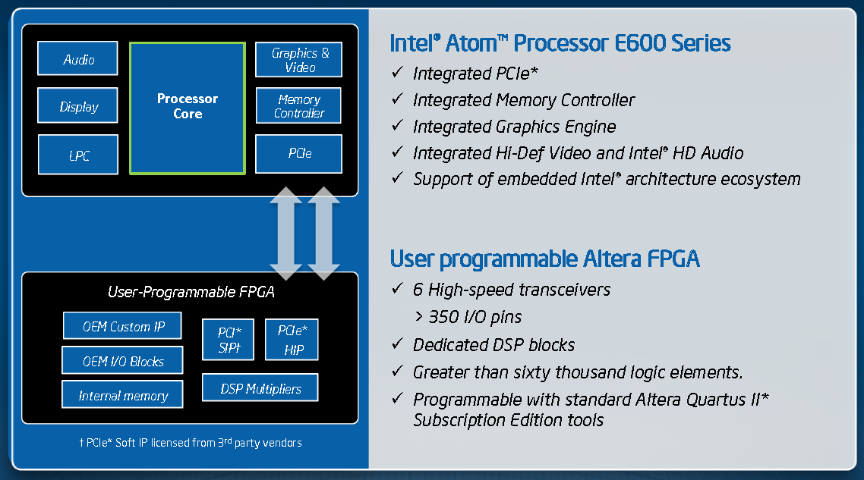
Intel Atom E600 Series with FPGA Fabric

Slide 19
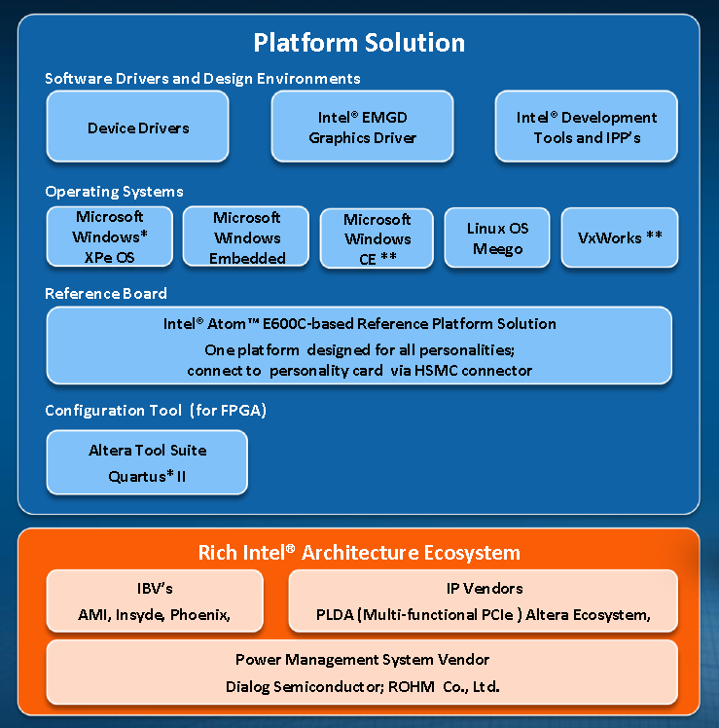
Intel Platform Solution

Slide 20

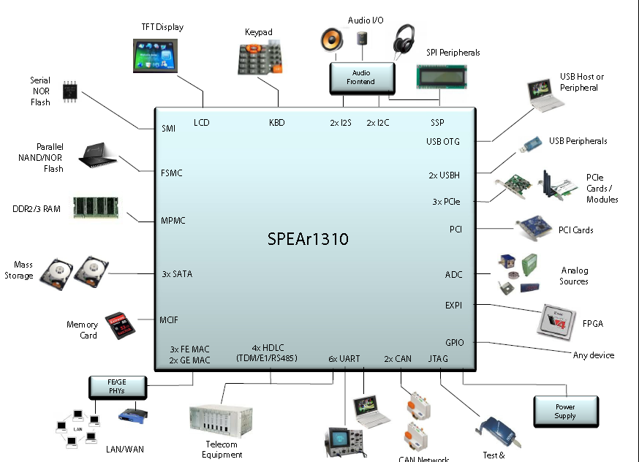
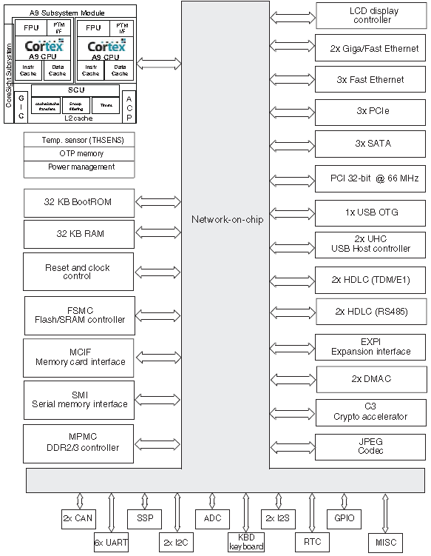
SPEAr 1310 –One Time Programmable ASSP
Notes:
Dual _ARM

Slide 21
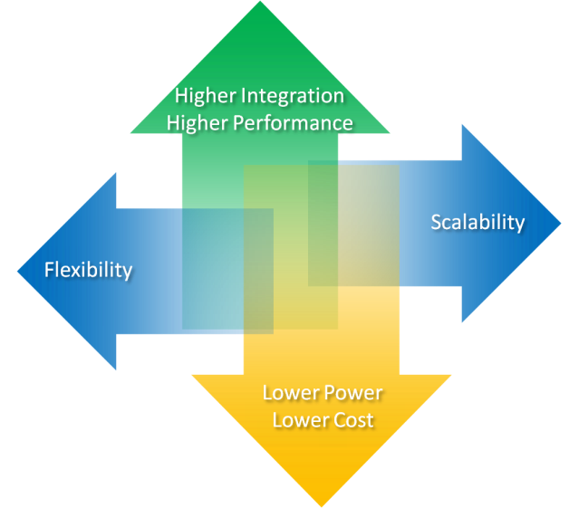
Current Selections Equal Compromise
 | ASIC | ASSP | 2 Chip Solution
Performance | + | + | .
Power | + | + | -
Unit Cost | + | + | -
TCO | . | + | +
Risk | - | + | +
TTM | - | + | +
Flexibility | - | - | +
Scalability | - | . | +
+ = positive, - = negative, . = neutral
Conflicting Demands Not Served

Slide 22
New Class of Product
Extensible Processing Platform
Extensible Processing Platform
Processing System
Hardwired SoC
High Performance
Low Power, Low Cost
Boots OS at Reset
Memory Interfaces
Additional
Peripherals
Off the-
Shelf
ARM®
Dual Cortex™-A9MPCore
Complex
ARM
Dual Cortex-A9 MPCore
Complex
Common Peripherals
Custom
High-Bandwidth
AMBA-AXI Interfaces
Programmable Logic for Extensions
Rapid Differentiation
High Performance, Scalable
Programmed by Processor
High Performance, Reconfigurable,
Application Optimized Accelerators
Off the-
Shelf
Custom

Slide 23
Zynq-7000 EPP Family Highlights
Complete ARM Processing System
  Dual ARM® Cortex™-A9
  Integrated Memory Controllers & Peripherals
Tightly integrated Programmable Logic
  Extends Processing System
  Scalable density and performance
  Over 3000 Internal Interconnects
Flexible array of I/O
  Wide Range of external Multi Standard I/O
  High Performance integrated serial tranceivers
  Analog-to-Digital Converter inputs
Processing
System
Memory
Interfaces
7 Series
Programmable
Logic
Common
Peripherals
ARM®
Dual Cortex-A9 MPCore™
Common Peripherals
Custom
Peripherals
Common Accelerators
Custom Accelerators
Software & Hardware Programmable

Slide 24
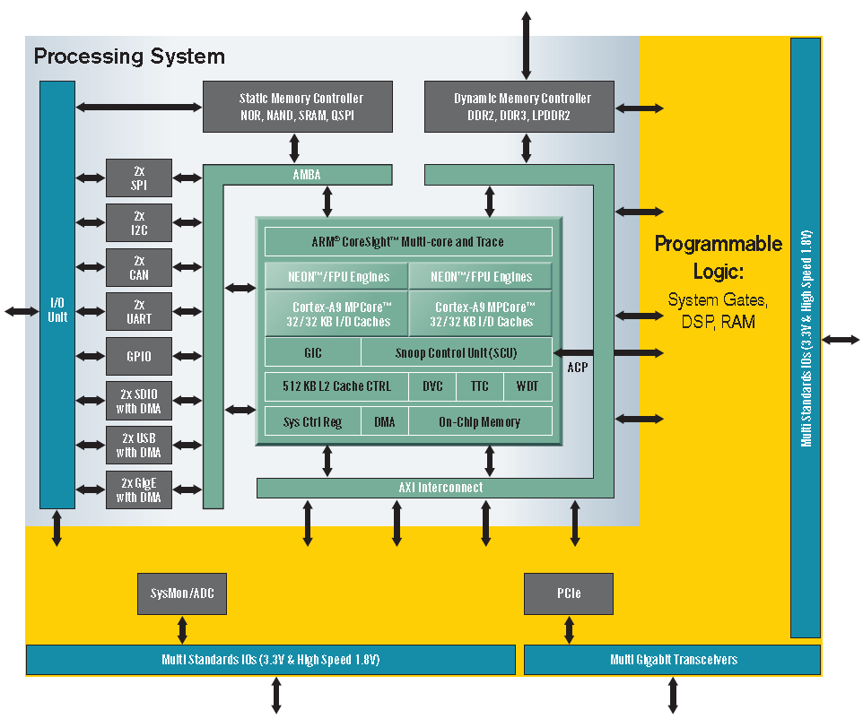
Emulation of an Extensible Processing Platform

Slide 25
Zynq-7000 EPP Device Portfolio Summary
 | Zynq-7000 EPP Devices | Z-7010 | Z-7020 | Z-7030 | Z-7040
Processing System | Processor Core | Dual ARM® Cortex™-A9 MPCore™
 | Processor Extensions | NEON™ & Single / Double Precision Floating Point
 | Max Frequency | 800MHz
 | Memory | L1 Cache 32KB I / D, L2 Cache 512KB, on-chip Memory 256KB
 | External Memory Support | DDR2, DDR3, LPDDR2, 2x QSPI, NAND, NOR
 | Peripherals | 2x USB 2.0 (OTG), 2x Tri-mode Gigabit Ethernet, 2x SD/SDIO, 2x UART, 2x CAN 2.0B, 2x I2C, 2x SPI, 32b GPIO
Programmable Logic | Approximate ASIC Gates | ~430K (30k LC) | 1.3M (85k LC) | 1.9M (125k LC) | 3.5M (235k LC)
 | Extensible Block RAM | 245KB | 573KB | 1,085KB | 1,904KB
 | Peak DSP Performance (Symmetric FIR) | 58 GMACS | 158 GMACS | 480 GMACS | 912 GMACS
 | PCI Express® (Root Complex or Endpoint) | - |  | 1x Gen2 x4 | 1x Gen2 x8
 | Analog to Digital Converters (ADC) | Dual 12bit 1Msps A/D Converter
I/O | Processor System IO | 130
 | Multi Standards 3.3V IO | 100 | 200 | 100 | 200
 | Multi Standards High Performance 1.8V IO | - |  | 150 | 150
 | Multi Gigabit Transceivers | - |  | 4 | 12

Slide 26
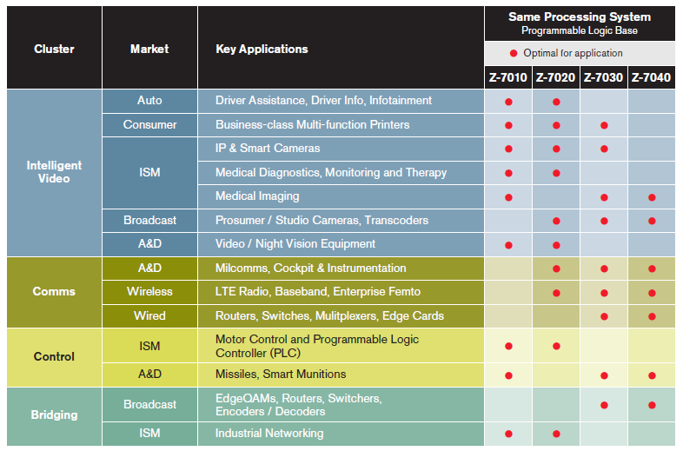
Application Mapping Table

Slide 27
Zynq-7000 EPP Platform Offering
Applications
Libraries & APIs
Custom
OS BSP’s
OS Kernel
High Level and Low Level Drivers
Reference Design & Board
Partners
Processing System
Programmable Logic
Xilinx
Silicon
Simulators
SW Development
Tools
SW & HW IP
IDS
More than just Silicon: A Comprehensive Platform Offering

Slide 28
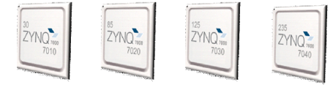
Embedded Design Flow Using Zynq-7000 EPP
System
Architect
Software
Developer
Hardware Designer
Industry-Leading Tools
  Xilinx SDK
  ARM Ecosystem
Many Sources of SW IP
  Xilinx, ARM libraries
  3rd Parties
Industry-Leading Tools
  C-Gates / AutoESL
  System Generator
  VHDL/Verilog
Many Sources of
HW IP
  Standardized around AXI
  3rd Parties
Programming
Design
Custom IP
Integrate IP
Xilinx IP
Integrate IP
Partner IP
Test
Test
Debug
Debug
Accelerates Application Development and TTM
Notes:
Unified architecure.

Slide 29










Zynq-7000 EPP SW Development Environment
Widely used ARM
development environment
  Easily migrate code already
  developed for ARM-based systems
ARM ecosystem support
  ARM
  Xilinx Software Development Kit
  other 3rd Parties
Vast off-the-shelf SW and Libraries
  Open source
  Commercially available
Applications
Libraries & APIs
Custom
OS BSP’s
OS Kernel
High Level and Low Level Drivers
Processing System
Programmable Logic
Silicon

Slide 30






Zynq-7000 EPP HW Design Environment
Xilinx ISE Development Suite
  Embedded Edition
  AutoESL HLS Support
Plug & Play IP Portfolio
  AXI Enabled
Hardware abstraction layer
  Simplifies interface between Cortex-A9 and custom accelerators/peripherals
Drivers and APIs
  Provided for a common set of accelerators for key applications
Applications
Libraries & APIs
Custom
OS BSP’s
OS Kernel
High Level and Low Level Drivers
Processing System
Programmable Logic
Silicon

Slide 31
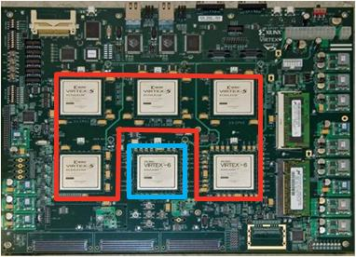
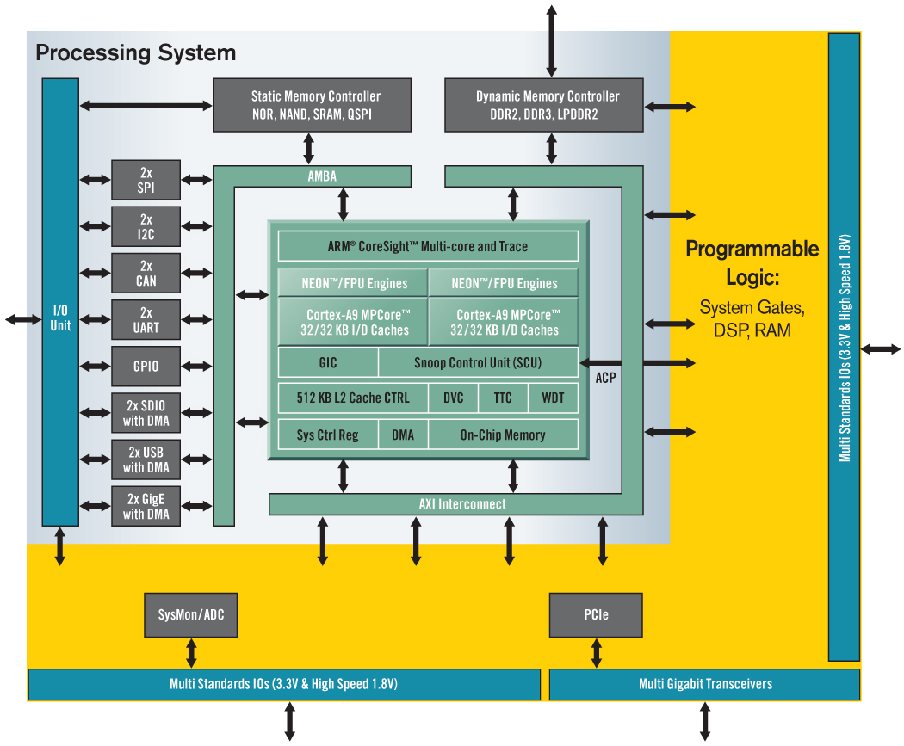
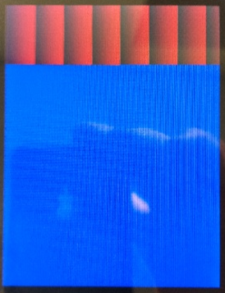

Image Processing Example – System Validation
Android 2.2 based multi channel video processing
Image enhancement with ARM Dual Cortex-A9
System interoperability w/ AMBA AXI IP & FMC display
Emulation Platform
Camera Link Interfaces
iVeia FMC Daughter Card
Touch Screen
3.5” LCD
640x480

Slide 32
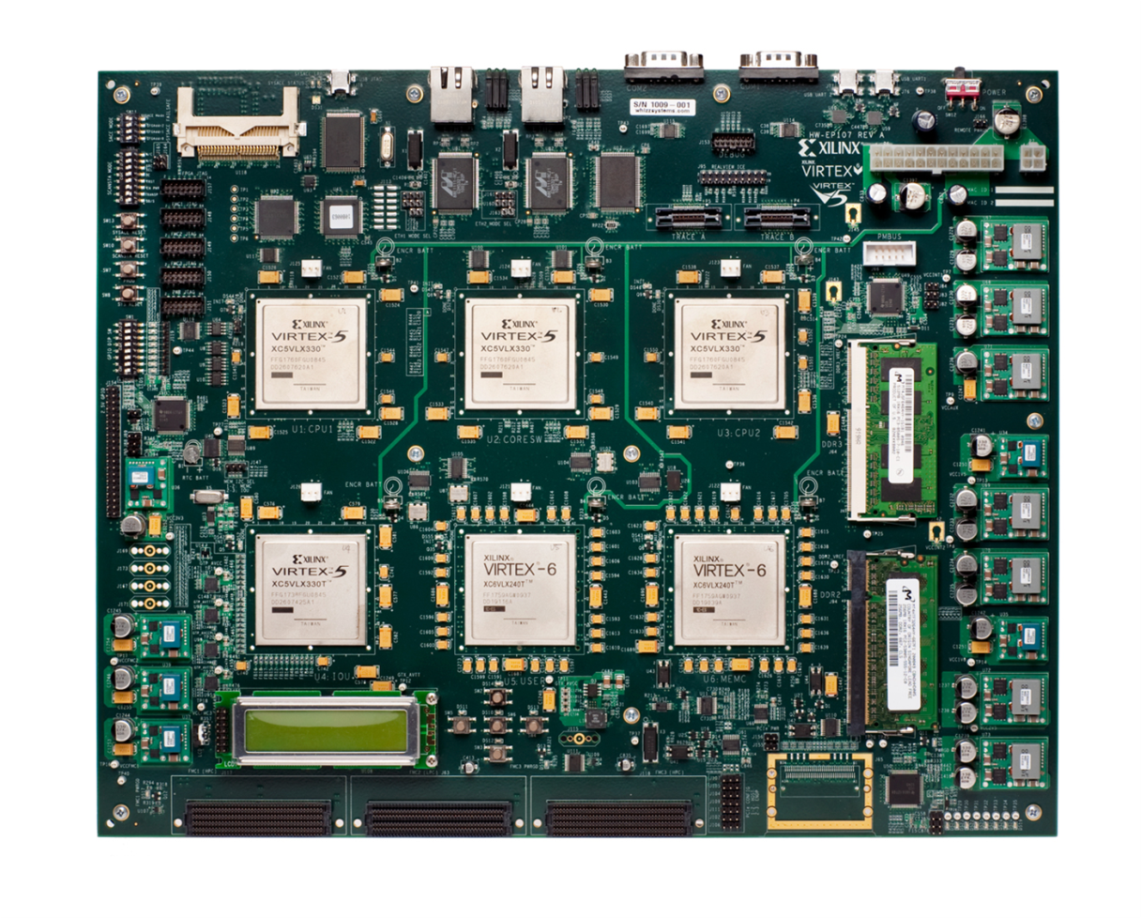
Significant Head Start
Emulation Platform: Alpha Participants
  First systems delivered ~ 6 months ago
  Customers & Partners already completed development of SW, HW IP own daughter cards
Customer and Partner Efforts
  Android Handheld
  Driver Assistance
  OS port w/ CAN and GigE
  Real Time Linux applications
  Custom AXI IP blocks
  3rd party GNU & Debugging tools
  and more…

Slide 33
Conclusion

Slide 34
Zynq-7000 EPP Value Proposition
 | ASIC | ASSP | 2 Chip Solution | Zynq-7000
Performance | + | + | . | +
Power | + | + | - | +
Unit Cost | + | + | - | .
TCO | . | + | + | +
Risk | - | + | + | +
TTM | - | + | + | +
Flexibility | - | - | + | +
Scalability | - | . | + | +
+ = positive, - = negative, . = neutral
Conflicting Demands Now Served by Zynq-7000 EPP

Slide 35
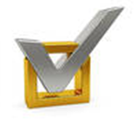
What’s Needed in Embedded Processing Systems
Key Requirements
Higher Performance with
Lower System Power
More Integration with
Reduced System Cost
Increased Scalability
IP Inter-operability
Design Re-use
Ease of Programming
Extensive Ecosystem
Improved Products
Increased Productivity
Notes:
Need full range of embedded product line – not just processors in high end chips
Need unified architecture – across device families so make it easy to migrate both SW and HW across diff levels of product
Need to raise design abstraction – like LabView offering from NI, ESL, other
Need to free designers from having to reinvent what is already proven to go beyond that

Slide 36
Zynq-7000 ARM Processing System
Processor Core Complex
  Dual ARM® Cortex™-A9 MPCore™ with NEON™ extensions
  Single / Double Precision Floating Point support
  Up to 800 MHz Operation
High BW Memory Interfaces
  Internal
  L1 Cache – 32KB/32KB
  L2 Cache – 512KB Unified
  On-Chip Memory of 256KB
  Integrated Memory Controllers (DDR2, DDR3, LPDDR2, 2xQSPI,
  NOR, NAND Flash)
Open Standard Interconnect Enabled by AXI
  High Bandwidth Interconnect
  between Processing System and Programmable Logic
  ACP port for enhanced Hardware Acceleration and cache coherency
  for additional Soft processors
Integrated Memory Mapped Peripherals
  8 DMA Channels
  2x USB 2.0 (OTG) w/DMA
  2x Tri-mode Gigabit Ethernet w/DMA
  2x SD/SDIO w/DMA, 2x UART, 2x CAN
  2.0B, 2x I2C, 2x SPI, 32b GPIO
Processing System Ready to Program

Slide 37
Tightly Integrated Programmable Logic
Built with State-of-the-art
7 Series Programmable Logic
  28K-235K logic cells
  430K – 3.5M equivalent ASIC gates
Over 3000 internal Interconnects
  Up to 100Gb of BW
  Memory-mapped
  interface
Integrated ADCs
  Dual 12-bit A/D converter
  Up to 1Msps
Enables Massive
Parallel Processing
  Up to 760 DSP blocks
  delivering over 910 GMACs
Scalable Density and Performance

Slide 38
Flexible External I/O
54 Processor I/O
  Supports integrated peripherals
  Static Memory (NAND, NOR,
  QSPI)
Flexible Memory Interfaces
  32 bit DDR2 / DDR3 / LPDDR2 Memory Interfaces
High Performance Integrated Serial Tranceivers
  Up to 12 Transceivers
  Operates at up to 10.3Gbs
  Supports popular protocols …
  Integrated PCIe Gen2 block in the
  2 Largest devices
350 Multi-standard and
High Performance I/O
  Up to 200 3.3V capable
  Multi-standard I/O
  Up to 150 High Performance I/O
  Up to 17 ADC Inputs
Flexibility Beyond Any Standard Processing Offering

