Slide 1
Developing Cutting edge Embedded Applications for Consumer Electronics
Global Embedded Conference India 2011
May 21st 2011
R.V. Raman

Slide 2
Contents
What is cutting edge?
Consumer Electronics Market
Consumer electronics trends
Key aspects of cutting edge apps
How to Develop cutting edge apps?
Summary

Slide 3
Cutting Edge
Out of the box
Unique
Advanced
Artistic work
Developed by expert people in a particular field

Slide 4
Consumer Markets
Highly volatile and dynamic
Fragmented
Low entry barrier
Convergence at its best!
Today a new or a high end feature will be mandatory feature down the line
Technology and pricing is playing key role

Slide 5
Consumer Electronics trends
Internet changing consumer electronics world
More and more devices are getting connected
Online Video watching
Watch your content anywhere anytime on any device
Cloud based video service
Apple is preparing to launch far reaching Video service

Slide 6
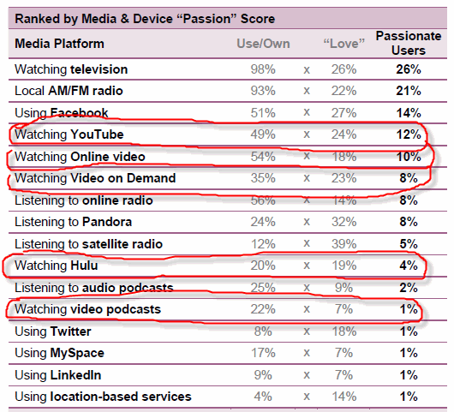
Online Video watching
Courtesy: Media & Device Reach

Slide 7
Key Aspects of cutting edge embedded apps
‘Cool’ features
Some from trends and some out of box ideas
Right technology
Matured and provide the right benefits
Hitting the market at the right time
Is there something like ‘right time’?
Right people

Slide 8
Development aspects of cutting edge apps

Slide 9
Cutting edge apps - Features
Right set of features
Are they ‘cool’ enough?
Easy to use with simple steps
Just works, no hassles
‘WoW’ effect
Out of the box
Never expected
How to identify these features?
Traditional requirement engg will help?
Play around with new ways of doing things, create small prototypes
Solving a specific problem (only for few consumers to start with)
Domain expertise

Slide 10
Cutting edge apps - Technology
Choosing the right technology and platform
Chip capabilities in case of Hw dependency
Open platform or closed
Technology maturity and availability
Scalability: Ready to deploy in mass markets
Price point
Will it help to sell volumes at some stage?

Slide 11
Cutting edge apps – Dev Lifecycle
Agile methodologies
Rapid time to market
Right quality
Ability to change and improvise continuously on features
Light weight framework
Does not burden the development team

Slide 12
Cutting edge apps - People
Ready to explore
No standard ways of doing
Don’t need hackers!
Risk takers
Things may not work first attempt!
Attitude to change and adapt
Course corrections
A Sense of never give up

Slide 13
Summary…
There is a big market for cutting edge apps
Consumers have appetite to try out new things
These apps can be developed systematically
No longer that few companies can do this!

