Slide 1
Session 2: Industrial Smart Grid and Metering: Challenges in developing Smart Meters
Global Embedded Conference India
Saturday, 21st May, 2011

Slide 2
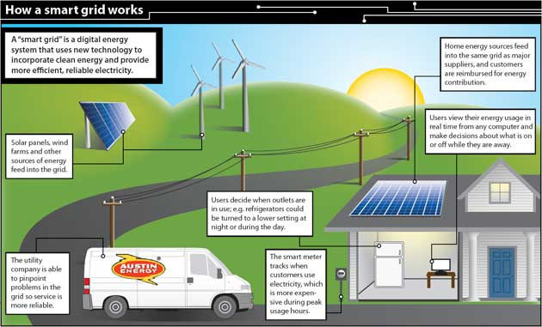
Smart Grid
A smart grid is a form of electricity network using digital technology. A smart grid delivers electricity from suppliers to consumers using two-way digital communications to control appliances at consumers' homes; this could save energy, reduce costs and increase reliability and transparency
Smart metering, forms a part & pre-requisite of larger Smart Grid concept.
In Smart Grid implementation Gov/utilities are considering overall improvement of
efficiency/quality of supply
reducing carbon footprnt
managing peak demand
facility to include distributed &
large number of renewable energy
Sources (wind, solar..) in grid..,
total remotely manageable devices
Source: http://www.theenvironmentalblog.org/wp-content/uploads/2009/03/smart-grid.jpg

Slide 3
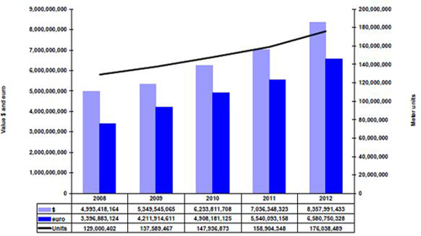
Smart Meters
Energy meter is a device that measures the amount of electric energy consumed by a residence, business, or an electrically powered device. Electricity meters are typically calibrated in billing units, the most common one being the kilowatt hour.
First energy meter was produced during 1889, Earlier meters were based on electromechanical form, using an induction disk whose rotational speed was made proportional to the power in the circuit.
But now the industry is moving towards smart meter. In few countries, they are installed and in few countries they are mandated to install over some period 2013 to 2020.
Meter Demand Projection between 2008-2012.(Source ABS Energy Research)

Slide 4

Why Smart Meter?
Improve consumers’ ability to monitor and control their electricity use, potentially allowing for cheaper and more efficient energy use
Reduce the overall maintenance cost to service providers
The basic elements of a Smart Utility Meter are the same as those of a Basic Utility Meter. However, the Smart version differs from the Basic one in terms of its
capability to communicate more efficiently with the outer world,
ability to control and monitor individual appliances,
more processing capabilities and memory,
enhanced tamper protection and security features

Slide 5
Why smart meter design is challenging?
No more the energy meters are providing just energy consumed. They are becoming a ‘data points’
The metrology function in the meter measures and computes instantaneous power, and time-integrated energy use of the end-user
The advanced metrology function processes, and transforms this measurement data into a series of metrological quantities.
Notes:
5

Slide 6
Data Points
Smart meters measures or creates following data points
Import and export of electricity, both billing rates could be different
Current RMS voltage/current value, min/max voltage/current over period
KW imported/exported, KWArQ1,2,3,4, KWA
Active energy imported/exported, Reactive Energy 1Q, 2Q, 3Q, 4Q, Net active energy (active energy received – delivered)
Demand, Min/Max demand
Apparent energy values
Min/Max power factor (leading/lagging)
Firmware also supports
Pulse output to indicate consumption of active or reactive power
Time of Use
Load profile
Calendar based activity scheduler
Remote disconnect
Event logger
What do these data points means to the system design?
Need high performance CPU
Better memory at lower cost
Real time operating system
Optimized foot prints
Smart meters are having over 100MHz processor speed, 256K flash, 128K RAM memory

Slide 7
Challenge in developing Smart Meter
Mixed Development Approach: NPI, Value Engg, Re-engg, Reverse Engineering
Manufacturability
Regulatory Standards
Convergence of Technologies
Reliability
Notes:
7

Slide 8

Mixed Development Approach
The key development is becoming a mix of NPI, re-engineering, value engineering and Reverse Engineering with aggressive time lines.
NPI – in some cases, the product packaging may not be available, and concepts needs to be created, this cycle needs creative knowledge as well as ability to create many options
Re-engineering – the company which develops the meter has the knowledge and basic design of meter which it in turn try to reuse the block which are reusable
Value Engineering – smart meter products are having aggressive target cost, Typically the value engineering programs in other domains like automotive are taken up on the product which are generally built already, with clear target for material, process reduction targets the value engineering is addressed. But in case of smart meters, the value engineering has to be performing along with main product development.
The typical cost target for finished electronics with all components including the printed circuit board is less than USD 10, with additional USD8 for PLC cost of component.
The typical cost target for finished mechanical enclosure with all components including the fastners is less than USD5. Even the typical product assembly time is expected to be less than 6 mins.

Slide 9

Convergence
Convergence – meters are expected to have features like Zigbee, WiFi, GPRS, display console, tilt detection (accelerometer), data storage etc.,
Most of these features are common among the consumer products. So there is a kind of convergence being happening between communication, consumer and industrial product.
Some of these interfaces are proven working in consumer market, but in industrial environment these interface can impact the performance of the core meter functionality.
Also some of these interfaces need higher processing power at lower cost.

Slide 10

Manufacturability
Manufacturability – the volume being high, the manufacturability is another key aspect of the smart meter product development.
Both tool based or manual method to cross verity the manufacturability can be followed.
Typical manufacturability issue may lead to spin, each spin cost material as well as schedule slip.
It is preferable to initiate 2nd spin itself at customer preferred EMS facility (early migration to EMS) to know the issues related to manufacturability.

Slide 11

Reliability
Reliability – Since the very beginning meters are high reliable electromechanical meters, the expectations of smart energy meters are higher than earlier meters,
the product development cycle needs to include the reliability estimation/analysis and testing.
The typical reliability expectation is are over 15 to 20 years

Slide 12

Regulatory
Regulatory Standards – expectation is to meet many standards like UNE-EN 62053/2/4/8-xx, 62056-xx, these standards calls for a list of test and equipment needs to meet the performance while the test being conducted.
The energy meter design needs to consider the protection mechanism against these test pulses or conditions.
Typical failure on regulatory will lead to respin, each spin cost one material as well as timelines of the development.
Since the number of test being higher, the lab infrastructure planning has to be well taken to avoid the risk of not meeting the deadlines.

Slide 13
Conclusion
In summary
Smart meter development will demand for high quality, low cost, reliable, manufacturable, certified product within short time
Hybrid development approach would help in development
With additional focus on cost, manufacturability, reliability and regulatory demands

Slide 14


Slide 15
Thank You

