Slide 1
iPad Games
“Touching the World on the Other Side of the Glass”
By Sri Satish Mavuri

Slide 2
What’s iPad?
Games
Web
iPad
Media
Applications

Slide 3
Games

Slide 4
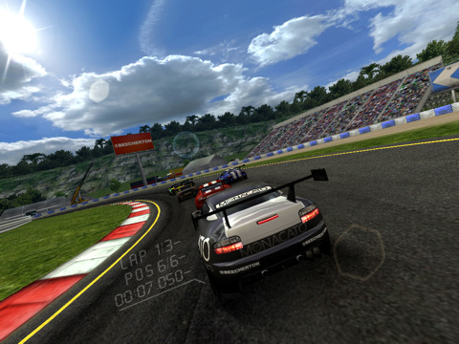
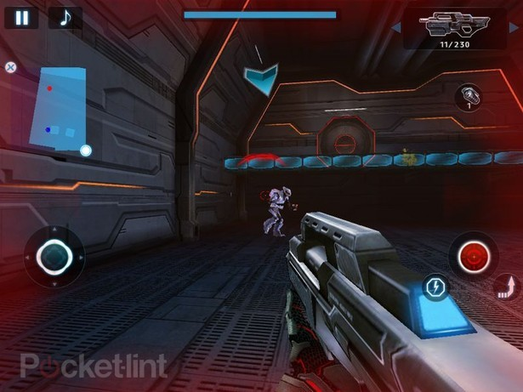
Games

Slide 5
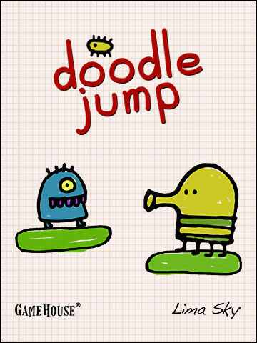
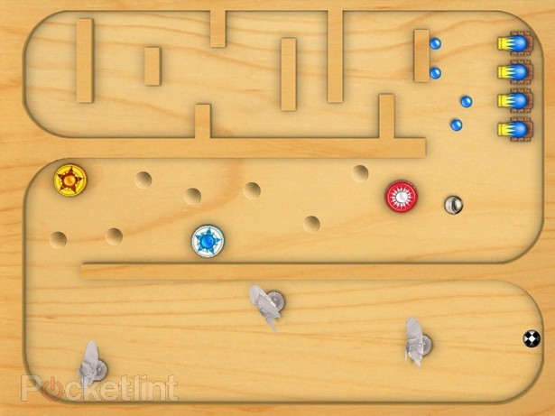
Casual Gaming

Slide 6
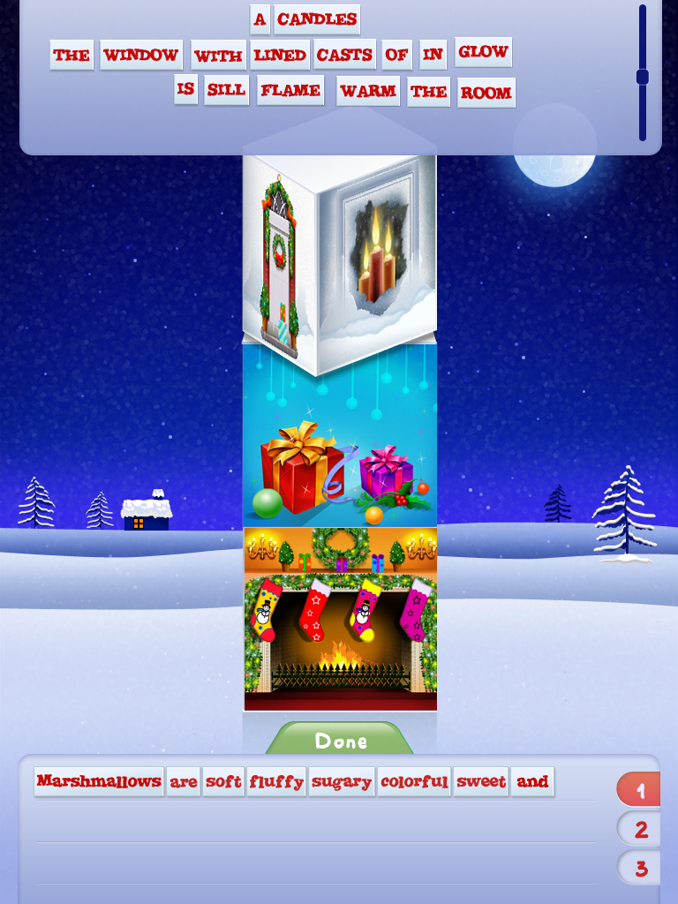
Learning & Games

Slide 7
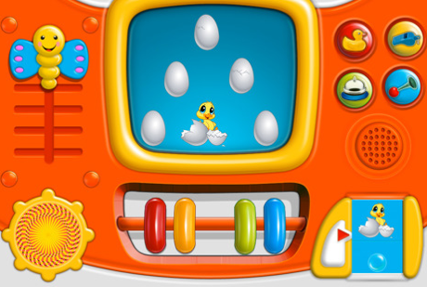
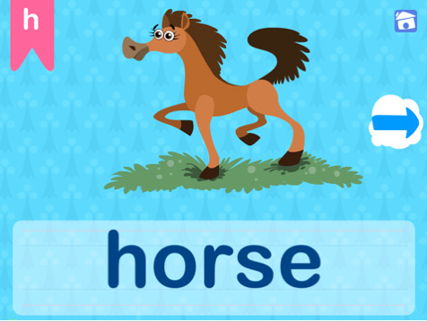
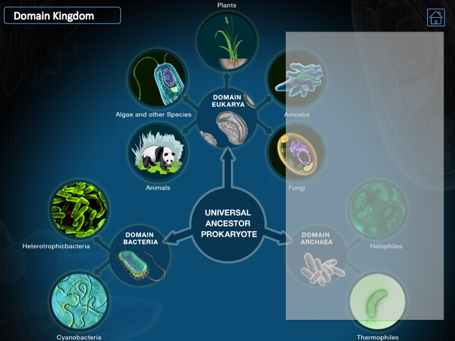
Learning & Games
1. Preschool
Under 6 years
2. Elementary School
5 to 11 years ( K - 5 )
3. Middle School
11 to 14 years (Grade 6 - 8)
4. High school
14 to 18 years (Grade 9 - 12)
5. Post - secondary
18 to 23 years (College/ University)

Slide 8
Preschool
Learning & Games

Slide 9
Elementary School
Learning & Games

Slide 10
High School
Learning & Games

Slide 11
Frog Dissection
Learning & Games

Slide 12
Learning & Games

Slide 13
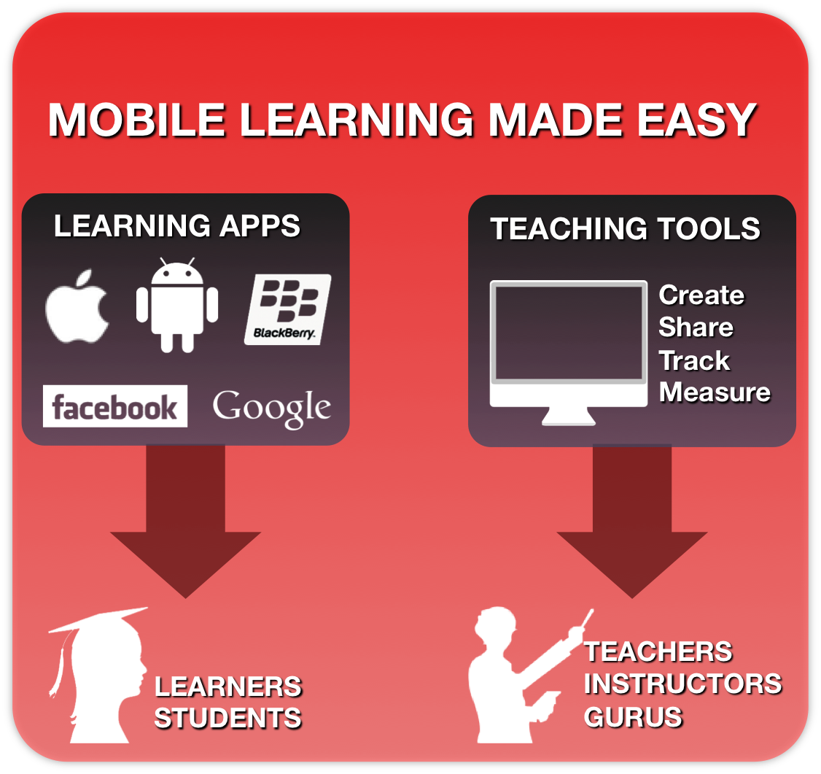
College/University
Learning & Games

Slide 14
Developers
XCode
Objective C
iOS 4.3 SDK
IDE
Instruments
Version Controller
C / Smalltalk
Object-Oriented
Cocoa API
Frameworks
Interface Builder
Intel Mac & Mac OS X Snow Leopard
Help

Slide 15
Developers
iPod/iPhone
iPad
Universal
480 X 320
Landscape/ Portrait
Retina Display
1024 X 768
Split Views
High Performance
One Build. Two Targets.

Slide 16
Developers
Graphics
Sound
3rd Party Tools
OpenGL ES
Core Graphics
OpenAL
AVFoundation
Unity 3D
Cocos2D
Box 2D

Slide 17
Developers
Profiles
App Store
Apple
Developer
Ad-hoc
Distribution
Free Apps
Paid Apps
In-App purchase
Testing
Promotion
Charts
$99/annum

Slide 18
Summary

Slide 19
Thank You!
Sri Satish Mavuri
Project Lead ( iOS Dev)
Emantras Inc.
srisatish.m@emantras.in

