Slide 2
First 3D Game | 1981
Image Courtesy

Slide 3
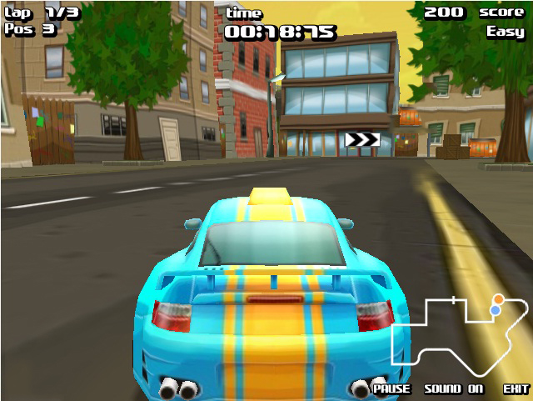

Slide 4
Native 3D Support
2. NVIDIA PhysX Support
3. Flash 9 Support

Slide 5
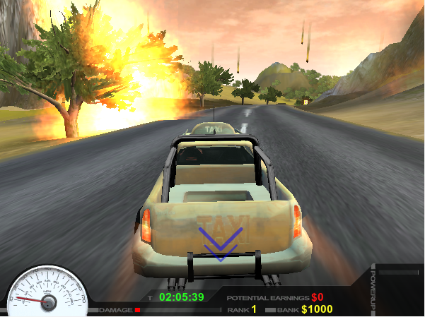

Slide 6
Native 3D Support
2.iPhone and Android Support
3. NVIDIA Physx and Ragdoll Wizard
4. Supports JS,C# and Boo

Slide 7
Silverlight 4
3D Engine support from Balder and Kit3D (among others)
2. Windows Phone 7

Slide 8
Silverlight 5
1. Releasing end of 2011
2. Native 3D Support, GPU Accelerated

Slide 9
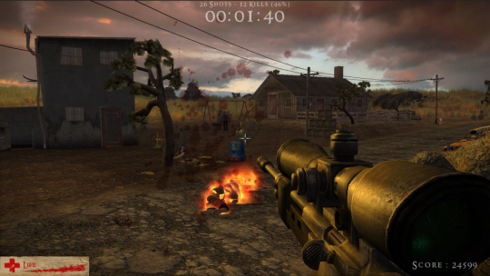

Slide 10
1. Native 3D support
2. Windows, Mac,Linux,iPhone/Pad Android and WebOS
3. Browser supoort, Mozilla, IE, Safari

Slide 11
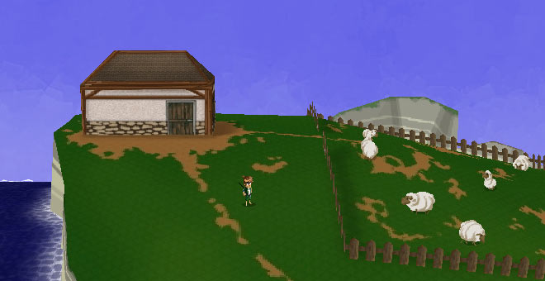

Slide 12
1. No Native robust 3D engine
2. 3D Support available from PV3D and Away3D among others like Coppercube ,Alternativa3D

Slide 13
MOLEHILL
1. Low level GPU accelerated 3D APIs
2. Molehill will rely on DirectX 9 on Windows and OpenGL 1.3 on Mac OS X and Linux
3. Hundreds of thousands of z-buffered
triangles to be rendered at HD resolution in full screen
at around 60H

Slide 14
Saagar Dhoke
saagar.dhoke@funelement.co.in

