Slide 1
Balancing Fun and Frustration in Puzzle Design

Slide 2
Fact sheet
Apargames fact sheet
Mumbai based studio
Operational since 2007
Services :
Online game development
Game art outsourcing
Advergame development
Smartphones and tablet

Slide 3
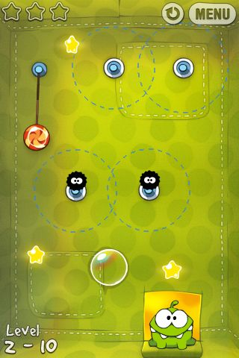
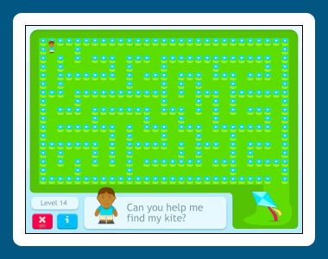
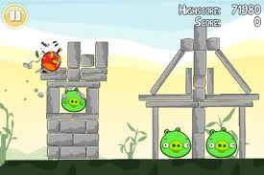
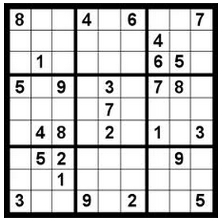
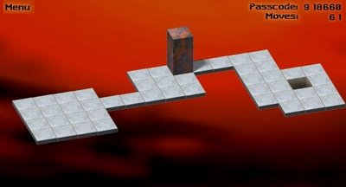
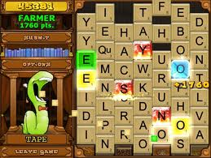
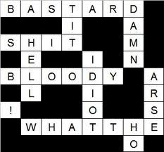
Type of Puzzles by domain and Gameplay
Physics (Angry Birds, cut the rope),
Mathematics (arithmetic, logic, space)
Language (crossword, Bookworm, Scrabble)

Slide 4
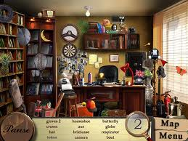
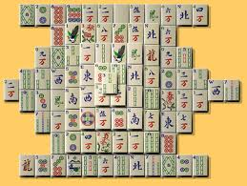
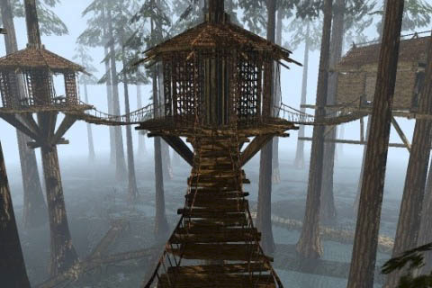
Type of Puzzles by domain and Gameplay (cont...)
visual field (spot-the-difference and hidden-object puzzles, majong, jigsaws )
common sense and situations (Action-Adventure)
Notes:
Pull the leaver, get the lift, climb it up etc.

Slide 5
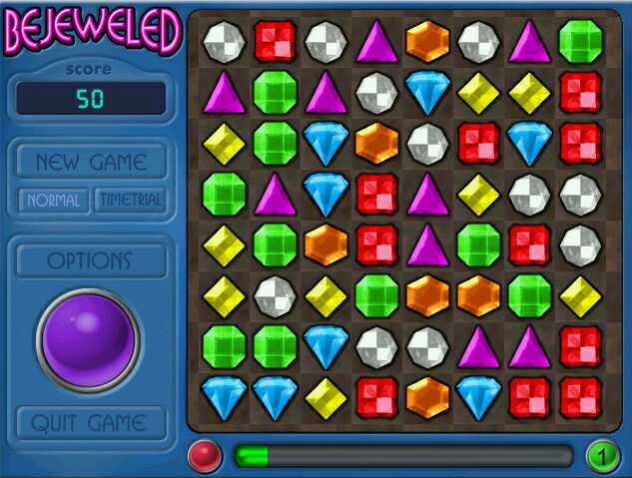
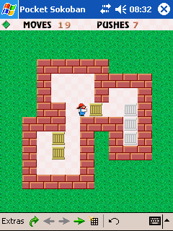
Types of puzzle By game designing method
Procedural puzzle games (Tetris or Bejeweled)
Level designed (Sokoban)
Combinatory (Braid)

Slide 6
What is Fun?
FUN
Amazement
Curiosity
Bewilderment
Laughter
Achievement
Happiness
Game-defined goals,
Player-defined goals,
Just learning
Incredible experience
Notes:
Happiness is the emotion resulting from the achievement (or preservation) of values. Accomplishing something you don't value doesn't feel rewarding. Players are happy when they achieve something meaningful. That could be game-defined goals, player-defined goals, or even just learning.
being happy isn't the same thing as having fun.
If you don't have anything to think about or do, you get bored. But being occupied isn't the same as fun. Sometimes you are working so hard that you don’t have time to get bored. I didn't have time to get bored, but I wasn't having fun, either.
Achieving a goal that you planned for and expected to win isn't as much fun as an unexpected victory; the emotion in the latter is stronger.
I also think seeing new wonders - whether it's high-level gear or foes in Warcraft, or funky new buildings in SimCity or Travian - is stronger than happiness-related fun.

Slide 7
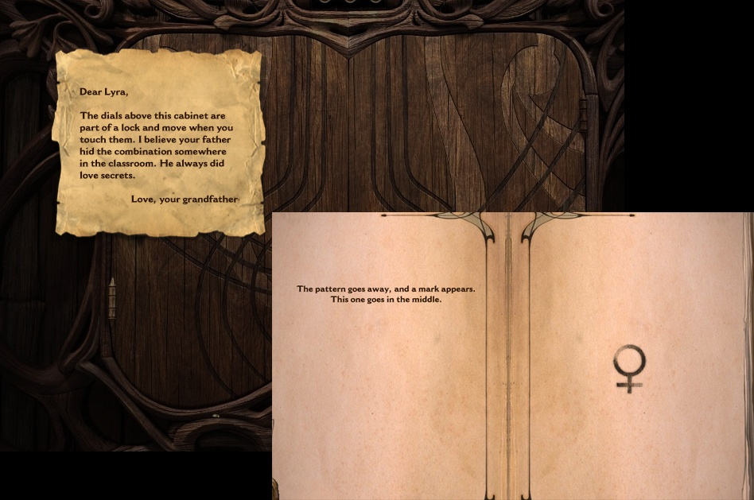
What is Fun?
Dream chronicles - Hidden object game – Creating curiosity
Notes:
Happiness is the emotion resulting from the achievement (or preservation) of values. Accomplishing something you don't value doesn't feel rewarding. Players are happy when they achieve something meaningful. That could be game-defined goals, player-defined goals, or even just learning.
being happy isn't the same thing as having fun.
If you don't have anything to think about or do, you get bored. But being occupied isn't the same as fun. Sometimes you are working so hard that you don’t have time to get bored. I didn't have time to get bored, but I wasn't having fun, either.
Achieving a goal that you planned for and expected to win isn't as much fun as an unexpected victory; the emotion in the latter is stronger.
I also think seeing new wonders - whether it's high-level gear or foes in Warcraft, or funky new buildings in SimCity or Travian - is stronger than happiness-related fun.

Slide 8
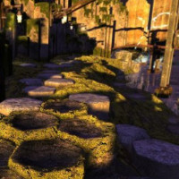
What is Fun?
Big reward of Amazement – MYST III :Exile - Travel to the other part of the world
Notes:
Happiness is the emotion resulting from the achievement (or preservation) of values. Accomplishing something you don't value doesn't feel rewarding. Players are happy when they achieve something meaningful. That could be game-defined goals, player-defined goals, or even just learning.
being happy isn't the same thing as having fun.
If you don't have anything to think about or do, you get bored. But being occupied isn't the same as fun. Sometimes you are working so hard that you don’t have time to get bored. I didn't have time to get bored, but I wasn't having fun, either.
Achieving a goal that you planned for and expected to win isn't as much fun as an unexpected victory; the emotion in the latter is stronger.
I also think seeing new wonders - whether it's high-level gear or foes in Warcraft, or funky new buildings in SimCity or Travian - is stronger than happiness-related fun.

Slide 9
What is Fun?
Laughter – Angry birds
Notes:
Happiness is the emotion resulting from the achievement (or preservation) of values. Accomplishing something you don't value doesn't feel rewarding. Players are happy when they achieve something meaningful. That could be game-defined goals, player-defined goals, or even just learning.
being happy isn't the same thing as having fun.
If you don't have anything to think about or do, you get bored. But being occupied isn't the same as fun. Sometimes you are working so hard that you don’t have time to get bored. I didn't have time to get bored, but I wasn't having fun, either.
Achieving a goal that you planned for and expected to win isn't as much fun as an unexpected victory; the emotion in the latter is stronger.
I also think seeing new wonders - whether it's high-level gear or foes in Warcraft, or funky new buildings in SimCity or Travian - is stronger than happiness-related fun.

Slide 10
What is Fun? (Cont…)
Break the monotonous activity They want something new, because new is fun
People value achievements that came with high cost.
Expected to win | unexpected victory
Success cannot be present unless there’s Failure
HAPPINESS
FUN
Notes:
Example of Expected to win : X n O game where the one who starts and acquires corners,

Slide 11
What is Frustration in puzzle games?
Time taken for an achievement.
Achievement is not justified for the time spent.
Reaction time is too less and no Breathing space.
Opponent (/challenge creating mechanism) is too powerful / Clever / Resourceful.

Slide 12
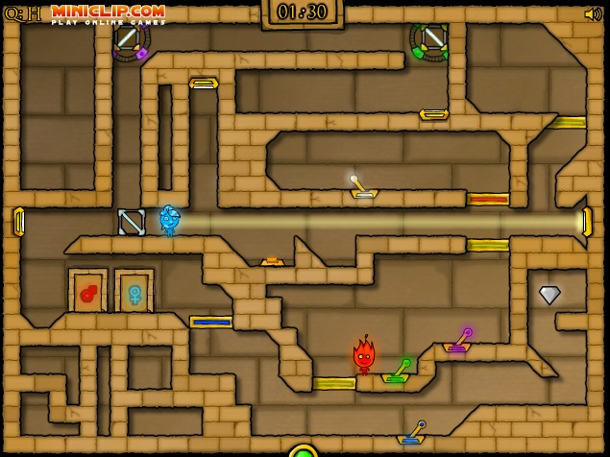
What is Frustration in puzzle games? (cont…)
No “Quick reset” of level after long series of tasks.
There seem to be only one way to solve the puzzle (Read game designers mind?)
Yes or no kind decision making which are directly linked to success or failure.
Light Temple

Slide 13
What is Frustration in puzzle games? (cont…)
Mental stress level
Memory
Logical arrangement
Failing often and not even learning new out of it.
Failing having high penalty

Slide 14
Balancing FUN and Frustration
Provide enough clues to players.
If YES or NO kind of decision making is directly linked to success or failure then have failure cost less
Chance to do trial and error.
Good way to reset a part of puzzle especially after performing long series of tasks.
Introduce “new” elements at a interval.
Avoid too long series of tasks to perform to solve a puzzle.
Notes:
If we give many things that wILL result in fun like too many new environments, too many surprises etc. then we will lose the “fun factor” of fun.
Similarly very difficult tasks, too many dead ends. Will result in player turning away from the game.
So we need to balance the game.

Slide 15
Balancing FUN and Frustration
Assist the Player in solving Puzzles eg. “Hint” in HO levels
Sometimes a way to skip a level or part of puzzle. E.g Mighty Eagle in Angry birds
Reduce puzzles involving repetitive tasks. Eg. HO games Minigames break the monotony
Guide the player to the solution. Most applicable for adding puzzle in action-adventure game.
Easy goal setting (keeps you in the game) Eg “stars” in Angry birds
Puzzle game setting has to be a logical world
Limbo uses “Dying” as a Learning tool for players.

Slide 16
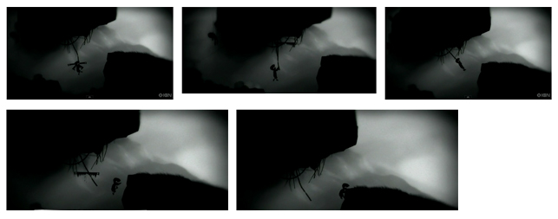
Balancing FUN and Frustration

Slide 17
Creating puzzle
A puzzle should be made up primarily of two things: a defined goal, and clues as to how that goal might be achieved.
Ordinary use of an object in the way it was obviously designed.
Unusual use of an object.
Building third object with the raw material
Supply a missing piece of information. Eg. word puzzle
Excluded middle Setting up dependable cause-and-effect relationships, (find the missing link)
Timing puzzles
Sequence puzzles. These are puzzles that rely on performing a series of actions in just the right order.
Logic puzzles.
Classic game puzzles. Brainvita (jump the peg and leave one behind)
Riddles. Then player needs plenty of hints around
Trial and error puzzles
Mazes
Notes:
Lit the candle
Put candle below the map/note to read invisible letter

Slide 18
Puzzle design principles (cont…)
Combinatory design principle let’s designer zero on
mechanics;
level design;
teaching mechanics and Gameplay principles to the player;
revealing information and content;
complexity of combining mechanics;
difficulty and progression;
perception shifts (using mechanics in unusual ways).
Notes:
Procedural puzzle games: he designer designs the core mechanics and then allows the computer to put them together to create puzzles for the player – often randomly

Slide 19
Have fun!!
Thanks!

