Slide 1
FUN! & The Art of Game Testing
R.Kasturi Rangan
Site Head & Sr. Operations Manager
e4e Interactive Entertainment Services

Slide 2
Market Size - US and Europe
Segment | Money Spent | # of Players
USA | $ 25,290,000,000 | 183,500,000
UK | £ 3,780,000,000 | 31,300,000
Germany | € 3,650,000,000 | 25,400,000
France | € 3,570,000,000 | 35,300,000
Notes:
Can we change “Game Portals” to “Social” unless you mean “Casual” and “Pc Games” to “PC”
I believe the total market is about $50B – 43B Console, 6B MMO, 1B Social. So how do we get 11% Social? Need to validate this data.
This is a per the Newzoo 2010 report.

Slide 3
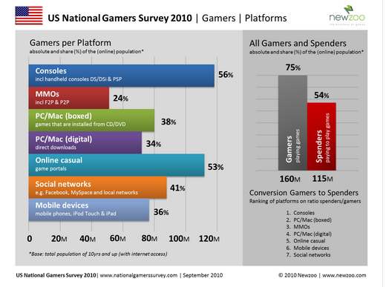
Gamers Share (US)
Notes:
http://www.newzoo.com/ENG/1564-National_Surveys_%282010%29.html

Slide 4
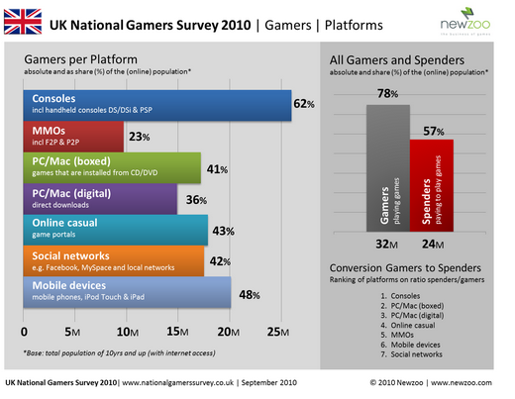
Gamers Share (UK)
Notes:
http://www.newzoo.com/ENG/1564-National_Surveys_%282010%29.html

Slide 5
Game | Test : The Beginning
Test Process for Video Game(s) QC/QA
GAMES (UX)
Play to have Fun
No Structure or a standard procedure
Constructive Progression
Possible element of Chaos
Testing (UX)
Test to find bugs
Structured, Procedural
Destructive Progression
Known Protocol and Procedures = Process
Game Testing = User Defined Variable ☺
Notes:
Software testing process for QC of Games
Primary function includes The Discovery and documentation of bugs

Slide 6
Counter Strike – Bug #1
Notes:
Why do you need to find bugs – This is why!

Slide 7
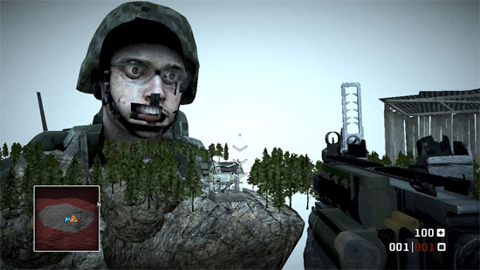
ScreenShots
Call of Duty – Bug #2

Slide 8
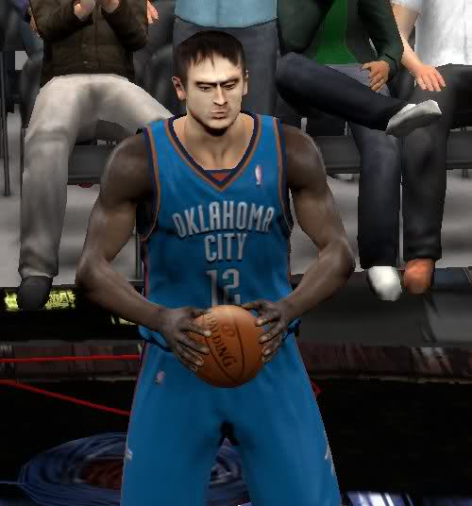
NBA 2K Bug #3

Slide 9
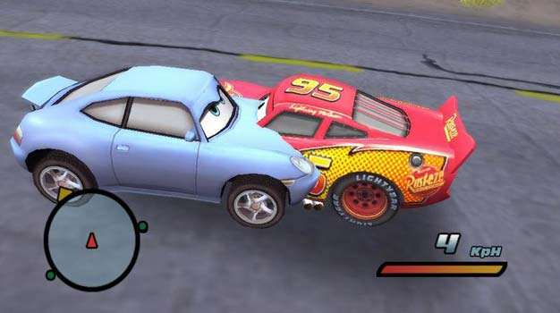
V Cars 2 Bug #4

Slide 10
Game Production Life Cycle
Pre -Prod
Prod
GD Implementation
Alpha
Post-Prod
Alpha -> Release Candidate
Game Designers
Concept
Testing
Testing
Game Design
Production Team
Deployment
Artists
Programmers
Tech Directors
Functional Testers
Compliance QA Test Team
Functional QA Test Team
Notes:
Talk about tracker too here.

Slide 11
Test Approach
Ad-hoc
Play like the end-user, interesting findings
“sit on a random tree, throw a grenade at a donkey”
Test Coverage could fail to cover all areas in-game
Testers focus varies depending on play style
Test cases
All Common Known areas tested
Disciplined, Procedural
Test Random Situations
Coverage is dependent based on TC writers
Games have too many random variables, TC’s cant cover ALL
Notes:
the biggest misconception about software testing is that any one method of testing is better than another. There is both an art and a science to game testing, and neither of them should be ignored.

Slide 12
Game Testers – The Specialization
Platform Specific – The Ground
Microsoft XBOX, 360, Kinect
Sony - PS2, 3, PSP, Move
PC, Force feedback,
Nintendo – DS, DS Lite, 3DS
Online & SNG
Mobile
Test Specialist – The Focus
Functional
Compatibility
Localization
Automation
Compliance

Slide 13
Pro. Game Tester: The Road to Success
Passion
Noob
Improvise hand-eye coordination
Pro. Gamer
Platform Specialization
Test Focus
Master Test Approach
Clear Documentation and Master Detection Skills
1337 Game Tester

Slide 14
Thank YOU!
Q&A → QA

