Slide 1
Mobile Gaming in India: A Startup Perspective
Himanshu Pant
Co Founder and Director
Mactabilis Arts

Slide 2
Mobile Gaming: Introduction
Mobile game is a video game played on a mobile phone, smartphone, PDA,or portable media player.
One of the first game which was pre-installed on the mobile phone (almost all phones) is the snake game.
Platform and handset dependent
Technologies such as Windows Mobile, Palm OS, Symbian OS, Adobe’s Flash Lite, DoCoMo’s DoJa, J2ME, BREW, WIPI, iPhone OS or Google Android platforms.
Java (J2ME) being the most popular platform amongst the above.

Slide 3
Mobile Gaming in India: Service Discovery Channels
Over the Air (OTA) – Game is delivered to the mobile device via wireless carrier networks
Sideloaded – Game is loaded onto the mobile phone while connected to a PC, either via USB cable or Bluetooth
Pre-installed – Game is preloaded onto the device by the original device manufacturer
Mobile browser download – Game is downloaded directly from a mobile website
App Stores

Slide 4
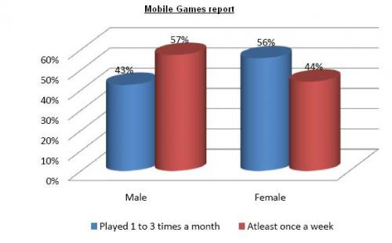
Mobile Gaming in India: User Behavior

Slide 5
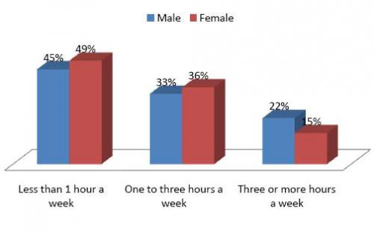
Mobile Gaming in India: Duration of Play

Slide 6
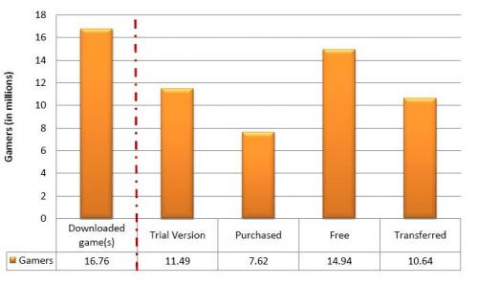
Mobile Gaming in India: Insights into user behavior

Slide 7
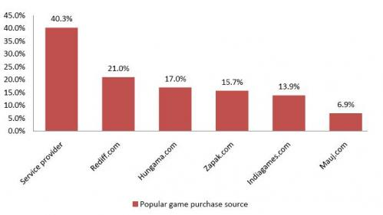
Mobile gaming in India: Source of Games

Slide 8
Mobile Gaming in India: Free vs Purchased

Slide 9
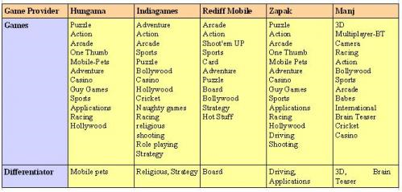
Mobile Gaming in India: Competitive Content Landscape

Slide 10
Mobile Gaming in India: Some Success Stories
God of War (Hungama) The game has seen 50,000 downloads. Price: Rs 99
Dangerous Grounds (Mauj Telecom) 9,000 downloads per month. Price: Rs 50
Super Cricket 08-09 (Mauj) 15,000 downloads per month. Price: Rs 50
Russian Mafia (Hungama) more than 35,000 downloads. Price: Rs 99

Slide 11
Mobile Gaming in India: Trivia and Facts from IndiaGames Report
Maximum number of mobile games download take place between 1 pm to 5pm and 7pm to 11 pm.
Top 10 games comprise of Cricket, Hollywood and action based games
40 % of all mobile gamers belong to 22-35 years of age, followed by 13-21 yrs and 35+ (each 25%).
Airtel has the largest share in games followed by Vodafone and Reliance Communications.
GSM has market share of 70% as far as # of downloads is concerned, and 79% for revenue split.
Nokia handsets are loved by gamers – all top 10 handsets belong to Nokia (6030 is #1)
Gujarat is the top GSM circle followed by Mumbai and Karnataka.
The unique user base for IndiaGames is up 85% from 6 months ago; and IndiaGames expects the addressable market to be around $240-288bn by 2010.

Slide 12
Innovative pricing / business models:
Pay-per-play
Satchet packaging
Time-based gaming or subscription model
Advergaming – the use of mobile games for promotion of a product
Game stacks – where packs of three games can be downloaded for Rs 100
Splitting of a game into various levels/ parts which allow users to download only a part of the game for a minimal amount
Interactive model where users can buy additional weapons, add-ons to enhance the gaming experience

Slide 13
Mobile Gaming in India and Bollywood
It all started with 'Sholay', with the game crossing the 150,000 downloads mark on GSM operators and 800,000 on CDMA phones,"
From 'Rang De Basanti' , to ' Sarkar' , even 'Home Delivery' , 60-odd movies converted into mobile games.
Bollywood constitutes nearly Rs 10 crore, expected to touch Rs 30 crore in next two years,"
Downloading costs anything from Rs 50 to Rs 150 per download,
On average, a bollywood game sells 7K to 10K copies with more popular movies even going up to 25K downloads.
How well the game would be received depends on how popular the movie was and how well the game has been made
Already there are games being made based on Tamil and Bengali movies

Slide 14
Mobile Gaming in India: Challenges for a Startup in India
What is your game idea ?
What is your target audience ?
What is your target platform ?
What is your target distribution channel ?

Slide 15
Mobile Gaming in India: Optimism
In small towns and villages of India, the avenues for entertainment are less
With 3G Connectivity and decreasing prices of download for games
Multi Player Games will let people from different parts of country compete against each other using location based games
India lives in villages and our rural population is crazy about Movies, Cricket and Mobile Phones. Gaming is the next big thing

Slide 16
Mobile Gaming in India: A Startup Perspective
The Industry needs HITS like 3IDIOTS to capture the imagination of the masses
Innovation in both game design and game marketing
More startups means more game ideas, more game ideas means more chances of a HIT
The JUNTA is ready to consume, we have to keep delivering
Thank You

