Slide 1
Intel AppUpSM: Apps on PC Narendra Bhandari Director – Developer Relations Software & Services Group, APAC

Slide 2
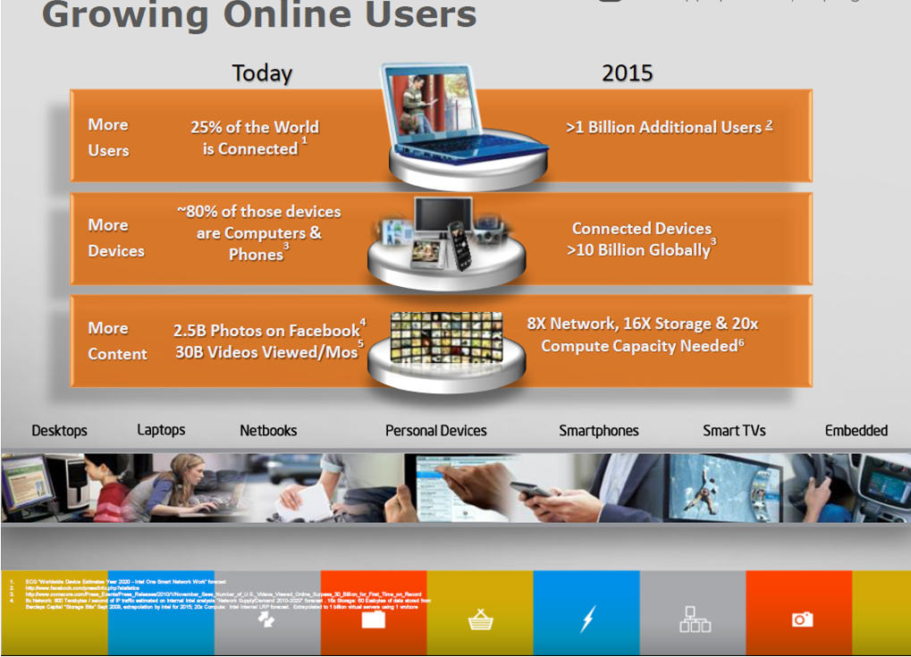

Slide 3
India: Emerging Market Paradigm
Largest Young Population: 60% are < 30 years of age
Have money + See value = Will spend
Among top three Internet countries @100 Mn
Music Download / Email / Gaming / Social / Chat / Job Search /
Among the largest Facebook communities at 30+ Mn
Connected / Social / Viral / Engaged
PC Sales growth outpaces global rate by 8:1
Content consumption / content creation
*Source: Marketing Whitebook 2011-12, Others

Slide 4
Consumer Behaviors and Aspirations
Mobility, Connectivity
Content across platforms, anytime, anyplace
Education, Edutainment
Commerce – early signs
Multiple Devices
Imaging, Videos, Music and Social

Slide 5




Intel Compute Continuum Vision
Workstations
Desktops
Laptops
Netbooks
Tablets
Handhelds
Smart TVs
Embedded
A Consistent, Seamless User Experience Across Devices
All trademarks, copy rights, and brands are properties of third party companies.

Slide 6
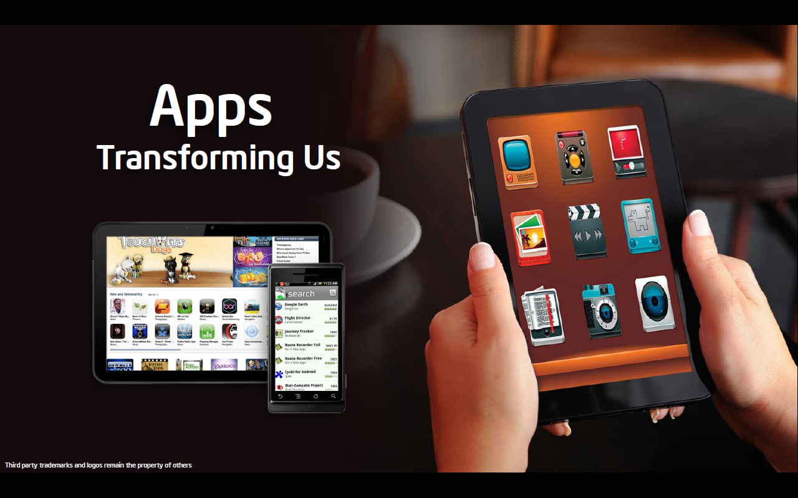

Slide 7

The (Fast) Emerging Economy
Turnover 2010: $5 Bn
2015: $25 Bn
No. of Apps. 2010: 8.2 Bn
2014: 185 Bn
App Stores 2009: 18
2011: 57
Source: Economic Times Sunday dated 26th June 2011, Gartner and Juniper
Image for representation only. Third party trademarks and logos remain the property of others

Slide 8

Intel AppUp℠ center: Apps on PC
http://www.appup.com || http://appdeveloper.intel.com
4500+ Validated Apps | 20+ Categories | Try & Buy Model

Slide 9
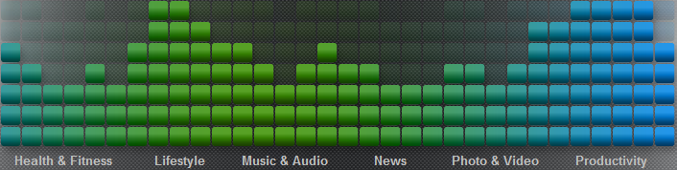


Why Intel AppUp℠ center?
24 hr
trial period
Education, entertainment, social, travel, health, productivity & more...
Single Destination
for loads of fun & useful apps
Try before you buy Cancel purchase within 24 hrs
No Virus or Spyware
Apps tested and validated by Intel
Family Friendly
Strict content rating norms

Slide 10
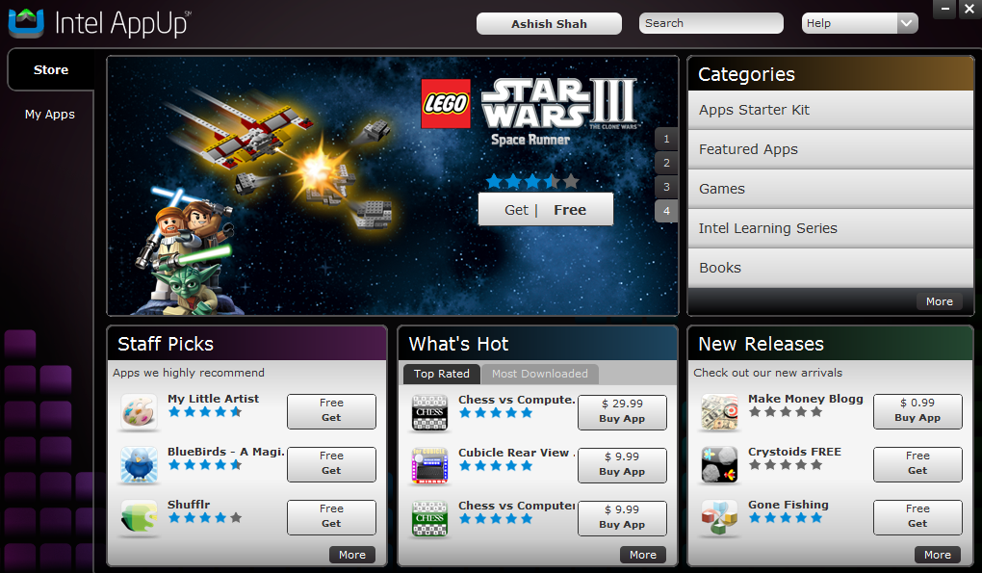
The Store Overview
www.appup.com
Featured Apps
Staff favorites
User’s choice
New additions
Notes:
When you launch the store, this is the default screen that welcomes you.
On the top you have the highlighted apps for the month.
Below you have 3 sections to help make your app choices on the store:
Best apps based on staff review
The apps that have received the best rating from users
The latest apps to be added to the store
The more buttons allow you to view complete listing on each of these sections

Slide 11













Application Categories
Books
Business
Music
Education
Navigation
Entertainment
News
Finance
Photos
Games
Productivity
Health
Security
Home and Family
Social
Communication
Sports
Medical
Travel
Utilities
Reference

Slide 12




Slide 13

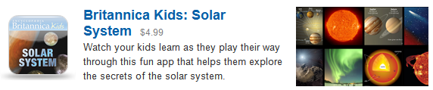


Slide 14


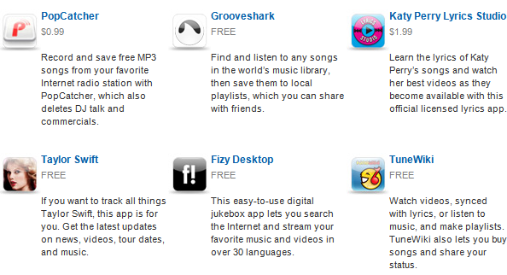

Slide 15



Apps for the Traveler

Slide 16








Find Your Favorite Games & More!

Slide 17
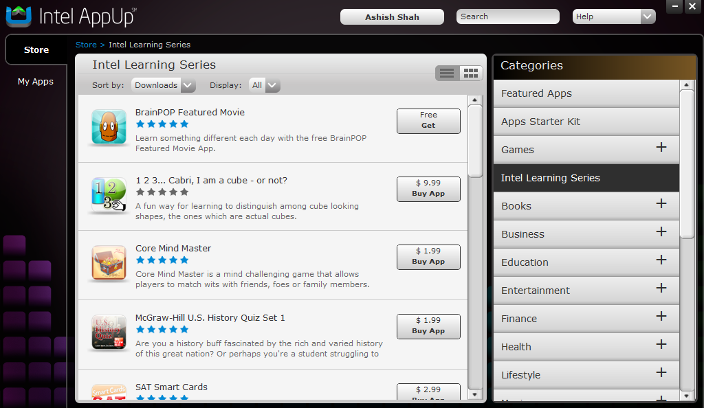
Curate: Create Your Own Store
Illustration: Intel Learning Series
Ease of Discovery
Parental Control
Share with Like Minded People
Ability to create thousands of stores

Slide 18

UltrabookTM: New Class of Notebooks
Excellent traditional computing experience plus the benefits of a tablet
Ultra Responsive
Ultra Thin
Ultra Affordable
Powered by 2nd Generation Intel Core processor family;
Wakes up in a hurry !
Less than an inch in thickness
Less than $1000; Launching Oct 2011

Slide 19
UltrabookTM: The Next PC App Destination
Intel AppUpSM center
UltrabookTM to Go
Better Experience
Better Reach
Better power management / Instant on / Always connected
Faster, better video
Faster, Hi-fidelity sound
Estimated to account for 40% of notebooks by end 2012

Slide 20

Lastly…

Slide 21
Legal Disclaimer
INFORMATION IN THIS DOCUMENT IS PROVIDED IN CONNECTION WITH INTEL® PRODUCTS. NO LICENSE, EXPRESS OR IMPLIED, BY ESTOPPEL OR OTHERWISE, TO ANY INTELLECTUAL PROPETY RIGHTS IS GRANTED BY THIS DOCUMENT. EXCEPT AS PROVIDED IN INTEL’S TERMS AND CONDITIONS OF SALE FOR SUCH PRODUCTS, INTEL ASSUMES NO LIABILITY WHATSOEVER, AND INTEL DISCLAIMS ANY EXPRESS OR IMPLIED WARRANTY, RELATING TO SALE AND/OR USE OF INTEL® PRODUCTS INCLUDING LIABILITY OR WARRANTIES RELATING TO FITNESS FOR A PARTICULAR PURPOSE, MERCHANTABILITY, OR INFRINGEMENT OF ANY PATENT, COPYRIGHT OR OTHER INTELLECTUAL PROPERTY RIGHT.
Intel may make changes to specifications and product descriptions at any time, without notice.
All products, dates, and figures specified are preliminary based on current expectations, and are subject to change without notice.
Intel, processors, chipsets, and desktop boards may contain design defects or errors known as errata, which may cause the product to deviate from published specifications. Current characterized errata are available on request.
Intel AppUp Center, Intel AppUp developer program and other code names featured are used internally within Intel to identify products that are in development and not yet publicly announced for release. Customers, licensees and other third parties are not authorized by Intel to use code names in advertising, promotion or marketing of any product or services and any such use of Intel's internal code names is at the sole risk of the user
Performance tests and ratings are measured using specific computer systems and/or components and reflect the approximate performance of Intel products as measured by those tests. Any difference in system hardware or software design or configuration may affect actual performance.
Intel, AppUp and the Intel logo are trademarks of Intel Corporation in the United States and other countries.
*Other names and brands may be claimed as the property of others.
Copyright ©2010 Intel Corporation.

Slide 22
Risk Factors
The above statements and any others in this document that refer to plans and expectations for the second quarter, the year and the future are forward-looking statements that involve a number of risks and uncertainties. Many factors could affect Intel’s actual results, and variances from Intel’s current expectations regarding such factors could cause actual results to differ materially from those expressed in these forward-looking statements. Intel presently considers the following to be the important factors that could cause actual results to differ materially from the corporation’s expectations. Demand could be different from Intel's expectations due to factors including changes in business and economic conditions; customer acceptance of Intel’s and competitors’ products; changes in customer order patterns including order cancellations; and changes in the level of inventory at customers. Intel operates in intensely competitive industries that are characterized by a high percentage of costs that are fixed or difficult to reduce in the short term and product demand that is highly variable and difficult to forecast. Additionally, Intel is in the process of transitioning to its next generation of products on 32nm process technology, and there could be execution issues associated with these changes, including product defects and errata along with lower than anticipated manufacturing yields. Revenue and the gross margin percentage are affected by the timing of new Intel product introductions and the demand for and market acceptance of Intel's products; actions taken by Intel's competitors, including product offerings and introductions, marketing programs and pricing pressures and Intel’s response to such actions; defects or disruptions in the supply of materials or resources; and Intel’s ability to respond quickly to technological developments and to incorporate new features into its products. The gross margin percentage could vary significantly from expectations based on changes in revenue levels; product mix and pricing; start-up costs, including costs associated with the new 32nm process technology; variations in inventory valuation, including variations related to the timing of qualifying products for sale; excess or obsolete inventory; manufacturing yields; changes in unit costs; impairments of long-lived assets, including manufacturing, assembly/test and intangible assets; the timing and execution of the manufacturing ramp and associated costs; and capacity utilization. Expenses, particularly certain marketing and compensation expenses, as well as restructuring and asset impairment charges, vary depending on the level of demand for Intel's products and the level of revenue and profits. The majority of our non-marketable equity investment portfolio balance is concentrated in the flash memory market segment, and declines in this market segment or changes in management’s plans with respect to our investment in this market segment could result in significant impairment charges, impacting restructuring charges as well as gains/losses on equity investments and interest and other. Intel's results could be impacted by adverse economic, social, political and physical/infrastructure conditions in countries where Intel, its customers or its suppliers operate, including military conflict and other security risks, natural disasters, infrastructure disruptions, health concerns and fluctuations in currency exchange rates. Intel’s results could be affected by the timing of closing of acquisitions and divestitures. Intel's results could be affected by adverse effects associated with product defects and errata (deviations from published specifications), and by litigation or regulatory matters involving intellectual property, stockholder, consumer, antitrust and other issues, such as the litigation and regulatory matters described in Intel's SEC reports. An unfavorable ruling could include monetary damages or an injunction prohibiting us from manufacturing or selling one or more products, precluding particular business practices, impacting our ability to design our products, or requiring other remedies such as compulsory licensing of intellectual property. A detailed discussion of these and other factors that could affect Intel’s results is included in Intel’s SEC filings, including the report on Form 10-Q for the quarter ended March 27, 2010.

