Slide 1
Developing Scalable Web Applications on Amazon Web Services
Janakiram MSV
Technology Evangelist
Amazon Web Services
Notes:
Good morning, my name is X, I'm Y for Amazon Web Services, based in Singapore.
Today we will talk about Cloud Computing, and explain to you why it's important to know about it.

Slide 2
Agenda
1) Cloud Computing
2) Amazon Web Services
3) Demo
4) How to get started

Slide 3
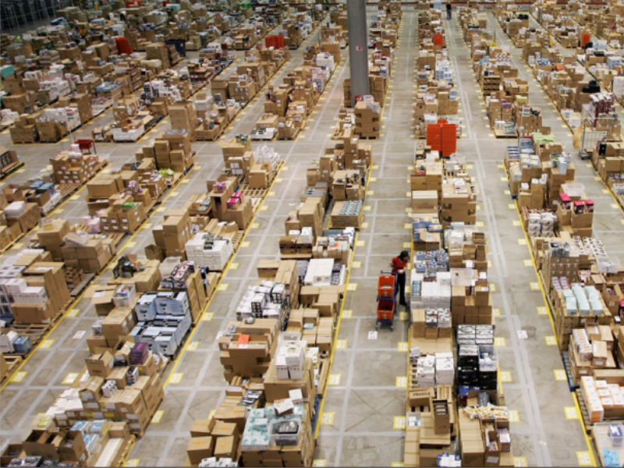
What is Amazon.com?
Notes:
Who knows Amazon.com? Yes, most of you do. Amazon.com is a successful e-commerce website.
But there's something else that not everyone knows.

Slide 4
Amazon’s Three Businesses
Consumer (Retail) Business
Seller Business
IT Infrastructure
Business
Tens of millions of active customer accounts
Seven countries: US, UK, Germany, Japan, France, Canada, China
Sell on Amazon websites
Use Amazon technology for your own retail website
Leverage Amazon’s massive fulfillment center network
Cloud computing infrastructure for hosting web-scale solutions
Hundreds of thousands of registered customers
Notes:
Amazon.com, in fact, can be divided into three branches:
the Consumer Business
The Seller Business
The IT Infrastructure Business, or Amazon Web Services.

Slide 5
Agenda
1) Cloud Computing
2) Amazon Web Services
3) Demo
4) How to get started
Notes:
This is the Agenda for today
A brief introduction to Cloud Computing
Success stories
A closer look at Amazon Web Services, using examples to explain the most popular services
Dispel the most common cloud computing myths
And finally, how to get started
So, ready to go?

Slide 6
Gartner's definition
Cloud Computing:
A style of computing in which elastic IT-enabled capabilities are delivered as a service to external customers using Internet technologies.
Gartner, 2008
Notes:
Let's start first with Gartner's definition of Cloud Computing:
A style of computing in which
elastic IT-enabled capabilities
are delivered as a service
to external customers
using Internet Technologies.
Let's see what Amazon has to add to this.

Slide 7
1) Elastic Capacity
Notes:
First, a true Cloud Computing platform should provide elastic capacity, or the capacity to scale your infrastructure up and down, on demand.

Slide 8
Predicting Infrastructure Needs
Actual Usage
Customer Dissatisfaction
Compute Power
Predicted Usage
Waste
Time
Notes:
Let's look at this graph here. We have compute power on the Y axis, and time on the X axis.
Predicting infrastructure needs is usually very difficult, because the actual needs for infrastructure can be very different, which results in waste of capacity, and customer dissatisfaction.
You can solve both problems by adopting a flexible virtual infrastructure that can closely follow your infrastructure needs.

Slide 9
2) Faster time to market
Notes:
The second advantage is time to market: since your infrastructure is no longer a barrier, and provisioning becomes instant requisition of cloud capacity, your product or service can hit the market much sooner.

Slide 10
3) No initial investment (No CapEx)
Notes:
There is no need for initial investment, or Capex. A true Cloud Computing platform doesn't require you to invest large sums of money before being able to run your infrastructure.

Slide 11
4) Pay as you go, pay for what you use
Notes:
Even more importantly, you pay as you go, and pay only for what you use.
As an example, you can "pay as you go" for a server, which means paying only a few cents per hour.
You only pay for what you use, which means that if you run 3 servers now, 5 in the next hour, 2 in the following hour, you will only pay for the servers that you activated and used during these hours.

Slide 12
5) Focus on your business
Notes:
Last, but not least, with Cloud Computing you can automate most things, and manage your assets in a more efficient way. This allows you to focus more time on your business.

Slide 13
Cloud Computing (summary)
Elastic Capacity
Faster time to market
No initial investment (No Capex)
Pay as you go, pay for what you use
Focus on your business
Notes:
This is a summary of what Amazon considers core characteristics of a true Cloud Computing Platform.
1) Elastic Capacity, being able to scale capacity up and down, on demand;
2) Faster time to market, since IT infrastructure is no longer a barrier;
3) No initial investment is needed;
4) You pay as you go, and pay only for the IT Infrastructure that you need on that specific moment in time.
5) You can manage IT assets in the Cloud much more efficiently, thus being able to focus more time on your business.

Slide 14
Agenda
1) Cloud Computing
2) Amazon Web Services
3) Demo
4) How to get started
Notes:
This is the Agenda for today
A brief introduction to Cloud Computing
Success stories
A closer look at Amazon Web Services, using examples to explain the most popular services
Dispel the most common cloud computing myths
And finally, how to get started
So, ready to go?

Slide 15
The “Living and Evolving” AWS Cloud
Your Application
Libraries and SDKs
.NET/Java etc.
Web Interface
Management Console
Tools
AWS Toolkit for Eclipse
Command Line Interface
Tools to access services
Authentication and Authorization AWS IAM, MFA
Monitoring
Amazon CloudWatch
Deployment and Automation
AWS Elastic Beanstalk AWS CloudFormation
Cross Service features
Parallel Processing
Amazon Elastic MapReduce
Payments
Amazon DevPay
Amazon FPS
Content Delivery
Amazon CloudFront
Workforce
Amazon Mechanical Turk
Messaging
Amazon SNS
Amazon SQS
Email
Amazon SES
Platform building blocks
Compute
Amazon EC2
Storage
Amazon S3
Amazon EBS
Network
Amazon VPC
Elastic LB
Amazon Route 53
Database
Amazon RDS
Amazon SimpleDB
Infrastructure building blocks
Amazon Global Physical Infrastructure
(Geographical Regions, Availability Zones, Edge Locations)

Slide 16
Common Use Cases
Web site hosting
Application hosting / SaaS hosting
Internal IT application hosting
Content delivery and media distribution
High performance computing, batch data processing, and large scale analytics
Storage, backup, and disaster recovery
Development and test environments

Slide 17
Agenda
1) Cloud Computing
2) Amazon Web Services
3) Demo
4) How to get started
Notes:
This is the Agenda for today
A brief introduction to Cloud Computing
Success stories
A closer look at Amazon Web Services, using examples to explain the most popular services
Dispel the most common cloud computing myths
And finally, how to get started
So, ready to go?

Slide 18
How to Get Started
Create an AWS Account
Learn the basics (EC2, S3)
Start a Small Project
Review Results
Expand your AWS Usage

Slide 19
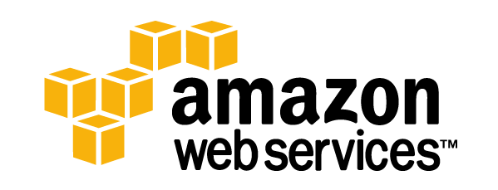
jmsv@amazon.com
@janakiramm
http://aws.amazon.com
Notes:
No notes for this slide.

