Slide 1
Cloud Computing A Paradigm Shift for IT Community
Bhavin Raichura
bhavin_raichura@infosys.com

Slide 2
Agenda
Cloud Computing: An Innovative Case Study
Cloud Computing is a Disruptive Change
The Impact of Cloud Computing on IT Ecosystem
Paradigm Shift: It is not about TECHNOLOGY & SYNTAX
A Day-in-a-Life for You & Me Tomorrow !

Slide 3
How many of you know GAIA ?

Slide 4
How many of you recognize the below ?
http://www.hdwallpapers.in/female_character_in_avatar-wallpapers.html
Gaia will play a part in Cameron's future films, he added. Lightstorm and Microsoft have just signed an extension to their original agreement that cements their working relationship. "We will not do a production without Gaia," Landau said.
http://www.microsoft.com/microsoftservices/en/us/article_Microsoft_Role_In_Avatar.aspx

Slide 5
A Short Video
http://www.youtube.com/watch?v=umr4zbtx7Gs

Slide 6
Cloud Computing : An Innovative Case Study
Cameron Says Microsoft's Role in 'Avatar' Was Key
Director James Cameron relied on Microsoft technology to store the massive amounts of data generated during the filming of "Avatar." As technology's role in moviemaking expands, Microsoft looks to be a player in film's digital revolution.
"Look at 'Avatar' and how it was built," he said. "Essentially, it was an IT project." The problems that filmmakers increasingly will face–keeping track of massive amounts of data, enabling large numbers of people to access that data, and coordinating among production crews that are literally on the other side of the world, as they were during "Avatar"– are all perfectly tailored for a cloud-computing solution.
http://www.microsoft.com/microsoftservices/en/us/article_Microsoft_Role_In_Avatar.aspx
THE CLOUD COMPUTING IS A DISRUPTIVE CHANGE

Slide 7
Impact of Cloud Computing on IT Ecosystem
Hosting Providers
ISVs
Impact of Cloud Computing
System Integrators
Developers, Testers & Support Engineers
Customers
…the whole IT Community & Ecosystem is impacted

Slide 8
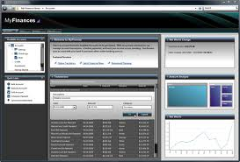
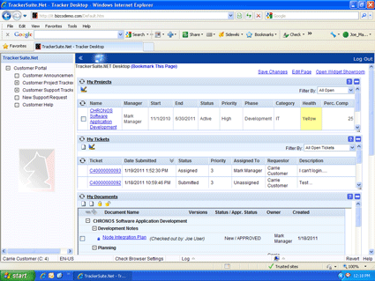
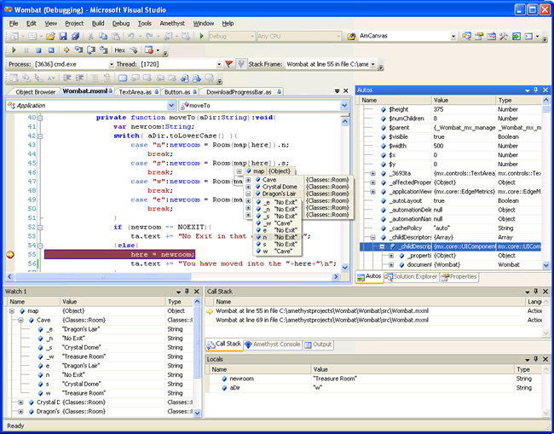
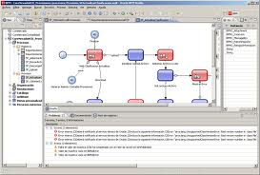
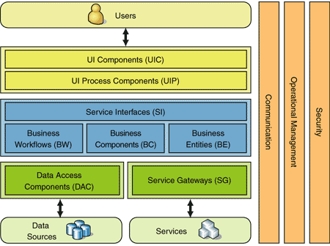
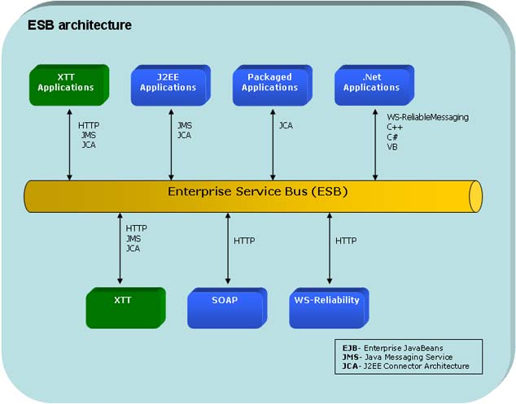
What & How We do Things Today !
Apps
IDEs & Platforms
Architecture Stereotypes
It is NOT about the TECHNOLOGY, SYNTAX, APIs or ARCHITECTURE

Slide 9
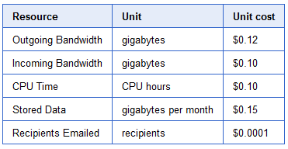
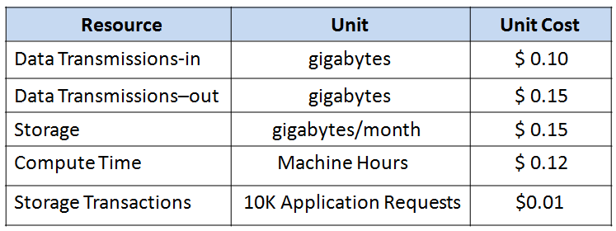
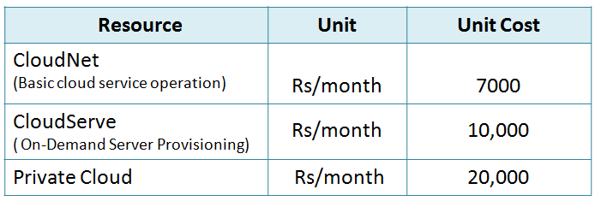
Why the Change is Inevitable
Source: Google Code
Source: Amazon, Amazon
Source: Microsoft Azure
Source: BusinessWorld
http://www.infosysblogs.com/cloud/2009/07/is_price_the_only_criteria_to_2.html#more

Slide 10
It is not just the Business Case …
Storage as a Service
100TB of storage space on cloud can save $1M per year
Infrastructure as a Service
100 server provisioning can save >1MN per year, reduces time-to-market from 6-8 weeks to min
Cost per GB per Year | Tier-1 | Tier-2 | Tier-3 | Cloud
Single Node (99.9% SLA) | $43 | $15 | $12 | $3
3 Geo Nodes (100%) | $129 | $45 | $36 | $9
Infrastructure Provisioning | On-premise | Other Hosted | Cloud
Server + OS Cost per Month | $1000 | $500 | $230
Provisioning time-to-market | 8 weeks | 2 weeks | Minutes
Software as a Service
Microsoft Online Services save $2 MN for enterprise collaboration and messaging solutions
Platform as a Service
Cloud makes PaaS affordable to everyone, help increasing the market penetration to fuel growth
Cost per User per Month | On-premise | Other Hosted | Cloud Based
Exchange Online | $25 | $9* | $20
SharePoint Online | $30 | $1 | $7
Cost per User per Month | On-premise | Other Hosted | Cloud Based
CRM | $100 | $65 | $44
IVRS Platform
http://www.infosysblogs.com/cloud/2009/06/the_economics_of_cloud_computi.html#more

Slide 11
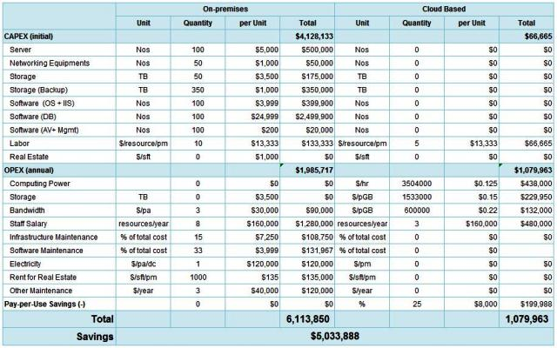
It is not the niche-technology…
free-up 2MN CAPEX
~50% Y-o-Y savings
save ~500K OPEX every year
http://www.infosysblogs.com/cloud/2009/06/the_cloud_roi_framework.html#more

Slide 12
THANK YOU !
Bhavin Raichura
bhavin_raichura@infosys.com

