Slide 1


LifeSize Communications

Slide 2
Agenda
LifeSize at a Glance
Industry Evolution
Strategic partnerships | Update
Infrastructure Enhancements - July 7th
Product Announcements - July 20th
Notes:
1

Slide 3



LifeSize at a Glance
The world’s first mainstream HD video communications system in 2005
15,000 customers in 100 countries
More than 55,000 units shipped
1,500 resellers around the world
Types of customers: Large enterprise; Small to mid-market enterprise; Education; Healthcare; Public sector
Headquartered in Austin, Texas with global offices throughout Americas, Europe, and Asia-Pacific
Became a division of Logitech in December 2009
Core technology partnerships:
Notes:
Speaking Points:
LifeSize has always led the industry through relentless innovation starting with introducing the first mainstream HD video system in 2005
We sell through the channel and have a strong global presence with more 15,000 customers and counting
Our breadth of solutions and end to end portfolio that cover both video systems, infrastructure solutions and control management software means that customers from all verticals and sizes find the solutions that meet their organizational needs
We continue to broaden and expand our technology partnerships with key technology and UC vendors; for example we recently announced we are the first video vendor fully qualified to work with OCS and are interoperable today with Lync. Our video systems have received Avaya DevConnect Tested status.
2

Slide 4
Agenda
LifeSize at a Glance
Industry Evolution
Strategic partnerships | Update
Infrastructure Enhancements - July 7th
Product Announcements - July 20th
Notes:
3

Slide 5
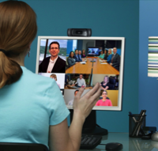



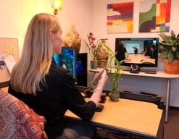
Industry Evolution
New wave driving explosive growth - Microsoft, Skype, Google, Apple
UC convergence highlights critical need for interoperability
LifeSize Focus Areas:
Cloud – Global B2B platform for infrastructure as service
Accessibility – bringing video to everyone from SMBs to Fortune 500
Mobile – Align video with the way people work – smartphones/tablets are now a work environment
Notes:
Just as we embraced and introduced HD quality to the mainstream video conferencing space in 2005, the new trends we see and our aligning partnership and development efforts are making good on the key trends we’re seeing in the market today – cloud-based conferencing, mobility and expanding accessibility to video conferencing for more organizations.

Slide 6
Agenda
LifeSize at a Glance
Industry Evolution
Strategic partnerships | Update
Infrastructure Enhancements - July 7th
Product Announcements - July 20th
Notes:
5

Slide 7
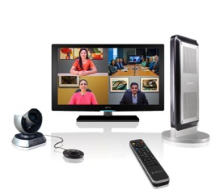
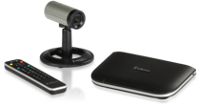

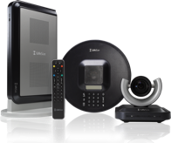
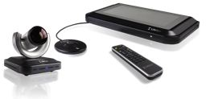
Microsoft: Full Qualification July 11, 2011
LifeSize® Team 220™
LifeSize® Passport™
LifeSize® Express 220™
LifeSize® Room 220™
“The combination of LifeSize technology with Microsoft UC platforms will enable customers to extend their video conferencing ecosystems from the desktop to the boardroom, and everywhere in between.”
- Kirk Gregersen, Senior Director, Microsoft Lync

Slide 8

Avaya
DevConnect Certification
Jointly develop ecosystem of Avaya/LS UC solutions
Transfer of GTM to Sales
OEM
Resell LifeSize branded products
Extend existing LifeSize agreement to APAC and AI
Products
Passport, Express 220, Team 220, Room 220
Adding Video Center and LifeSize Bridge
Revenue increasing quarterly
Adding Federal and Brazil markets

Slide 9
Agenda
LifeSize at a Glance
Industry Evolution
Strategic partnerships | Update
Infrastructure Enhancements - July 7th
Product Announcements - July 20th
Notes:
8

Slide 10
LifeSize Vision
Universal Video Collaboration™
Intelligently Optimized for Your Network
LifeSize introduces a scalable,open HD video framework that offers the lowest total cost of ownership and ultimate flexibility. With LifeSize, you can consistently and reliably enable the highest quality video collaboration in your network environment.
Performance
Flexibility
Simplicity
Open & Interoperable
Lowest Total Cost of Ownership (TCO)
Notes:
HD video for anyone. Anywhere.
Universal Video Collaboration, or UVC, is a framework that will guide the development of all current and future LifeSize products – starting with a rapid-fire of new products launching this summer and more to come throughout the year.
Universal Video Collaboration focuses on 4 foundational requirements: Superior Performance, Flexibility, Simplicity and Interoperability.
UVC framework sets a higher standard, reinforcing our values and making video more flexible, simpler and easier to deploy, manage and use.

Slide 11
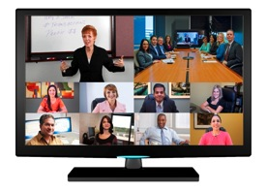
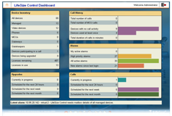

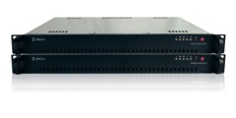
Infrastructure Enhancements July 12, 2011
With enhancements to our infrastructure offerings, LifeSize delivers increased flexibility to deploy, manage and expand video collaboration on a larger scale
LifeSize Transit: Fully virtualized deployment options
LifeSize Bridge: Expanded bridging support for enterprise & greater calling flexibility (48-way calling). Unmatched price performance
LifeSize Control: The industry’s most open and interoperable video management system
LifeSize® TransitTM Server & LifeSize® TransitTM Client
LifeSize® BridgeTM
LifeSize® ControlTM

Slide 12

Modular, Flexible, Scalable
Fits both centralized and distributed networks
Modular deployments let organizations put resources when and where they are needed: No large upfront investment or guessing future capacity
Allows organizations to adapt video conferencing to existing networks to deliver seamless connectivity from within a single building or around the globe
Support for scheduled and/or on-demand calling
Now scales a 16-way meeting up to 48 participants
Page 10
© Logitech All Rights Reserved. Confidential.

Slide 13
Agenda
LifeSize at a Glance
Industry Evolution
Strategic partnerships | Update
Infrastructure Enhancements - July 7th
Product Announcements - July 20th
Notes:
12

Slide 14
Finally, universal video collaboration with true mobility:
Fully interoperable, enterprise video conferencing software solutions for distributed desktop and mobile users

Slide 15

Logitech Acquires Mirial
Leading provider of personal and mobile video conferencing solutions
Customers now have access to full enterprise desktop solution and best in class mobile device support
Seamless video collaboration from any mobile to any conference room
Fully interoperable today with all standards-based video conferencing systems
Full HD quality and firewall/NAT traversal capabilities to the PC, Mac, iOS and Android™ devices including:
iPhone 4, 3GS and iPad 2; HTC EVO, Desire, Incredible, myTouch® 4G, Sensation™ and ThunderBolt; Motorola Atrix™ and Xoom; Samsung Epic™ 4G, Galaxy S™ and Galaxy Tab as well as Google Nexus S and Dell™ Streak™.
Mirial added to LifeSize portfolio
Financial terms will not be disclosed
Notes:
Mirial has the same innovative spirit and technology leadership that LifeSize has been known for since we were founded.
Their products are focused on ensuring universal video collaboration for anyone, anywhere.
Mirial’s core IP and development capabilities are focused on interoperable,standards-based mobile video conferencing. Which makes their products a perfect addition to the LifeSize portfolio.

Slide 16
Infrastructure Choice
Relentless Innovation =
More Flexibility.
More Choice.
New Deployment Options.
Notes:
Within this framework, and one of most significant innovations that permeates all our new developments, is a new approach to how video is used and deployed, with more choices to fit any budget, any business, or any work setting. That’s why LifeSize is relentless about innovating solutions and technologies for universal video collaboration.

Slide 17
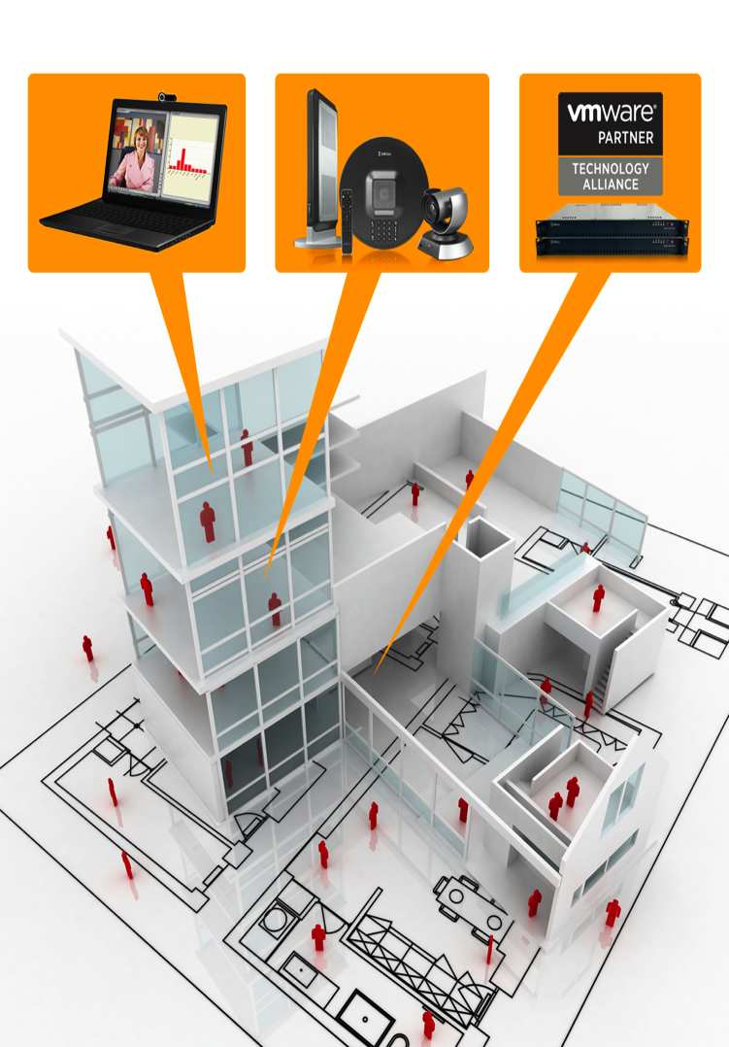
On Premise
Absolute control and flexibility to fit your IT environment
Fully customizable, modular, scalable to support HD video collaboration
© LifeSize – All Rights Reserved. Confidential
16
Notes:
We’ll have products designed for “on-premise” deployment, for the enterprise seeking absolute control and flexibility to integrate HD video within their network environment.

Slide 18

Cloud-Based
Cloud-Based Simplicity Meets Business-Class Performance
The fastest, easiest way to add and extend HD video collaboration in your business
Notes:
And we will have cloud-based, or hostedvideo, for fast, easy HD video via the all-new, web-based LifeSize Connections.

Slide 19

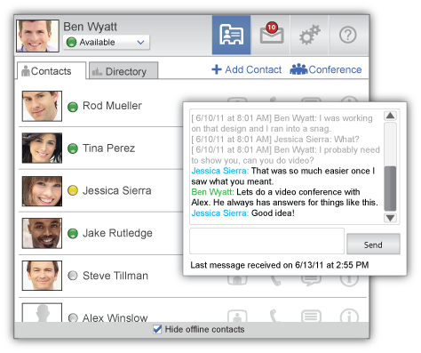
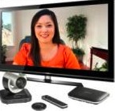


Introducing LifeSize Connections
LifeSize Connections is a cloud-based,
business-class HD video collaboration platform
Seamless HD calling from PCs, Macs, and LifeSize endpoints
Simple deployment without IT expertise
Reduces upfront capital investment
Includes firewall traversal, bridging, global directory and management
Guest invitation capability expands reach beyond video endpoints
Notes:
With the LifeSize Connections cloud-based platform, we’ve taken all highest quality of experience and performance standards our LifeSize solutions have long been known for and paired them with the simplicity of deployment and use that ‘cloud-based’ promises.
With LifeSize Connections, infrastructure to support business-class universal video collaboration is hosted and handled in the LIfeSize Connections cloud. Companies’ IT teams don’t have to be burdened with managing firewall traversal, bridging, global directory and ongoing management. Just install and go.
And with the guest invite capability, you can collaborate with anybody you need to, when you need to, as you choose. Reliably and easily. The guest invite feature of LifeSize Connections is easy to use - if a user wants to collaborate over video they simply send a guest invite link via email to their contact – great for ad hoc conversations with colleagues, partners and peers who don’t have ready access to a video conferencing system.

Slide 20
Target markets
Companies that lack expertise in video or IT resources to deploy and configure video infrastructure
Need powerful solution that is easy to deploy and manage
Organizations with a high level of client interaction and a mobile, distributed workforce:
Professional Services, Management Consulting, Insurance, Financial Services, Healthcare, IT Consulting
Existing video users that want to extend their reach and communicate with remote employees, clients, and partners
Pricing
Desktop Client: ~ $30/user/month
Endpoint: ~ $100/seat/month
Pricing includes:
unlimited usage, 9-way 720p video bridging for every seat
Availability
Globally available in the third quarter 2011
Notes:
With LifeSIze Connections, organizations that have not yet embraced video conferencing or have mainly been using it on a limited basis or for intra company discussions, now can easily collaborate inside or outside the organization without taking on excess IT burden, huge upfront investment, or waiting weeks to months for deployment.
Organizations have the flexibility to start small or go big.
Great for use in distributed environments, where client relationships are critical to maintain and foster. Healthcare for example – with LifeSize Connections, doctors can keep in teach and monitor and treat/counsel patients over video by simply sending them a guest invite link to connect and talk via LifeSize Connections.

Slide 21




Amazingly simple. Simply amazing.
Cloud-Based Simplicity Meets Business-Class Performance
Travelling salesperson in a hotel room connects over video from LifeSize Connections on their PC to 5 customers sitting in their conference room equipped with LifeSize endpoint.
Law firm invites multiple clients to prepare for depositions over video via LifeSize Connections guest invite
Advertising agency uses LifeSize Connections to present new messaging platform with client executives around the world in their meeting rooms and computers
Notes:
These are just a few scenarios where LifeSize Connections is an ideal choice.

Slide 22








LifeSize India - Partial Customer list
Case Study
“ LifeSize is very simple, a complete value with great quality—it’s the ideal solution for conferencing.”
– Sanjay Singh, General Manager of Operations, Virgin Mobile India

Slide 23
Thank You

