Slide 1
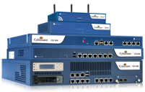
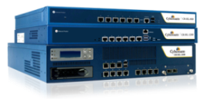
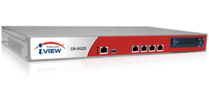
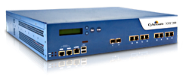
Insider Threats –
Its significance and how to identify them
AJAY NAWANI
Presales Head – Global Operations
Our Products
Unified Threat Management
Cyberoam – Endpoint Data Protection
SSL VPN
Data Protection & Encryption
Device Management
Application Control
Asset Management
Notes:
1

Slide 2
Agenda of Presentation
An overview of significant cyber security events
Insider Threats
Is your network security Future-ready?

Slide 3
An overview of significant cyber security events

Slide 4
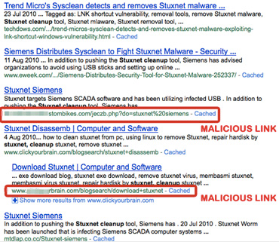
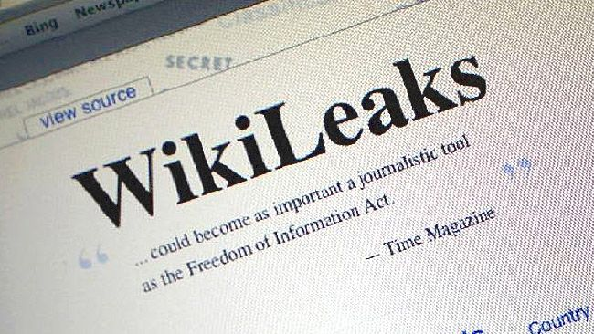
Major recent security incidents
Stuxnet
Jan 2010: Targets industrial software and equipment
Hydraq Trojan
July 2010: Hackers made backdoor entry to corporate Intranets
Kama Sutra virus via downloadable ppt
Jan 2011: Downloaded presentation runs malware in the background
News events driving spam in corporate networks
Wikileaks, Osama Bin Laden death
Notes:
4

Slide 5
Key threat statistics
More than 300 million unique malicious programs in 2010
Mobile threat landscape comes into view
Public app stores leveraged for attacks
93% increase in web-based attacks
Attacks emerge using shortened URLs
14 NEW zero-day attacks per day
Including Hydraq, Stuxnet, Kama Sutra etc.
260,000 identities exposed per data breach
Hacking incidents drive identity theft in organizations
Notes:
What we found out the possibilities that I mentioned are just the tip of the iceberg, it is indeed possible to map the DNA of the organizations using the information that is available on social media. One can derive the intangible set of information about the company, such as core values, hierarchy, communication patterns, industry environment, employee morale by observing the social networking activity of the organization and the organizations employees, information such this would not have been available at one time without getting within the organization. Besides the intangibles, the tangible information such as intellectual property, financial information or even trade secrets can be available by monitoring the organization’s social presence.
5

Slide 6
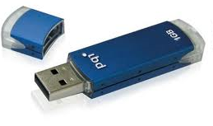
The evolution of the threat landscape
Past
Lesser complex networks that were manageable
Fewer mediums of security vulnerability
External drives, Instant Messengers, Email etc.
Notes:
6

Slide 7
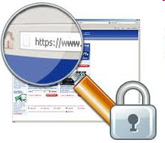
The evolution of the threat landscape
Present
Complex networks
Rise in number of incidents due to
Wireless technologies
Handheld devices (like PDAs, iPads, cellphones)
Extending networks to partners, customers and more
HTTPS / SSL websites
Social media & Web 2.0
Future: The threats would grow more serious
Cloud-residing data
Heterogenous networks (HetNets)
Notes:
7

Slide 8
Insider Threats

Slide 9
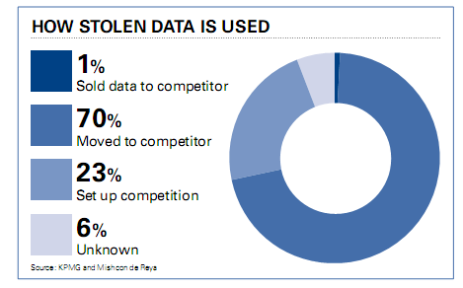
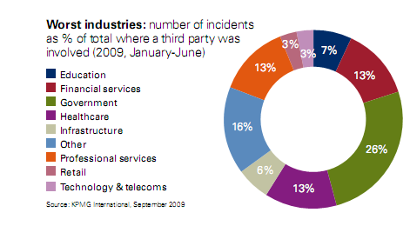
How vulnerable is my organization to insider threats?
93% employees had betrayed the organization to directly benefit competition
(SOURCE – KPMG Data Loss Baramoter, 2009)
Notes:
9

Slide 10
Why are insider attacks succeeding?
Greater fluidity of network parameter
Employee access to business-critical applications, Web 2.0, social media
Traditional security’s inability to identify human role
Victim - User ignorance, surfing patterns, trust, lack of awareness, lax security policy
Attacker - Malicious intent, vengeance, greed
Notes:
10

Slide 11
Inside-out Threat Scenarios
Corporate LAN
192.168.3.105
192.168.3.1
192.168.3.120
192.168.3.120
Internet
192.168.3.108
192.168.3.108
?
In an inside-out threat scenario, user activities remain untraced
Multiple users on same machine can share a common IP address
“Human Identity” behind the IP address is a Question Mark
Administrator

Slide 12
Social Media: An increasing risk
Individual tidbits of information lying across Twitter, Facebook,
LinkedIn etc. when seen together, constitute insider threats
The DNA of the entire organization can be decoded
INTANGIBLES
Core values, hierarchy, communication patterns, industry environment, employee morale
TANGIBLES
Intellectual property, financial information, trade secrets
What we did at Cyberoam
Monitored 20 companies with active social media presence
Notes:
What we found out the possibilities that I mentioned are just the tip of the iceberg, it is indeed possible to map the DNA of the organizations using the information that is available on social media. One can derive the intangible set of information about the company, such as core values, hierarchy, communication patterns, industry environment, employee morale by observing the social networking activity of the organization and the organizations employees, information such this would not have been available at one time without getting within the organization. Besides the intangibles, the tangible information such as intellectual property, financial information or even trade secrets can be available by monitoring the organization’s social presence.
12

Slide 13
Key demographics and distribution
Notes:
What we did was something very simple, we selected a random set of 20 small and medium companies and tried to find out what most could be derived from their social media and networking presence. Even though we were physically thousands of miles away from these organizations, we could feel as if we were within their offices, getting to know the day to day happenings of the organization.
As we were going through gather these tidbits, we had a challenge of how could we document our findings and we searched for a possible structure. During our search we chanced upon the Booze & Company’s definition of organizational DNA.
13

Slide 14
More details about Cyberoam research…
Pick an organization X
Identify as many employees as possible from X’s Linkedin profile
Go through the Twitter and Facebook profile of employees
Monitor the information feed from these sources
Identify the structure and hierarchy
Sketch decision-makers and key employee motivators
Chart the organization X’s DNA
Notes:
What we did was something very simple, we selected a random set of 20 small and medium companies and tried to find out what most could be derived from their social media and networking presence. Even though we were physically thousands of miles away from these organizations, we could feel as if we were within their offices, getting to know the day to day happenings of the organization.
As we were going through gather these tidbits, we had a challenge of how could we document our findings and we searched for a possible structure. During our search we chanced upon the Booze & Company’s definition of organizational DNA.
14

Slide 15
Example 1: Company A
Singapore-based multimedia company
Reason for selection?
Asian corporation with impressive clients list
Employees monitored
Sales director, department head, designers
Methods used
Private tweets of all mentioned individuals
Notes:
What we did was something very simple, we selected a random set of 20 small and medium companies and tried to find out what most could be derived from their social media and networking presence. Even though we were physically thousands of miles away from these organizations, we could feel as if we were within their offices, getting to know the day to day happenings of the organization.
As we were going through gather these tidbits, we had a challenge of how could we document our findings and we searched for a possible structure. During our search we chanced upon the Booze & Company’s definition of organizational DNA.
15

Slide 16
Social media profile – Company A
Employees not getting salary
+
Cashflow problems in organization
+
Bounced salary checks
+
Employees looking for new jobs
Notes:
What we did was something very simple, we selected a random set of 20 small and medium companies and tried to find out what most could be derived from their social media and networking presence. Even though we were physically thousands of miles away from these organizations, we could feel as if we were within their offices, getting to know the day to day happenings of the organization.
As we were going through gather these tidbits, we had a challenge of how could we document our findings and we searched for a possible structure. During our search we chanced upon the Booze & Company’s definition of organizational DNA.
16

Slide 17
Security Executives are in a Middle of a Complex System
CSO
Costs
Mobility – Ubiquity - Productivity
Incident Response - Continuity
Threats
Security Policy
Compliances

Slide 18
Is your network security Future-ready?

Slide 19
Need of ‘Layer 8 Technology’
– Building Security around the User
Notes:
This feature allows policies to be created at the user level based on work profiles facilitating identification of behavior patterns to denote misuse, unauthorized intrusions, or malicious attacks from inside or outside the enterprise by specific users or group.”

Slide 20
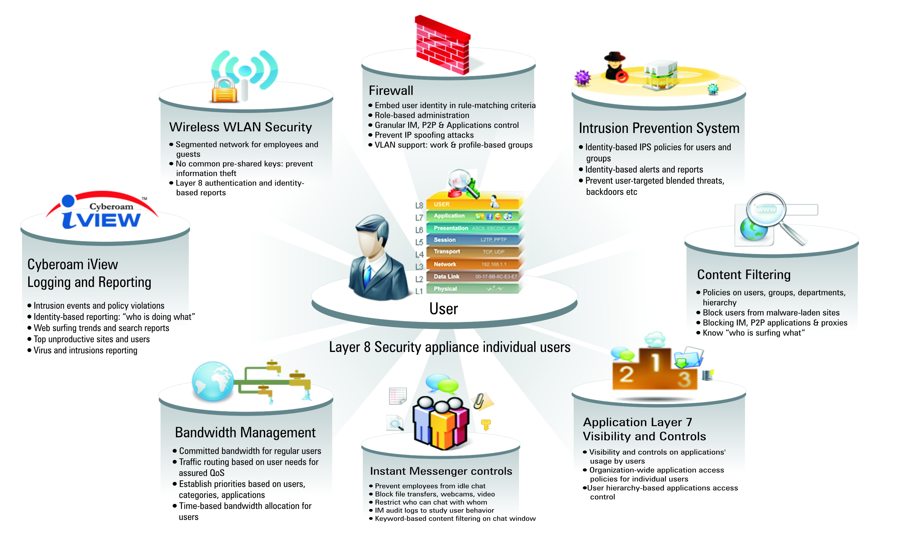
Expectation from Layer 8 technology:

Slide 21
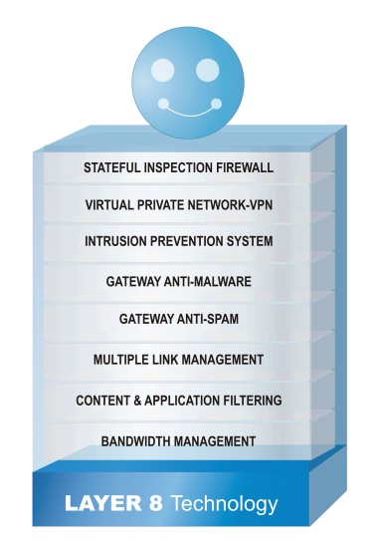
What Layer 8 does? Provides Identity-based security
Corporate LAN
192.168.3.105
192.168.3.110
192.168.3.110
Mona
Internet
192.168.3.110
Shiv
Applies security policies based on actual identity of users.
User-specific rules for multiple users to share a common IP address
Administrator

Slide 22
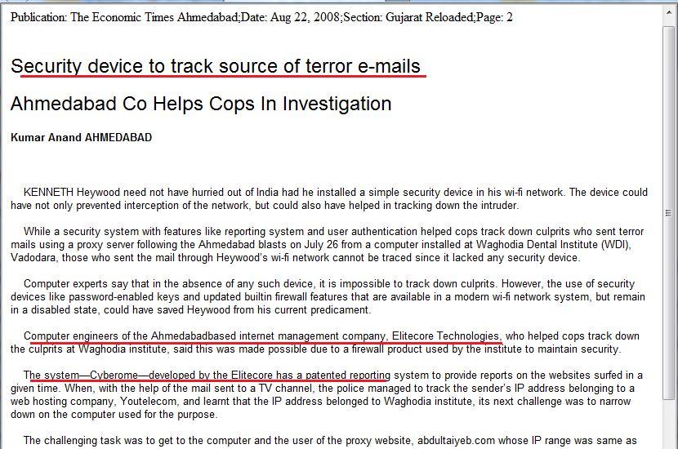
Fighting Terrorism through Identity
Location – Ahmedabad, India
Date: 26th July 2008
Attack Type: 21 serial bomb blasts
Cyberoam – Identity based management solved the case and culprit was arrested.

Slide 23
Solution that can help mitigate insider threats
Measure User Threat Quotient (UTQ)
Help build patterns of activity profiles
Layer 8 security
Identity-based approach to control
Who is doing what?
Who can connect using which device?
What is being accessed over the network and by whom?
Who are the likely targets?
Securely extends network to customers, partners, remote workers
Role based access to resources and social media
Notes:
23

Slide 24
Applications and More Applications. Am I in control?
Who decides which applications are important to business and run on network ?
Notes:
24

Slide 25
A crowd of applications – how will you prioritize?
You
Tube
IM
Application
Web
mail
Casual
Traffic
Sales
force
ERP
CRM
Notes:
25

Slide 26
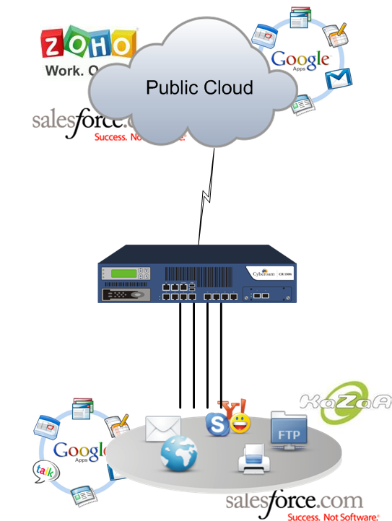
Need of Application Visibility & Control
Know and classify applications trying to enter the network
Business critical
Socio-business
Non critical
Undesirable
Allows control over
Who (user)
When (Time)
What (Application)
How (Bandwidth)
Essential for Cloud Computing
Assures availability of business-critical applications
Controls bandwidth costs
Notes:
26

Slide 27
Threat environment is dynamic. Can I keep up with it?
Is my existing network security setup rigid and hard-coded?
Can the architecture grow to accommodate future threats?
Notes:
27

Slide 28
Future-ready security with Extensible Security Architecture
IM
control
L7
Anti
virus
Firewall
Next
Gen
GUI
AS
Intrusion
Prevention
Notes:
28

Slide 29
Overcoming latest & unknown threats
Extensibility Security Architecture (ESA):
Ability to accommodate additional features and capabilities
Protecting investment: No need to invest in new expensive hardware or additional rackspace
Multicore-aware software architecture:
Parallelism – sharing computing load on multiple processors
Quickly deliver new patches and policies online
Notes:
29

Slide 30
Does your appliance meet compliance challenges?
Regulatory compliance is becoming increasingly
mandatory for organizations in all verticals
Why?
Organizations must follow best practices laid down by industry
Notes:
30

Slide 31
Solution which facilitates security compliance
Regulatory compliance is becoming increasingly mandatory for organizations in all verticals
Why?
Organizations must follow best practices laid down by industry
Challenges to be addressed by security solution
Complicated documentation processes
Identifying users and their online behavior
Painful audit process
H I P A A
CI P A
Notes:
31

Slide 32
How effectively are you spending?
Am I spending lesser and smarter?
How many security products I have to manage?
Firewall, Routers
Content filters, Bandwidth Managers
Multiple Link Managers, VPN
…and more
Does my Total Cost of Security Operations increase with multiple solutions?
How much am I spending on licensing and subscription costs?
Do I spend lot of time configuring and managing my network security solution?
Notes:
32

Slide 33
Solution that helps you spend smartly on security
Reduced complexity:
Single security solution, single vendor and single AMC
No need for multiple software applications to be installed or maintained
Troubleshooting ease: Single point of contact with 24X7 support
Reduced technical training requirements: one product to learn
Easy management: Simple is always more secure; Web-based GUI; saves time
Future-ready: Preparing against HTTPS/SSL attacks, Cloud-based attacks
Notes:
33

Slide 34
Q&A
If any??
Notes:
34

Slide 35
Thank you!
Notes:
35

