Slide 1


Core Team:
xxx
Analyzing Data with SAP BusinessObjects BI Platform
February 2011
Sendhil P
Solution Engineering

Slide 2
Table of Contents
NEED FOR SPEED (IN-MEMORY)
SEARCH BASED BI (EXPLORER)
QUESTIONS

Slide 3
Table of Contents
NEED FOR SPEED (IN-MEMORY)
SEARCH BASED BI (EXPLORER)
QUESTIONS

Slide 4

Vision: In-Memory Computing
Background and Context
Technology that allows the processing of
massive quantities of real time data
in the main memory of the server
to provide immediate results from
analyses and transactions

Slide 5



SAP HANA:
SAP High-Performance Analytic Appliance
Real-time
  Sub-second update latency
  No materialized views
Fast
  Native multi-core & MMP support
  Full featured in-proc calc engine
Simple & Easy
  Pre-configured appliance
  Modeling based on SBO Information Designer (“universe”)
  Packaged SAP content
Open
  Full ANSI 92 SQL
  MDX
Other
Applications
SAP BusinessObjects
SQL
MDX
BICS
Data
Modeling
In-Memory
SAP
Business
Suite
Real-time
Replication
3rd Party
ETL
SAP BW

Slide 6





In-Memory Computing – The Time is NOW
Orchestrating Technology Innovations
The elements of In-Memory computing are not new. However, dramatically improved hardware economics and technology innovations in software has now made it possible for SAP to deliver on its vision of the Real-Time Enterprise with In-Memory business applications
HW Technology Innovations
SAP SW Technology Innovations
Multi-Core Architecture (8 x 8core CPU per blade)
Massive parallel scaling with many blades
One blade ~$50.000 = 1 Enterprise Class Server
Row and Column Store
Compression
Partitioning
64bit address space – 2TB in current servers
100GB/s data throughput
Dramatic decline in price/performance
No Aggregate Tables
Insert Only on Delta

Slide 7
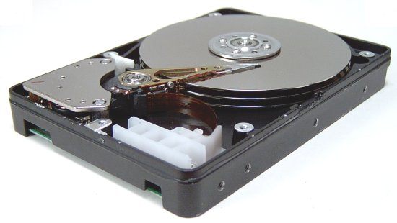
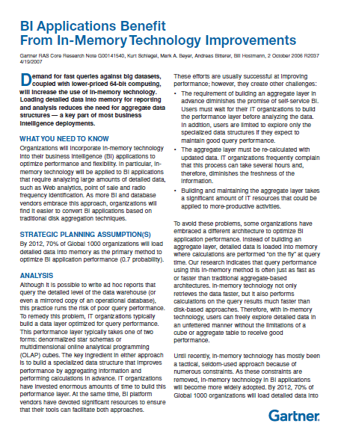
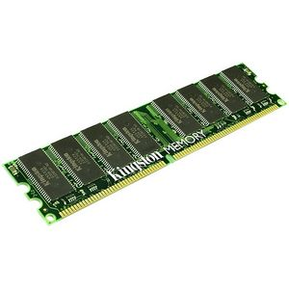
Speedup Data Access
1 Million Times Faster Than Disk
Conventional Databases
Disk Read
5 milliseconds
In-Memory Databases
Disk Read
5 nanoseconds
“By 2012, 70% of Global 1000 organizations will load detailed data into memory as the primary method to optimize BI application performance.”
- Gartner
Notes:
The answer is in-memory BI. The next frontier is switching from disk drives to memory. We are already doing that in our personal lives. How many of your walk around with a floppy disk? We all use flash drives. The same is true for our corporate data marts. It’s the shift to in-memory.
SAP BusinessObjects introduced in-memory databases in 2006 and is the first major vendor to deliver in-memory technology for BI applications. SAP BusinessObjects customers can query tens of millions of rows with an average query response of three seconds. No other BI platform or database vendors using traditional aggregation techniques can deliver this performance.
Today, SAP BusinessObjects has enabled in-memory business intelligence at 350+ global 1000 customer.
Examples – Novartis, Kimberley-Clarke, 7-11, Sharp, Yamaha, BP, Anadarko, Colgate, Kraft, BP, Conagra, T-Mobil, Bayer, Celanese

Slide 8
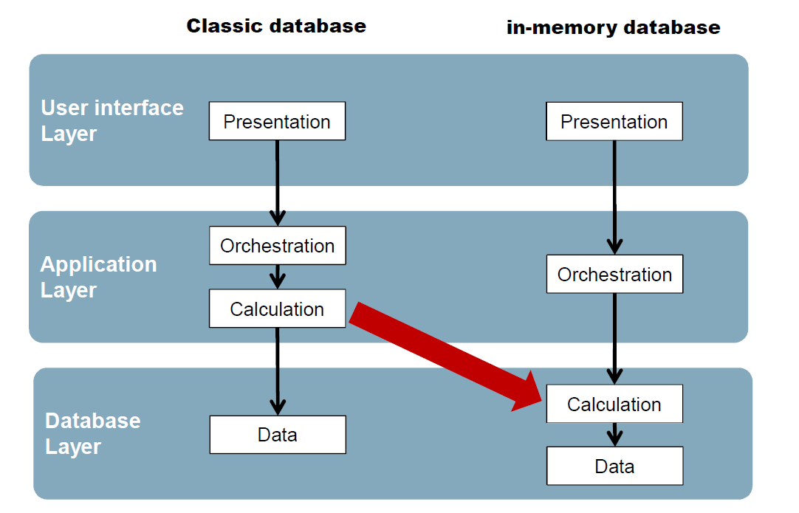
Minimize Data Movement

Slide 9



The Real Real-Time Enterprise is Real!
  Consumer Products: Experience 1
  How Our Innovation Provides the Real Time Visibility of Retailer Demand Data, promotion data and Out of Stock Analysis enabling
  Real-time → 70R - 460B - 50TB – 0.04Sec
  Automotive: Experience 2
Real time evaluated Contribution Margin by Brand, By Dealer, By Location and By Vin #
Executives received new insight into margin loss that they could act on right away
Notes:
Examples
Optionally show the Unilever demo – don‘t mention name!!
We are so eager to do make it impactful for YOU!
Mention Kraft data in voiceover and potential impact
But need w working model and agreement to make this happen (next slide)

Slide 10
Table of Contents
NEED FOR SPEED (IN-MEMORY)
SEARCH BASED BI (EXPLORER)
QUESTIONS

Slide 11

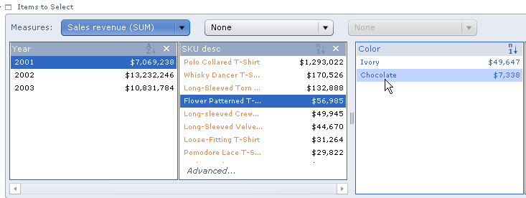
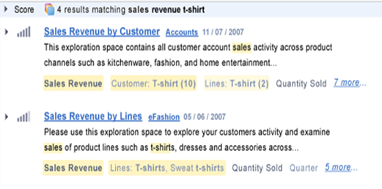
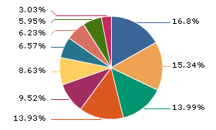

Solution Overview
SAP BusinessObjects Explorer
  SAP BusinessObjects Explorer, accelerated version brings together high-performance in-memory acceleration with intuitive search and exploration
  Users can search and explore large volumes of any enterprise data to answer ‘on the fly’ questions, discover relationships, and uncover root cause
  You can bring BI to all business users with immediate insight at the speed of thought without needing assistance from business analysts or IT

Slide 12

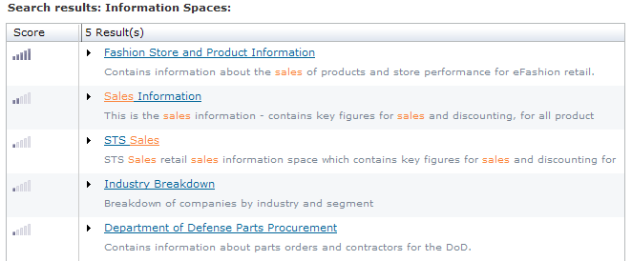
What Is SAP BusinessObjects Explorer?
It’s Search Against BI . . .
Uses familiar key-word search to find business information
  Answers on-the-fly and investigative questions
Searches directly on
pre-indexed data
  No previous reports or metrics need exist
  Provides fast search and exploration
Searches across all data sources
  Any universe accessible source
  Any source accessible to SAP BusinessObjects Accelerator
Notes:
Talk about the simplicity of search in a BI context and how intuitive it is to get information.
As a company we are introducing a new tool to serve these business users…
Draw parallels between Google search/analysis and Polestar. Polestar is also search and analyze. The workflow is similar to internet search.
It’s a self-service, search driven, point-and-click, and visually engaging information access to more users.
The overall experience is as easy as searching on the internet or browsing an online store and appealing to users who are not currently served by BI tools
Its as easy as exploring data with Google earth – very visual and interactive.

Slide 13
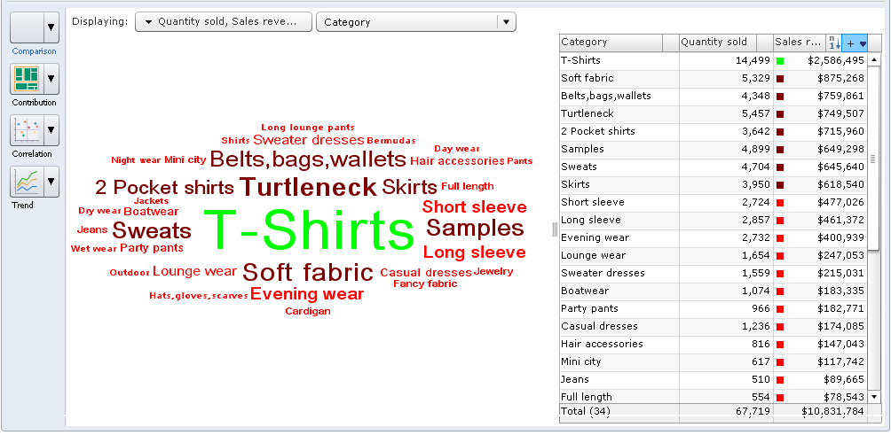
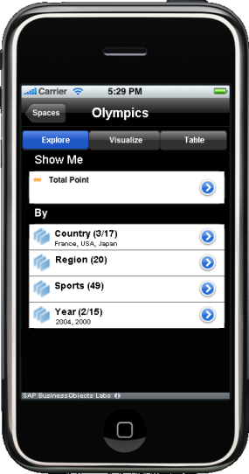
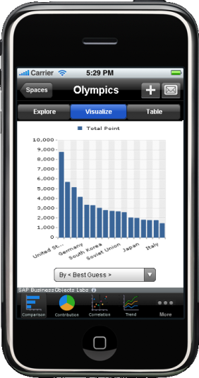
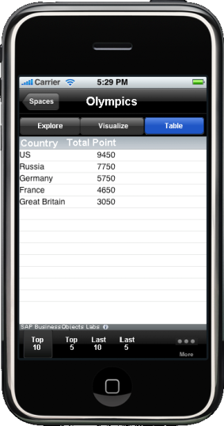
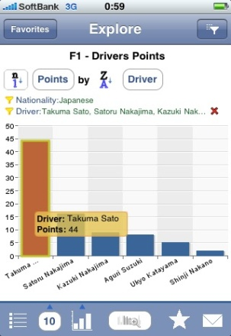
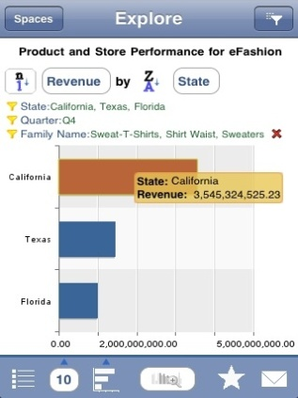
. . . and Then It’s Exploration of the Results
Intuitively explore on data
  No data model or data knowledge required
  Web or mobile
Automated relevancy of results
  Most relevant information is displayed first
  Best chart type auto generated
Share insights with others
  Export to CSV file or image
  Save locally as a browser bookmark
  Click once to send to e-mail
Notes:
Talk about the simplicity of exploring the relevant information that has been returned.
Give some examples auto relevancy
Comparing multiple measures like revenue and profit, Polestar displays a bar chart
Displays percentage breakdown of sales revenue by city – pie chart.
Without having to think too much what they are doing, instead focus on information.

Slide 14
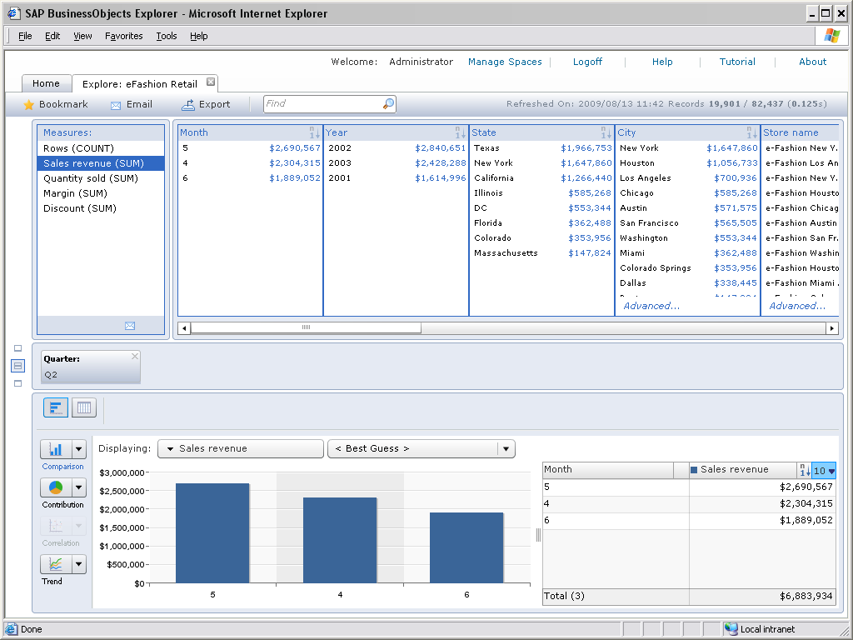
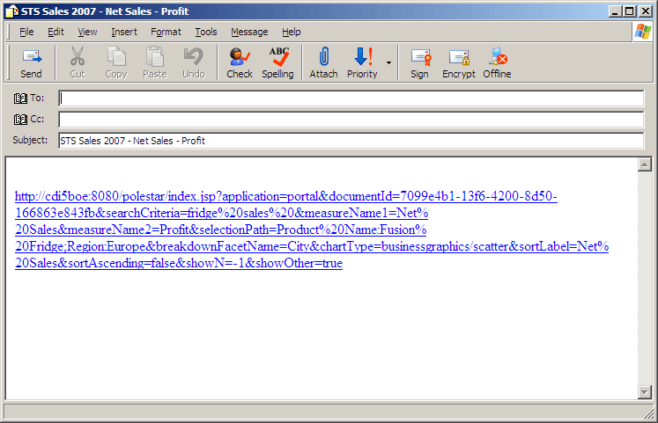
SAP BusinessObjects Explorer
Capabilities
Search
Explore
Visualize
Share
Notes:
Solution highlights
Search Against BI
Use familiar key-word search to find business information
Searches directly on
pre-indexed data
Searches across all data sources (any Universe or SAP NW BW Accelerator accessible source)
Explore the Results
Intuitively explore the data
Automated prioritization and relevancy of results
Easily share insights with others
Key Benefits
Enables higher performing organizations, thanks to pervasive BI and fact-based timely decisions
Allows IT to become a more proactive business partner supporting and even driving business changes, thanks to shorter time to delivery and heightened agility
Obtain valuable, never before identified insights that can be exploited for competitive advantage

Slide 15

Demo
What is SAP BusinessObjects Explorer software?
Search and exploration at the speed of thought.

Slide 16
Seeing Is Believing
Try It for Yourself!
Test Drive
You can go to http://www.ondemand.com/BI to register
Receive a confirmation e-mail with your access information
Go to the site, upload, and view datasets using SAP BusinessObjects Explorer

Slide 17

Questions

Slide 18
Contact
Sendhil P
SAP India Pvt Ltd
Bangalore
M +91 – 9886868609
s.p.sendhil@sap.com
www.sap.com

Slide 19
THANK YOU

