Slide 1
BEST PRACTICES
IN
DATA WAREHOUSING

Slide 2
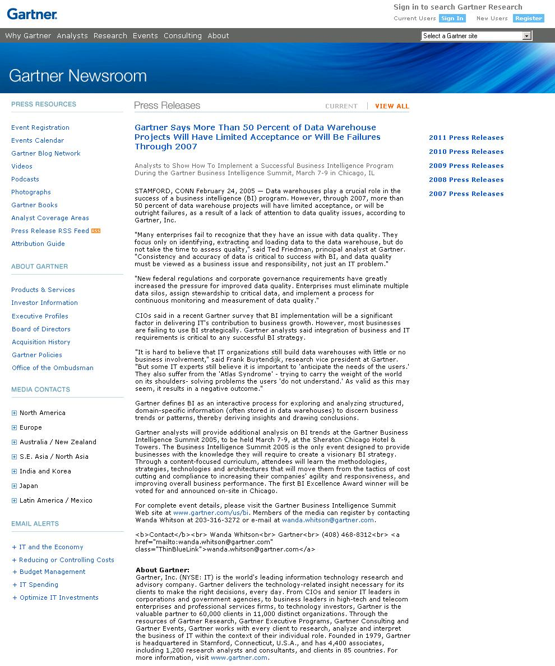
Best Practice # 1: Define Data Warehouse missions/goals:
Lot of confusion between Operational Data Store and Data Warehousing. One customer debating for months trying to findout: “What they need – ODS or DW”
Understand what BI can bring to the organization, Business Requirements of Data Warehouse & Useful Business Queries/Reports etc.
Gartner says: ‘However, through 2007, more than 50 percent of data warehouse projects will have limited acceptance, or will be outright failures
‘

Slide 3
Best Practice # 2: Effective DW/ETL Components/Processes’ Design and Implementation:
Effective ETL process is required for clean/useful data.
Recently, during our DW implementation:
We found lot of data quality issues while moving source to target.
Mismatched data types between source db (legacy, multiple databases)
to target database
-Incorrect Numeric value transformation
Incorrect Char value transformation (causing truncations, trailing nulls etc)
-Incorrect functional mapping of data (eg native CRM apps to Siebel etc)
We developed MIGRATION VALIDATOR product, fully customizable,
helped this client and many others

Slide 4
Best Practice # 3: DATA/DW/BI/Analytics is VALUABLE Businesses in decision making
Convince organizations that:-
PROFITABLE BUSINESS INTELLIGENCE and DECISIONS can be accomplished with DATAWAREHOUSING
DATAWAREHOUSING IS ORGANIZATION of CORPORATE DATA
HENCE, EVERY CORPORATE DATA IS VALUABLE
I remember hearing that:
Walmart made millions after 9/11 by realising patriotic sentiments in US caused huge demand for US Flag. By their BI applications on demand patterns of customers, Walmart realised this trend quickly, and sourced/stocked US flags in all their stores, overnight.

Slide 5
Best Practice # 3: Business Analytics getting popular
Business Analytics is fast emerging as a highly sought after process for every organization.
SW Vendors are quickly adding products and services in this area
(evidenced by many M&As in this area –
IBM acquiring COGNOS
Oracle acquiring Hyperion etc.
One of my friend who is an IBM FELLOW in USA, mentioned
in his presentations that
Business Analytics is has bubbled up as one of the top 3
strategic technology focus areas for many large companies,
to align their products and services.

Slide 6
Best Practice # 4: KEEP ALL CORPORATE DATA ONLINE
DON’T PURGE CORPORATE DATA, IT IS VERY VALUABLE
INVEST ON APPROPRIATE SW/HW for DATAWAREHOUSING
DW is vastly different than OLTP in schema, system requirements etc.
Keep OLTP and DW in different servers
DW databases can scale into Terabytes and Petabytes
Hardware Capacity is getting cheaper

Slide 7
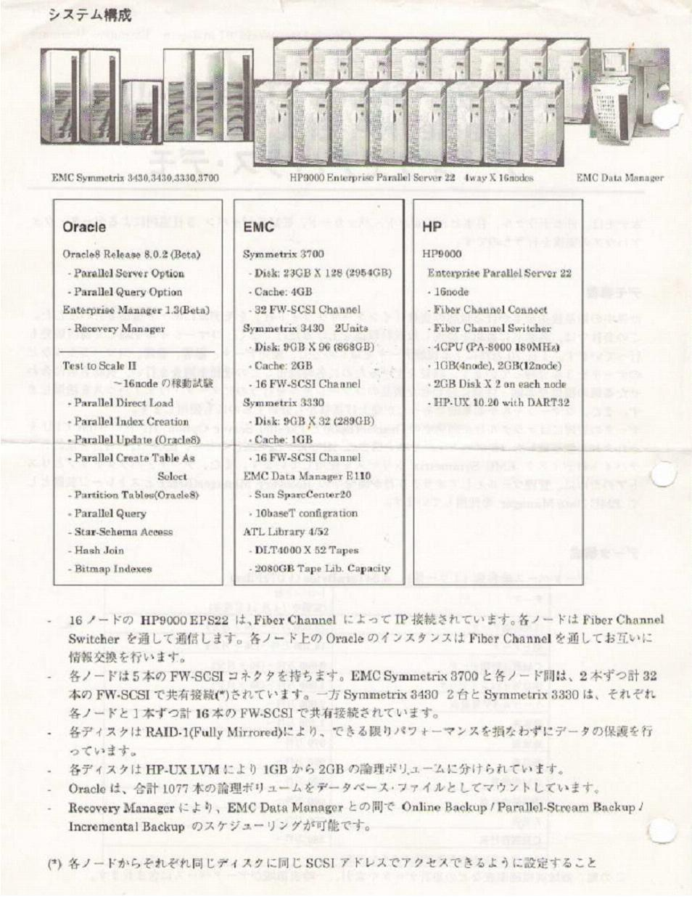
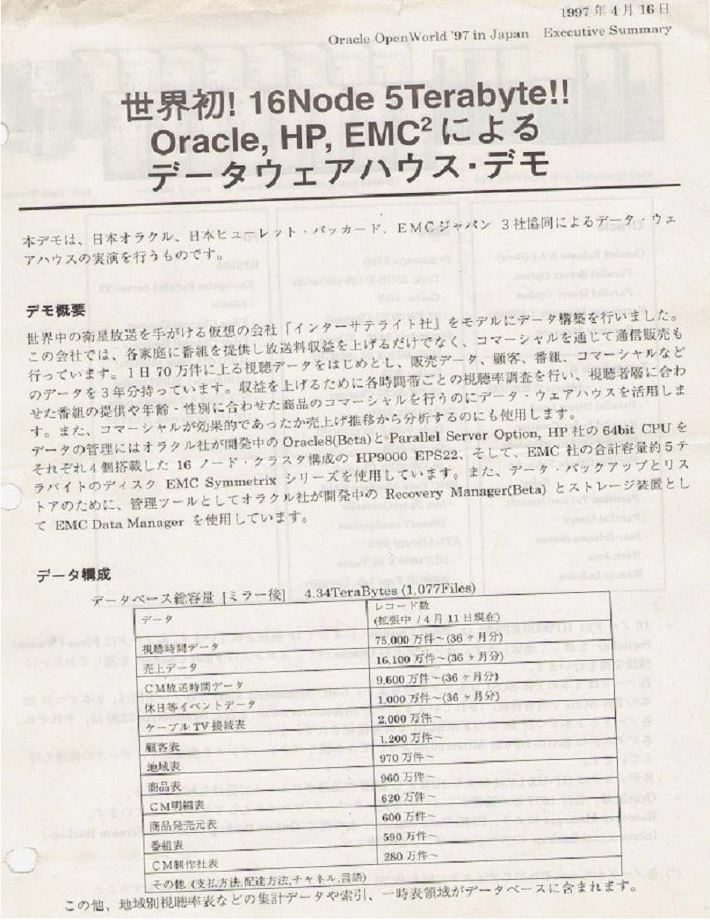
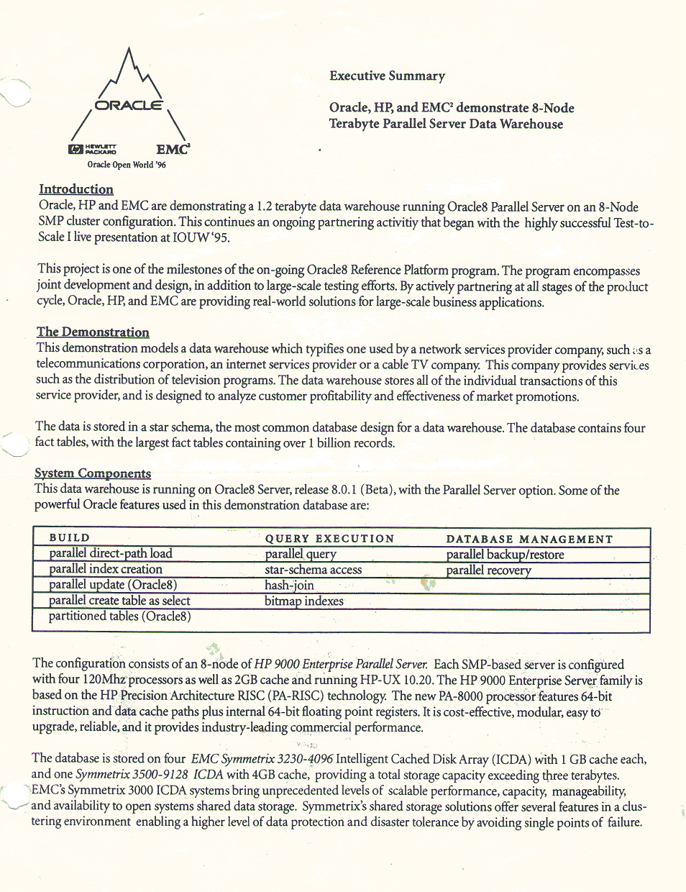
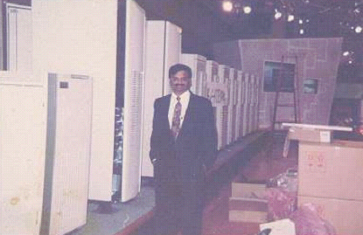
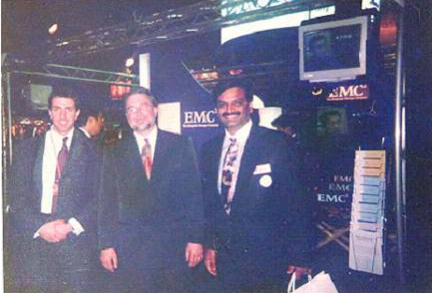
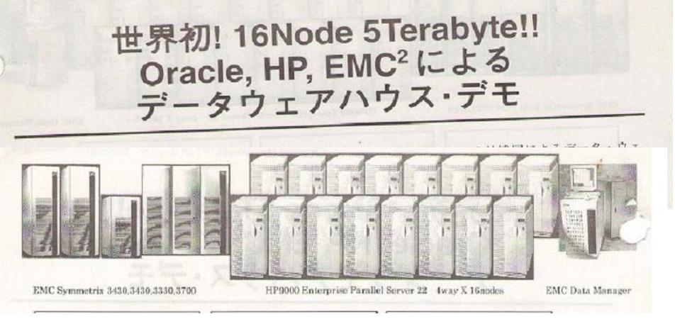

Slide 8
Best Practice # 4: DW sizes in early 1990s
Biggest DBs in 1992 was around 10TB Teradata/Mainframes
Open Systems 380GB (Merwyns)
Biggest Open System (Live/Prototype DW)
5TB in 1996 at OOW SFO/Tokyo (DW non-production)
68TB for British Telecom in 1998/99 (DW non-production)

Slide 9
Best Practice # 4: Size Does not matter
Metrics on eBay’s main Teradata data warehouse include:
2 petabytes of user data
10s of 1000s of users
Millions of queries per day
72 nodes
140 GB/sec of I/O, or 2 GB/node/sec, or maybe that’s a peak when the workload is scan-heavy 100s of production databases being fed in.
Biggest Open Systems Databases exceed 100 Terabytes

Slide 10
Best Practice # 4:
Metrics on eBay’s Greenplum data warehouse (or, if you like, datamart) include:
6 1/2 petabytes of user data
17 trillion records
150 billion new records/day, which seems to suggest an ingest rate well
over 50 terabytes/day
96 nodes
200 MB/node/sec of I/O (that’s the order of magnitude difference that
triggered my post on disk drives)
4.5 petabytes of storage
70% compression
A small number of concurrent users

Slide 11
Best Practice # 4: Data warehouses getting HUGE!!!
eBay:- 5 petabytes
Walmart:- 2.5 petabytes.
Bank of America:- 1.5 petabytes.
An unnamed financial services company:- 1.4 petabytes.
Dell:- 1 petabyte.

Slide 12
Best Practice # 5: DATAWAREHOUSING PERFORMANCE
Use Appropriate Schema (Star/Snowflake/hybrid/cube)
Use Appropriate Performance Optimization Techniques for the Schema
Use Materialized Views extensively for better query performance (my opinion), for pre-solving aggregates, built-in functions etc.
Think overall performance of system (etl/load efficiency and performance, Query performance, Reports’ flexibility and performance etc )
Use extensive hw (cpu/io parallelism for query performance, load performance etc.

Slide 13
Best Practice # 5: DATAWAREHOUSING PERFORMANCE
Use PPPs for performance
Power (Raw CPU/IO Bandwidth
Partitioning (Partition Large objects like Fact tables)
Parallelism
Use extensive hw (cpu/io parallelism for query performance, load performance etc.
Use ‘In the box CPU Scaling (with SMP Servers, by adding CPUs.
Or Clustered ‘Out of the box CPU Scalling’ using Parallel Databases

Slide 14
Best Practice # 6: Appropriate ETL tools and products
Found many unique requirements in many ETL Scenarios
For best results use standard tools for customised ETL environment,
Or
Customised components – like Fast Direct Data Loader etc…
We have developed a fully customizable ETL product for a customer
In less than 6 months (using about 40 man-months), this saves their
ETL daily processing time by more than 60%, and data is lot more cleaner
With built in Data Verification/Validation, with flexible Transformation Rules.

Slide 15
Source objects
Target objects
Mapping
Source modeling
Mapping
Target modeling
Source base model
Target base model
Extraction
Extracted Data
Transformation
Extraction Engine
Loading
DB
connection
Failure message.
Check connection
parameter
Control files Structure
Loading Process
Bad File
if any
Oracle Target DB
Log File

Slide 16
Contact us: Raman Govindarajan, rgovinda@perfsystems.com
India:
Perfsystems India Pvt Ltd.,
4/39, Prithvi Avenue,
Abhiramapuram,
Chennai, 600 018.
Phone 91 (44) 2499 2084
Fax 91 (44) 4210 1582
USA:
Perfsystems Inc.,
#2880, Zanker Road,
Suite 203,San Jose,
California 95134 USA.
Phone 408 954 7320
Singapore:
Perfsystems Singapore Pte. Ltd.,
111 North Bridge Road,
#16-04 Peninsula Plaza
Singapore 179098.
Phone: 6492 5823
Follow us on:
mktg@perfsystems.com || hr@perfsystems.com
www.perfsystems.com

Slide 17
Thank You

