Slide 1
“Applied BI and Analytics” in Retail & CPG
Vadiraj Muthya

Slide 2
Just so that we are on the same page…
The term BI in this discussion encompasses Business Intelligence, Information Management and Business Analytics
Retail – Refers to broad range of retailers across the globe which includes Wal-Mart, Target, Best Buy, Tesco,Morrisons, Big Bazaar
CPG – refers to consumer products group which are primarily manufacture consumer products. Ex: Hindustan Unilever, Proctor and Gamble, Wipro Consumer Care, Nestle and Colgate

Slide 3
Objectives of this session
1
Introduce you to Business aspect of BI
2
How Retail companies leverage BI
3
Think Differently !! about application of BI
Notes:
30 se

Slide 4




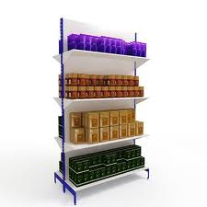
Retail Store- A Day in life
Customer Happiness Index has direct impact on financial success of the company

Slide 5



Retail Store- A Day in life
1
2
3
Who are our suppliers ?
Supplier Effectiveness !
Do we have enough inventory ?
Product Affinity Analysis
Who are our customers ?
What are they buying ?
How do we ensure retention ?
What is our Employee cost ?
How to minimize ?

Slide 6
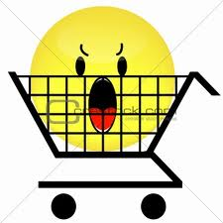

A Day in life-Popular Retail Store in India
1
2
3
Who are our suppliers ?
Supplier Effectiveness !
Do we have enough inventory ?
Product Affinity Analysis
Who is our customer ?
What are they buying ?
How do we ensure retention ?
What is our Employee cost ?
How to minimize ?

Slide 7
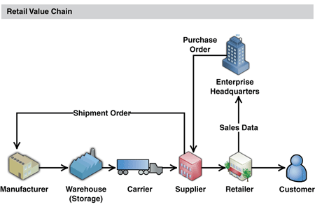
Retail Value Chain
Customer
Sales & Marketing
Store Operations
Merchandise Management
Supply Chain Management
Corporate Functions

Slide 8
Information Value Chain
Optimization
What is the best than can happen ?
Predictive Modeling
What will happen next ?
Forecasting
What if the trend continue ?
Statistical Analysis
Why is this happening ?
Alerts
What actions are needed ?
Queries/Drill Down
Where exactly is the problem ?
Adhoc Reports
How many, how often, where ?
Standard Reports
What Happened ?

Slide 9
BI/DW Reference Architecture
Source Systems
Data Integration
Pre ETL Scripts
Staging Area
Data Cleansing
Tool based solutions
Information Layer
Data Model
Metadata
Rules Engine
Presentation Layer
Reports
Alerts
Cubes
Dashboards
Data Mining tools
Analytical Reports
ERP
Mainframe
CRM
External Data

Slide 10
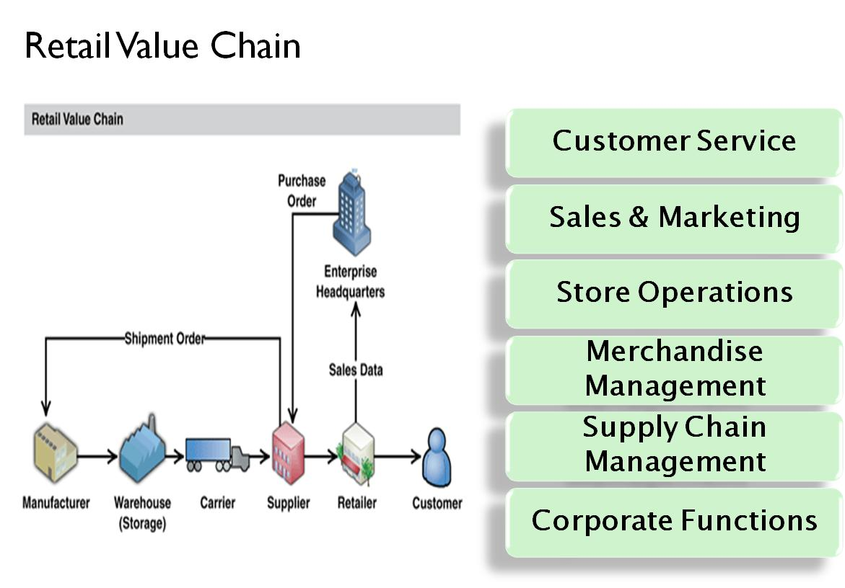
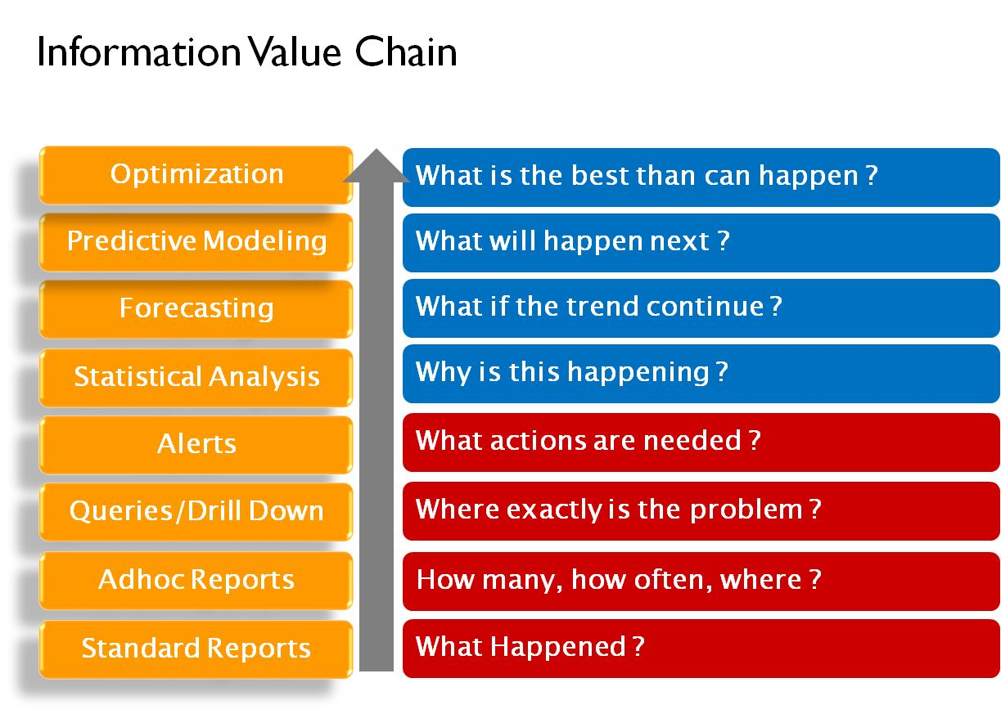
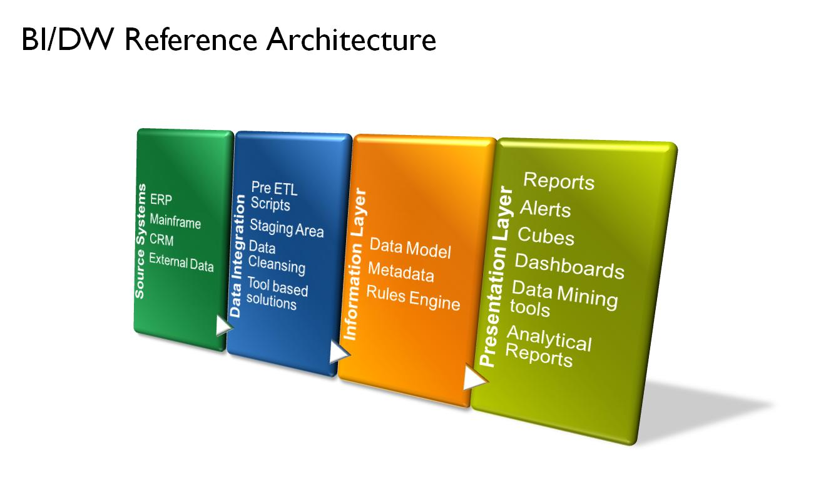
Putting Pieces together- foundation for “Applied BI and Analytics”
Focus on maximum impact area in Retail Value Chain
..and understand Information value chain needs for chosen area
..and build information layer in conjunction with above requirement

Slide 11
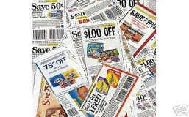

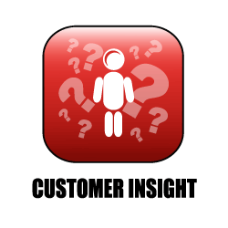
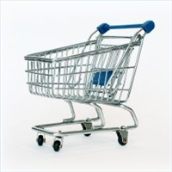






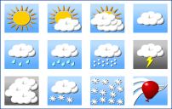


Know your Customer – Value chain
Campaign
Reporting
Coupon Redemption Report
MEASURE
Trip-level insight
Brand Preference
UNDERSTAND
Competitor Response
Loyalty Scorecard
NURTURE
Market Basket Analysis
Email mktg dashboard & Social Media Conversion Reports
TARGET
National Sales and Weather Dashboard
Customer Life Time Value Scoring
Campaign Response Modeling
11

Slide 12












UNDERSTANDING Ms. John
Demographic attributes
Behavioral attributes
Television is her primary media influence
Lives in St. Louis
Her Average basket size is $ 45
She works as a teacher
In the local primary school
She transacts at multiple
Stores
She is Brand Loyal
Psychographic attributes
In store attributes
Prefers traditional family sit down dinners
She is a health freak
Loves Social Networking
She lingers the longest in sections which have promotions/offers
On an average I spend 63 minutes per trip in the store
Customer Segmentation
Customer Lifestyle and Life stage
Customer Profiles
Loyalty Analysis

Slide 13
CONNECTING with Ms. John
The right message
To the right customers
Using the right channels
Wow!!! Just got a 10%
Coupon on organic vegetables through my mobile. Just what I need
I am eligible for a surprise gift because I joined the loyalty program
I am a fan of Retailer XYZ’s page on Facebook. I can track all their offers
Real time…
Oh my, I get 1% off if I use my co-branded credit card? That's nice!!!
Coupons analysis
LTV Modeling
Campaign Management

Slide 14
Summary
It is critical to understand Retail and CPG Industry value chain and underneath data/metrics to be effective
Study your customer’s BI Adoption maturity by using Information Value Chain.
Focus, Focus and Focus on building right Information model to realize the value of “Applied BI and Analytics”
Every BI Project must have alignment with key business impact- watch out for this.

Slide 15
Thank you vadiraj.muthya@gmail.com

