Slide 1
Android pitfalls
Business challenges and Technical challenges
Gururaj K Parvati
Technical Director
MindTree Ltd

Slide 2
An automaton that is created from biological materials and resembles a human.

Slide 3
Agenda
A shameless promotion about
Myself and MindTree
Business reasons to re-think Android
Is Android really a great platform to migrate your products to?
Android beyond phone – A view on where it is getting used?
Technical reasons
Do you really want to do Android development? What are the challenges
A demo of lighting control using a Android phone

Slide 4
Disclaimer
I don’t hate Google
I don’t hate Apple or Microsoft either
These are my personal views
There is no one right or wrong answer
I am not promoting Android development
I am not discouraging Android development
I love Android

Slide 5
Business reasons
Why you need to be careful?

Slide 6
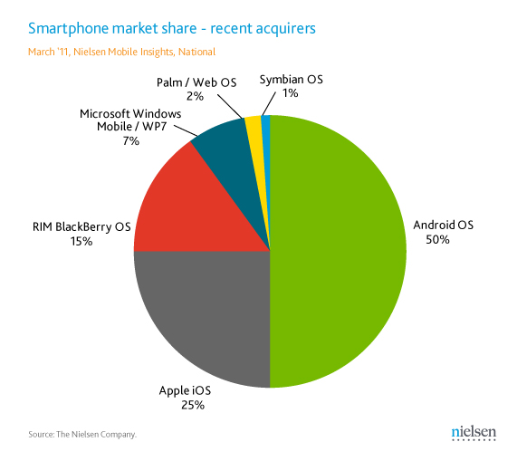
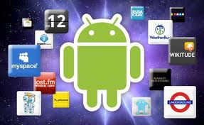
A look at the market condition
It is very tempting

Slide 7
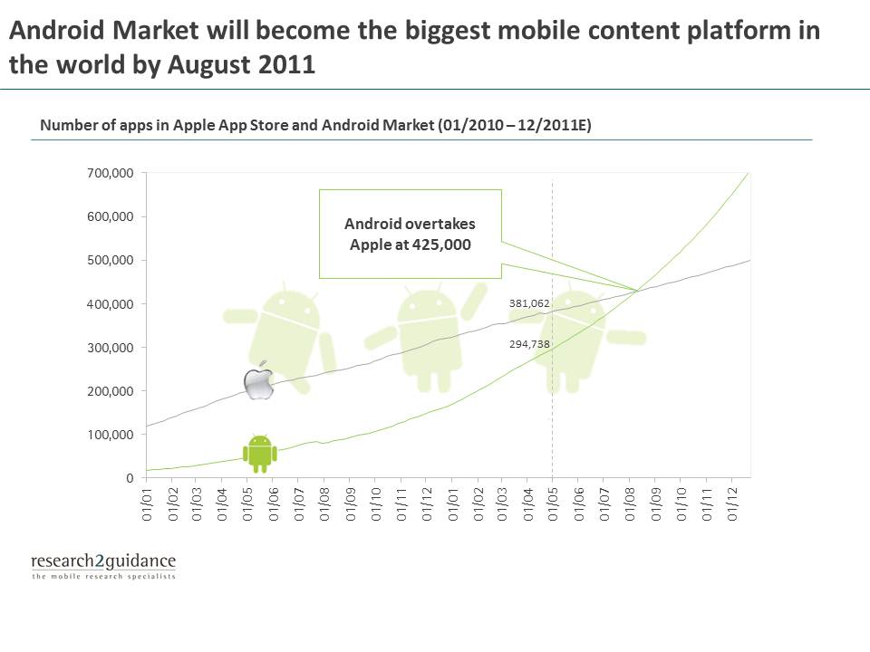
It is very tempting

Slide 8
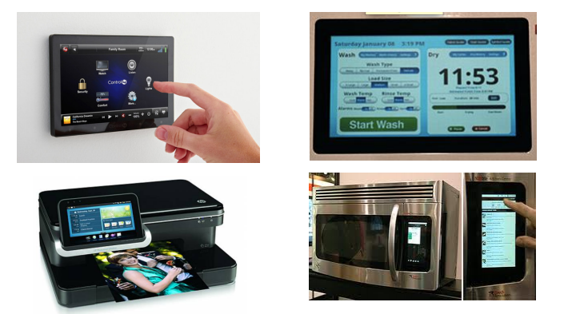
Android beyond phone

Slide 9
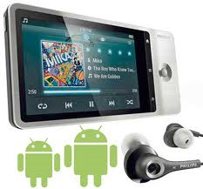
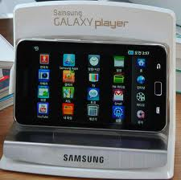
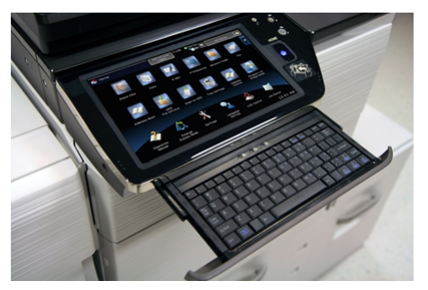
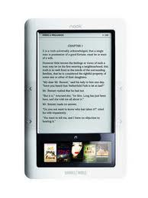
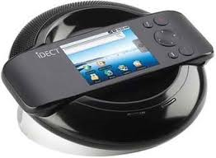
Android beyond a phone

Slide 10
What is available and what is missing?
What is available | Missing pieces
Open source platform | Custom libraries, drivers, app frameworks for printer, scan, fax
Off the shelf hardware | Security
Growing developer base | Priority of the services
Lot of stack components | App store control/app market locking
Touch screen | Device management (below froyo)
Bluetooth | Multi user support
Wifi | VoIP telephony (SIP Components are in 2.3+)
Graphics | Video conferencing (Front camera support in 2.3.1, USB Host (in 3.0)
Sensors | UI for TV use (Honey comb has a emulator now)
Audio, | Picture in picture
Video | Reliability for auto industry
Codecs | Multi screen support
 | Streaming and DRM support

Slide 11
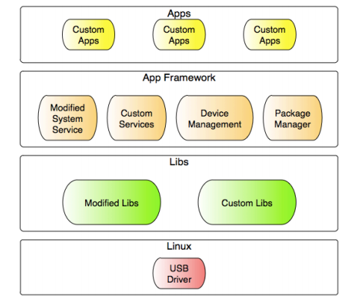
Where all do you need to modify?
Custom drivers

Slide 12
However..
It is a messy market do you know why?

Slide 13
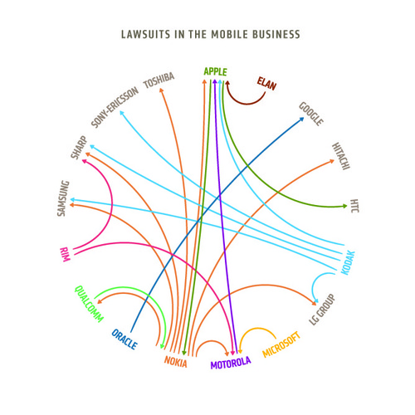
Source http://www.guardian.co.uk/technology/2010/oct/04/microsoft-motorola-android-patent-lawsuit

Slide 14
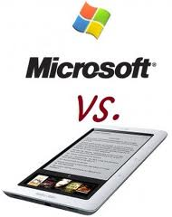
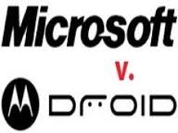
Point 1: If you can’t beat ‘em, sue ‘em.
Source: http://9to5google.com/2011/07/06/microsoft-seeking-royalties-from-samsung-potentially-worth-200-million-a-year-on-galaxy-s-smartphone-alone/

Slide 15
Point 2: The update process is painful
Samsung Epic 4G Android 2.2 Update Causing Problems, Suspended by Sprint
If one vendor makes a terrible Android phone, it has the ability to taint the perception of the Android platform itself.

Slide 16
Point 3: Some more issues
Google was forced to remove several applications from the Android Market after they were found to contain malware. Worst of all, they were believed to be downloaded over 250,000 times. Experimental hobby?
Is 2.3.4 is last edition of Android for phones? What next? Google is switching its strategies very fast from Phones to Tablets to Google TV and Chrome based laptop. Which market it is looking for?
Unclear distribution channels: People can host their application without having them added to Google App store

Slide 17
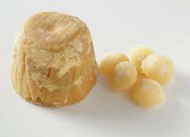
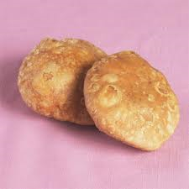
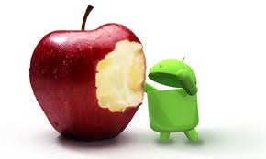
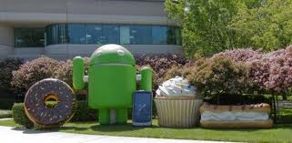
Point 4: Other consideration
Google has always been saying this is free, but looking at who is making the money in the smart phone biz, Google may want to have a share of the “Apple” pie. Given the open and closed nature, can we rule this out?

Slide 18
Who is winning and losing?

Slide 19
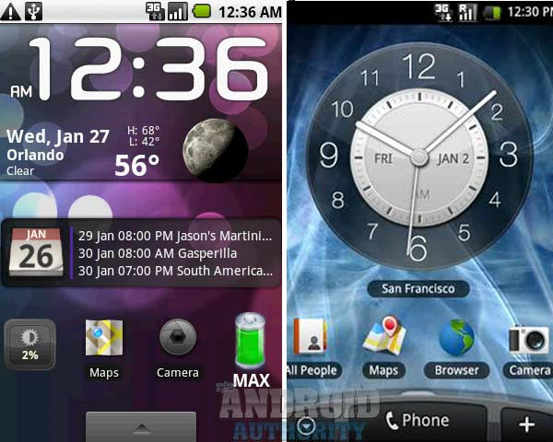
Android Advantages: Question the status quo?
Ability to customize the OS like never before. Differentiate or Die
Reduced Product life cycle
Men Wanted: For Hazardous Journey, Small Wages, Bitter Cold, Long Months of Complete Darkness, Constant Danger, Safe Return Doubtful, Honour and Recognition In Case of Success.
-- Sir Ernest Shackleton, 1954

Slide 20
Technical reasons
Why you need to be careful?

Slide 21
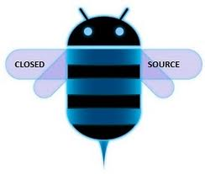
Point 1: Do you want to be a open source developer?

Slide 22
Point 2: Documentation issues
Android came up with new multimedia framework Stagefright. However this was no documentation available at all!!
Multiple instances where developers are struggling to get the required support

Slide 23
Point 3: A2DP, Power Management
It is not easy to add a new SBC or a Mp3 codec for streaming on a end product to a A2DP profile
Power management features like wake on call (pm_qos), IPC binder is not accepted by Linux community (D-Bus is preferred way).

Slide 24
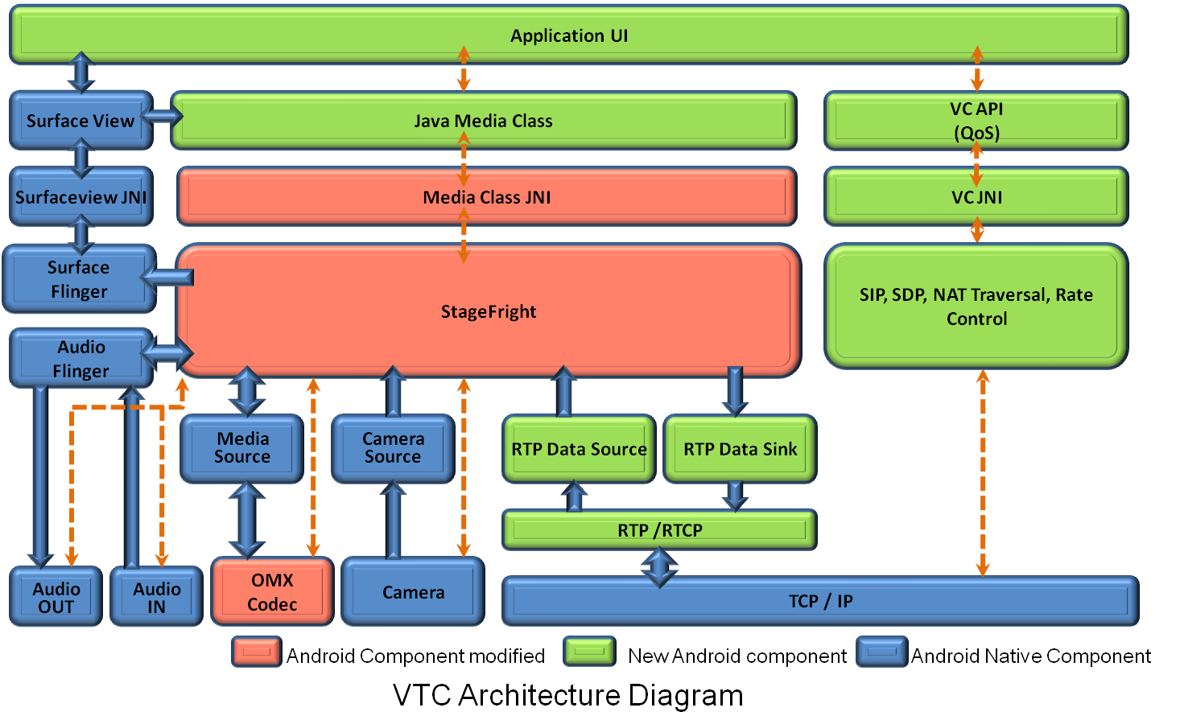
Point 4 : Multimedia Issues – Does it look easy!

Slide 25
Point 5: Do you want to migrate your IP?

Slide 26
Is this a good idea to be a Android developer?
Yes your skills on driver development from Linux background will help. In future if Android is not there you can still fall back on good old Linux.
Yes if you can base your game engine on C/C++ code with Native NDK implementation and learn OpenGL 2D/3D. In Android it is similar to J2ME JSR239 OpenGL ES API.
Yes if you are a Java developer you can migrate to Android. However Android has specific set of classes and libraries that is suitable for a phone device

Slide 27
A Video demo of lighting control system

Slide 28
In Summary
Enjoy the gold rush while it lasts.

Slide 29
Questions

