Slide 1
Cloud Testing – Guidelines and Approach

Slide 2
Agenda
Understanding “The Cloud”?
Why move to Cloud?
Testing Philosophy
Challenges
Guidelines to select a Cloud based solution
Optimum Approach
Questions?

Slide 3
Understanding “The Cloud”
Cloud Computing – model for Software development, deployment and delivery, providing real-time delivery of products, services and solutions over the Internet
Cloud Services – model for providing commercial and business applications, services and solutions that are delivered and consumed in real-time over the Internet

Slide 4
Understanding “The Cloud”
Cloud Services
Offsite, provided by third-party vendor
Accessible globally over internet
Managed services – no implementation and maintenance effort
Provisioning
Cost – based on usage
Shared resources – Standard software editions

Slide 5
Why move to the Cloud?
Massive Computing Power:
Cloud infrastructure providers are built on the world’s largest datacenters.
This allows them to marshal gigantic quantities of computing power as-needed.
Improved Cost Basis:
Cloud providers focus on offering access to highly efficient computing resources.
They have not only economies of scale but also a dedicated focus on providing these infrastructures.
These efficiencies can be passed on to you so your company can focus less on managing hardware and more on what differentiates you.
Elastic Pricing Models:
Based on usage. This means that you pay for what you use as you use it, avoiding large upfront costs.

Slide 6
Testing Philosophy – Will it change?
Alignment with Business / Requirements
Risk Based Testing – Prioritization
Test Planning – Plans, Test cases, Scripts etc.,
Defect / Issue Management
Project Metrics Collection

Slide 7
Challenges – While testing from the Cloud
Multiple environments – Integration issues
Test Data Management – Data creation, Data masking
Security concerns
Regulatory and Legal Compliance
Defect Isolation and Resolution
Dependency on “Third party services” – Roles and Responsibilities

Slide 8
Guidelines to select a Cloud based solution

Slide 9
Distributed availability
Peak Demand vary based on Geography and Schedule
Accessible across globe and pay just for what is needed
May
June
July

Slide 10
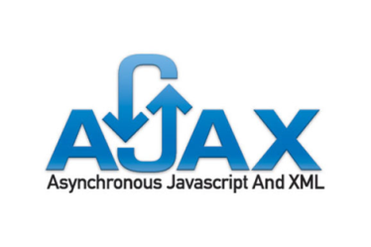
Support for relevant Technologies
Web 2.0 Internet applications
Background interactions and rich client-side support

Slide 11
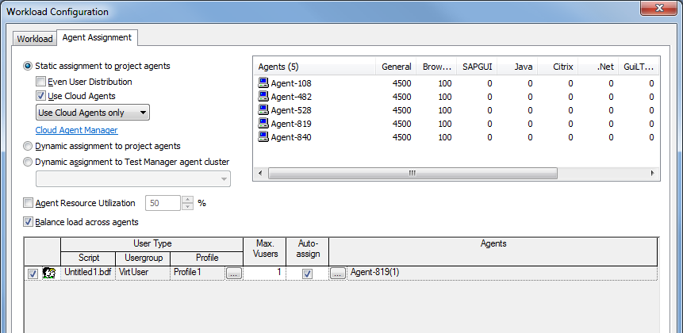
Ease of Management
Control tests with powerful management tool
Add instances to a test
Configure Cloud agents for VU’s
Manage tests – not cloud infrastructure
Reuse existing Performance testing assets
Performance Test tool
Cloud based Offering
Existing Scripts

Slide 12
Controlled Costs
200,000
When your application fails during test, you should pay only for what you’ve used
VU Goal Level
150,000
Application fails
100,000
Virtual Users
Match costs with business reasons for testing
50,000
0
Time

Slide 13
Enterprise Coverage
Cloud-Based Test Agents
XYZ Enterprise Cloud Services
Cloud-based
Application
Loads
Manage
Virtual Users
Loads
Internet-facing
Application
Performance Test tool
Virtual Users
Internet-facing
Application

Slide 14
The Optimum Approach
Solution should not be exclusively Cloud based
No capabilities for managers to diagnose identified issues in an application
If a transaction is non-performant or a system doesn’t scale, you need more than response times and other related metrics
You need deep-dive information to show what occurred in the application.
You need to identify which transactions, workloads, or code are consuming high levels of resources and resulting in scalability issues
An approach that offers both Cloud-based load generation and onsite monitoring and diagnostics is the most reliable approach for this

Slide 15
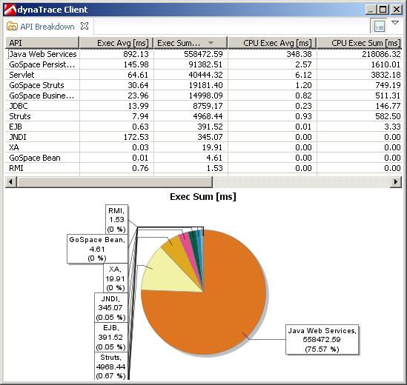
Rapid Issue Resolution
Legacy
85,000 Objects
over SOA calls (19 sec)
Locate and understand issues to speed resolution
Web/RIA/RC
Java
.NET
Legacy
Memory
Leak
163 Calls to Database
(24 sec)
CICS MQ
Context log messages, exceptions, method arguments, …
DBMS
EAI SOA
Poor
Component
Performance
(10 sec)
Synchronization issue (15 sec)
Traversed path

Slide 16
Thank You
keerthi.kulkarni@microfocus.com

