Slide 1
What’s ailing retail today
A presentation made to Silicon India Strategic Marketing Summit
on 26th November 2011
26th November 2011

Slide 2
Let’s do a little quiz . . .

Slide 3
Which shop belongs to which brand?

Slide 4
Okay. Look closer

Slide 5
And the other one . . .

Slide 6
One is Giovani and the other Van Heusen
These outlets are one shop apart on the same floor of the same mall
If, as educated retailers it’s difficult to tell the difference . . .

Slide 7
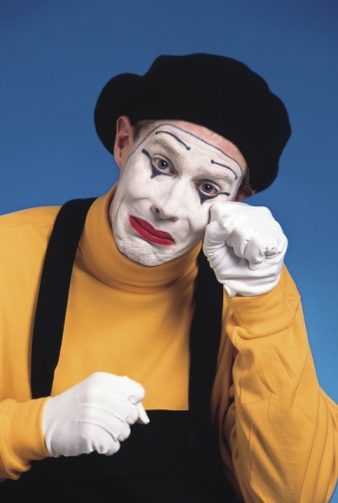
(Pity the poor consumer)

Slide 8
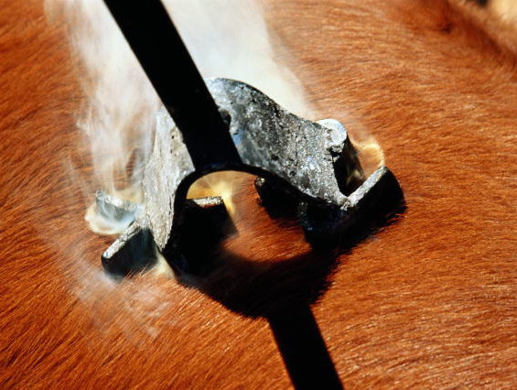
And that’s what is ailing retail today – branding (or the lack thereof)
There is simply no differentiation
There is a view that a mere brand name and the product range-price equation can substitute branding
While consumer products have traditionally used huge amounts of research and therefore consumer insights, retail has just used a simplistic twin strategy:

Slide 9
Logo . . .
And Location

Slide 10
That’s why you get questions like this:
I have a Food World, a Spencer’s, a Reliance Fresh and a More within 500 meters of my house – where do I go for a box of Close-up?”
Hey! I’m entitled to go 5-star - so Taj, Oberoi, Welcomgroup, Leela - anything goes for me. What’s the big difference?

Slide 11
Branding an experience versus branding a product
Consumer goods manufacturers offer something tangible which consumers can see, touch, feel
Making the brand easier for a consumer to understand
Even when differences between brands are narrow, consumers can see differences more easily – though they may find them to be narrow
The retailer has a more difficult time as a service needs to be experienced

Slide 12
But . . .
It takes about 60 seconds to feel the difference and know how one retailer stacks up against another
There is a need to make every customer, even when there are millions, feel human, unique and important for those 60 seconds
Which involves “a relentless focus on the intangibles”
But the “intangibles” must be dictated by your brand

Slide 13
So what is a brand?

Slide 14
A definition
A brand is a bundle of functional benefits and added values that some people value enough to buy into repeatedly.
The added values are normally a result of a strong, well-differentiated brand idea

Slide 15
This is what’s missing in most Indian retail brands

Slide 16
Why every brand needs a unique idea

Slide 17
Emotion – the key to consumer behavior
Purchase decisions are never based on rational thought processes. Never
All consumer research and practical marketing experience has shown that emotions drive decisions and behavior
An international research has shown that emotions are twice as important as any other consideration when it comes to a buying decision
Only after making a decision emotionally do we call upon our powers of reasoning to rationalize our decisions – even terrible decisions

Slide 18
Style is substance
Fashion is function
Feelings are the most important facts
The soft stuff is the hardest stuff to get right

Slide 19
Changing customer expectations
35 years ago there were only three car brands available in India
Today there are upwards of 100 and people still complain about the quality of cars
All cars are either discounted or given to a customer with special concessions on financing or with extra free fittings
In 1986 there were only 5 models of motorcycles available to the Indian consumer – and we were all enormously excited by the new 100cc bikes Hero-Honda, TVS-Suzuki and Escorts-Yamaha had launched
Now there are more than 200 motorcycles and variants in the market and manufacturers are pursuing the most venal tactics to win customers

Slide 20
Where our mothers were satisfied with Ponds Cold Cream, our wives are looking at a choice of over 250 different skin-care products from more than 10 brands
In the 1970s, our choice of toothpaste was limited to Colgate, Close-Up and Promise – today, there are four variants of Pepsodent alone

Slide 21
Our standards are going up
A large percentage of today’s customers consider fast broadband a necessity – 24% in the United States and up to 12% in India
Most office workers consider air-conditioning a necessity – over 75% of Indian employees in the private sector
No research is available on this, but I’m willing to bet that these trends are catching up in India:
An ever-increasing number of customers believe air-conditioning is a necessity in a bank’s branch
Most customers are worried when a bank has no ATMs
Credit cards are increasingly being seen as a necessity

Slide 22
People are increasingly seeing what was considered a luxury as a necessity
So how does that make a difference to brand strategy?

Slide 23
The brave new world of branding
The earlier paradigm was “Fast, good or cheap – pick any 2”
This no longer applies.
Today’s customers want fast, good and cheap. No question of making that choice
Which means that superficial is anything but
Customers want the little things done better
Competitive advantage will be built on elements once considered superficial

Slide 24
Simply, consumers want Fast + Good +
Cheap +
X-Factor

Slide 25
And the X-Factor is what makes a brand

Slide 26
What can be the X-Factor that’ll build a retail brand?
That’s the big question

Slide 27
A choice of X-Factors
There are a range of possible X-Factors to choose from, but they all involve two factors:
Internal buy-in
External desires

Slide 28
X-Factor = Responsibility

Slide 29
Responsible – what it means
Paying heed to Corporate Social Responsibility to both environmental and ethical issues
A positioning based on how you treat the community in which you operate and where you source your raw material and labor

Slide 30
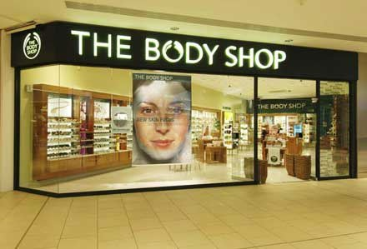
The Body Shop
The Body Shop has built a business on a reputation for social and environmental activism
It was banned in China because none of its products have been tested on animals
It formed an alliance with Greenpeace in 1986 for their ‘Save The Whales’ campaign
Even after a buy-out by L’Oreal, sales continue to grow

Slide 31
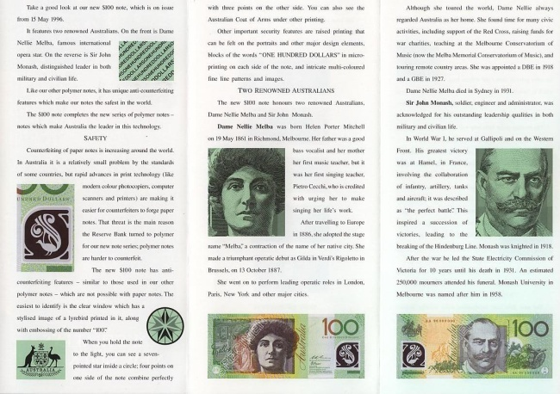
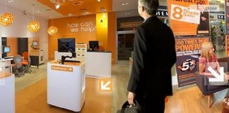
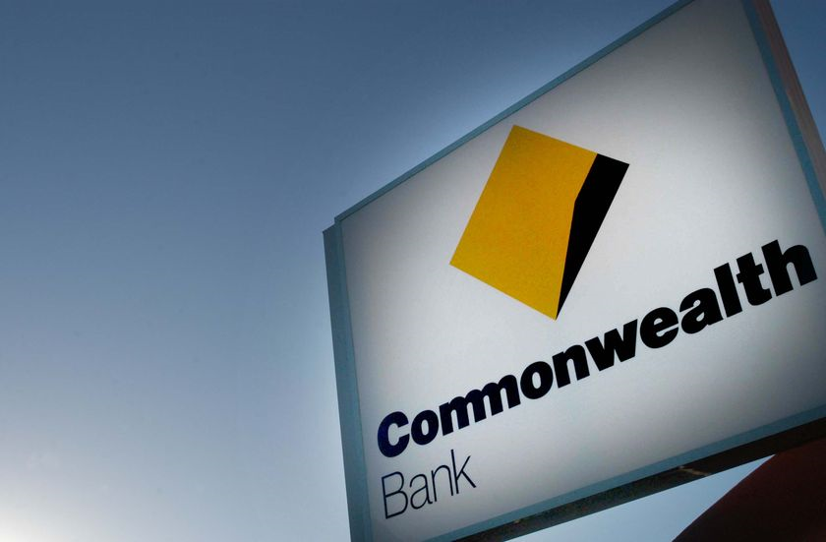
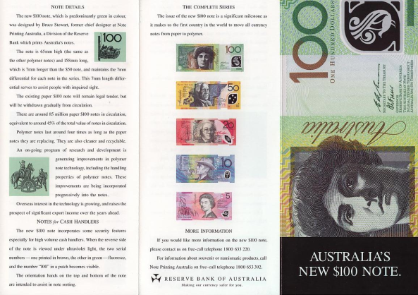
Commonwealth Bank
In Australia the bank invests millions of dollars in helping young Australians to improve their financial literacy with seminars, websites and leaflets
(Apart from sponsoring cricket)
Deposits by the youth have increased 55%

Slide 32
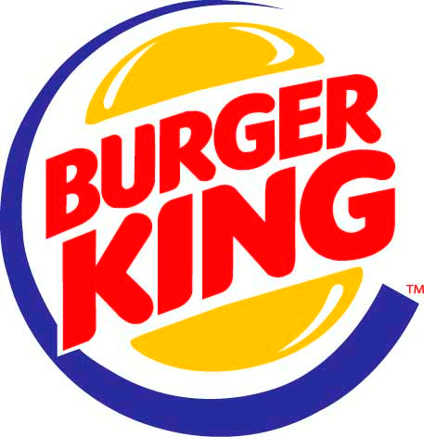
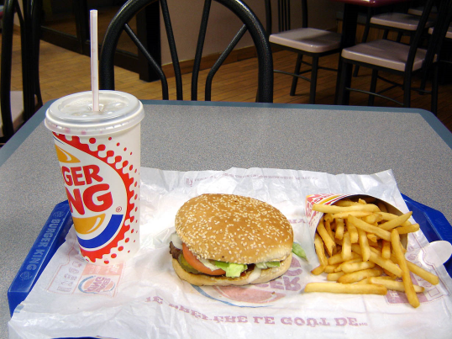
Burger King
The fast food giant announced it would source more eggs from free range chickens and pork from pen-based farms.

Slide 33
How can you be seen as ‘responsible’
How do you dispose of your garbage?
How can you look like you’re socially responsible?
By using recycled paper bags instead of plastic?
By using solar power in your stores?
By limiting the use of fossil fuels in your delivery vans or motorcycles – go battery operated?
Can you hire the physically or intellectually challenged?
Do you have ramps or elevators at all locations?
Where do your delivery trucks park outside your store?
Do you have parking for customers?
What else?
(A hint: ask your customers)

Slide 34
X-Factor = beauty

Slide 35
Beauty – what it means
There is evidence to prove that people buy beautiful things even when they are not as practical – preferring beauty to practicality
This would add up to a position where your product is quite simply more beautiful than the competition

Slide 36
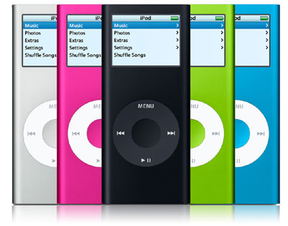
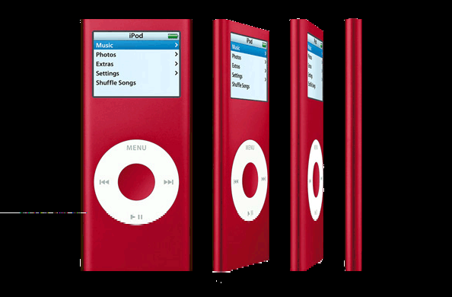
The iPod
Apple sells 25% more product than similar-featured mpeg players – simply because iPod is better looking

Slide 37
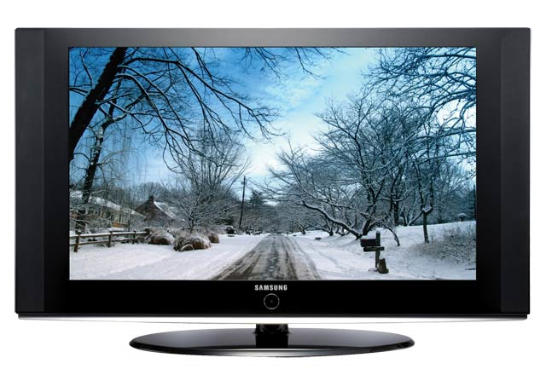
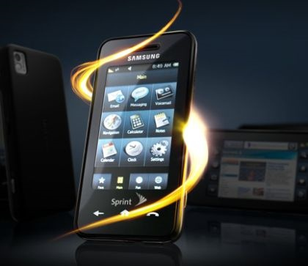
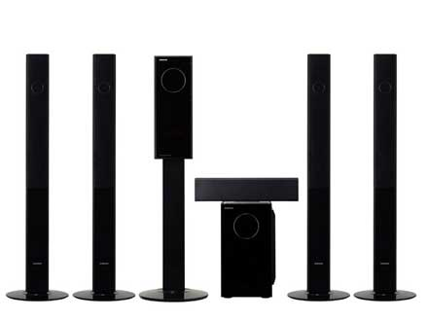
Samsung – the beautiful
Samsung has changed its entire image in the US market – from a cheap Korean brand – by concentrating on design

Slide 38
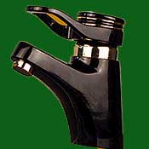
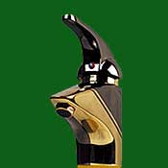
Beautiful taps
In India, Ranutrol-Hansa transformed the market for taps and plumbing equipment, so that, today, beauty is a key branding and product feature

Slide 39
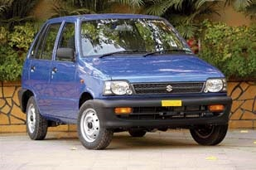
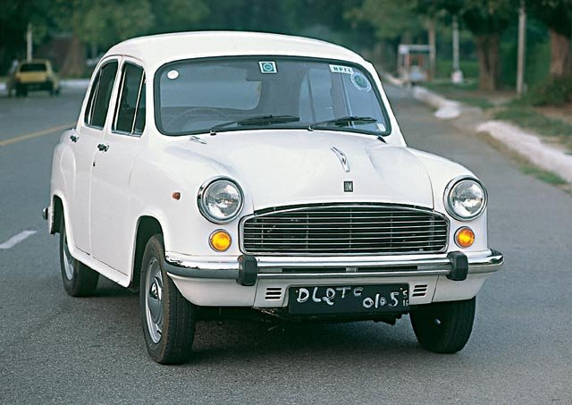
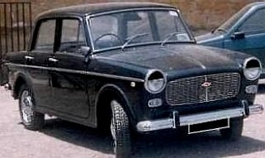
The good ol’ 800
One hypothesis suggests that Maruti made such an impact simply because even the tiny 800 simply looked so much better than either the Ambassador or the Premier Padmini

Slide 40
Can your retail brand be more beautiful?
Can the place simply ‘look’ much better?
Can it have more space?
Can you use white extensively?
Can you reduce the amount of goods stocked so as to make the retail environment more aesthetically pleasing?
Can you govern the quality of your staff by looks?
Can you make sure your POS is of a superior quality?
Can you make sure your staff’s uniforms are carefully designed?

Slide 41
X-Factor = Ease

Slide 42
Ease – what it means
Increasingly, people who feel they don’t have the mental energy to take certain decisions or actions will pay a premium for services that make things easier for them
This would add up to a position where your brand simply makes things easier for a consumer – it obviates the necessity for a decision or for any action

Slide 43
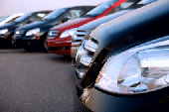
Pronto Valet parking
Pronto works at Sidney airport
They take your car and park it for as long as you need it to be parked – in a country where only a rare few people have drivers and would like to be back home soon instead of waiting for a taxi

Slide 44
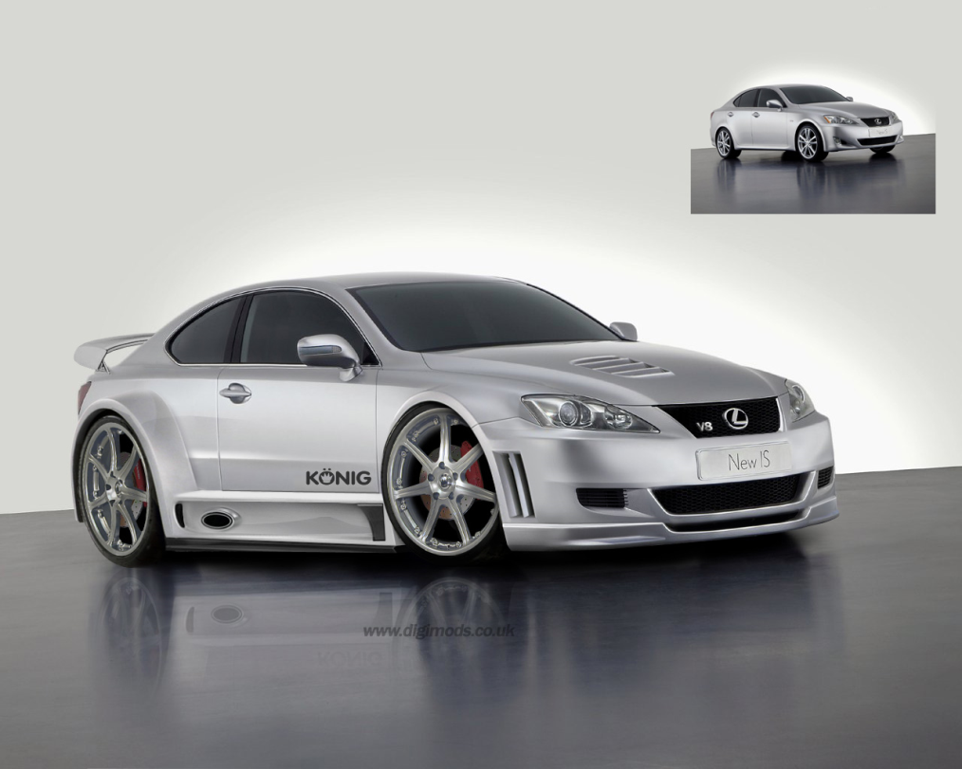
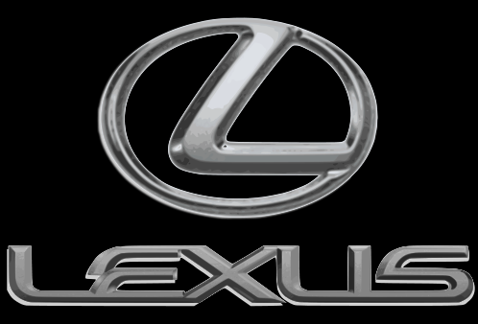
Lexus
Lexus Service standards
Lexus picks up your car for service at home or at office
They leave a brand-new replacement for you to use – the car that could be your next purchase
They return the car clean with Lindt chocolates on the front seat
Lexus has also hooked up with public places to give special parking slots for Lexus owners (eg: the Sydney Opera House)

Slide 45
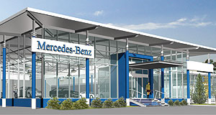
Mercedes-Benz’s Airport Express
This is a combination of a dealership and a service station at major airports in Europe and Australia.
People who travel regularly are likely to be in their target audience. But that’s not all, Mercedes-Benz also gives you an array of other services:
They send any clothes you might have kept at the back of the car for dry-cleaning
They arrange that your car comes to pick you up
They give you a goodies bag for your travel (with chocolate, bottled water meusli bars and tea)
The result? Sales are running at twice the projected levels

Slide 46
Some questions for your retail brand
Can your service standards mark you out as special?
Can you think of adding details to your service so that people remember you?
Can you think of doing things that no competitor does – but your customers would appreciate?

Slide 47
X-Factor = location

Slide 48
Location – what it means
Where the brand values are emphasized and underlined by the location of the store or retail outlet
For example, a location on Rue St. Honoré or Faubourg St. Honoré immediately makes a statement of class
If your store is at UB City next to Louis Vuitton, Chanel and Rolex, it lifts you to a different level from being next to Shoppers Stop

Slide 49
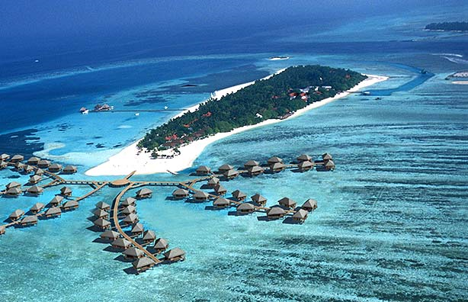
Club Med
Club Med has built its entire brand on location
Its locations are based on their positioning of being a romantic place to meet other singles like yourself
Its locations are chosen to be appropriate for its customer base of yuppy Europeans and Americans
The kind of entertainment provided is also about helping singles to meet
It’s not the kind of place that’s meant for families and neither are the locations

Slide 50
Some questions
Is your location a real brand-location or just an address?
Will your location make a difference to your brand?
Do you choose your location for the number of ‘footfalls’ or because it will make a difference to your brand?
In sum, is your location a brand decision or a sales decision?

Slide 51
X-Factor = Fun

Slide 52
Fun – what it means
Some products or services have substitutes and either regulation or cost structures prevent a meaningful cost difference
In this case it makes sense to be more fun than other products in your category
This would add up to a position where the product makes you smile with its communication and where every interaction you have with the brand is more fun
It should always be in places where the consumer is having fun and it should give services that accentuate the idea

Slide 53
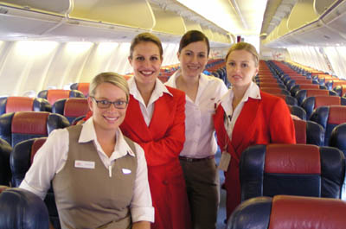
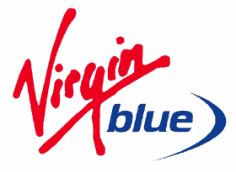
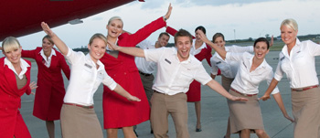
Virgin Airlines
Virgin Blue in Australia is fast, good and cheap, but it has made fun its main selling point
Jokey announcements by stewards
Practical jokes by stewardesses
The look of the crew’s uniforms

Slide 54
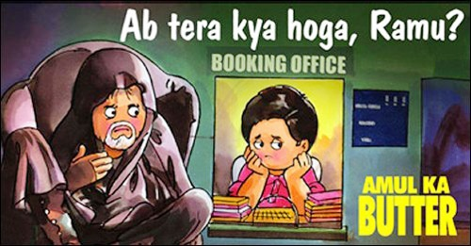
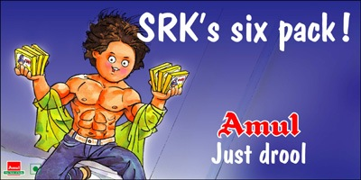
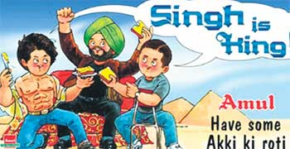
Amul Butter
Amul butter has distinguished itself by being more fun than its competition with its now famous hoardings that comment on current affairs with an utterly-butterly pun

Slide 55
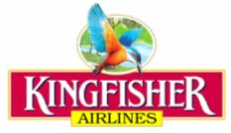
Kingfisher
Kingfisher Airlines has translated fun as sexy so you have
The infamous red uniforms, pearls and red shoes
Referring to customers as ‘guests’
The ‘in-flight entertainment system’ etc.

Slide 56
How can your brand be more ‘fun’?
First, how do you define fun?
Adult?
Sexy?
Humorous?
Kiddish?
Could you have café theatre in your premises or rock shows?
Could you change your people’s uniforms?
Could you make your place more ‘surprising’ in some way?
Could you make the place more noisy, more quiet, more musical, more child-friendly, more adult-attractive?

Slide 57
X-Factor = Green

Slide 58
Green – what it means
Customers the world over are becoming more and more aware of environmental issues. Increasing numbers of affluent, time-stressed and upwardly mobile people are seeking the opportunity to control their personal contribution to the world’s pollution as a normal part of their daily routine.
By relieving them of part of their sense of guilt as conspicuous consumers, brands are not merely satisfying needs – they’re fulfilling wants
The brand positioning here is a combination of guilt alleviation and stress relief – the easy way to go green, without really affecting your life-style

Slide 59
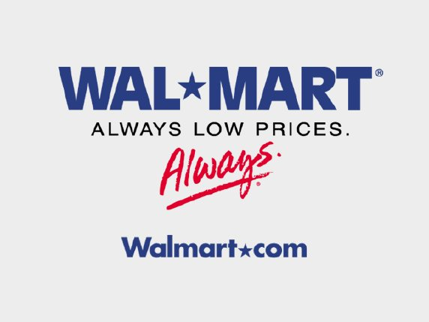
Walmart (Yes it’s gone green(?!))
Wal-Mart grew to its current enormous size (over US$312 Billion turnover) by being the best combination of fast+good+cheap
It was however an easily copied strategy and it began losing ground to competition
It began a ‘green’ agenda in 2004 as a ‘defensive strategy’
It is now corporate policy for several reasons:
It has brought more customers to Wal-Mart
Good public relations
It has created heightened morale and productivity among its 1.2 million employees
Millions of dollars in savings in lower energy, packaging and other costs

Slide 60
Measures taken:
25% increase in the efficiency of its truck fleet by 2010 and 100% increase by 2020
30% decrease in store energy use
25% reduction in solid waste
It sources salmon only from sustainable fisheries
It has 14 ‘sustainable value supplier networks’
Organic cotton has been a huge success with consumers – and has resulted in a 20% increase in global organic cotton production
The results have prompted the US’s second-largest retailer, Home Depot, to go green too

Slide 61
BP – Beyond Petroleum
In 1997, the company withdrew from the Global Climate Coalition, an oil industry organization dedicated to promoting climate change scepticism
Measures taken:
BP have started making low-sulfur diesel
Have begun creating a network of hydrogen fuelling stations in California
Have purchased Solarex and now account for 20% of the world’s production of photo-voltaic panels
Have acquired a reputation for being the most ‘green’ among all the petroleum companies and a more desirable employer

Slide 62
X-Factor = inaccessibility

Slide 63
Accessibility – what it means
Sometimes a brand’s value comes out of the fact that it is not easily available – that accessibility is limited

Slide 64
Exclusivity that leads to passion
Gmail had a big promise: 1GB of space
Launched in a ‘beta’ version
Getting a Gmail account was by invitation only
Getting an invitation became a cachet - indicated some kind of superior knowledge about the world-wide web
With no advertising, no publicity, no PR, within 2 years, Gmail became a major player in the email space

Slide 65
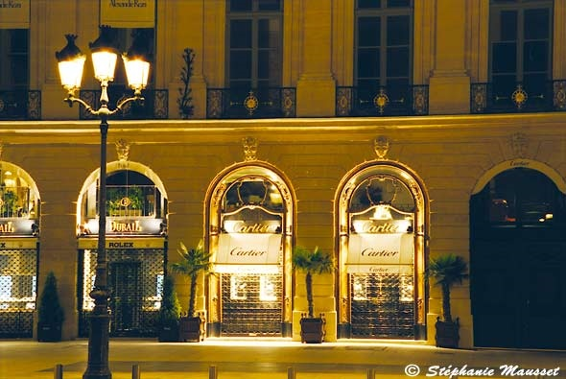
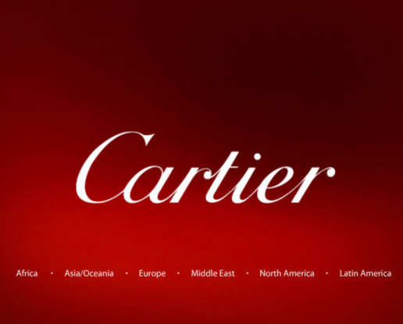
Exclusivity adds intrigue
Cartier only allows a limited number of people into its store at one time – it’ll never be crowded
It is deliberately exclusive
They have a limited range of products – some of their designs date back almost a century
The Baignoire and Tortue models were launched in 1912 and the Tank debuted in 1917
Their products are extremely expensive

Slide 66
In short, glamour and inaccessibility

Slide 67
To summarize

Slide 68
There are numerous possible X-Factors
Responsibility
Beauty
Ease
Location
Fun
Green
Availability
To these you could add
several more

Slide 69
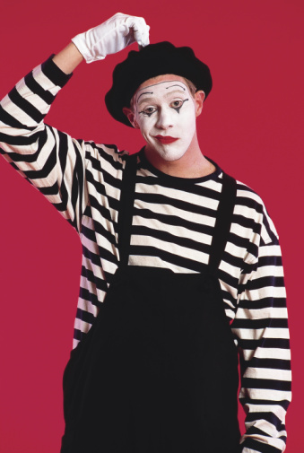
?
?
?
?
?
?
?
?
?
?
So how do you decide what’s relevant to your customers?

Slide 70
There are two ways
Luck, gut-feel, instincts or sheer development over time – it all boils down to the same thing . . .
The proverbial crap-shoot

Slide 71
We believe
The only way to arrive at a strong brand is through a robust strategy
And the only way to arrive at a robust strategy is through a scientific process, which is:
Logical
Verifiable
Takes a 360º perspective

Slide 72
A 360º perspective involves acquiring knowledge about …..

Slide 73
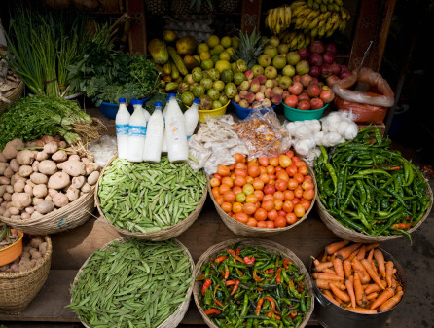
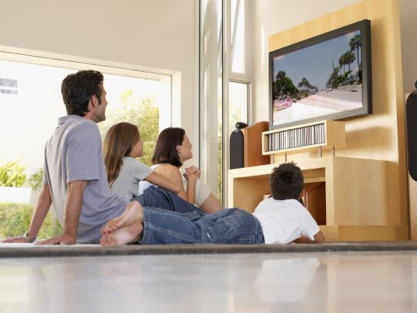
Realistic market potential
Consumer insights
A company’s internal strengths
The environnent

Slide 74
Using a methodology that is:

Slide 75
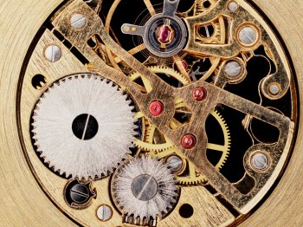
Scientific
Transparent
And Process-Driven

Slide 76
Resulting in

Slide 77
Brand ideas

Slide 78
Vivid . . .
Vivid

Slide 79
Flexible . . .
Flexible

Slide 80
Long-lasting ideas
And long-lasting

Slide 81
We believe
A different brand idea will make a different brand
q
A different brand will necessarily involve a different brand experience
q
A different brand experience will mean that the consumer will be given a genuinely different choice
q
And the right to choose means that the consumer is likely to stay married to his choice

Slide 82
In short, in retail, a genuine, different brand idea is of over-riding importance

Slide 83
After all, what do you want to depend on for your success?
Your brand – or your Venture Capitalist?

Slide 84
Yours and ours.
Because Better Brands Lead To A Better Future.

Slide 85
More About vertebrand
appendix

Slide 86
Raghu B Viswanath (Founder and MD)
Before establishing Vertebrand, Raghu spent over a decade at the helm of brand management at leading companies like SmithKline Beecham Consumer Healthcare and Titan. A celebrated speaker at brand summits across the world, his vision and astute business strategy have steered many of India's biggest brands to the top of the ladder.
Ronald J Palat (Management Advisor)
Among the pioneers of retail in India, Ronnie, as he is fondly called, introduced brands like Mother care to the country's big cities in, as far back as, the 1980s. With over 30 years' experience across apparel, luxury retail, consumer durables and technology, he has been a strategy consultant to a host of Indian and International organizations.

Slide 87
Nalin Khannaa (President)
Nalin brings expertise built over 30 years of experience in top management positions across industries like FMCG, Plantations, Commodities- Trading and Infrastructure. Prior to Vertebrand he has served as the CEO of Best and Crompton Engineering as well as Director and Chief Executive of Parry Agro Industries Ltd.
Anustup Datta (Chief Strategy Officer)
Anustup's expertise lies in the areas of Brand Strategy, Brand Identity Creation, Corporate Planning and Market Research, honed over seventeen years in Titan, SmithKline Beecham Pharmaceuticals and Vertebrand. He also specializes in Brand Valuation, Brand Due Diligence and Brand-related M&A, and has been guest faculty at several premier management institutes in the country.

Slide 88
Parthasarathy Pingali (Chief Acquisition Officer)
A Mechanical Engineer by education, Parthasarathy draws from 30 years of learning in Sales, Marketing and Product Management while working with Escorts, Parry Engg., Kirloskar and Voltas. A B2B brand strategy specialist, he has significant domain expertise in import/export and marketing of industrial goods.

Slide 89
Our mission
To create and grow brand value for businesses across diverse sectors, using a
combination of passion and intellect through a true partnership engagement model with
the client, sharing both risks and rewards.

Slide 90
Industries we cater to:
Agri business and foods
Industrial products and services
Consumer and Retail
Fashion, Textile and Luxury
Auto and Auto Ancillaries
Healthcare
Technology and Telecom
Education, Entertainment and Hospitality

Slide 91
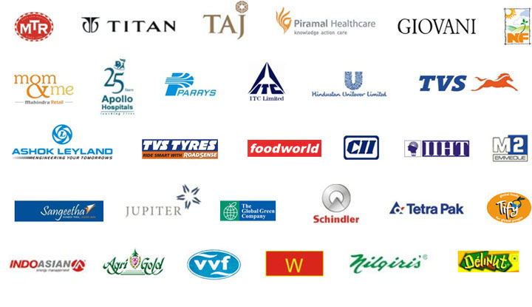
Representative Client list

Slide 92
Representative Client list

