Slide 1
Appliance-based architectures for high performance data intensive applications Session at Silicon India
Rajgopal Kishore
Vice President and Global Head of BI & Analytics,
HCL Technologies
rkishore@hcl.in
rkishore9@gmail.com

Slide 2
Agenda
State of data
Challenges
Need of the day
Rise of the machines
Features & Advantages
Key Players

Slide 3
What all these Applications have in Common
Federal
Cyber defense
Fraud analysis
Watch list analysis
Internet / Social Media
User behavioral analysis
Graph analysis
Pattern analysis
Context-based click-stream analysis
Telecommunications
Service personalization
Call Data Record (CDR) analysis
Network analysis
Speed
Frequent analysis of all data with insights in seconds/minutes
Common Use Cases
Forecasting
Modeling
Customer segmentation
Clickstream analysis
Scale
Analysis that must scale to terabytes to petabytes of data
Retail
Packaging optimization
Consumer buying patterns
Advertising and attribution analysis
Financial Services and Insurance
Credit and risk analysis
Value at risk calculation
Fraud analysis
Richness
Deep data exploration
Ad hoc, interactive analysis rather than simple reports

Slide 4
State of data
Data driven business
Businesses have been collecting information all the time
Mine more == Collect more (& vice-versa)
Challenges

Slide 5
Data driven business
Applications
Social Data, Email, Blogs, Video clips, Product Listings
ERP, CRM, Databases, Internal Applications, Customer/Consumer facing products
Mobile
Context
Web, Customers, Products, Business Systems, Process and Services
Support Systems
CRM, SOA, Recommendation Systems/Processes, Data warehouses, Business Intelligence, BPM

Slide 6
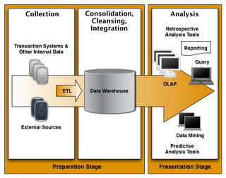
Mine more, Collect More
Drivers
ROI
Customer Retention
Product Affinity
Market Trends
Research Analysis
Customer/Consumer Analytics
Data Intensive Processes
Clustering
Classification
Build Relationship
Regression
Types
Structured
Semi-structured
Unstructured

Slide 7
Challenges
Growth is constant
Application complexities
Workload Requirements
Data growth
Infrastructure
Meet SLA’s
Delivery ROI
Reduce Risk

Slide 8
Need of the day
System that can handle high volume data
System that can perform complex, analytical operations
Scalable
Rapid Accessibility
Rapid Deployment
Highly Available
Fault Tolerant
Secure

Slide 9
Rise of the machines
“A data warehouse appliance is an integrated system, which has hardware (processors and storage) and software(operating systems and database system) components, specifically optimized for data warehousing”

Slide 10
Features
Designed to do one thing and one thing only
Processing optimized to handle high-volume of data
Data is process in parallel operations (mostly massively parallel operating units)
System is resilient to data-growth and operations
Highly tolerant to hardware and database failures
Highly available
Server units operates in isolation, so risk is local or less
Pre-tuned for high query performance

Slide 11
Advantages
Integrated architecture
More reporting and analytical capabilities
Flexibility
Less management (tuning and optimization)
Operational BI
Cost Reductions

Slide 12
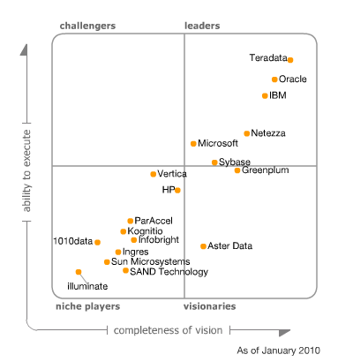
Key Players

Slide 13
Continuing Challenge
While traditional DW appliances speeded up data access by 100x, processing times still remained a challenge.
Two ways out of this -
Take data closer to processing – in-memory!
Take the processing closer to data – in-database!

Slide 14
Look at this scenario…
Complex processing on large dataset of a bank using Teradata – 17 hours
Same processing using Teradata’s SAS apis – 3 minutes

Slide 15
An Example of such a DW Appliances - AsterData
Automatic Parallelization
Automatically parallelizes applications using Aster’s integrated analytics engines and SQL-MapReduce
Parallelization is key for processing large volumes of data
100% Processing In-database
100% of analytics processing runs in-database, so processing is co-located with data
Eliminates need for massive data movement

Slide 16
Aster Data Analytic Foundation (1 of 2) Examples of Business-Ready SQL-MapReduce Functions
Modules | Select Examples of Delivered, Business-ready SQL-MapReduce Functions
Path Analysis Discover patterns in rows of sequential data | nPath: complex sequential analysis for time series analysis and behavioral pattern analysis Sessionization: identifies sessions from time series data in a single pass over the data
Statistical Analysis High-performance processing of common statistical calculations | Correlation: calculation that characterizes the strength of the relation between different columns Regression: performs linear or logistic regression between an output variable and a set of input variables
Relational Analysis Discover important relationships among data | Basket analysis: creates configurable groupings of related items from transaction records in single pass Graph analysis: finds shortest path from a distinct node to all other nodes in a graph

Slide 17
Aster Data Analytic Foundation (2 of 2) Examples of Business-Ready SQL-MapReduce Functions
Modules | Select Examples of Delivered, Business-ready SQL-MapReduce Functions
Text Analysis Derive patterns in textual data | Text Processing: counts occurrences of words, identifies roots, & tracks relative positions of words & multi-word phrases Text Partition: analyzes text data over multiple rows
Cluster Analysis Discover natural groupings of data points | k-Means: clusters data into a specified number of groupings Minhash: buckets highly-dimensional items for cluster analysis
Data Transformation Transform data for more advanced analysis | Unpack: extracts nested data for further analysis Multicase: case statement that supports row match for multiple cases

Slide 18
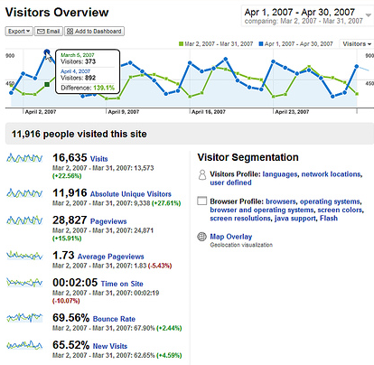
Example: nPath Function for time-series analysis
Uncovering patterns in sequential steps
What this gives you:
- Pattern detection via single pass over data
Allows you to understand any trend that needs to be analyzed over a continuous period of time
Example use cases:
- Web analytics– clickstream, golden path
- Telephone calling patterns
- Stock market trading sequences
nPath in Use: Marketing Attribution
Complete Aster Data Application:
Sessionization required to prepare data for path analysis
nPath identifies marketing touches that drove revenue

Slide 19
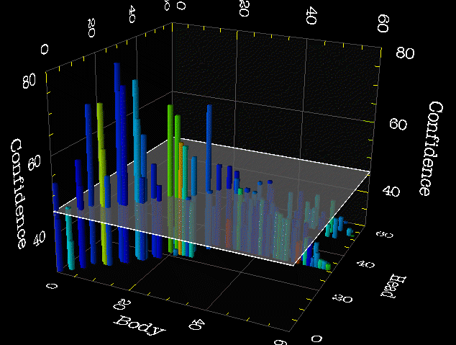
Example: Basket Generator Function
Extensible market basket analysis
What this gives you?
Creates groupings of related items via single pass over data
Allows you to increase or decrease basket size with a single parameter change
Example use cases:
Retail market basket analysis
People who bought x also bought y
Basket Generator in Use
Complete Aster Data Application:
Evaluate effectiveness of marketing programs
Launch customer recommendations feature
Evaluate and improve product placement

Slide 20
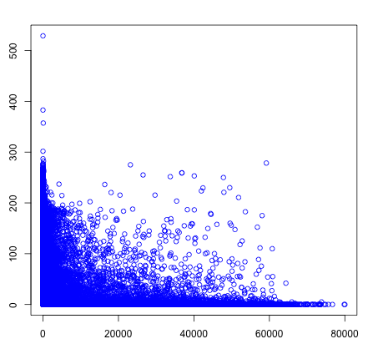
Example: Unpack Function
Transforming hidden data into analyst accessible columns
Unpack in Use: Pricing Analysis
What this gives you:
Translates unstructured data from a single field into multiple structured columns
Allows business analysts access to data with standard SQL queries
Example use cases:
Sales data
Stock transaction logs
Gaming play logs
Complete Aster Data Application:
Text processing required to transform/unpack third party sales data
Sessionization required to prepare data for path analysis
Statistical analysis of pricing

Slide 21
Questions!

