Slide 1
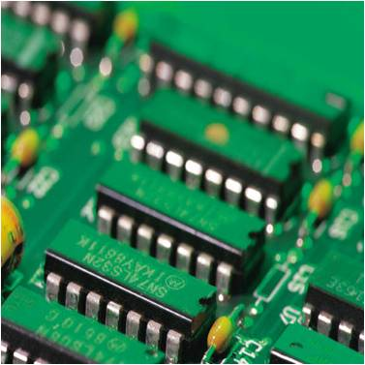
Java Memory Model AND its implications
Srikanth Seshadri
srikanth@thoughtworks.com

Slide 2
JAVA Memory model
public class NoVisibility {
private static boolean ready;
private static int number;
private static class ReaderThread extends Thread {
public void run() {
while (!ready)
Thread.yield();
System.out.println(number);
}
}
public static void main(String[] args) {
new ReaderThread().start();
number = 42;
ready = true;
}
}

Slide 3
Double Checked locking
if(!ready){
synchronized(lock){
if(!ready){
//create and initialize singleton
ready=true;
}
}
}
The "Double-Checked Locking is Broken" Declaration
http://www.cs.umd.edu/~pugh/java/memoryModel/DoubleCheckedLocking.html

Slide 4
Happen-before
To guarantee that the thread executing action B can see the results of action A there must be happens-before relationship between A and B.
Program order rule. Each action in a thread happens-before every action in that thread that comes later in the program order.
Monitor lock rule. An unlock on a monitor lock happens-before every subsequent lock on that same monitor lock.
Volatile variable rule. A write to a volatile field happens-before every subsequent read of that same field.

Slide 5
Volatile
Initialize all the data
Thread-2
volatile ready=true;
If(ready)
Thread-1
Skip initialization
if(!ready){
synchronized(lock){
if(!ready){
//create and initialize singleton
ready=true;
}
}
}

Slide 6
Memory barriers - Paul E. McKenney
Memory Barriers: a Hardware View For Software Hackers
http://www.rdrop.com/users/paulmck/scalability/paper/whymb.2010.06.07c.pdf
Memory Ordering in Modern Microprocessors
http://www.linuxjournal.com/article/8211

Slide 7
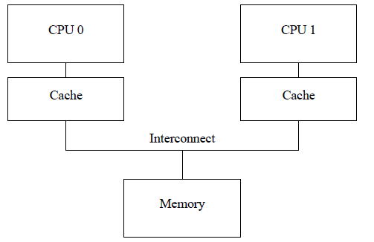
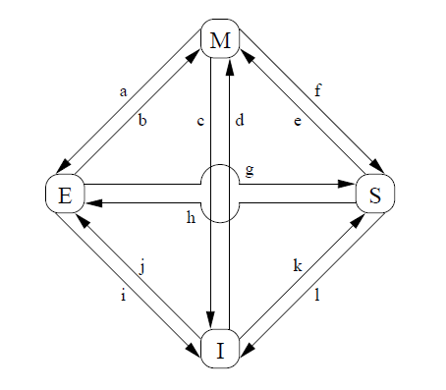
Cache COHERENCE PROTOCOL

Slide 8
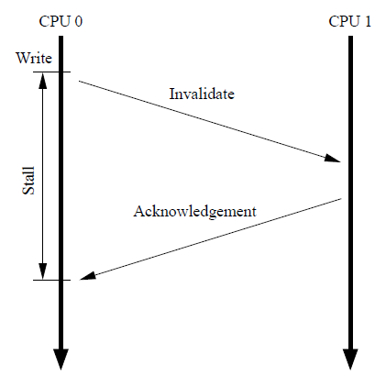
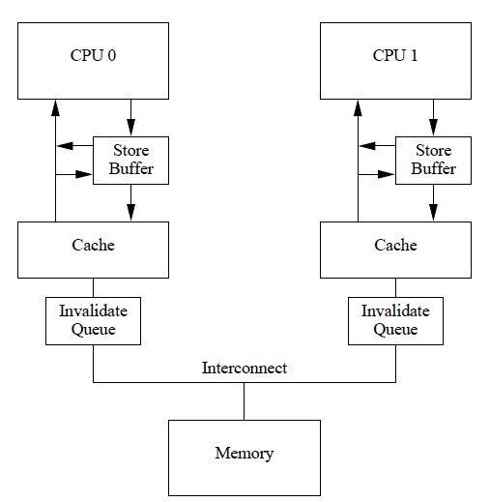
Cache COHERENCE PROTOCOL

Slide 9
Memory barriers
AMD – lfence/sfence/mfence
Intel – lock addl
Volatile
Status Flag
Read-Write Lock Trick
Managing Volatility
http://www.ibm.com/developerworks/java/library/j-jtp06197.html

Slide 10
Read-Write Lock Trick
public class Counter {
private volatile int value;
public int getValue() { return value; }
public synchronized int increment()
{ return value++; }
}

Slide 11
LL - SC
Load Linked (LL) And Store Conditional (SC)
DEC Alpha - ldl_l/stl_c
Power PC - lwarx/stwcx
MIPS –ll/sc
Intel- lock cmpxchg
Non-Block Alogorithms
Lock-Free
Wait-Free

Slide 12
NON-BLOCKING QueuE
structure node_t {value: data type, next: pointer}
structure queue_t {Head: pointer, Tail: pointer}
initialize(Q: pointer to queue_t)
node = new_node()
node->next = NULL
Q->Head = Q->Tail = node
-
A
B
Head
C
D
Tail

Slide 13
Non-blocking ENQUEUE
enqueue(Q: pointer to queue_t, value: data type)
E1: node = new_node()
E2: node->value = value
E3: node->next = NULL
E4: loop
E5: tail = Q->Tail
E6: next = tail->next
E7: if tail == Q->Tail // Are tail and next consistent?
E8: if next == NULL
E9: if CAS(&tail->next, next, node)
E10: break // Enqueue is done. Exit loop
E11: endif
E12: else
// Try to swing Tail to the next node
E13: CAS(&Q->Tail, tail, next)
E14: endif
E15: endif
E16: endloop
// Enqueue is done. Try to swing Tail to the inserted node
E17: CAS(&Q->Tail, tail, node)

Slide 14
NON Blocking DEQUE
dequeue(Q: pointer to queue_t, pvalue: pointer to data type): boolean
D1: loop
D2: head = Q->Head
D3: tail = Q->Tail
D4: next = head->next
D5: if head == Q->Head // Are head, tail, and next consistent?
D6: if head == tail // Is queue empty or Tail falling behind?
D7: if next == NULL // Is queue empty?
D8: return FALSE // Queue is empty, couldn't dequeue
D9: endif
// Tail is falling behind. Try to advance it
D10: CAS(&Q->Tail, tail, next)
D11: else // No need to deal with Tail
// Read value before CAS
// Otherwise, another dequeue might free the next node
D12: *pvalue = next->value
// Try to swing Head to the next node
D13: if CAS(&Q->Head, head, next)
D14: break // Dequeue is done. Exit loop
D15: endif
D16: endif
D17: endif
D18: endloop
D19: free(head)

Slide 15
ATOMICs
j.u.c atomic Operations
get
set
lazySet
compareAndSet
weakCompareAndSet
ABA Problem

Slide 16
Interested In Concurrency
Follow
Doug Lea
Brian Goetz
Concurrency Interest Forums

Slide 17
REFERENCES
References
Java Memory Model
http://www.ibm.com/developerworks/java/library/j-jtp02244.html
http://www.ibm.com/developerworks/library/j-jtp03304/
http://java.sun.com/docs/books/jls/third_edition/html/memory.html
http://gee.cs.oswego.edu/dl/jmm/cookbook.html
Double Checked Locking
http://www.javaworld.com/jw-02-2001/jw-0209-double.html
http://www.cs.umd.edu/~pugh/java/memoryModel/DoubleCheckedLocking.html
Hotspot
http://wikis.sun.com/display/HotSpotInternals/PrintAssembly
http://www.infoq.com/articles/memory_barriers_jvm_concurrency
http://weblogs.java.net/blog/2008/03/30/deep-dive-assembly-code-java
Memory Barriers
http://citeseerx.ist.psu.edu/viewdoc/download?doi=10.1.1.152.5245&rep=rep1&type=pdf
http://www.google.co.in/url?q=http://www.intel.com/Assets/ja_JP/PDF/manual/253668.pdf&sa=X&ei=gTdeTOG1Esmwcf6jlNoO&ved=0CBkQzgQoADAA&usg=AFQjCNH4oEOTrvSbSltVaQequTdhmxD-pQ
Atomics
http://www.ibm.com/developerworks/java/library/j-jtp11234/
http://www.cs.rochester.edu/u/michael/PODC96.html

Slide 18
Questions

